Slide 1

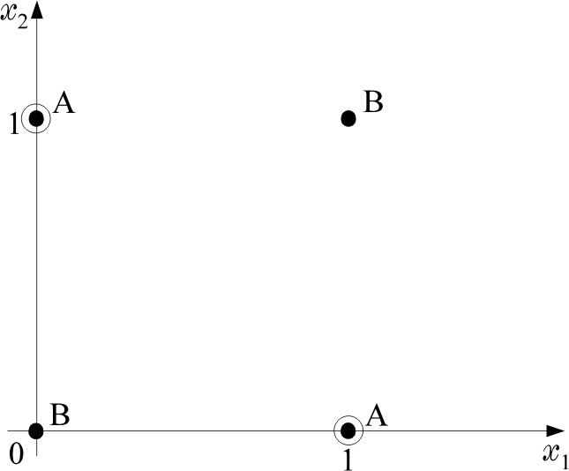

Non Linear Classifiers
The XOR problem
x₁ | x₂ | XOR | Class
0 | 0 | 0 | B
0 | 1 | 1 | A
1 | 0 | 1 | A
1 | 1 | 0 | B

Slide 2
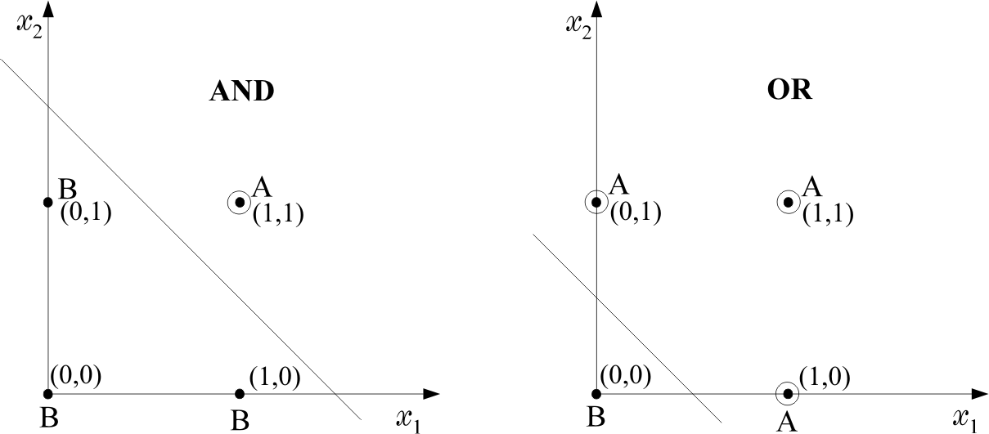
There is no single line (hyperplane) that separates class A from class B. On the contrary, AND and OR operations are linearly separable problems

Slide 3
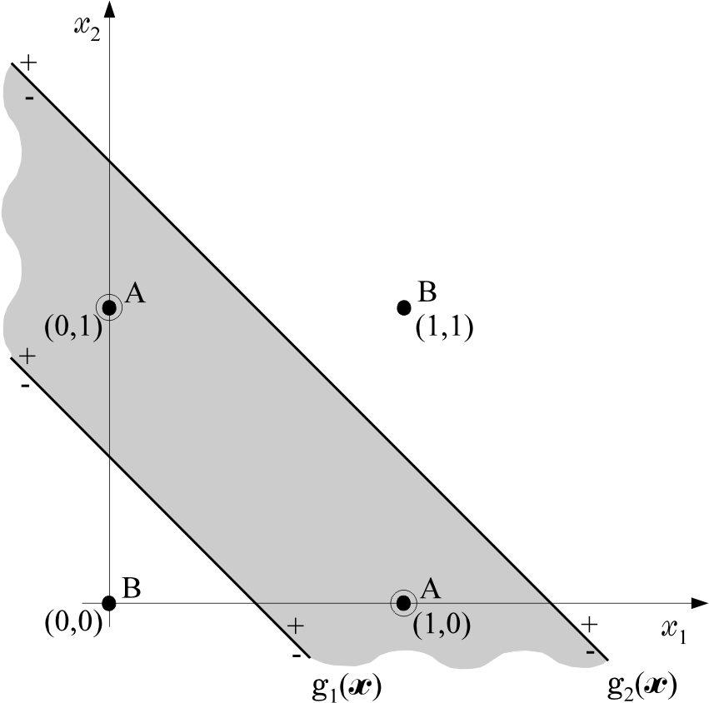
The Two-Layer Perceptron
  For the XOR problem, draw two, instead, of one lines

Slide 4

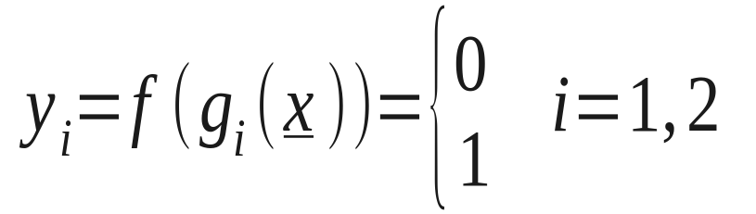
  Then class B is located outside the shaded area and class A inside. This is a two-phase design.
    Phase 1: Draw two lines (hyperplanes)
    Each of them is realized by a perceptron. The outputs of the perceptrons will be
    depending on the position of x.
    Phase 2: Find the position of x w.r.t. both lines, based on the values of y₁, y₂.

Slide 5
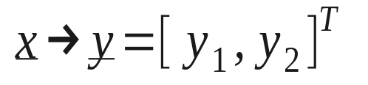
1st phase |  |  |  | 2nd phase
x₁ | x₂ | y₁ | y₂
0 | 0 | 0(-) | 0(-) | B(0)
0 | 1 | 1(+) | 0(-) | A(1)
1 | 0 | 1(+) | 0(-) | A(1)
1 | 1 | 1(+) | 1(+) | B(0)
Equivalently: The computations of the first phase perform a mapping

Slide 6

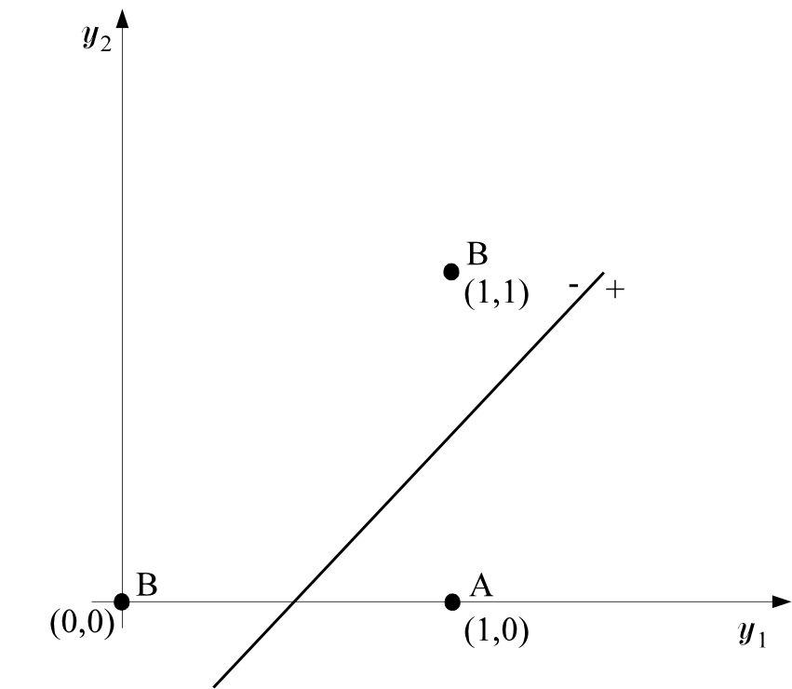

The decision is now performed on the transformed data.
This can be performed via a second line, which can also be realized by a perceptron.

Slide 7
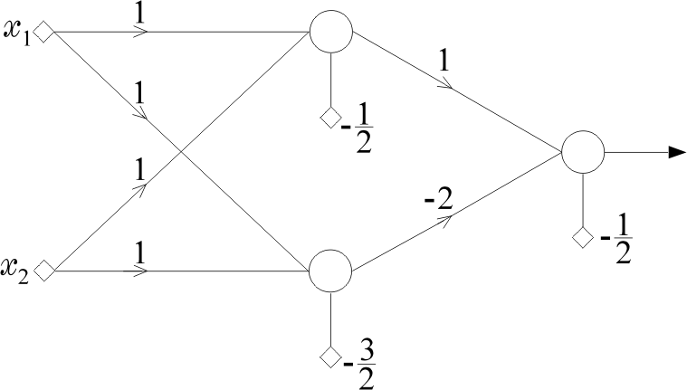
  Computations of the first phase perform a mapping that transforms the nonlinearly separable problem to a linearly separable one.
  The architecture

Slide 8
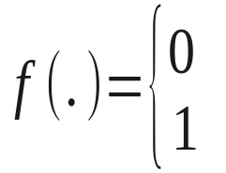
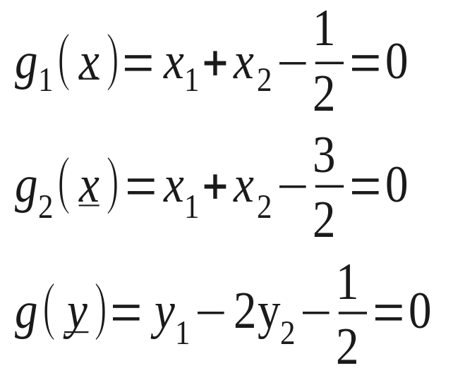
    This is known as the two layer perceptron with one hidden and one output layer. The activation functions are
    The neurons (nodes) of the figure realize the following lines (hyperplanes)

Slide 9
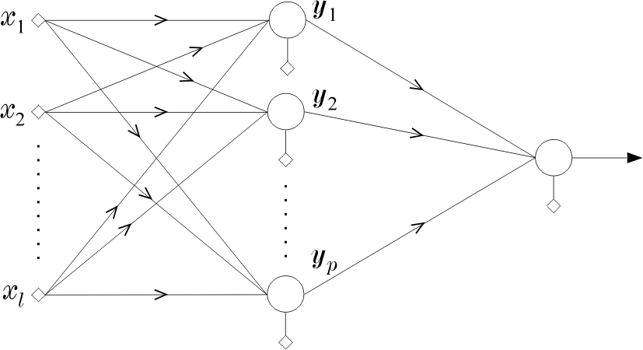
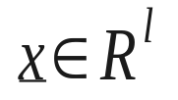
Classification capabilities of the two-layer perceptron
  The mapping performed by the first layer neurons is onto the vertices of the unit side square, e.g.,
  (0, 0), (0, 1), (1, 0), (1, 1).
  The more general case,

Slide 10
  performs a mapping of a vector
  onto the vertices of the unit side H_{p} hypercube
  The mapping is achieved with p neurons each realizing a hyperplane. The output of each of these neurons is 0 or 1 depending on the relative position of x w.r.t. the hyperplane.

Slide 11
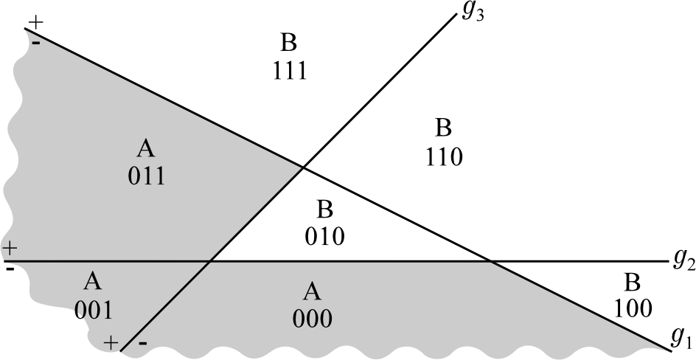
  Intersections of these hyperplanes form regions in the l-dimensional space. Each region corresponds to a vertex of the H_{p} unit hypercube.

Slide 12
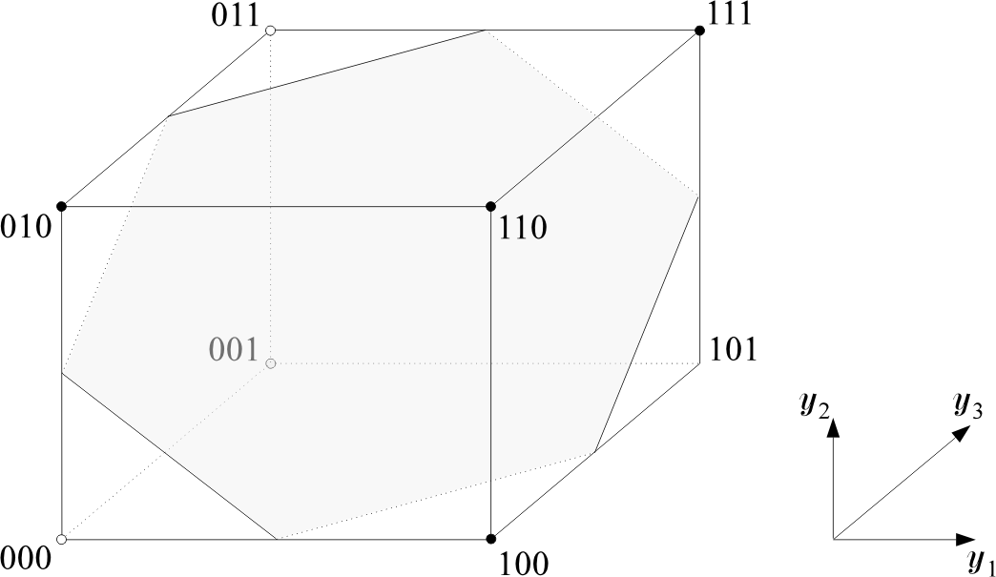
For example, the 001 vertex corresponds to the region which is located
to the (-) side of g₁ (x)=0
to the (-) side of g₂ (x)=0
to the (+) side of g₃ (x)=0

Slide 13
  The output neuron realizes a hyperplane in the transformed space, that separates some of the vertices from the others. Thus, the two layer perceptron has the capability to classify vectors into classes that consist of unions of polyhedral regions. But NOT ANY union. It depends on the relative position of the corresponding vertices.

Slide 14
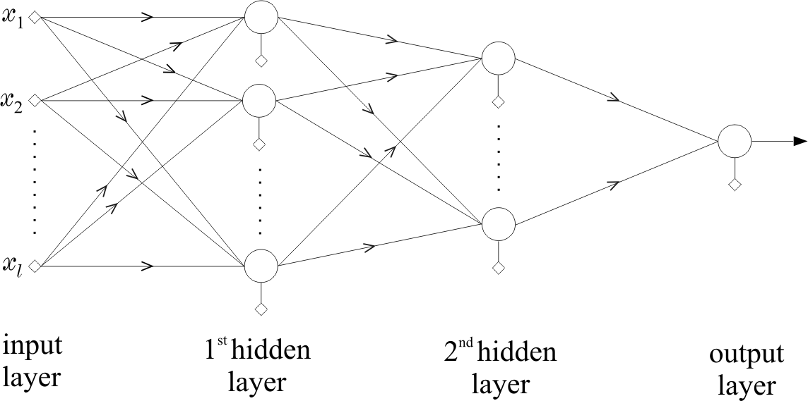
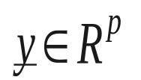
Three layer-perceptrons
  The architecture
  This is capable to classify vectors into classes consisting of ANY union of polyhedral regions.
  The idea is similar to the XOR problem. It realizes more than one planes in the space.

Slide 15
  The reasoning
    For each vertex, corresponding to class, say A, construct a hyperplane which leaves THIS vertex on one side (+) and ALL the others to the other side (-).
    The output neuron realizes an OR gate
  Overall:
    The first layer of the network forms the hyperplanes, the second layer forms the regions and the output neuron forms the classes.
Designing Multilayer Perceptrons
  One direction is to adopt the above rationale and develop a structure that classifies correctly all the training patterns.
  The other direction is to choose a structure and compute the synaptic weights to optimize a cost function.

Slide 16
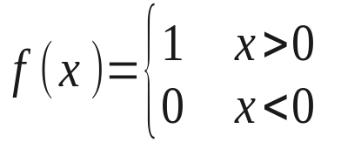
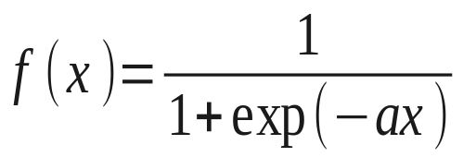
The Backpropagation Algorithm
  This is an algorithmic procedure that computes the synaptic weights iteratively, so that an adopted cost function is minimized (optimized)
  In a large number of optimizing procedures, computation of derivatives are involved. Hence, discontinuous activation functions pose a problem, i.e.,
  There is always an escape path!!! The logistic function
  is an example. Other functions are also possible and in some cases more desirable.

Slide 17
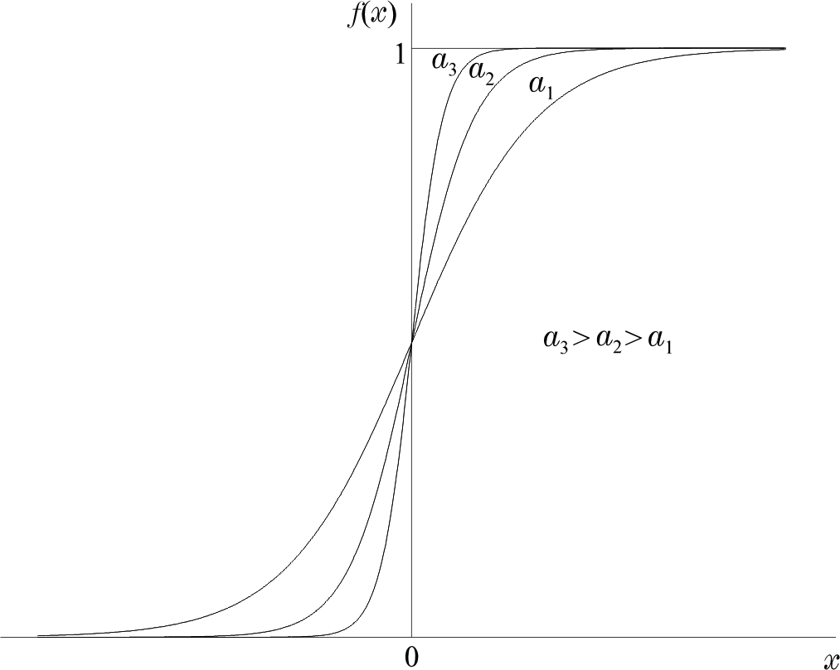

Slide 18
  The steps:
    Adopt an optimizing cost function, e.g.,
      Least Squares Error
      Relative Entropy
    between desired responses and actual responses of the network for the available training patterns. That is, from now on we have to live with errors. We only try to minimize them, using certain criteria.
    Adopt an algorithmic procedure for the optimization of the cost function with respect to the synaptic weights
    e.g.,
      Gradient descent
      Newton’s algorithm
      Conjugate gradient

Slide 19
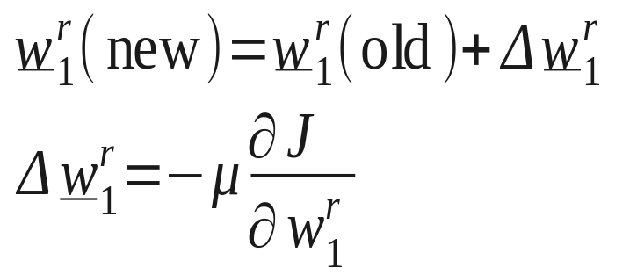
    The task is a nonlinear optimization one. For the gradient descent method

Slide 20
  The Procedure:
    Initialize unknown weights randomly with small values.
    Compute the gradient terms backwards, starting with the weights of the last (3rd) layer and then moving towards the first
    Update the weights
    Repeat the procedure until a termination procedure is met
  Two major philosophies:
    Batch mode: The gradients of the last layer are computed once ALL training data have appeared to the algorithm, i.e., by summing up all error terms.
    Pattern mode: The gradients are computed every time a new training data pair appears. Thus gradients are based on successive individual errors.

Slide 21
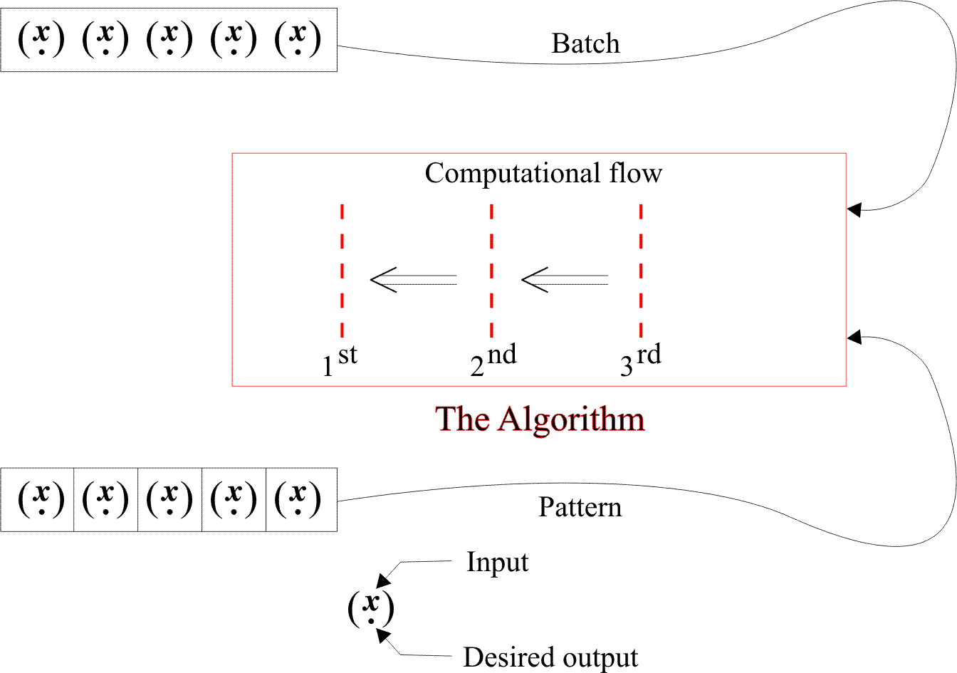

Slide 22
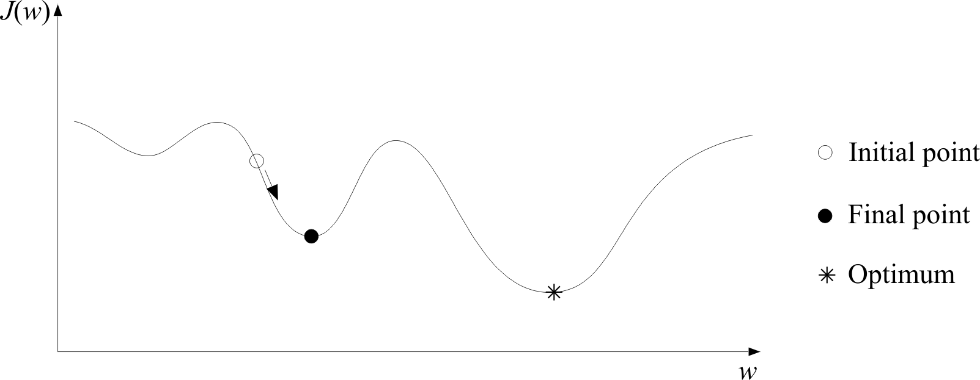
  A major problem: The algorithm may converge to a local minimum

Slide 23
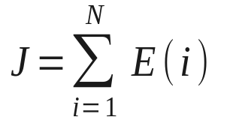
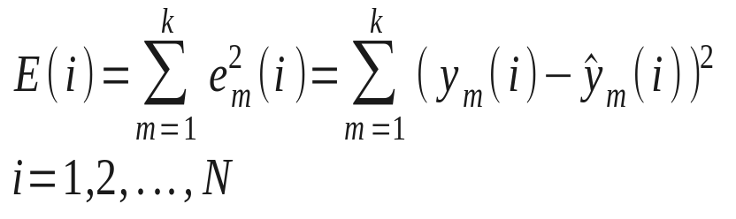
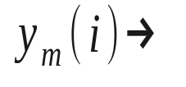

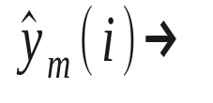
  The Cost function choice
  Examples:
    The Least Squares
        Desired response of the m^{th} output neuron
        (1 or 0) for
        Actual response of the m^{th} output neuron, in the interval [0, 1], for input

Slide 24
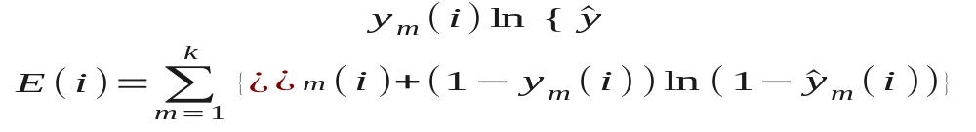
  The cross-entropy
  This presupposes an interpretation of y and ŷ as probabilities
  Classification error rate. This is also known as discriminative learning. Most of these techniques use a smoothed version of the classification error.

Slide 25
  Remark 1: A common feature of all the above is the danger of local minimum convergence. “Well formed” cost functions guarantee convergence to a “good” solution, that is one that classifies correctly
  ALL training patterns, provided such a solution exists. The cross-entropy cost function is a well formed one. The Least Squares is not.

Slide 26

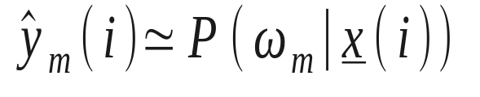
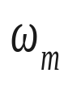
  Remark 2: Both, the Least Squares and the cross entropy lead to output values that approximate optimally class a-posteriori probabilities!!!
  That is, the probability of class given .
  This is a very interesting result. It does not depend on the underlying distributions. It is a characteristic of certain cost functions. How good or bad is the approximation, depends on the underlying model. Furthermore, it is only valid at the global minimum.

Slide 27
  Choice of the network size.
  How big a network can be. How many layers and how many neurons per layer?? There are two major directions
    Pruning Techniques: These techniques start from a large network and then weights and/or neurons are removed iteratively, according to a criterion.

Slide 28
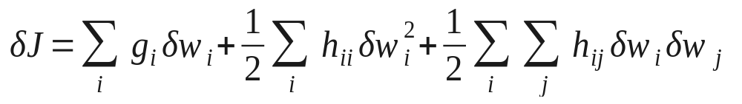
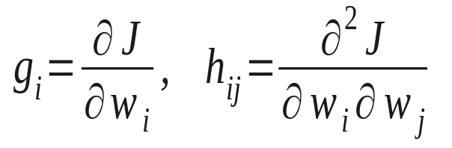
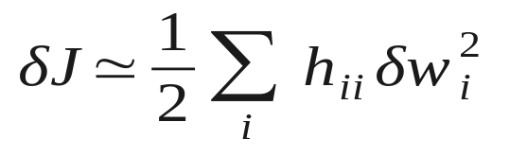
  Methods based on parameter sensitivity
  + higher order terms where
  Near a minimum and assuming that

Slide 29
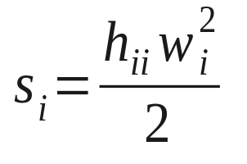
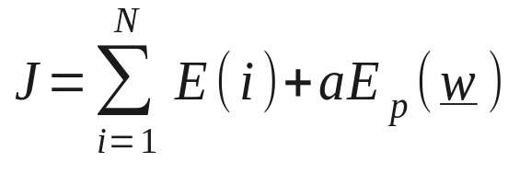
  Pruning is now achieved in the following procedure:
    Train the network using Backpropagation
    for a number of steps
    Compute the saliencies
    Remove weights with small s_{i}.
    Repeat the process
  Methods based on function regularization

Slide 30
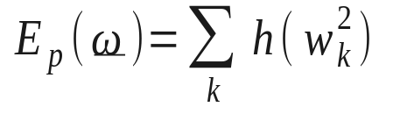
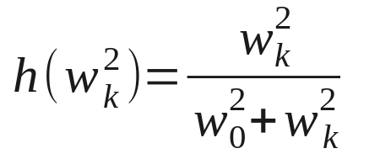
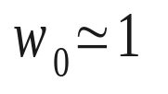
  The second term favours small values for the weights, e.g.,
  where
  After some training steps, weights with small values are removed.
    Constructive techniques:
    They start with a small network and keep increasing it, according to a predetermined procedure and criterion.

Slide 31
  Remark: Why not start with a large network and leave the algorithm to decide which weights are small?? This approach is just naïve. It overlooks that classifiers must have good generalization properties. A large network can result in small errors for the training set, since it can learn the particular details of the training set. On the other hand, it will not be able to perform well when presented with data unknown to it. The size of the network must be:
    Large enough to learn what makes data of the same class similar and data from different classes dissimilar
    Small enough not to be able to learn underlying differences between data of the same class. This leads to the so called overfitting.

Slide 32
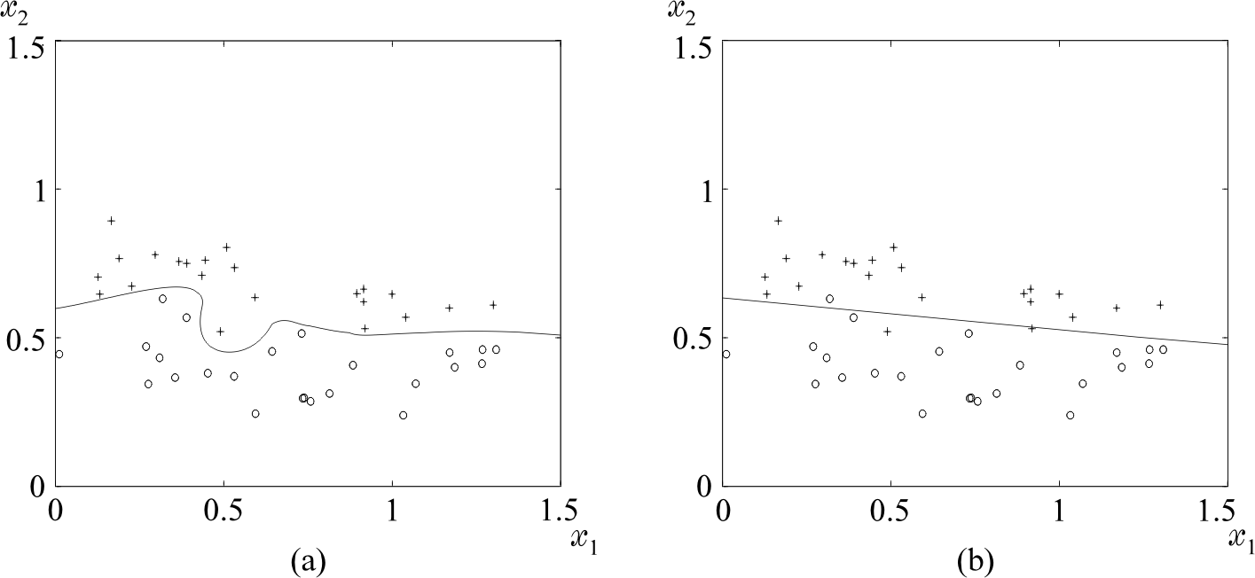
    Example:

Slide 33
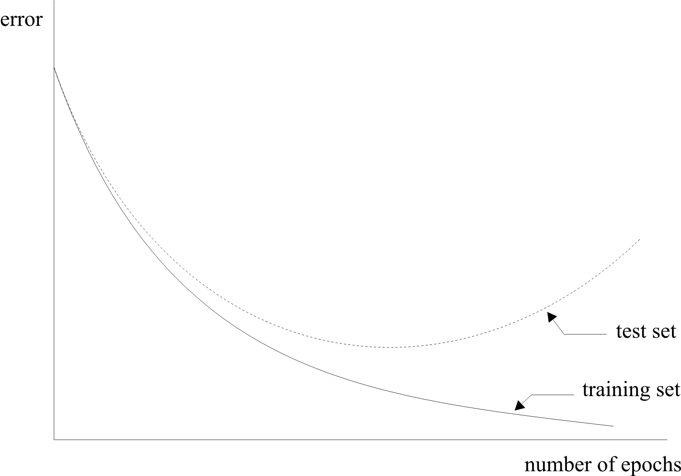
  Overtraining is another side of the same coin, i.e., the network adapts to the peculiarities of the training set.

Slide 34
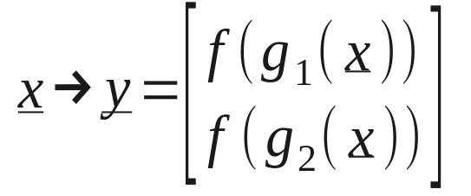


Generalized Linear Classifiers
  Remember the XOR problem. The mapping
        The activation function transforms the nonlinear task into a linear one.
  In the more general case:
    Let and a nonlinear classification task.

Slide 35
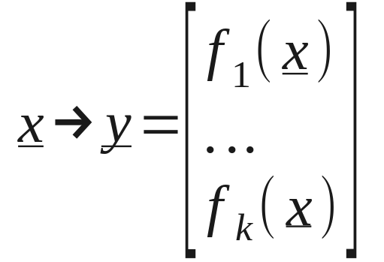
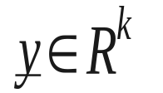
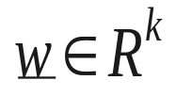
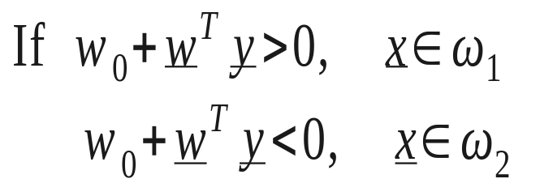
    Are there any functions and an appropriate k, so that the mapping
    transforms the task into a linear one, in the
    space?
    If this is true, then there exists a hyperplane
    so that

Slide 36

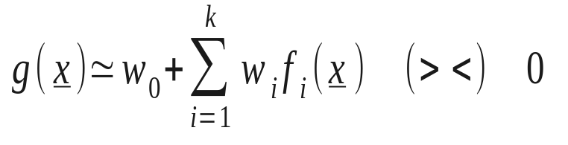

  In such a case this is equivalent with approximating the nonlinear discriminant function g(x), in terms of i.e.,
  Given , the task of computing the weights is a linear one.
  How sensible is this??
    From the numerical analysis point of view, this is justified if are interpolation functions.
    From the Pattern Recognition point of view, this is justified by Cover’s theorem

Slide 37



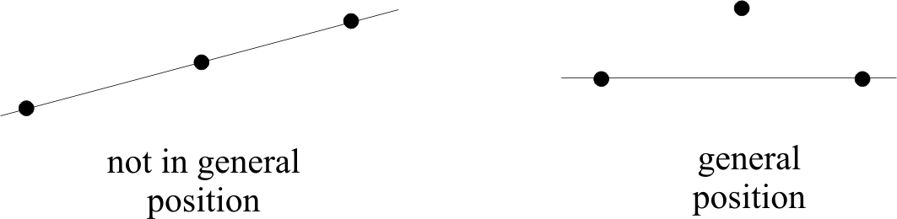
Capacity of the l-dimensional space in Linear Dichotomies
  Assume N points in assumed to be in general position, that is:
Not of these lie on a dimensional space

Slide 38
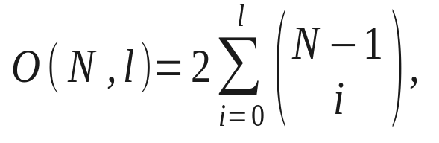
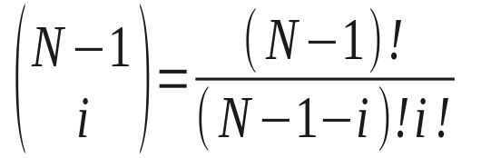
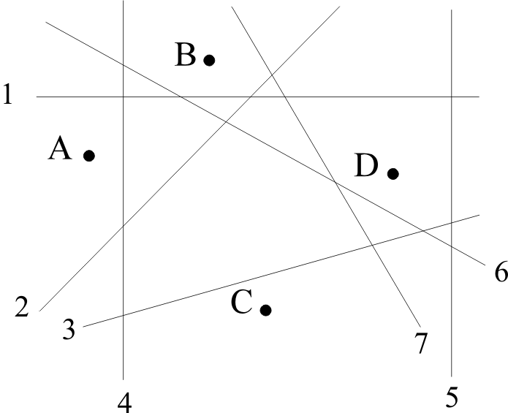
  Cover’s theorem states: The number of groupings that can be formed by (l-1)-dimensional hyperplanes to separate N points in two classes is
  Example: N=4, l=2, O(4,2)=14
  Notice: The total number of possible groupings is
  2⁴=16

Slide 39
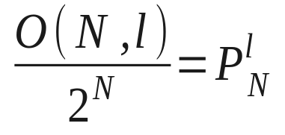
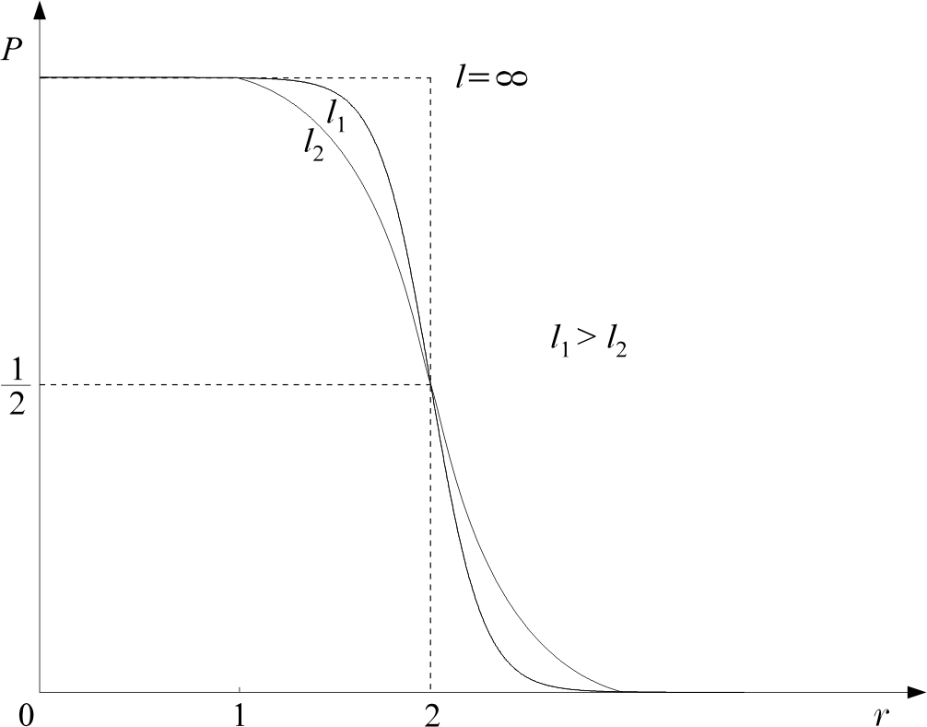

  Probability of grouping N points in two linearly separable classes is

Slide 40

  Thus, the probability of having N points in linearly separable classes tends to 1, for large , provided N<2( +1)
  Hence, by mapping to a higher dimensional space, we increase the probability of linear separability, provided the space is not too densely populated.

Slide 41

Radial Basis Function Networks (RBF)
  Choose

Slide 42


  Equivalent to a single layer network, with RBF activations and linear output node.

Slide 43



  Example: The XOR problem
    Define:

Slide 44



Slide 45

  Training of the RBF networks
    Fixed centers: Choose centers randomly among the data points. Also fix σ_{i}’s. Then
    is a typical linear classifier design.
    Training of the centers: This is a nonlinear optimization task
    Combine supervised and unsupervised learning procedures.
    The unsupervised part reveals clustering tendencies
    of the data and assigns the centers at the cluster representatives.

Slide 46

Universal Approximators
It has been shown that any nonlinear continuous function can be approximated arbitrarily close, both, by a two layer perceptron, with sigmoid activations, and an RBF network, provided a large enough number of nodes is used.
Multilayer Perceptrons vs. RBF networks
  MLP’s involve activations of global nature. All points on a plane give the same response.
  RBF networks have activations of a local nature, due to the exponential decrease as one moves away from the centers.
  MLP’s learn slower but have better generalization properties

Slide 47


Support Vector Machines: The non-linear case
  Recall that the probability of having linearly separable classes increases as the dimensionality of the feature vectors increases. Assume the mapping:
  Then use SVM in R^{k}
  Recall that in this case the dual problem formulation will be

Slide 48

  Also, the classifier will be
  Thus, inner products in a high dimensional space are involved, hence
    High complexity

Slide 49


  Something clever: Compute the inner products in the high dimensional space as functions of inner products performed in the low dimensional space!!!
  Is this POSSIBLE?? Yes. Here is an example
  Then, it is easy to show that

Slide 50




  Mercer’s Theorem
  and let the inner product in H be given as
  Then
  for any g(x), x:
  K(x,y) symmetric function known as kernel.

Slide 51



  The opposite is ALWAYS true. Any kernel, with the above properties, defines to an inner product in SOME space!!!
  Examples of kernels
    Radial basis Functions:
    Polynomial:
    Hyperbolic Tangent:
    for appropriate values of β, γ.

Slide 52


  SVM Formulation
    Step 1: Choose appropriate kernel. This implicitely assumes a mapping to a higher dimensional (yet, not known) space.
    Step 2:
    This results to an implicit combination

Slide 53


    Step 3: Assign x to
    The SVM Architecture

Slide 54


Slide 55



The kernel minimum Euclidean distance classifier
  As it was the case with SVMs, any classifier that can be expressed in inner products can be kernelized. The minimum Euclidean distance classifier is an example.
  Given a kernel function , make an implicit mapping from the original space to an RKHS, associated with
  Given the training vectors, for each class (the two-class case), the implicit mean values become

Slide 56





  Given an unknown , classify , if
  or if
  where

Slide 57

Decision Trees
This is a family of non-linear classifiers. They are multistage decision systems, in which classes are sequentially rejected, until a finally accepted class is reached. To this end:
  The feature space is split into unique regions in a sequential manner.
  Upon the arrival of a feature vector, sequential decisions, assigning features to specific regions, are performed along a path of nodes of an appropriately constructed tree.
  The sequence of decisions is applied to individual features, and the queries performed in each node are of the type:
  is feature
  where α is a pre-chosen (during training) threshold.

Slide 58


  The figures below are such examples. This type of trees is known as Ordinary Binary Classification Trees (OBCT). The decision hyperplanes, splitting the space into regions, are parallel to the axis of the spaces. Other types of partition are also possible, yet less popular.

Slide 59

  Design Elements that define a decision tree.
    Each node, t, is associated with a subset , where X is the training set. At each node, X_{t} is split into two (binary splits) disjoint descendant subsets X_{t,Y} and X_{t,N}, where
    X_{t,Y} ∩ X_{t,N} = Ø
    X_{t,Y} ∪ X_{t,N} = X_{t}
    X_{t,Y} is the subset of X_{t} for which the answer to the query at node t is YES. X_{t,N} is the subset corresponding to NO. The split is decided according to an adopted question (query).

Slide 60
    A splitting criterion must be adopted for the best split of X_{t} into X_{t,Y} and X_{t,N}.
    A stop-splitting criterion must be adopted that controls the growth of the tree and a node is declared as terminal (leaf).
    A rule is required that assigns each (terminal) leaf to a class.

Slide 61
  Set of Questions: In OBCT trees the set of questions is of the type
    is ?
  The choice of the specific x_{i} and the value of the threshold α, for each node t, are the results of searching, during training, among the features and a set of possible threshold values. The final combination is the one that results to the best value of a criterion.

Slide 62




  Splitting Criterion: The main idea behind splitting at each node is the resulting descendant subsets X_{t,Y} and X_{t,N} to be more class homogeneous compared to X_{t}. Thus the criterion must be in harmony with such a goal. A commonly used criterion is the node impurity:
  and
  where is the number of data points in X_{t} that belong to class ω_{i}. The decrease in node impurity is defined as:

Slide 63

    The goal is to choose the parameters in each node (feature and threshold) that result in a split with the highest decrease in impurity.
    Why highest decrease? Observe that the highest value of I(t) is achieved if all classes are equiprobable, i.e., X_{t} is the least homogenous.
  Stop - splitting rule. Adopt a threshold T and stop splitting a node (i.e., assign it as a leaf), if the impurity decrease is less than T. That is, node t is “pure enough”.
  Class Assignment Rule: Assign a leaf to a class ω_{j} , where:

Slide 64

  Summary of an OBCT algorithmic scheme:

Slide 65
  Remarks:
    A critical factor in the design is the size of the tree. Usually one grows a tree to a large size and then applies various pruning techniques.
    Decision trees belong to the class of unstable classifiers. This can be overcome by a number of “averaging” techniques. Bagging is a popular technique. Using bootstrap techniques in X, various trees are constructed, T_{i}, i=1, 2, …, B. The decision is taken according to a majority voting rule.

Slide 66

Combining Classifiers
The basic philosophy behind the combination of different classifiers lies in the fact that even the “best” classifier fails in some patterns that other classifiers may classify correctly. Combining classifiers aims at exploiting this complementary information residing in the various classifiers.
Thus, one designs different optimal classifiers and then combines the results with a specific rule.
  Assume that each of the, say, L designed classifiers provides at its output the posterior probabilities:

Slide 67




    Product Rule: Assign to the class :
    where is the respective posterior probability of the j^{th} classifier.
    Sum Rule: Assign to the class :

Slide 68


    Majority Voting Rule: Assign to the class for which there is a consensus or when at least of the classifiers agree on the class label of where:
    otherwise the decision is rejection, that is no decision is taken.
    Thus, correct decision is made if the majority of the classifiers agree on the correct label, and wrong decision if the majority agrees in the wrong label.

Slide 69
  Dependent or not Dependent classifiers?
    Although there are not general theoretical results, experimental evidence has shown that the more independent in their decision the classifiers are, the higher the expectation should be for obtaining improved results after combination. However, there is no guarantee that combining classifiers results in better performance compared to the “best” one among the classifiers.
  Towards Independence: A number of Scenarios.
    Train the individual classifiers using different training data points. To this end, choose among a number of possibilities:
      Bootstrapping: This is a popular technique to combine unstable classifiers such as decision trees (Bagging belongs to this category of combination).

Slide 70
      Stacking: Train the combiner with data points that have been excluded from the set used to train the individual classifiers.
      Use different subspaces to train individual classifiers: According to the method, each individual classifier operates in a different feature subspace. That is, use different features for each classifier.
  Remarks:
    The majority voting and the summation schemes rank among the most popular combination schemes.
    Training individual classifiers in different subspaces seems to lead to substantially better improvements compared to classifiers operating in the same subspace.
    Besides the above three rules, other alternatives are also possible, such as to use the median value of the outputs of individual classifiers.

Slide 71
The Boosting Approach
  The origins: Is it possible a weak learning algorithm (one that performs slightly better than a random guessing) to be boosted into a strong algorithm? (Villiant 1984).
  The procedure to achieve it:
    Adopt a weak classifier known as the base classifier.
    Employing the base classifier, design a series of classifiers, in a hierarchical fashion, each time employing a different weighting of the training samples. Emphasis in the weighting is given on the hardest samples, i.e., the ones that keep “failing”.
    Combine the hierarchically designed classifiers by a weighted average procedure.

Slide 72





  The AdaBoost Algorithm.
  Construct an optimally designed classifier of the form:
  where:
  where denotes the base classifier that returns a binary class label:
  is a parameter vector.

Slide 73


    The essence of the method.
    Design the series of classifiers:
    The parameter vectors
    are optimally computed so as:
      To minimize the error rate on the training set.
      Each time, the training samples are re-weighted so that the weight of each sample depends on its history. Hard samples that “insist” on failing to be predicted correctly, by the previously designed classifiers, are more heavily weighted.

Slide 74







    Updating the weights for each sample
      Z_{m} is a normalizing factor common for all samples.
      where P_{m}<0.5 (by assumption) is the error rate of the optimal classifier at stage m. Thus α_{m}>0.
      The term:
      takes a large value if (wrong classification) and a small value in the case of correct classification
      The update equation is of a multiplicative nature. That is, successive large values of weights (hard samples) result in larger weight for the next iteration

Slide 75

    The algorithm

Slide 76


  Remarks:
    Training error rate tends to zero after a few iterations. The test error levels to some value.
    AdaBoost is greedy in reducing the margin that samples leave from the decision surface.

