Slide 1
Support Vector Machines for
Pattern Recognition
Dr. A. Nayeemulla Khan

Slide 2
Courtesy
  C. Chandra Sekhar
  Andrew Moore
  Bennett Campbell
  R. Berwick
  Jason Weston
  Vojislav Kecman
  V. Sugumaran

Slide 3
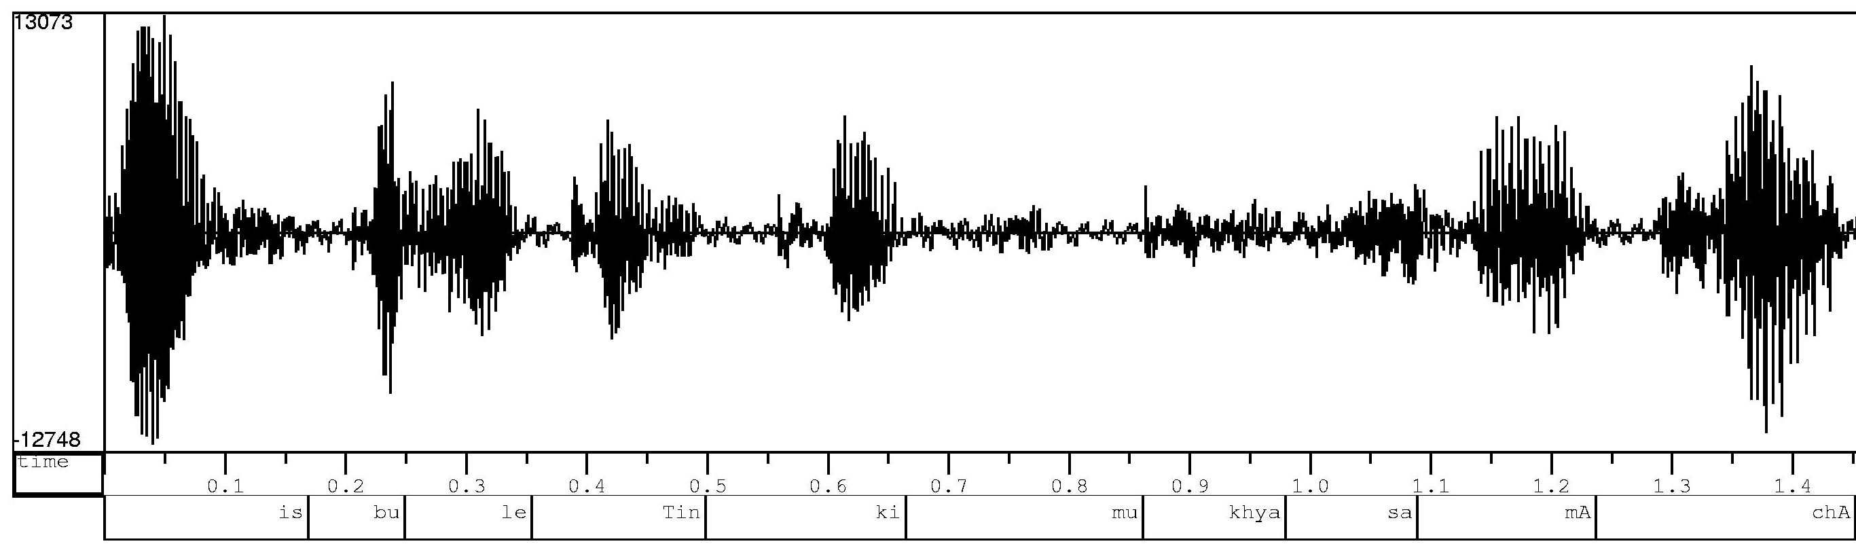
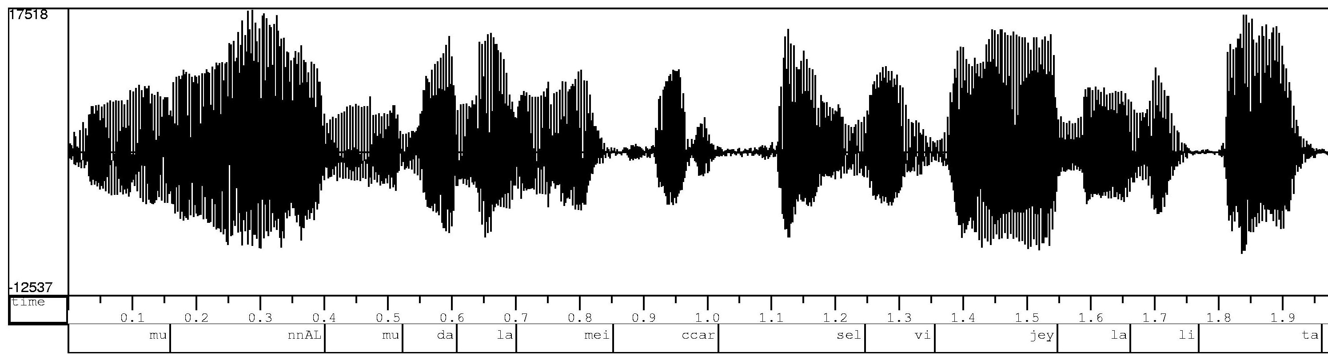
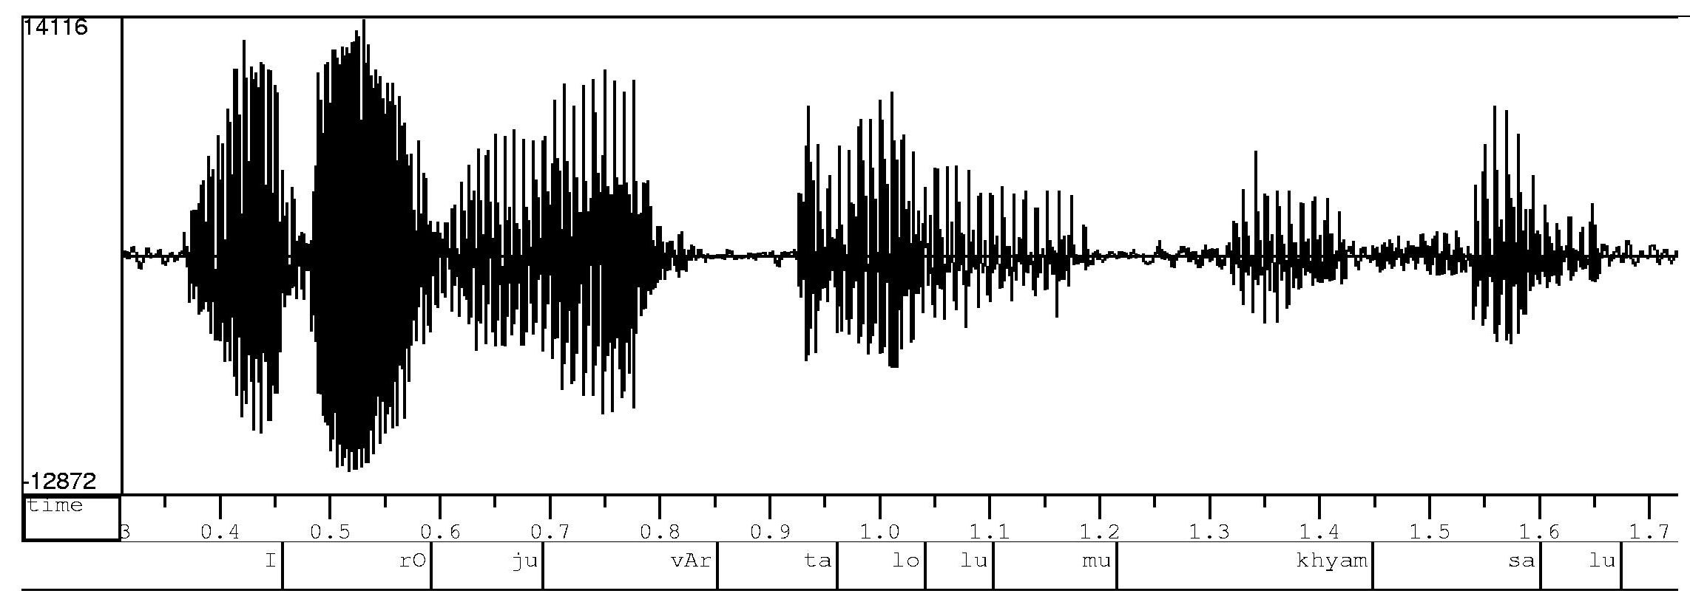
Speech Tasks
is
bu
le
Tin
ki
mu
khya
sa
mA
chAr
mu
nnAL
mu
da
la
mei
ccar
sel
vi
jey
la
li
ta
I
rO
ju
vAr
ta
lo
lu
mu
khyam
sa
lu

Slide 4
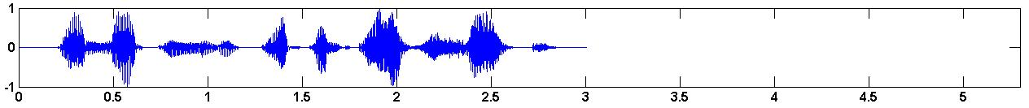

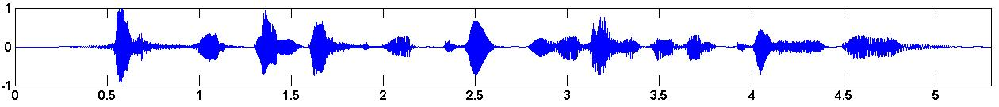
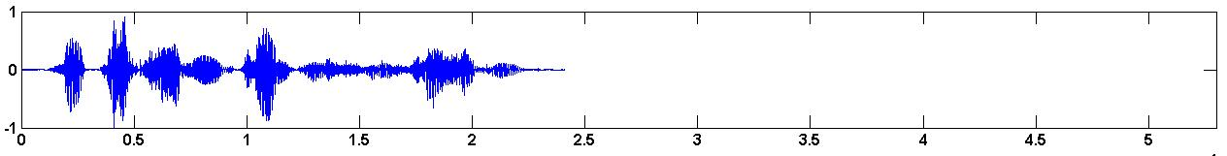
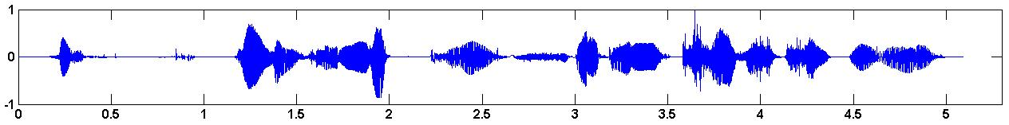
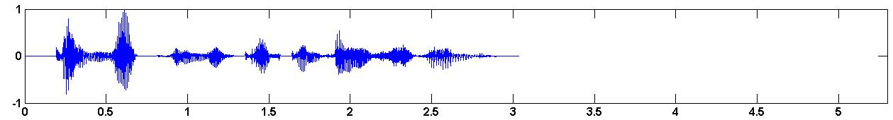
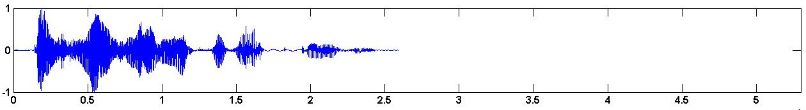
Speech Emotion Recognition
Anger
Fear
Happiness

Slide 5
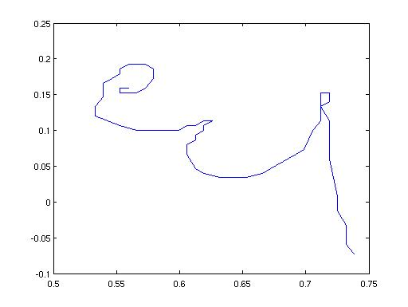
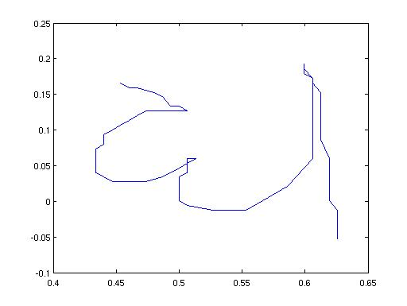
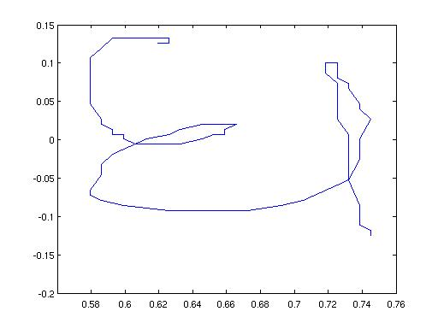
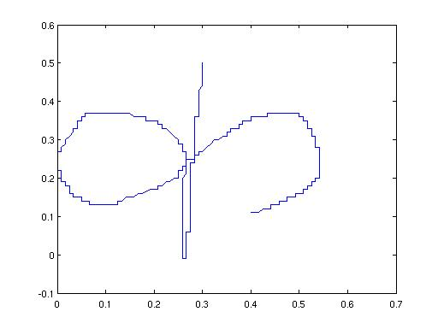
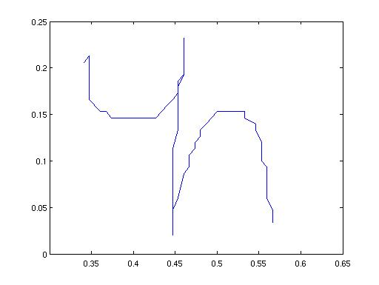
Handwritten Character Recognition
dha
dya
gha
ka
pha

Slide 6





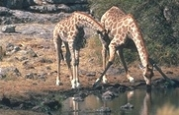
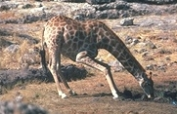
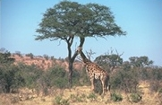
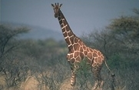
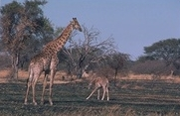
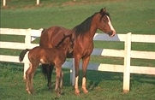
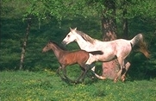

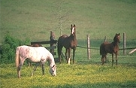






Image Classification
Tiger
Giraffe
Horse
Bear

Slide 7











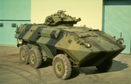

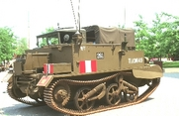











Scene Classification
Residential Interiors
Mountains
Military Vehicles
Sacred Places
Sunsets & Sunrises

Slide 8
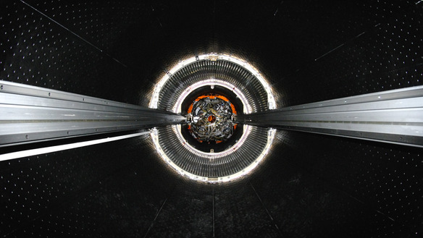
What is this ?

Slide 9
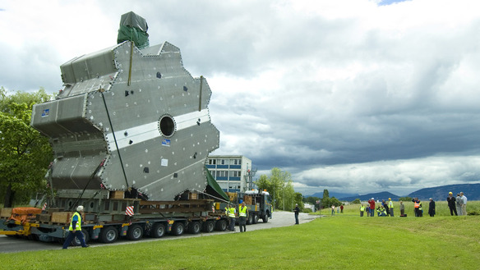
What is this ?

Slide 10
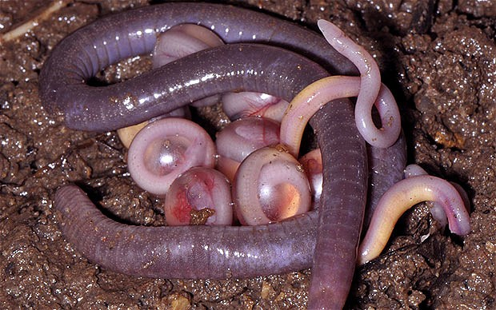
Chikilidae Family -Amphibian

Slide 11
Pattern Classification
Feature extraction
Training Examples
Feature vector 1
Tiger
Feature extraction
Class label
(Tiger)
Feature vector 2
Tiger
Training
Phase
Classifier
Feature extraction
Feature vector L
Bear
Testing
Phase
Feature extraction
Feature vector

Slide 12
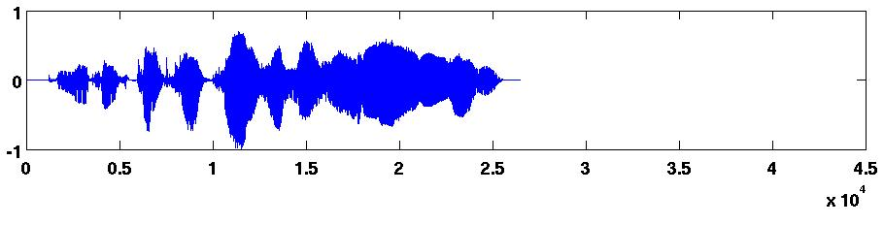
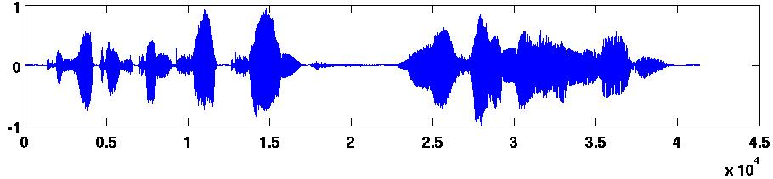
Sequential Pattern Classification
Training Examples
Feature extraction
Feature vector 1
Feature vector 2
Anger
Feature vector M₁
Class label
(Anger)
Feature extraction
Feature vector 1
Classifier
Feature vector 2
Anger
Training
Phase
Feature vector M₂
Feature extraction
Feature vector 1
Feature vector 2
Happy
Feature vector M_{L}
Testing
Phase
Feature extraction
Feature vector 1
Feature vector 2
Feature vector M

Slide 13
Evolution of Pattern Analysis Methods
Stage I (1960’s):
  Learning methods to detect linear relations among data
  Perceptron models
Stage II (Mid 1980’s):
  Learning methods to detect nonlinear patterns
  Gradient descent methods: Local minima problem
  Multilayer feedforward neural networks
Stage III (Mid 1990’s):
  Kernel methods to detect nonlinear relations
  Problem of local minima does not exist
  Methods are applicable to non-vectorial data also
    Graphs, sets, texts, strings, biosequences, graphs, trees
  Support vector machines

Slide 14
Neuron with Threshold Logic Activation Function
Input
Weights
Activation value
Output signal
a₁
w₁
w₂
M
x
s=f(x)
a₂
∑
w_{i}a_{i}-θ
i=1
a_{M}
w_{M}
Threshold logic activation function
McCulloch-Pitts Neuron

Slide 15
Linearly Separable Classes
Regions of two classes are separable by a linear surface (line, plane or hyperplane)
2-dimensional space: The
decision surface is a line
specified by
a₂
M-dimensional space: The decision surface is a hyperplane specified by
a₁
w_{i}a_{i} = w^{t}a = 0

Slide 16
Perceptron
Perceptron learning rule for weight update:
  At Step m, choose a training example a(m).
  w(m+1)=w(m) + ηa(m), for w(m)^{t}a(m)≤0 and a(m) C₁
  w(m+1)=w(m) - ηa(m), for w(m)^{t}a(m)>0 and a(m) C₂
  Here η is a positive, learning rate parameter.
Classification of a test pattern a
using the weights w obtained by
training the model :
  if w^{t}a > 0 then a C₁
  if w^{t}a ≤ 0 then a C₂
a₂
a₁

Slide 17
Multiclass Pattern Classification
One-against-the-rest approach:
a₂
a₁

Slide 18
Hard Problems
Nonlinearly separable classes
a₂
a₁

Slide 19
Neuron with Continuous Activation Function
Input
Weights
Activation value
Output signal
a₁
w₁
w₂
M
x
s=f(x)
a₂
∑
w_{i}a_{i}-θ
i=1
a_{M}
w_{M}
Sigmoidal activation function

Slide 20
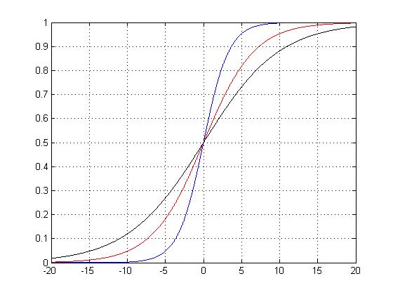
Continuous Activation Function
Activation function f(.) is a non-constant, bounded and monotonically increasing continuous function.
Sigmoid /logistic function:
β = 0.6
β = 0.2
β = 0.3
β is spread factor
f(x)
x

Slide 21
Multilayer Feedforward Neural Network
Architecture:
  Input layer ---- Linear neurons
  One or more hidden layers ---- Nonlinear neurons
  Output layer ---- Linear or nonlinear neurons
Input Layer
Hidden Layer
Output Layer
a₁
1
1
1
s₁
a₂
2
2
2
s₂
.
.
.
.
.
.
.
.
.
.
.
.
.
.
.
a_{i}
i
j
k
s_{k}
.
.
.
.
.
.
.
.
.
.
.
.
.
.
.
a_{I}
I
J
K
s_{K}

Slide 22
Backpropagation Learning -- Practical Considerations
Stopping Criteria:
  Threshold on average error
  Threshold on average gradient
  Cross-validation
Number of Weights:
  Depends on number of input nodes, output nodes, hidden nodes
Data Requirements
Limitations:
  Slow convergence
  Local minima problem

Slide 23
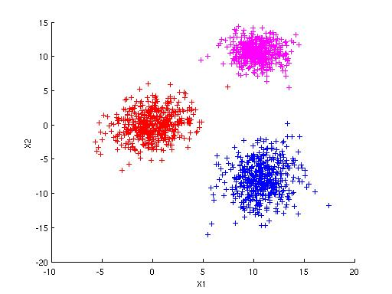
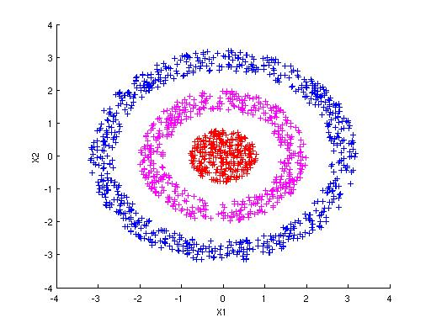
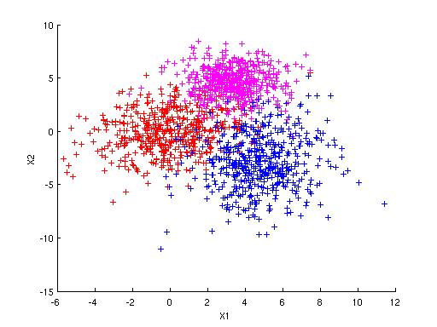
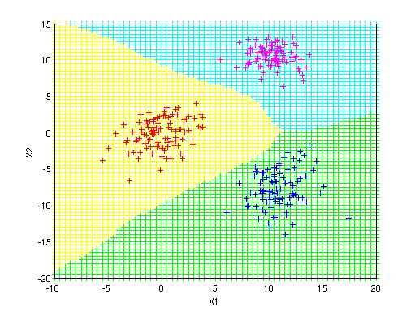
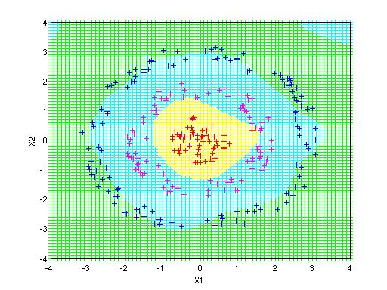
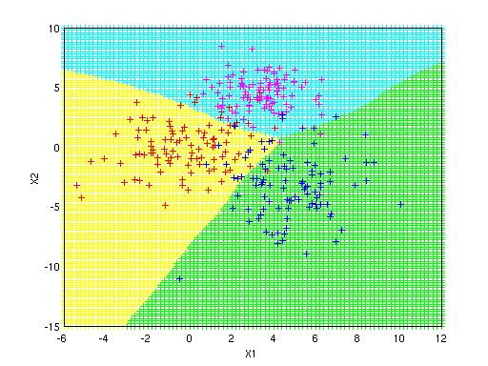
Pattern Classification using MLFFNN
Linearly Separable
Nonlinearly Separable
Overlapped

Slide 24
ANN animation

Slide 25
Differences ANN vs SVM

Slide 26
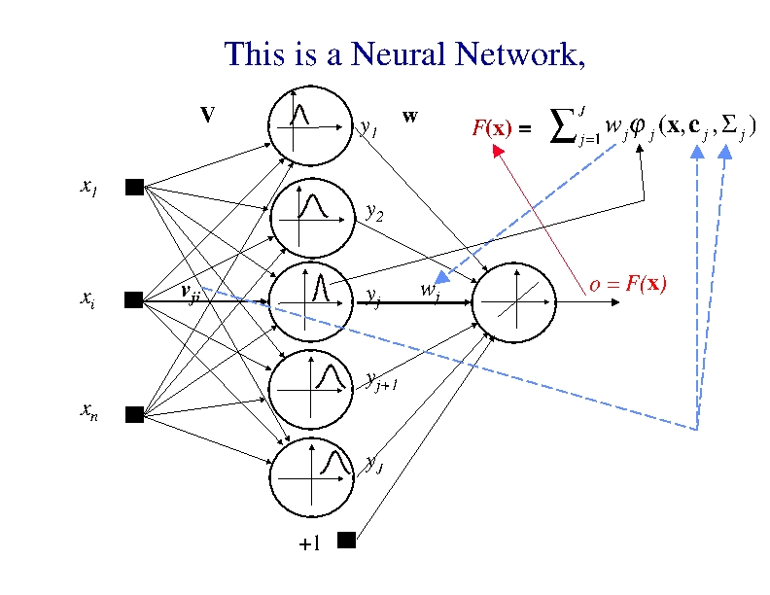

Slide 27
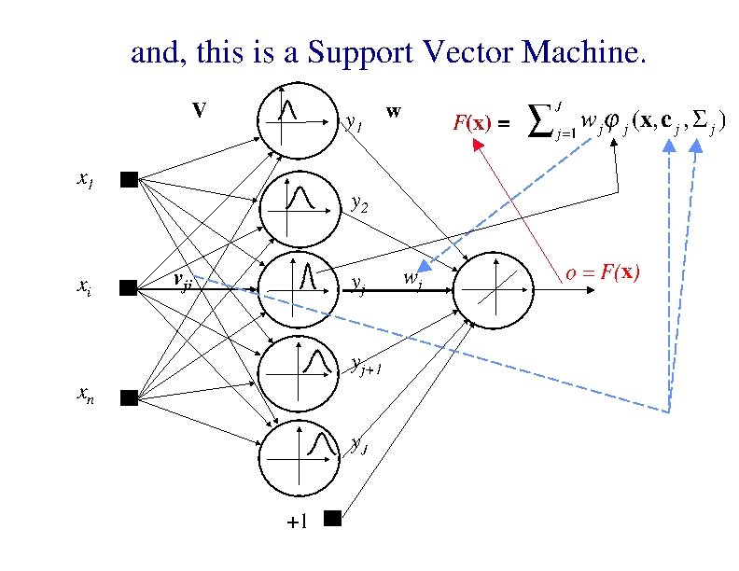
There is no difference in
representational capacity, i.e., in a
structure.
However, there is an important
difference in LEARNING

Slide 28
Classical Techniques
The classical regression and (Bayesian) classification statistical techniques are based on the very strict assumption that probability distribution models or probability-density functions are known.
Classical statistical inference is based on thefollowing three fundamental assumptions:

Slide 29
Assumptions of Classical Techniques
Data can be modeled by a set of linear parameteric functions; this is a foundation of a parametric paradigm in learning from experimental data.
In the most of real-life problems, a stochastic component of data is the normal probability distribution law, i.e., the underlying joint probability distribution is Gaussian.
Due to the second assumption, the induction paradigm for parameter estimation is the maximum likelihood method that is reduced to the minimization of the sum-of-errors-squares cost function in most engineering applications.

Slide 30
Issues with Assumptions
All three assumptions on which the classical statistical paradigm relied, turned out to be inappropriate for many contemporary real- life problems (Vapnik, 1998) due to the facts that:
Modern problems are high-dimensional, and if the underlying mapping is not very smooth the linear paradigm needs an exponentially increasing number of terms with an increasing dimensionality of the input space X, i.e., with an increase in the number of independent variables. This is known as ‘the curse of dimensionality’.
The underlying real-life data generation laws may typically be very far from the normal distribution and a model-builder must consider this difference in order to construct an effective learning algorithm,
From the first two objections it follows that the maximum likelihood estimator (and consequently the sum-of-error-squares cost function) should be replaced by a new induction paradigm that is uniformly better, in order to model non-Gaussian distributions.

Slide 31
ANN vs SVM
The development of ANNs followed a heuristic path, with applications and extensive experimentation preceding theory.
In contrast, the development of SVMs involved sound theory first, then implementation and experiments.
A significant advantage of SVMs is that whilst ANNs can suffer from multiple local minima, the solution to an SVM is global and unique.
Two more advantages of SVMs are that that have a simple geometric interpretation and give a sparse solution.
Unlike ANNs, the computational complexity of SVMs does not depend on the dimensionality of the input space.
The reason that SVMs often outperform ANNs in practice is that they deal with the biggest problem with ANNs, SVMs are less prone to overfitting.

Slide 32

Support Vector Machine (SVM)
A classifier derived from statistical learning theory by Vapnik, et al. in 1992
SVM became famous when, using images as input, it gave accuracy comparable to neural-network with hand-designed features in a handwriting recognition task
Currently, SVM is widely used in object detection & recognition, content-based image retrieval, text recognition, biometrics, speech recognition, etc.
V. Vapnik

Slide 33
Unique Features of SVM’s and
Kernel Methods
Are explicitly based on a theoretical model of learning
Come with theoretical guarantees about their performance
Have a modular design that allows one to separately implement and design their components
Are not affected by local minima
Do not suffer from the curse of dimensionality

Slide 34
α
Linear Classifiers
x
F
y^{est}
F(x,w,b) = sign(w x + b)
denotes +1
denotes -1
w x + b>0
w x + b=0
How would you classify this data?
w x + b<0

Slide 35
α
Linear Classifiers
x
F
F(x,w,b) = sign(w x + b)
denotes +1
denotes -1
How would you classify this data?

Slide 36
Linear Classifiers
α
x
F
denotes +1
denotes -1
F(x,w,b) = sign(w x + b)
How would you classify this data?

Slide 37
Linear Classifiers
denotes +1
denotes -1
Any of these would be fine..
..but which is best?

Slide 38
α
Linear Classifiers
x
F
y^{est}
F(x,w,b) = sign(w x + b)
denotes +1
denotes -1
How would you classify this data?
Misclassified
to +1 class

Slide 39
α
α
Classifier Margin
Classifier Margin
x
x
f
F
y^{est}
y^{est}
F(x,w,b) = sign(w x + b)
denotes +1
denotes -1
denotes +1
denotes -1
Define the margin of a linear classifier as the width that the boundary could be increased by before hitting a datapoint.
Define the margin of a linear classifier as the width that the boundary could be increased by before hitting a datapoint.

Slide 40
α
Maximum Margin
x
F
y^{est}
Maximizing the margin is good according to intuition and PAC theory
Implies that only support vectors are important; other training examples are ignorable.
Empirically it works very very well.
F(x,w,b) = sign(w x + b)
denotes +1
denotes -1
The maximum margin linear classifier is the linear classifier with the, maximum margin.
This is the simplest kind of SVM (Called an LSVM)
Support Vectors are those datapoints that the margin pushes up against
Linear SVM

Slide 41
Maximum Margin Hyperplane

Slide 42
Maximum Margin Hyperplane
Margin =
b

Slide 43
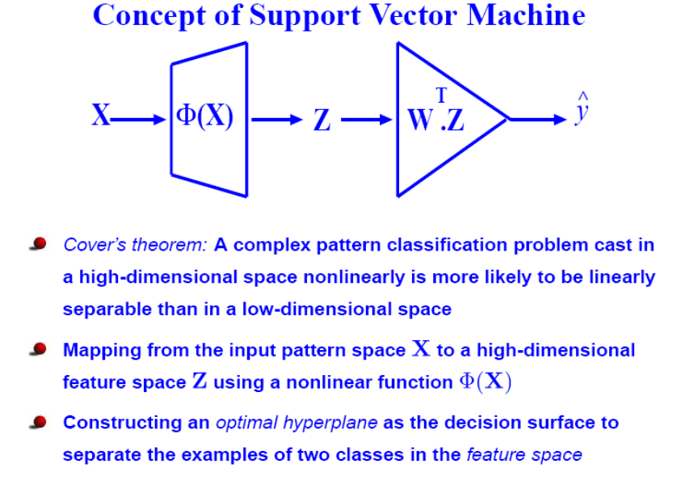

Slide 44
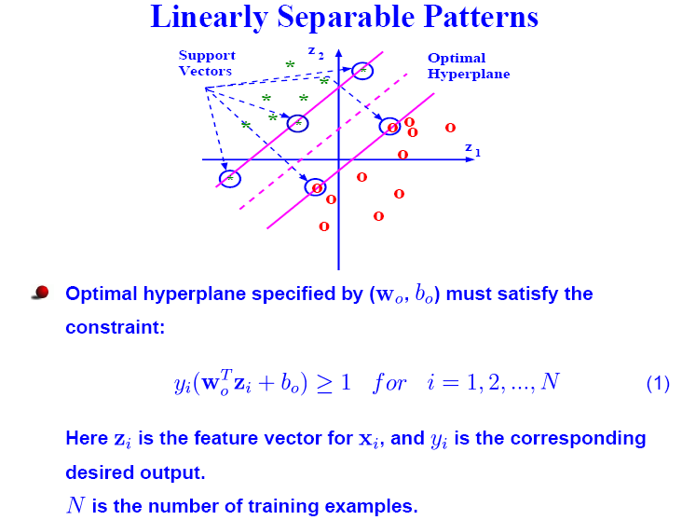

Slide 45
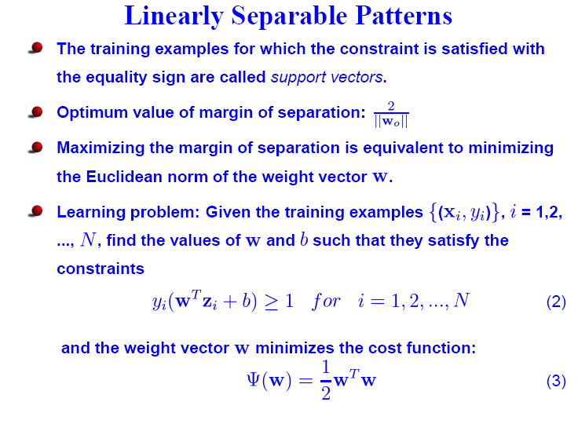

Slide 46
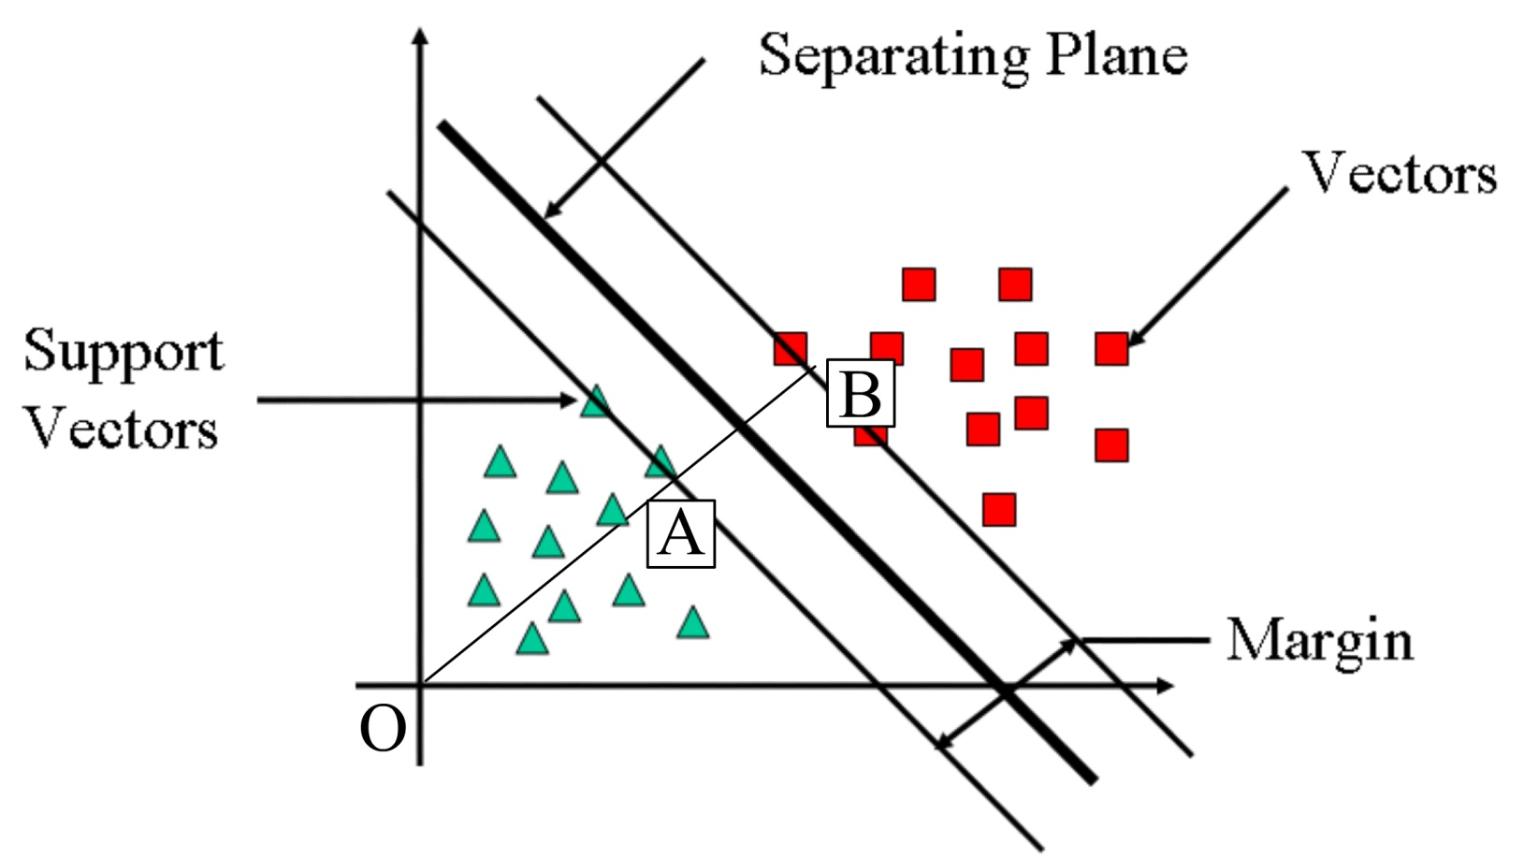
How to calculate margin
Margin = OB-OA

Slide 47
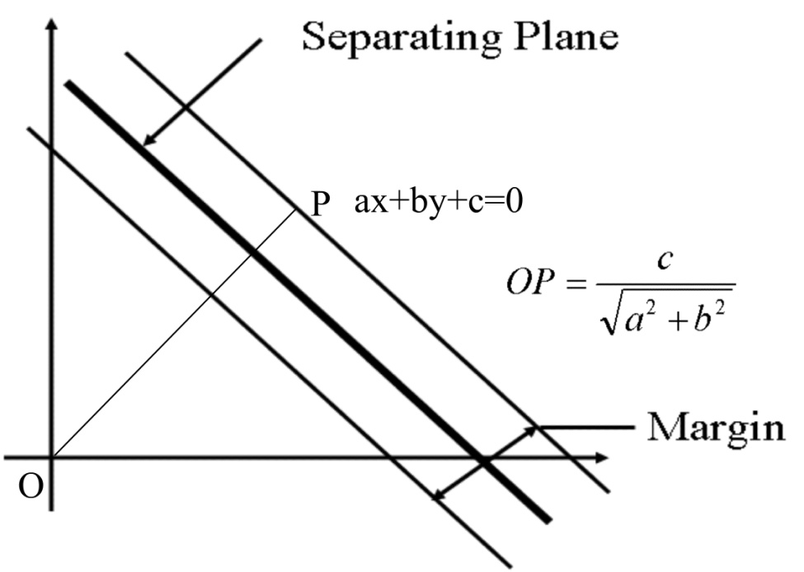
Margin

Slide 48
W is a vector say
Then, wT is row vector [w1 w2].
Therefore,

Slide 49
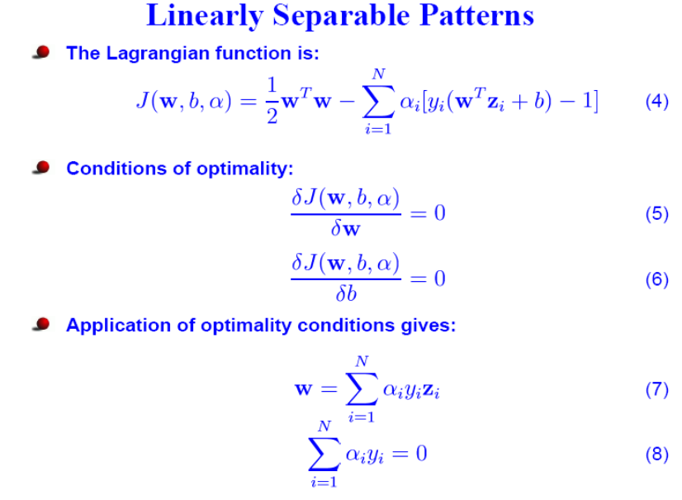

Slide 50
The Dual problem
Original problem: fix value of f and find α
New problem: Fix the values of α, and solve the (now unconstrained) problem max L(α, x)
ie, get a solution for each α, f*(α)
Now minimize this over the space of α
Kuhn-Tucker theorem: this is equivalent to original problem

Slide 51
Solving the Optimization Problem
Find w and b such that
Φ(w) =½ w^{T}w is minimized;
and for all {(x_{i} ,y_{i})}: y_{i} (w^{T}x_{i} + b) ≥ 1
Need to optimize a quadratic function subject to linear constraints.
Quadratic optimization problems are a well-known class of mathematical programming problems, and many (rather intricate) algorithms exist for solving them.
The solution involves constructing a dual problem where a Lagrange multiplier α_{i} is associated with every constraint in the primary problem:
Find α₁…α_{N} such that
Q(α) =Σα_{i} - ½ΣΣα_{i}α_{j}y_{i}y_{j}x_{i}^{T}x_{j} is maximized and
(1) Σα_{i}y_{i} = 0
(2) α_{i} ≥ 0 for all α_{i}

Slide 52
A digression… Lagrange Multipliers
In mathematical optimization, the method of Lagrange multipliers provides a strategy for finding the maxima and minima of a function subject to constraints.
For instance, consider the optimization problem
maximize
subject to
We introduce a new variable (λ) called a Lagrange multiplier, and study the Lagrange function defined by
(the λ term may be either added or subtracted.)
If (x,y) is a maximum for the original constrained problem, then there exists a λ such that (x,y,λ) is a stationary point for the Lagrange function
(stationary points are those points where the partial derivatives of Λ are zero).

Slide 53
The Optimization Problem Solution
The solution has the form:
Each non-zero α_{i} indicates that corresponding x_{i} is a support vector.
Then the classifying function will have the form:
Notice that it relies on an inner product between the test point x and the support vectors x_{i} – we will return to this later.
Also keep in mind that solving the optimization problem involved computing the inner products x_{i}^{T}x_{j} between all pairs of training points.
w =Σα_{i}y_{i}x_{i} b= y_{k}- w^{T}x_{k} for any x_{k} such that α_{k}≠ 0
f(x) = Σα_{i}y_{i}x_{i}^{T}x + b

Slide 54
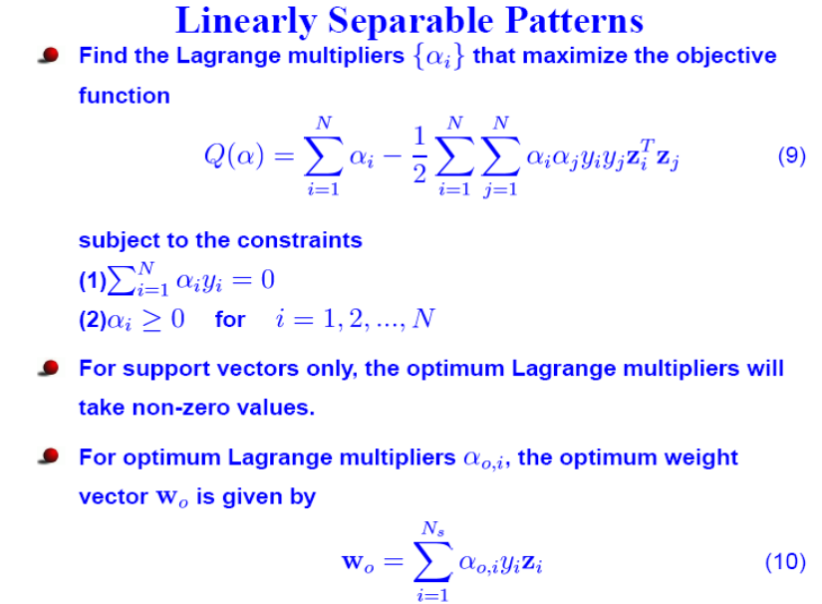

Slide 55
Linear SVMs
The classifier is a separating hyperplane.
Most “important” training points are support vectors; they define the hyperplane.
Quadratic optimization algorithms can identify which training points x_{i} are support vectors with non-zero Lagrangian multipliers α_{i}.
Both in the dual formulation of the problem and in the solution training points appear only inside dot products:

Slide 56
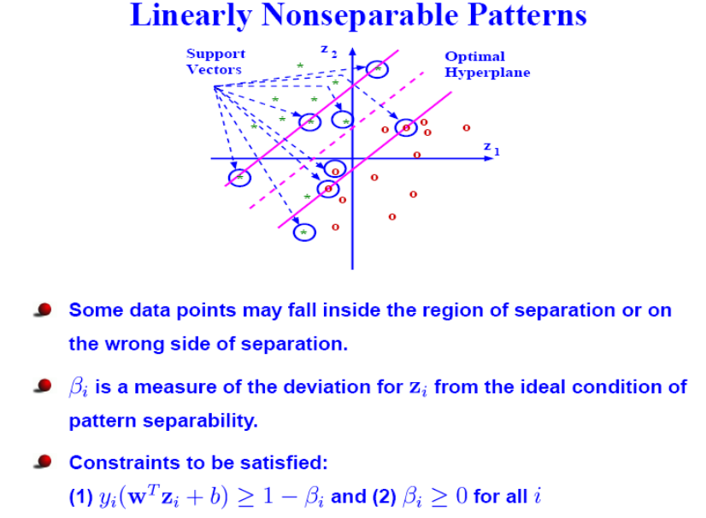

Slide 57
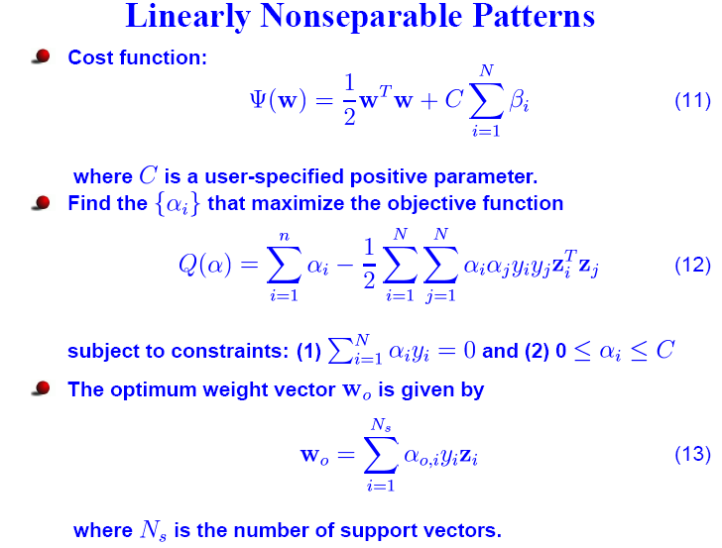

Slide 58
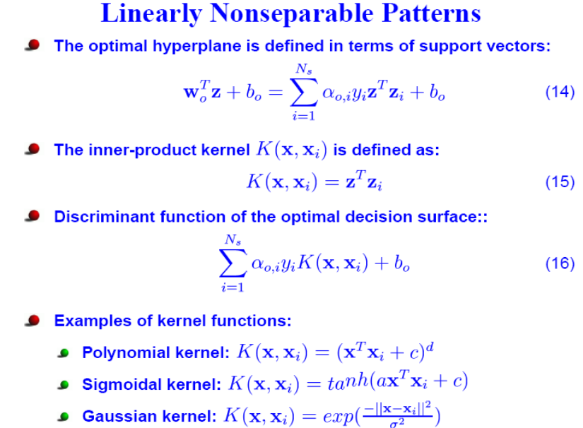

Slide 59
Non-linear SVMs
Datasets that are linearly separable with some noise work out great:
But what are we going to do if the dataset is just too hard?
How about… mapping data to a higher-dimensional space:
0
x
0
x
x²
0
x

Slide 60
Non-linear SVMs: Feature spaces
General idea: the original input space can always be mapped to some higher-dimensional feature space where the training set is separable:
Φ: x → φ(x)

Slide 61
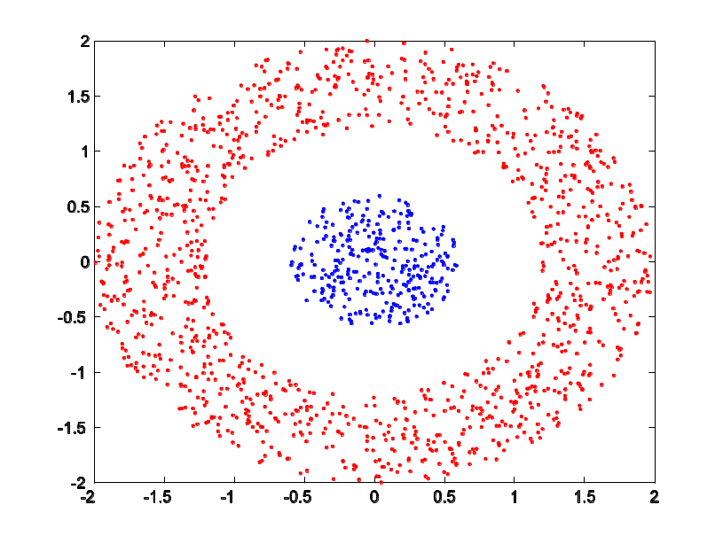
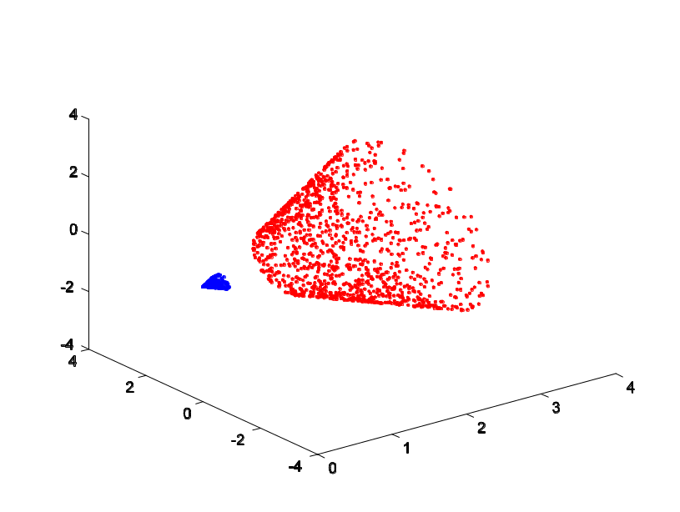
Illustration of Transformation
y
x

Slide 62
The “Kernel Trick”
The linear classifier relies on dot product between vectors K(x_{i},x_{j})=x_{i}^{T}x_{j}
If every data point is mapped into high-dimensional space via some transformation Φ: x → φ(x), the dot product becomes:
K(x_{i},x_{j})= φ(x_{i}) ^{T}φ(x_{j})
A kernel function is some function that corresponds to an inner product in some expanded feature space.
Example:
2-dimensional vectors x=[x₁ x₂]; let K(x_{i},x_{j})=(1 + x_{i}^{T}x_{j})²,
Need to show that K(x_{i},x_{j})= φ(x_{i}) ^{T}φ(x_{j}):
K(x_{i},x_{j})=(1 + x_{i}^{T}x_{j})²,
= 1+ x_{i1}²x_{j1}² + 2 x_{i1}x_{j1} x_{i2}x_{j2}+ x_{i2}²x_{j2}² + 2x_{i1}x_{j1} + 2x_{i2}x_{j2}
= [1 x_{i1}² √2 x_{i1}x_{i2} x_{i2}² √2x_{i1} √2x_{i2}]^{T} [1 x_{j1}² √2 x_{j1}x_{j2} x_{j2}² √2x_{j1} √2x_{j2}]
= φ(x_{i}) ^{T}φ(x_{j}), where φ(x) = [1 x₁² √2 x₁x₂ x₂² √2x₁ √2x₂]

Slide 63


Slide 64
Kernel Functions
Mercer kernels: Kernel functions that satisfy Mercer’s theorem
Kernel gram matrix: The matrix containing the values of the kernel function on all pairs of data points in the training data set
Kernel gram matrix should be positive semi-definite, i.e., the eigenvalues should be non-negative, for convergence of the iterative method used for solving the constrained optimization problem
Kernels for vectorial data:
  Linear kernel
  Polynomial kernel
  Gaussian kernel

Slide 65
Nonlinear SVM - Overview
SVM locates a separating hyperplane in the feature space and classify points in that space
It does not need to represent the space explicitly, simply by defining a kernel function
The kernel function plays the role of the dot product in the feature space.

Slide 66
Properties of SVM
Flexibility in choosing a similarity function
Sparseness of solution when dealing with large data sets
- only support vectors are used to specify the separating hyperplane
Ability to handle large feature spaces
- complexity does not depend on the dimensionality of the feature space
Overfitting can be controlled by soft margin approach
Nice math property: a simple convex optimization problem which is guaranteed to converge to a single global solution
Feature Selection

Slide 67
Kernel Functions
Kernels for non-vectorial data:
  Kernels on graphs
  Kernels on sets
  Kernels for texts
    Vector space kernels
    Semantic kernels
  Kernels on strings
    String kernels
    Trie-based kernels
  Kernels on trees
  Kernels on images
    Hausdorff kernels
    Histogram intersection kernels
Kernels learnt from data
Kernels optimized for data

Slide 68


Slide 69
Applications of Kernel Methods
Genomics and computational biology
Knowledge discovery in clinical microarray data analysis
Recognition of white blood cells of Leukaemia
Classification of interleaved human brain tasks in fMRI
Image classification and retrieval
Hyperspectral image classification
Perceptual representations for image coding
Complex SVM approach to OFDM coherent demodulation
Smart antenna array processing
Speaker verification
Kernel CCA for learning the semantics of text
G.Camps-Valls, J.L.Rojo-Alvarez and M.Martinez-Ramon, Kernel Methods in Bioengineering, Signal and Image Processing, Idea Group Publishing, 2007

Slide 70
Similarities ANN vs SVM
Both the NNs and SVMs learn from experimental data,
Both the NNs and SVMs are universal approximators in the sense that they can approximate any function to any desired degree of accuracy,
After the learning they are given with the same mathematical model and they can be presented graphically with the same so-called NN’s graph,
They differ by the learning method used. While NNs typically use either EBP (or some more sophisticated gradient descent algorithm) or some other linear algebra based approach, the SVMs learn by solving the QP or LP problem.

Slide 71
Advantages
Mathematical elegance
Applicable to classification, regression, novelty detection, wide range of problems ...
Issues with classical techniques overcome
Robust optimization algorithm
Simple to use
Successfully used in variety of domains

Slide 72
Some Issues
Is SVM always the best?
Do SVMs scale to massive datasets?
Do SVMs eliminate the model selection problem?
Can SVMs incorporate domain knowledge?
How interpretable are the results?
Format of data? Categorical data? Scaling of data?

Slide 73
Some Issues
Choice of kernel
- Gaussian or polynomial kernel is default
- if ineffective, more elaborate kernels are needed
Choice of kernel parameters
- e.g. σ in Gaussian kernel
- σ is the distance between closest points with different classifications
- In the absence of reliable criteria, applications rely on the use of a validation set or cross-validation to set such parameters.
Optimization criterion – Hard margin v.s. Soft margin
- a lengthy series of experiments in which various parameters are tested

Slide 74
Questions ?

