Slide 1
Topic: Real Time Fake News Detection using machine Learning and nlp
RDBMS IA-1
By:
SHRIKANT SAHU
1911113 B3 SY-COMPS

Slide 2
Introduction:
Newspapers are an authentic source of news, but nowadays social networks have become the emerging source of news and hence news can be easily manipulated which gives rise to fake ones.
Some people use it for economic and political benefits and some spread communal hate.
As authenticity of the news is important, this paper provides a predictive method to determine whether news is fake or real using machine learning classifiers like Support Vector Machine (SVM), Random Forest (RF),etc. The model which gives best accuracy and F1 score is deployed as the final classifier for the project.

Slide 3
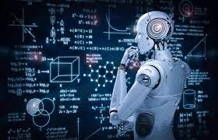
Machine Learning:
Machine Learning is the field of study that gives computers the capability to learn without being explicitly programmed.
ML is one of the most exciting technologies that one would have ever come across. As it is evident from the name, it gives the computer that makes it more similar to humans: The ability to learn.

Slide 4
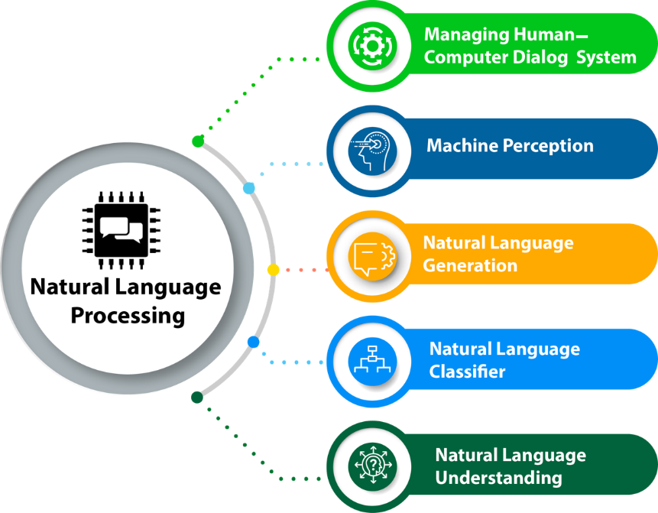
Natural language processing(NLp):
Natural Language Processing, usually shortened as NLP, is a branch of artificial intelligence that deals with the interaction between computers and humans using the natural language.
The ultimate objective of NLP is to read, decipher, understand, and make sense of the human languages in a manner that is valuable.

Slide 5
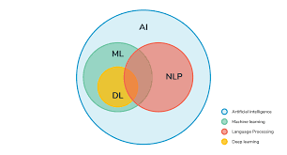
ML and NLP:
Artificial Intelligence (AI) - the broad discipline of creating intelligent machines
Machine Learning (ML) - refers to systems that can learn from experience
Deep Learning (DL) - refers to systems that learn from experience on large data sets
ML and NLP have some overlap as ML is often used for NLP tasks(like in this case ML is used to determine whether the news is fake or real).

Slide 6
Methodology:
The machine learning model/algorithm with the best performance(accuracy and F1 score) will be selected as the final model.
But before this, various intermediate processes are done which are shown in the flow diagram:

Slide 7
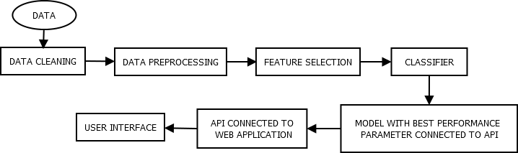
Flow diagram of proposed system:

Slide 8
Data:
Data is the prime ingredient for the model as it is fed to the machine learning model.
The data set is divided in the ratio of 80:20 for training and testing of
algorithms.
DATA CLEANING:
Certain symbols like special characters, blank spaces, etc. hardly have importance and in turn they could adversely affect the prediction model. Hence, they must be removed.

Slide 9
Data preprocessing:
For ease in feature extraction, data must be preprocessed.
It includes:
Converting lowercase letters to uppercase, removal of one letter words, removal of digits, punctuations, removal of stop words, tokenization of data and then removal of empty tokens.
Lemmatization: Converting words into their root form. E.g. studies – study(reduces some data). It comes with a POS tag to preserve meaning of that word.

Slide 10
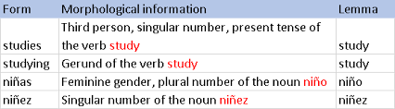
Lemmatization:

Slide 11
Feature selection:
Process in which those features(words) which contribute most to the model are selected. Fake news consist of such words.
Methods:
Bag of Words: Each document(news) is converted into vector in which the entries are the frequency of words.
TF-IDF: Some words might have high frequency but are of low importance. So a score is given to each word called TF-IDF.
POS-Tag: Associating words with their parts of speech.
N Gram: Group of words considered as single.

Slide 12
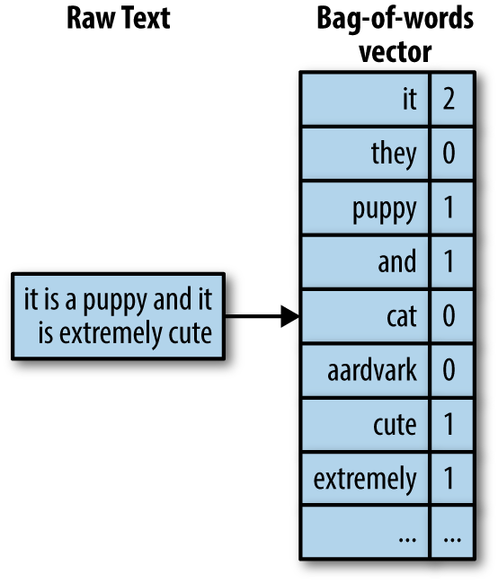
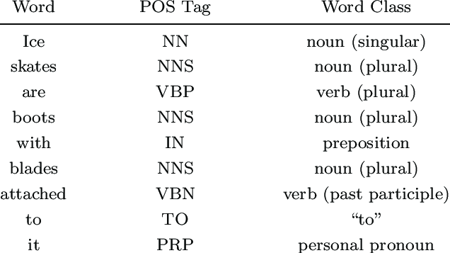
Bag of Words:
POS Tag:

Slide 13
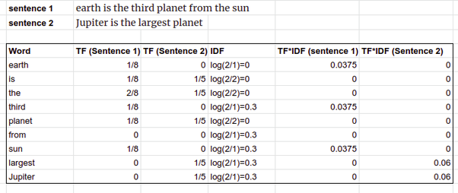
TF-IDF:

Slide 14
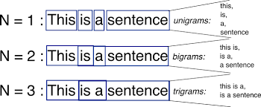
N Gram:

Slide 15
CLASSIFiers:
Classifiers are the algorithms that are capable of classifying the input based on the features present in the input.
The first classifier should be trained on features which will be present in a different class.

Slide 16
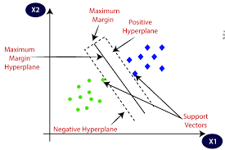
Support Vector Machine(SVM):
SVM is a supervised machine learning algorithm that can be used for classifications.
Features of both the classes are mapped to the graph and an optimum plane known as hyperplane is drawn between them to segregate the classes.
This plane is drawn the basis of two support vectors location each of which is nearest to features point of the each class.

Slide 17
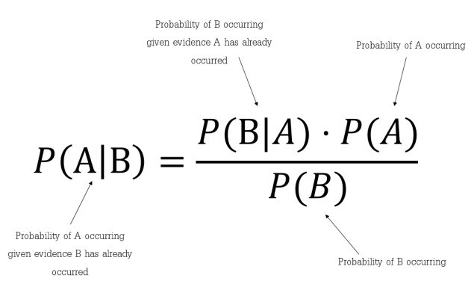
Naïve Bayes:
Naïve Bayes classifier is a probabilistic classifier based on Bayes Theorem with the assumption of independence among the features.
Multinomial Naive Bayes uses the frequency of the words as a feature to classify the data in various classes.

Slide 18
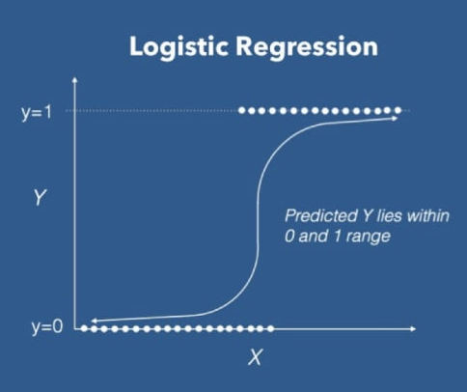
Logistic Regression :
It uses the sigma curve instead of the regression line for predicting the categorical dependent variable using a given set of independent variables.
In logistic regression, we use the concept of the threshold value, which defines the probability of either 0 or 1.

Slide 19
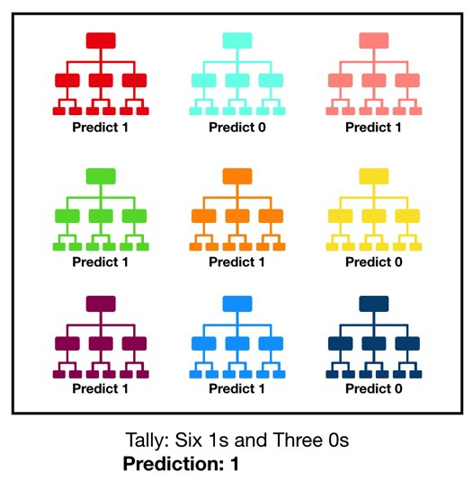
Random forest classifier:
It is the collection of many decision trees. Uncorrelated forest of trees is created whose prediction by committee is more accurate than that of any individual tree.
Prediction of each tree is taken as a vote to give the final
output.

Slide 20
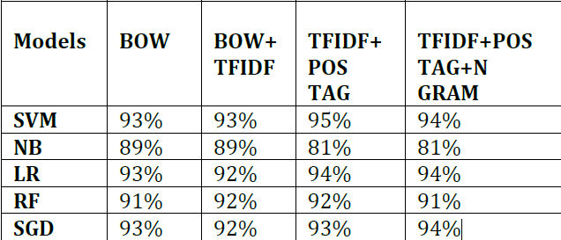
Result comparison:
Best Model i.e. combination of Machine learning algorithms with NLP method is selected after comparing the results of the twenty models. These twenty models are made by taking all ML algorithms with a combination of NLP methods.
( Accuracy of Models )

Slide 21
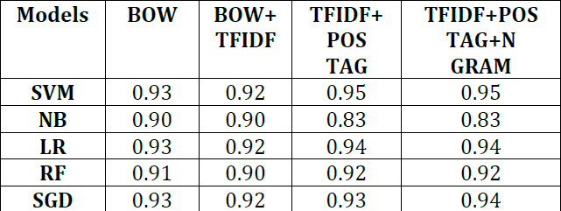
( F1 Score of Models )
From the above comparison of the parameters, the author concluded that the Support Vector Machine classifier with TFIDF and POS Tag method is the best performer in terms of both accuracy and F1 score i.e. 95% accuracy and 0.95 F1 scores.

Slide 22
Deployment:
Concept of pickling was used by the author of paper so that machine need not be trained every time when we want to use it.
For the end users, UI was created using html & css and linked to the project using flask API.
A dataset (csv file) having 6630 news with equal proportionality of fake and real was used by the author.

Slide 23
Implementation strategy:
I will create a basic webpage where the user can enter text(news).
This webpage will be connected to the main project via flask API.
I will save the model with max. accuracy by using pipelining(in the paper pickling was used but pipeline is a more updated method) so that every time I don’t need to train the model.
Datasets that will be used:
https://www.kaggle.com/c/fake-news/data?select=test.csv
https://www.kaggle.com/c/fake-news/data?select=train.csv
Train-test ratio = 80:20

Slide 24
References:
[1] Kushal Agarwalla, Shubham Nandan, Varun Anil Nair, D. Deva Hema, “Fake News Detection using Machine Learning and Natural Language Processing,” International Journal of Recent Technology and Engineering (IJRTE), Volume-7, Issue-6, March 2019.
[2] Chaitra K Hiramath, Prof. G.C Deshpande, Fake News Detection Using Deep Learning Techniques, 1st International Conference on Advances in Information Technology,2019.
[3] A.Lakshmanarao, Y.Swathi, T. Srinivasa Ravi Kiran, “An Effecient Fake News Detection System Using Machine Learning,” International Journal of Innovative Technology and Exploring Engineering (IJITEE), Volume-8, Issue-10, August- 2019.
[4] Abdullah-All-Tanvir, Ehesas Mia Mahir, Saima Akhter, Mohammad Rezwanul Huq, “Detecting Fake News using Machine Learning and Deep Learning Algorithms,” 7th International Conference on Smart Computing & Communications (ICSCC),2019.
[5] https://monkeylearn.com/blog/nlp-ai/

Slide 25
https://becominghuman.ai/a-simple-introduction-to-natural-language-processing-ea66a1747b32
https://devopedia.org/natural-language-processing
https://machinelearningmastery.com/gentle-introduction-bag-words-model/
https://towardsdatascience.com/machine-learning-classifiers-a5cc4e1b0623

Slide 26
Conclusion:
We can detect fake news by using a combination of machine learning and NLP methods.
The classification of whether the news is real of fake is done on the basis of presence of specific words found in the real and fake news respectively.
Usage of NLP makes the computer understand the data better.(Here, usage of POS tag gives more meaning to the data, removal of stop words/words with high frequency helps the computer(program) to emphasize only on the important data.)
These NLP methods give a boost to the accuracy and F1 score of the machine learning classifier and the model(using different combinations of classifiers and NLP methods) having highest accuracy and F1 score is deployed as the final model.

Slide 27
Thank YOU!

