Slide 1


Slide 2
What is Stripe?
A set of unified APIs and tools that instantly enables businesses to accept and manage online payments.
Built for developers!

Slide 3
What does Stripe cost?
2.9% + $0.30 per successful transaction
Discounted rates apply once you exceed $10,000 in transactions per month.
No setup fees
No monthly fees
Free refunds
Free failed transactions

Slide 4

API Libraries

Slide 5
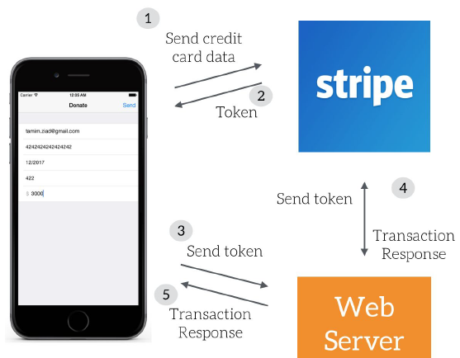
How Stripe works!
Functional Overview
All API requests must send over HTTPS (i.e. over secure channel)
Review* system in Stripe
Portability**
Radar – A modern tool to avoid fraud
Notes:
*Once a payment is Reviewed, it is marked as one of the below:
● Approve: Closes the review with no changes made to the payment
● Refund: Refunds the payment without reporting it to Stripe as fraudulent
● Refund and report fraud: Refunds the payment and reports it to Stripe as fraudulent. This improves our machine learning models’ judgments and
further increases the effectiveness of our fraud prevention. **If you ever decide to leave Stripe, they will help you transfer your data in a PCI compliant way.

Slide 6
How Do You Use Stripe?
API Keys
You need a publishable and a secret key
pk_test_TWiIAK1daBceEh3lfCDzjavf
sk_test_nigZcikILd8oLeaJk4hvuYtN
You get these in your dashboard under Account Settings,
API Keys

Slide 7
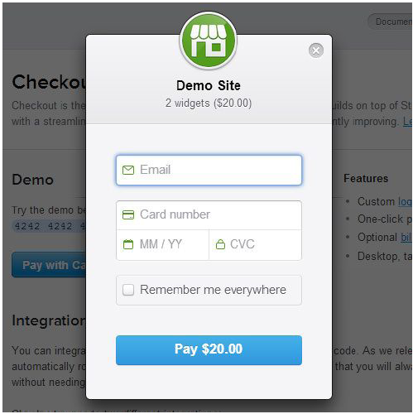
Simple Stripe form

Slide 8
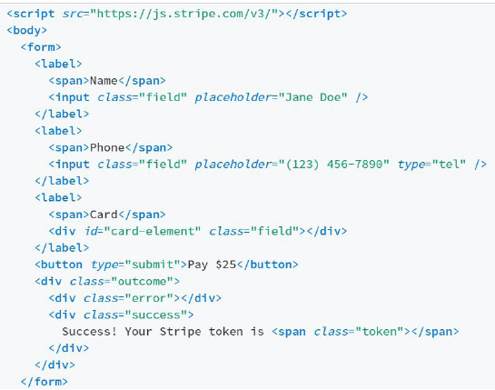
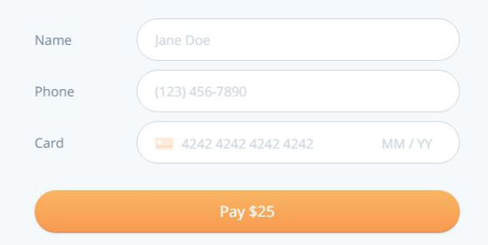
Create custom Stripe form
Include Stripe.js library
Add ‘data-stripe’ attribute for inputs
DO NOT add ‘name’ attribute to field which will communicate with Stripe

Slide 9

Payments security
Radar is a suite of modern tools to help you fight fraud.
Machine learning-based risk evaluations on all your card payments
Rules to automate custom business logic
Review unusual payments and take action through the Dashboard

Slide 10
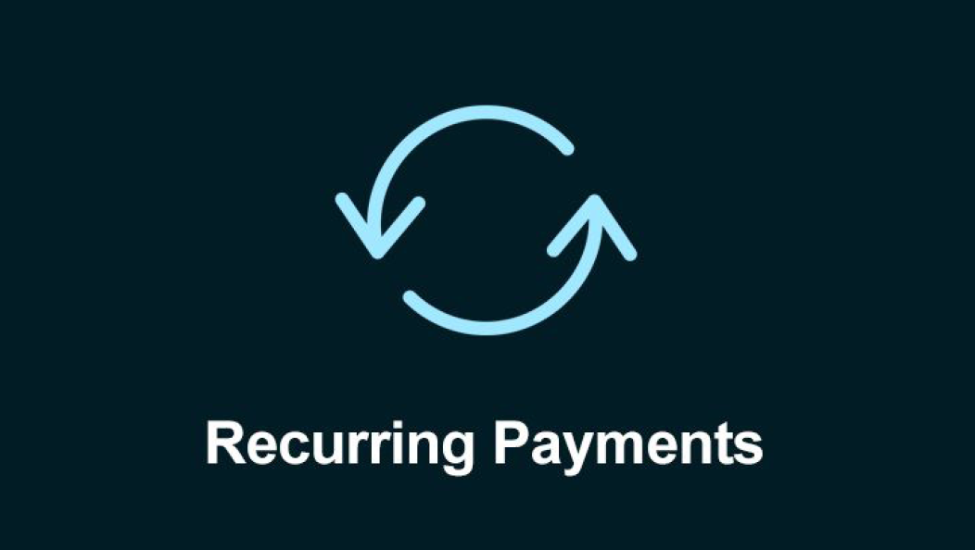
Subscription

Slide 11
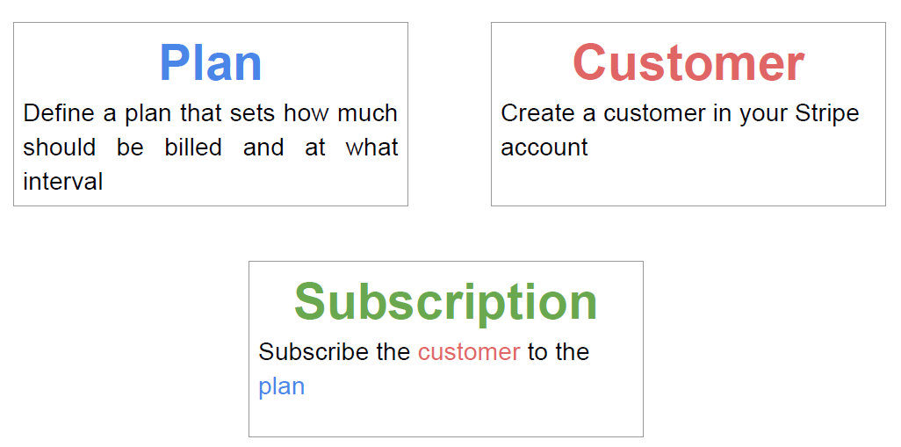
How it works

Slide 12
Stripe benefits
Full API Documentation
Supported Currencies 135+
PCI Service Provider Level 1
Custom form with security
Data Portability
Custom data learning machine(Radar)

Slide 13

Thank You!

