Slide 1
Micro-Crash Modeling with Machine Learning
Shrikant Fulari
The Data Incubator Project

Slide 2
Motivation
30,000 +
$ 300
Billion +
Deaths every year for the past decade in USA
Yearly average economic costs of crashes in USA
1.6
Million
50+
Traffic collisions reported for New York City (2012-2020)
State Department of Transport and many other role players
Source: https://www.transportation.gov/, https://www.nhtsa.gov/research

Slide 3
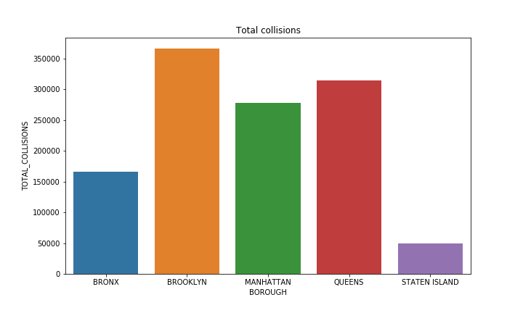
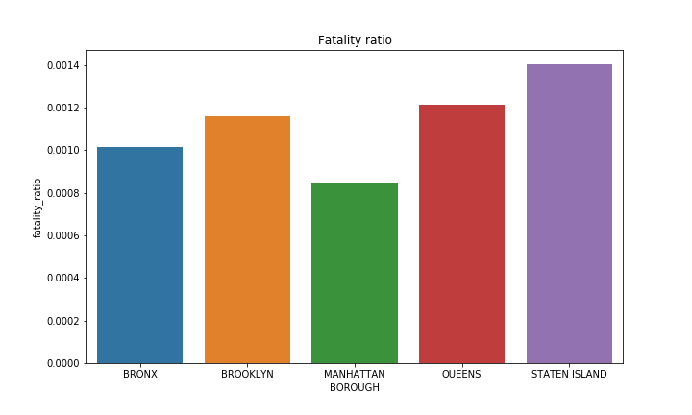
Insights from NYC collision data: Fatality ratio

Slide 4
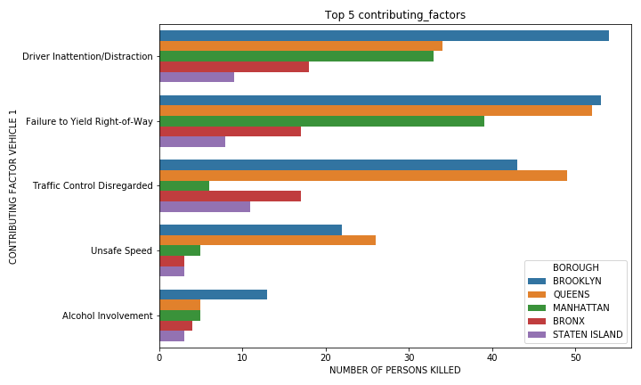
Insights from NYC collision data : Contributing factors

Slide 5
Fatal/non-fatal crash classification model
Data cleaning, feature selection
Make it a classification problem
Train and test sets using stratified shuffle split
Apply machine learning models
Treat null values
Generate variables such as hour, day of week and month from date time
Select most helpful features
Output variable: If Fatalities >0 then Fatal, else non-fatal event
AdaBoost
Logistic Regression
Support vector classifier
K-nearest neighbor
Decision Tree
Random Forest
Used stratified shuffle sampling to get reliable accuracy score
Pack the entire application in Tkinter using Python

Slide 6
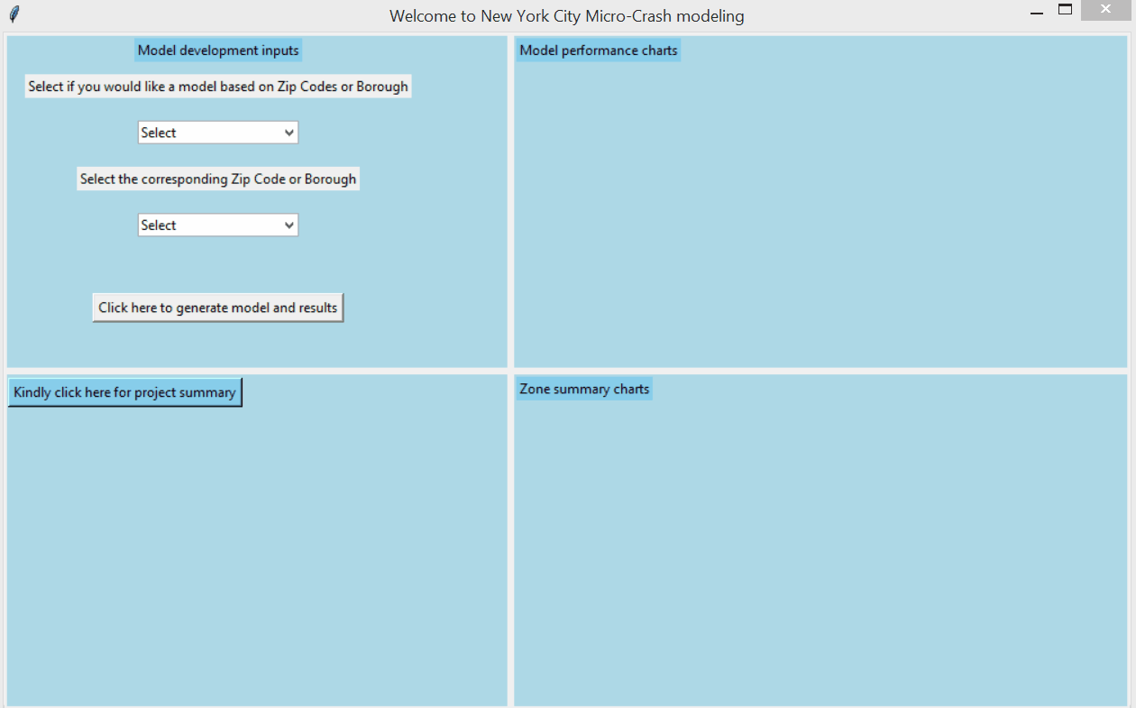

Slide 7
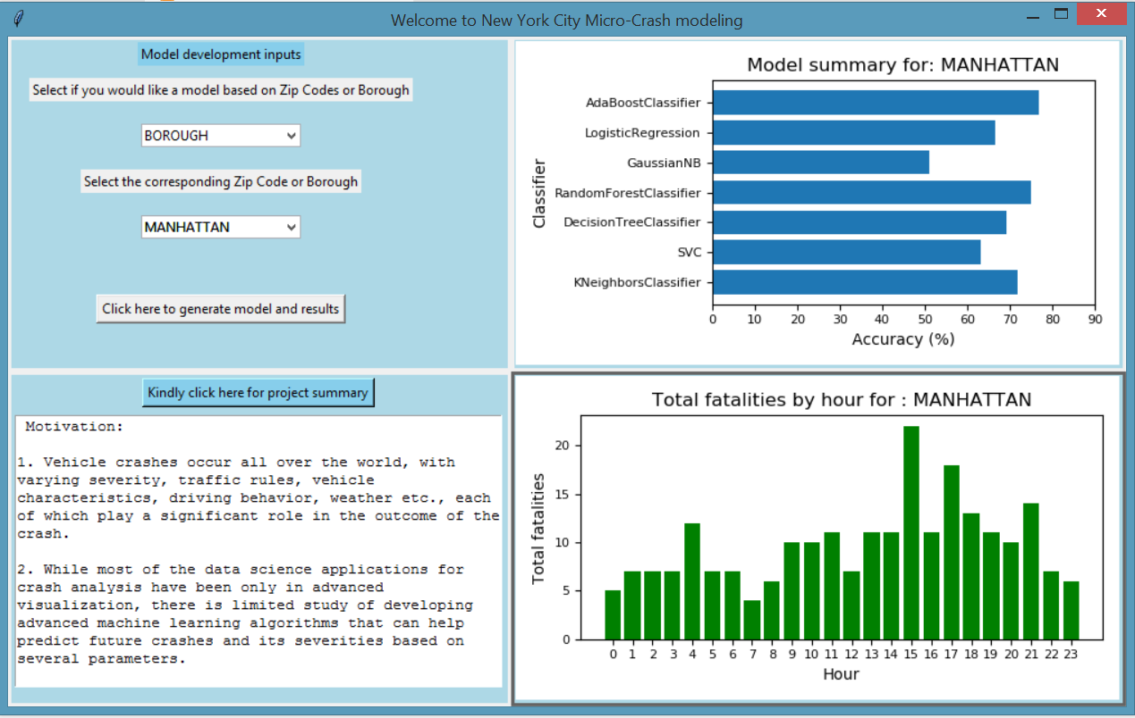

Slide 8
Scalability and future work
Benefits
Provide diverse end user applications
Instant control measures to prevent crashes
Enhance accuracy of models
More reliable crash predictions
Expand database for wide coverage
Better understanding of crash data
Develop a centralized application
One stop for all interacting agencies

Slide 9
THANK YOU!!

