Slide 1

JAWAHARLAL NEHRU NATIONAL COLLEGE OF ENGINEERING Department of Information Science and Engineering
DETECTION OF LUNG CANCER FROM CT SCANNED IMAGES
USING IMAGE PROCESSING.
By,
Sneha B 4JN16IS099
Sreelakshmi Adiga P 4JN16IS100
Vaidehi M S 4JN16IS113
Vaishnavi M S 4JN16IS114
Under the Guidence of,
Dr. Jyothi K BE,M.Tech.,Ph.D
Professor and Head
Dept of IS&E
JNNCE, Shivamogga.

Slide 2
CONTENTS
Abstract
Introduction
Objectives
Hardware and Software requirements
Experimental setup
Implementation
Obtained Results
Further work
References

Slide 3
ABSTRACT
Lung cancer seems to be the common cause of death among people throughout the world. Early detection of lung cancer can increase the chance of survival among people. The overall 5-year survival rate for lung cancer patients increases from 14 to 49% if the disease is detected in time. Although Computed Tomography (CT) can be more efficient than X-ray. However, problem seemed to merge due to time constraint in detecting the present of lung cancer regarding on the several diagnosing method used. Hence, a lung cancer detection system using image processing is used to classify the present of lung cancer in CT- images.
In this study, MATLAB codes have been used through python in every procedures made. Image processing techniques such as image pre-processing, segmentation,feature extraction and classification have been discussed in detail.

Slide 4
INTRODUCTION
The mortality rate of lung cancer is the highest among all other types of cancer.
Survival from lung cancer is directly related to its growth at its detection time.
CT are more effective than plain chest x-ray in detecting and diagnosing the lung cancer.
Due to recent improvements in medical technology, reliable CAD systems have been employed for the earlier and faster diagnosis of cancer.
Among rapidly growing technologies, with various aspects of business image processing forms core research area.

Slide 5
Following are the steps involved in image processing.
Image acquisition: Collecting the images and forming the database of the required images for further analysis.
Image Pre-processing: It involves adjusting the images as required for the future work. It is followed by segmentation.
Feature extraction: Here, certain features are extracted in order to gain the required information.
Classification: Based on the obtained features, the image is classified. Certain classifiers are used for the purpose.

Slide 6
OBJECTIVES
Collection of dataset i.e., CT scanned images of chest.
Implementing image processing techniques for Detection of lung region and Detection of tumors in lung region.
Classifying the image into cancerous and normal image.
Classifying the stage of Cancer.

Slide 7
HARDWARE AND SOFTWARE REQUIREMENTS.
Python Interpreter,OpenCv or MATLAB recent version.
Laptop with WINDOWS 8,10 version 64 bits recommended.
CPU quad-core, Intel i5/i7/Threadripper/Xeon Processor.
Hard disk SSD.

Slide 8
EXPERIMENTAL SETUP
Python is an interpreted, high level and general purpose programming language.
Python provides lots of libraries to aid image processing.
OpenCV : Image processing library mainly focused on real-time computer vision with application in wide-range of areas like 2D and 3D feature toolkits.
Numpy : For image manipulation and processing.
pyplot: pyplot is a collection of command style functions that make matplotlib work like MATLAB.
glob: glob module finds all the path names matching a specified pattern according to the rules used by the Unix shell.

Slide 9
IMPLEMENTATION
Image collection
Preprocessing
smoothing
enhancement
segmentation
Feature extraction
Classification
Fig.1. Flow chart on our work flow

Slide 10
Dataset of 15 patients is collected from an online database named Lung Image Database Consortium(LIDC) with an average of 150 images of each patient.
The database comprises of around 1018 cases’ images and each image is of the dimension 512 x 512.
From the obtained images 225 images are used for training(15 of each patient) and 150 are kept for testing purpose(10 of each patient)
Obtained images are converted to grayscale images.
Grayscale is a range of monochromatic shades from black to white. This process removes all color information, leaving only the luminance of each pixel
Noise removal is a process used to reduce or remove the visibility of noise by smoothing the entire image leaving areas near contrast boundaries.
Closing is the basic workhorse of morphological noise removal.

Slide 11
It removes small holes inside the foreground objects or small black points on the object.
Dilation increases the white region in the image or size of foreground object increases.
It is also useful in joining broken parts of an object.
The distance transform operator generally takes binary images as inputs.
In this operation, the gray level intensities of the points inside the foreground regions are changed to distance their respective distances from the closest 0 value.
Thresholding is a technique in OpenCV, which is the assignment of pixel values in relation to the threshold value provided

Slide 12
In thresholding, each pixel value is compared with the threshold value.
If the pixel value is smaller than the threshold, it is set to 0, otherwise, it is set to a maximum value (generally 255).
OpenCV implemented a marker-based watershed algorithm where we specify which valley points are to be merged and which are not.
It is not an automatic but an interactive image segmentation.
The "marker-based" means labeling where the region is a foreground or a background, and give different labels for our object.
Using one color, we label the region which we are sure of being the foreground or being background with another color.

Slide 13
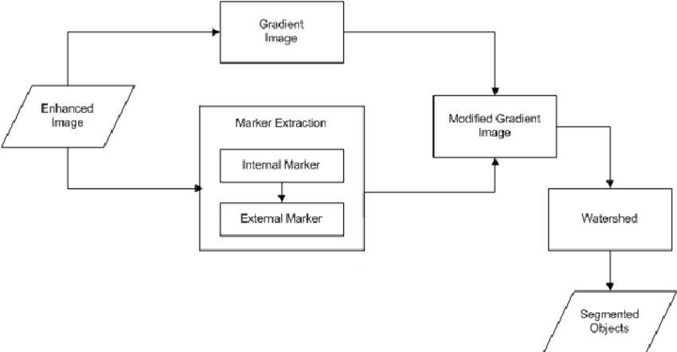
After that, we apply watershed algorithm. Then our marker will be updated with the labels we gave, and the boundaries of objects will have a value of -1.
Fig.2. Stages of marker based watershed segmentation

Slide 14
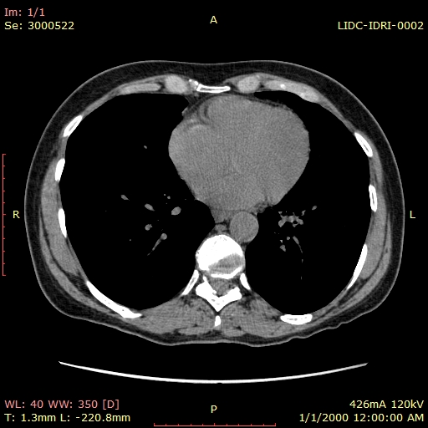
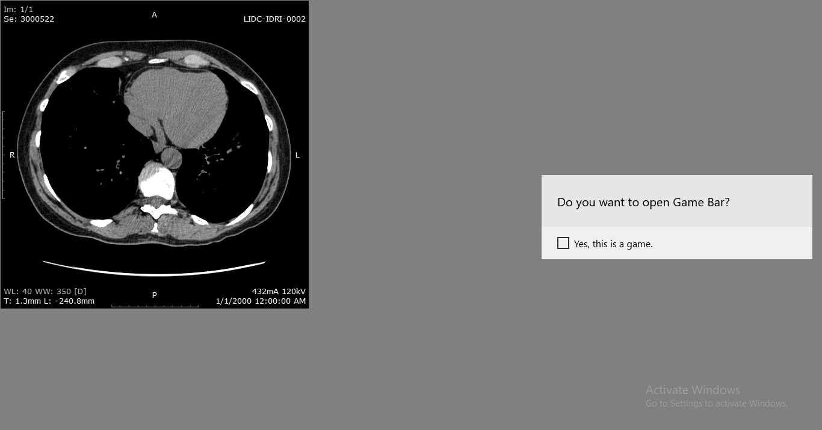
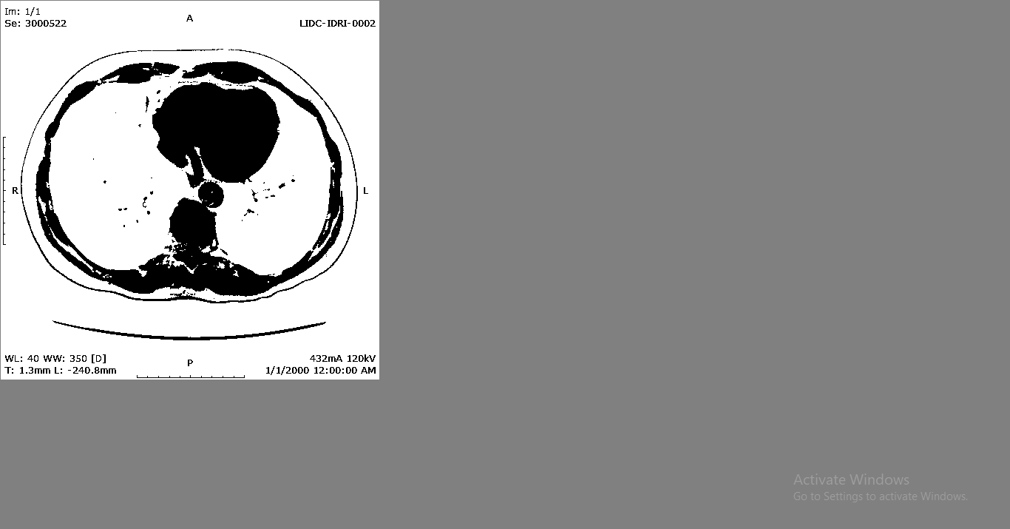
OBTAINED RESULTS.
Input image.
Gray image. Otsu’s binary threshold.
.

Slide 15
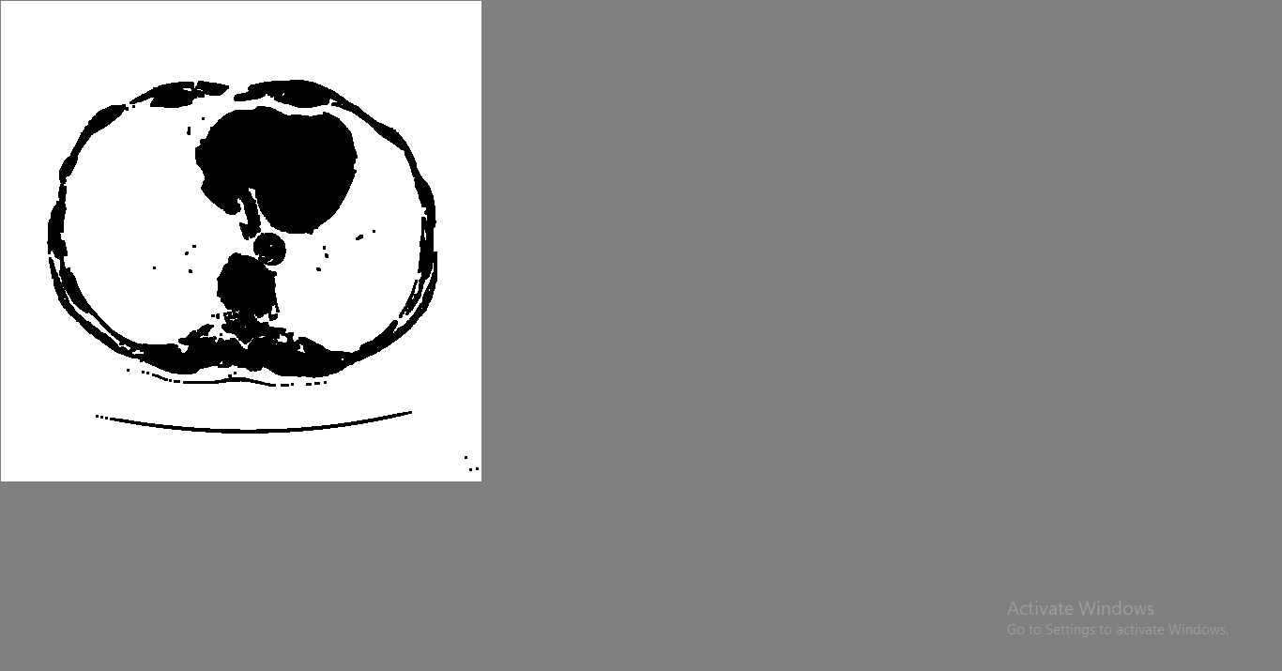
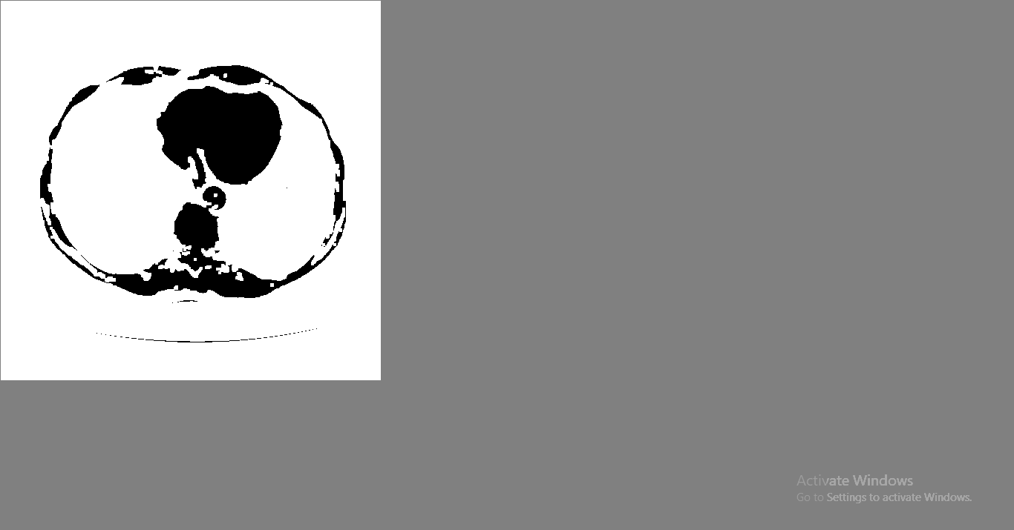

Morphological closing. Dilation. Distance transform.
From the above images it is visible that the foreground area is highlighted by setting the background to maximum(255) i.e making it appear white.

Slide 16

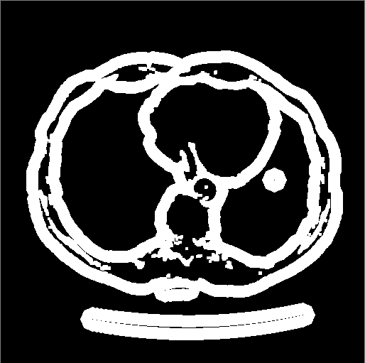
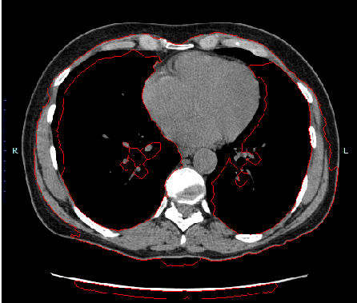
Thresholding. Unknown regions. Segmented image.
Among the obtained segmented images, 15 images of each patient are used for training purpose and 10 images of each patient are kept for testing with certain naming conventions.

Slide 17
FURTHER WORK.
The images that are kept for training will be further used for extracting features such as eccentricity, area, perimeter, major axis length ,minor axis length etc.
These features are used for classification of image into cancerous and normal image with the help of classifier.
The testing images are later used for result analysis.

Slide 18
REFERENCES
[1] S.KALAIVANI, PRAMIT CHATTERJEE, SHIKHAR JUYAL AND RISHI GUPTA, “Lung Cancer Detection using Digital Image processing and Artificial Neural Network” in 2017 International conference of Electronics, Communication and Aerospace Technology (ICECA).
[2] MANASEE KURKURE AND ANURADHA THAKARE “Lung Cancer Detection using Genetic approach” in 2016 International Conference on Computing Communication Control and automation (ICCUBEA).
[3] ANITA CHAUDHARY, SONIT SUKHRAJ SINGH, “Lung cancer detection on CT images by using image processing” in 2012 International Conference.

Slide 19
[4] M.GOMATHI , Dr.P.THANGARAJ “A computer aided diagnosis system for detection of lung cancer nodules using extreme learning machine” in International Journal of Engineering Science and Technology Vol. 2(10), 2010
[5] MOKHLED S. AL-TARAWNEH “Lung Cancer Detection Using Image Processing Techniques” in Leonardo Electronic Journal of Practices and Technologies issued January-June 2012
[6] MOFFY VAS , AMITA DESSAI “Lung cancer detection system using lung CT image processing” in 2017 International Conference.
[7] GAWADE PRATHAMESH PRATAP, R.P CHAUHAN, "Detection of lung cancer cells using image processing techniques ", 1st IEEE International Conference on Power Electronics, 2016.

Slide 20
THANK YOU.

