Slide 1
Explaining GIT in human language
Presented by Sanli Faez
Based on a lecture by Aron Opheij
Experiment Design 2022-23
version 1.12

Slide 2
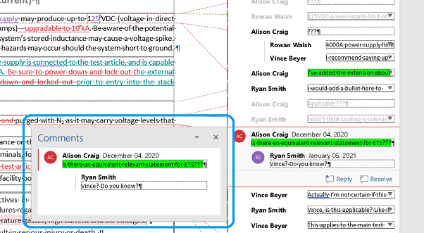
A more structured collaboration tool

Slide 3
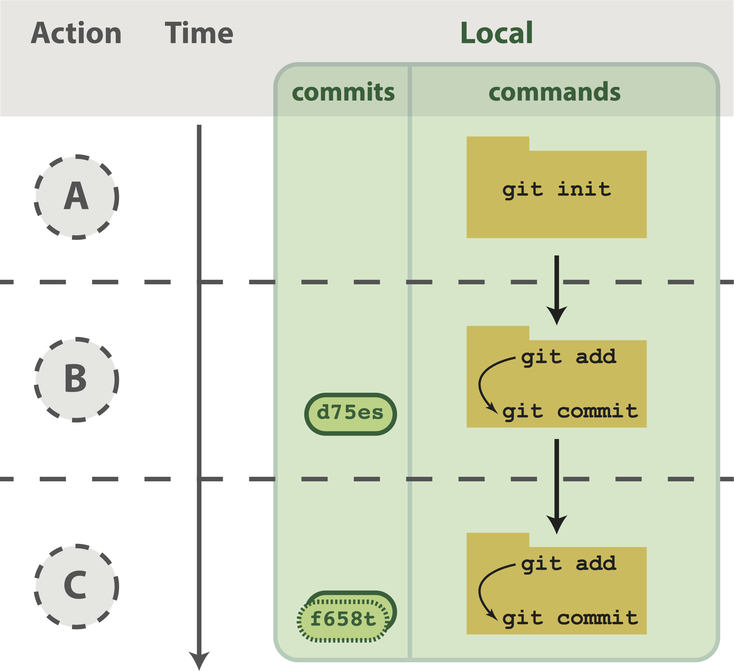
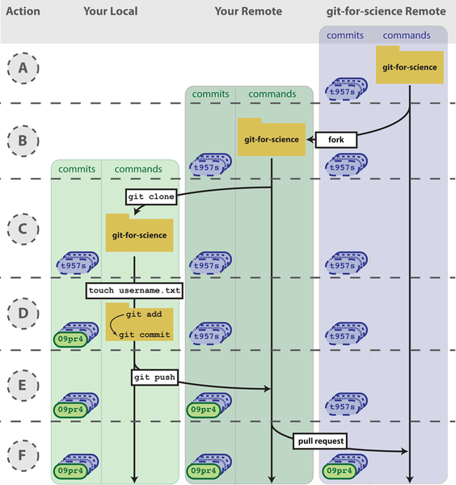
Blischak JD, Davenport ER, Wilson G (2016) A Quick Introduction to Version Control with Git and GitHub. PLOS Computational Biology 12(1): e1004668. https://doi.org/10.1371/journal.pcbi.1004668
https://journals.plos.org/ploscompbiol/article?id=10.1371/journal.pcbi.1004668

Slide 4
Learning by doing
Access your gitlab account on the science server (git.science.uu.nl)
“Fork” the UED2022 repository
Send a “merge” request after making your student directory
Submit your personal issue on UED2022 (not a native git feature)

Slide 5
Git is often very confusing to new users.
The following slides contain an attempt to explain it, by Aron Opheij

Slide 6
Versioning with Git, basics
Git can keep track of file-changes in a folder. This folder is then referred to as a repository.
However, it does not continuously store all changes. Once you’d like to commit to the changes you’ve made you need to tell git to do so.
To commit file changes, you first need to tell git which file-changes you’d like to include. This is called staging. (Through command line staging is done with git add …)
Once file-changes are staged, they can be committed and become part of the stored history of the repository (“folder”). Each commit should be accompanied with a short message describing what changes are made.
(Note that it is possible to stage file-changes and make more changes to the same file. If you commit at that point, only the staged changes are committed)
You could think of Git as storing a long list of cumulative consecutive commits (“file-changes”) in a folder.
…

Slide 7
Versioning with Git, branches
…
This main list of commits is usually referred to as the master branch. You can split off from this main branch into another branch. Meaning that these branches have a shared history up to the point where the split happens, and from there on they store their own new commits. This can be very useful when trying something out that you’re not sure yet you want to keep, or when working on one repository with multiple people.
One branch can be merged into another (i.e. the list of commits of one branch are added to another). For example, this way you could add the things you’ve been working on in a separate branch into the master branch.
Note that if both branches contain commits that include changes in the same part of the same file, Git can’t decide which to choose, and it tells you there’s a merge conflict. It will show the file with both versions of the conflicting parts, and you need to pick what you want to keep (i.e. delete sections) . Solving merge conflict can be a pain and is best to be avoided. It takes a bit of discipline to prevent working on the same file in different branches.
…

Slide 8
Versioning with Git, remote repository
…
To share code between multiple people (or even multiple computers of one user), it is convenient to store this repository on a server (e.g. website like Github or Gitlab) this is referred to as “remote” whereas your local copy is “local”. The remote becomes the central place for exchanging copies between multiple users/computers and is also referred to as “origin”.
You can push (the new commits of) your local branch to the origin. And you can pull (new commits of) a remote branch to your computer.
A pull can also be done in two steps: first fetch (which retrieves the data from the server), followed by a merge of the remote version of the branch into your local version of the branch.
…

Slide 9
Versioning with Git, tips
…
Keep your commits small and give them useful messages
When starting “something new” in your code, make a separate branch! It’s easier to keep your master branch clean while you try stuff out on the new branch. Especially if you only work on new files, merging won’t create conflicts
Don’t work on the same file in different branches! If you’ve made changes in branch A that you also want in branch B, you should merge branch A into B.
In general, but especially when working with multiple people on the same repository, it’s good practice to frequently pull changes from the master branch
Stay aware of what branch you’re working in
Before stepping away for a long period: It’s a good habit to make sure your code doesn’t crash and commit it. If you come back the next day (or several days later), it’s nice to have it in working order with a commit message you could read back, instead of having to figure out if these changes were valuable or should be trashed.

Slide 10
Homework
“Clone” your forked repository on your PC using command line OR a graphical git interface.
Add your contact to the contact list.
Personalize the contributing guidelines for your project.
Finalize your personal goals in your personal directory.
Choose a license for your project.

