Slide 1
interfacing electronic devices using Python and the labphew package
Aron Opheij
Experiment Design 2021 course
23-09-2021 Utrecht University
version 1.1

Slide 2
This lecture
Some philosophy of lab automation and structuring code
Introducing the labphew package
Expanding the code together to perform an IV-curve measurement of an LED (or we’ll see how far we get)
All of this is, a work in progress
It’s ok if you don’t understand everything today. This lecture serves as an introduction, after which you can explore at your own pace and ask us for help

Slide 3
Automating experimental setups
When doing experiments, you may quite quickly find yourself wanting or needing to automate your experimental setup. Some possible reasons may include:
You want to, or have to, speed things up
You have to repeat something many times
To achieve this, you’ll have to write code to control devices

Slide 4
A pitfall during development
You start with writing code to solve a small automation task (e.g. perform a single simple experiment with a single device)
Then it turns out you want to add complexity to the measurement procedure or the experimental setup:
add more devices perhaps
or exchange one device for another
or perform actions in a different order
…
As this continues, it becomes harder and harder to modify, maintain and understand your code

Slide 5
The onion principal: layers
In order to write expandable code it is important to split your code up in (smaller) encapsulated chunks.
The classes of Object Oriented Programming (OOP) are perfectly suited for this purpose.
Build classes on top of one another (like layers of an onion)
Easier to modify or exchange pieces without having to worry about other parts of the whole code
It is not always obvious where and how to split up code. Try to think about: how much would the rest of my code have to change if I make changes to this section?

Slide 6
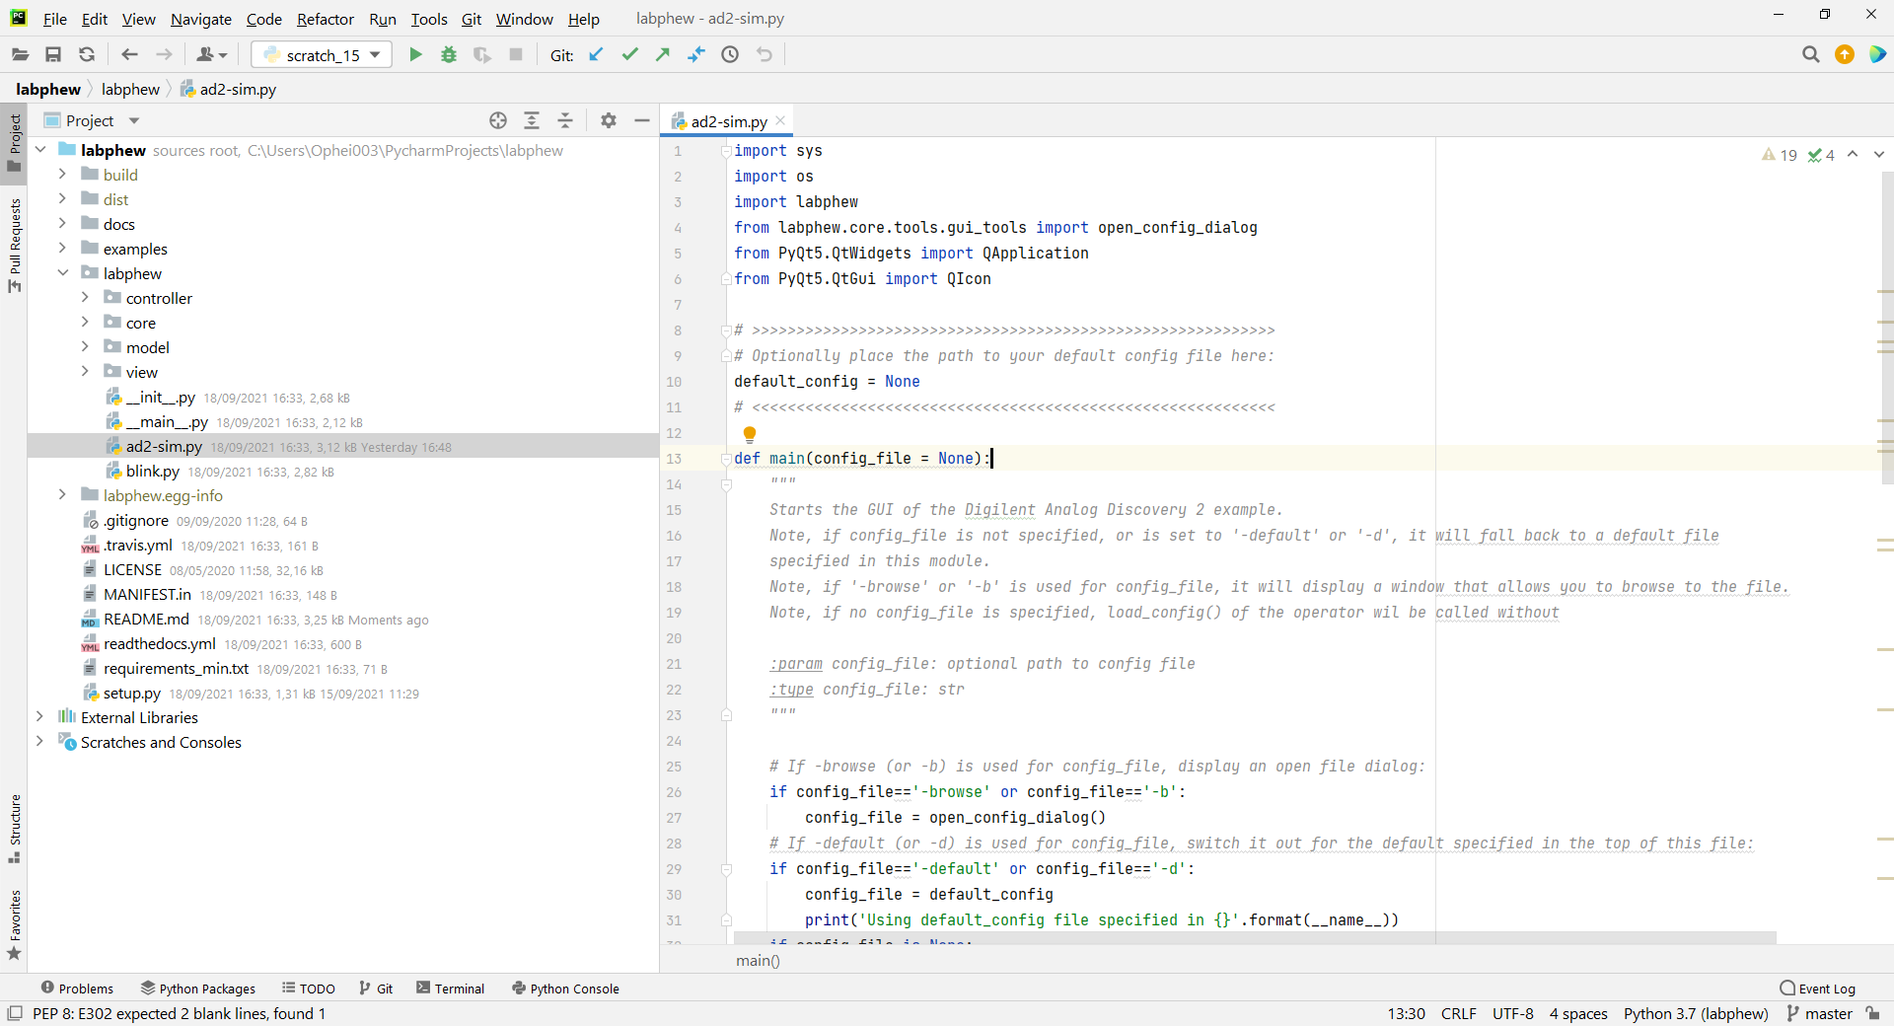
The layers in labphew:
Controller
device specific
Model
experiment specific
relies on controller(s)
independent of GUI
View
Provides a Graphical User Interface (GUI) to interact with the model
Let’s have a look!

Slide 7
Controller – Model – View in context of labphew
more detail for reviewing by yourself
Controller
Is specific to a device
Contains code to communicate with the device and possibly other code to make interacting with the device easier
Note for developers:
There exist “message-based devices” for which all communication happens as text commands over serial communication and devices which have their own driver/dll (these often prove a bit more difficult) and devices without a computer interface but that you operate by changing a voltage for example (you then need a device for that)
Often you can find that someone in the online community has already written something for a device. Otherwise you’re going to need the manual
Model
Is specific to an experimental setup
We call the classes inside a model Operator
When creating the Operator object one would pass one (or more) controllers as input arguments. These are the devices used by the Operator to perform a scan/experiment
The Operator should contain several “functions“ (methods):
To connect to the devices (with the controllers it was given as input)
Also to disconnect
To run a scan (experiment) (there could be multiple of such functions for different scans)
To save data
For live plotting in a graphical user interface (if you need that)
View
Allows you to interact with the Operator in a graphical user interface (GUI)
This has two classes which we call: MonitorWindow (for continuous a live “plotting”) ScanWindow (for performing a scan)

Slide 8
Controller – Model – View in context of labphew
more detail for reviewing by yourself
Controller
Is specific to a device
Contains code to communicate with the device and possibly other code to make interacting with the device easier
Note for developers:
There exist “message-based devices” for which all communication happens as text commands over serial communication and devices which have their own driver/dll (these often prove a bit more difficult) and devices without a computer interface but that you operate by changing a voltage for example (you then need a device for that)
Often you can find that someone in the online community has already written something for a device. Otherwise you’re going to need the manual
Model
Is specific to an experimental setup
We call the classes inside a model Operator
When creating the Operator object one would pass one (or more) controllers as input arguments. These are the devices used by the Operator to perform a scan/experiment
The Operator should contain several “functions“ (methods):
To connect to the devices (with the controllers it was given as input)
Also to disconnect
To run a scan (experiment) (there could be multiple of such functions for different scans)
To save data
For live plotting in a graphical user interface (if you need that)
View
Allows you to interact with the Operator in a graphical user interface (GUI)
This has two classes which we call: MonitorWindow (for continuous a live “plotting”) ScanWindow (for performing a scan)

Slide 9
Controller – Model – View in context of labphew
more detail for reviewing by yourself
Controller
Is specific to a device
Contains code to communicate with the device and possibly other code to make interacting with the device easier
Note for developers:
There exist “message-based devices” for which all communication happens as text commands over serial communication and devices which have their own driver/dll (these often prove a bit more difficult) and devices without a computer interface but that you operate by changing a voltage for example (you then need a device for that)
Often you can find that someone in the online community has already written something for a device. Otherwise you’re going to need the manual
Model
Is specific to an experimental setup
We call the classes inside a model Operator
When creating the Operator object one would pass one (or more) controllers as input arguments. These are the devices used by the Operator to perform a scan/experiment
The Operator should contain several “functions“ (methods):
To connect to the devices (with the controllers it was given as input)
Also to disconnect
To run a scan (experiment) (there could be multiple of such functions for different scans)
To save data
For live plotting in a graphical user interface (if you need that)
View
Allows you to interact with the Operator in a graphical user interface (GUI)
This has two classes which we call: MonitorWindow (for continuous a live “plotting”) ScanWindow (for performing a scan)

Slide 10
(Optional) Homework
Install the labphew package and use it to measure the IV curve of an LED with the AD2 USB-oscilloscope.
Submit an issue requesting an improvement to the labphew project,
if possible, accompany your issue with a pull-request.

Slide 11
Measuring an IV curve
Programmable power supply: pin V+
Analog In: pin 1+
V_{F}
Analog In: pin 1-
Analog In: pin 2+
R
V_{R} → I_{F} = V_{R} / R
Analog In: pin 2-
Ground: pin ↓

Slide 12
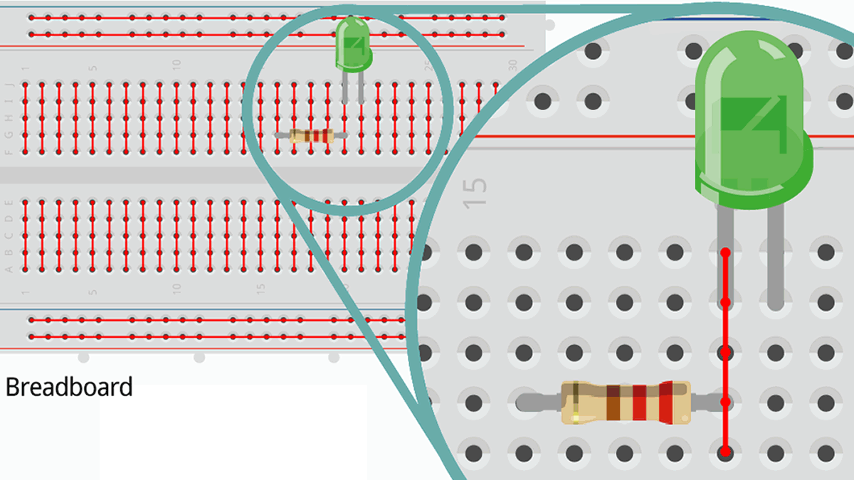
https://starthardware.org/en/unit-5-how-to-use-a-breadboard/

Slide 13
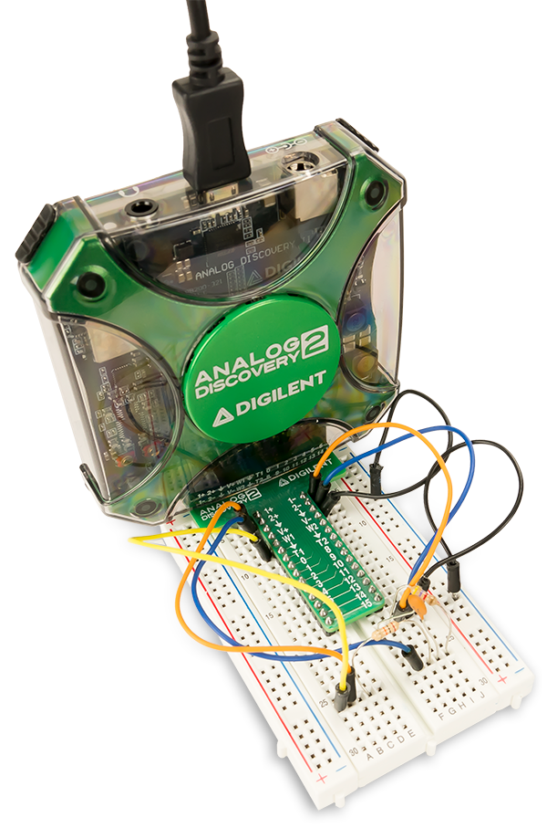
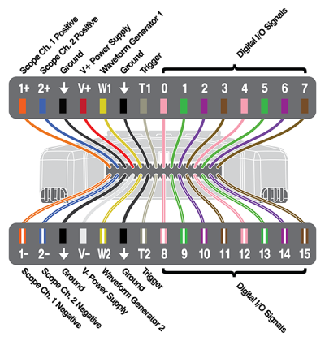
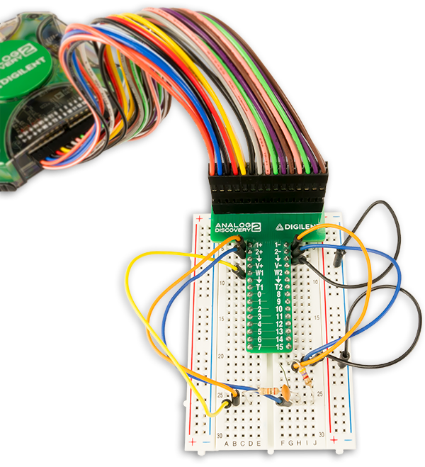
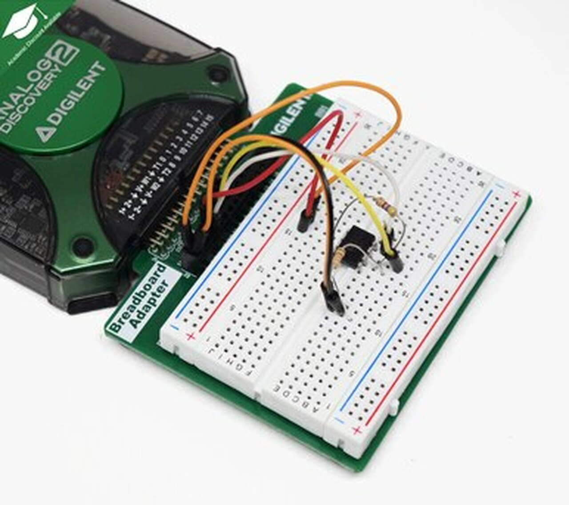
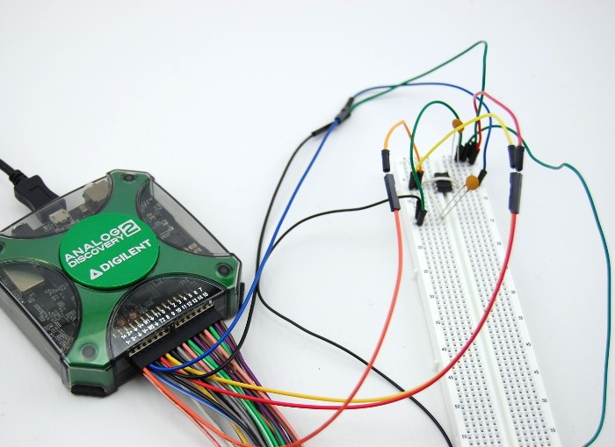
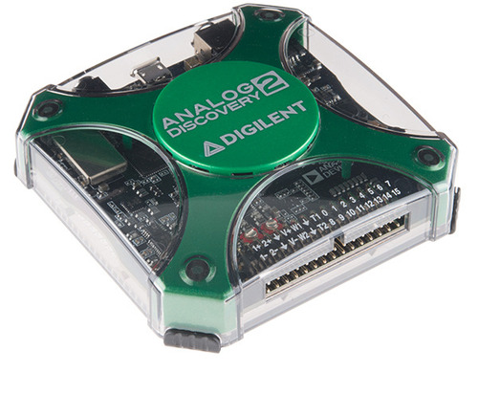

Slide 14
Go and build your hardware:
Programmable power supply: pin V+
Analog In: pin 1+
V_{F}
Analog In: pin 1-
Analog In: pin 2+
R
V_{R} → I_{F} = V_{R} / R
Analog In: pin 2-
Ground: pin ↓

Slide 15
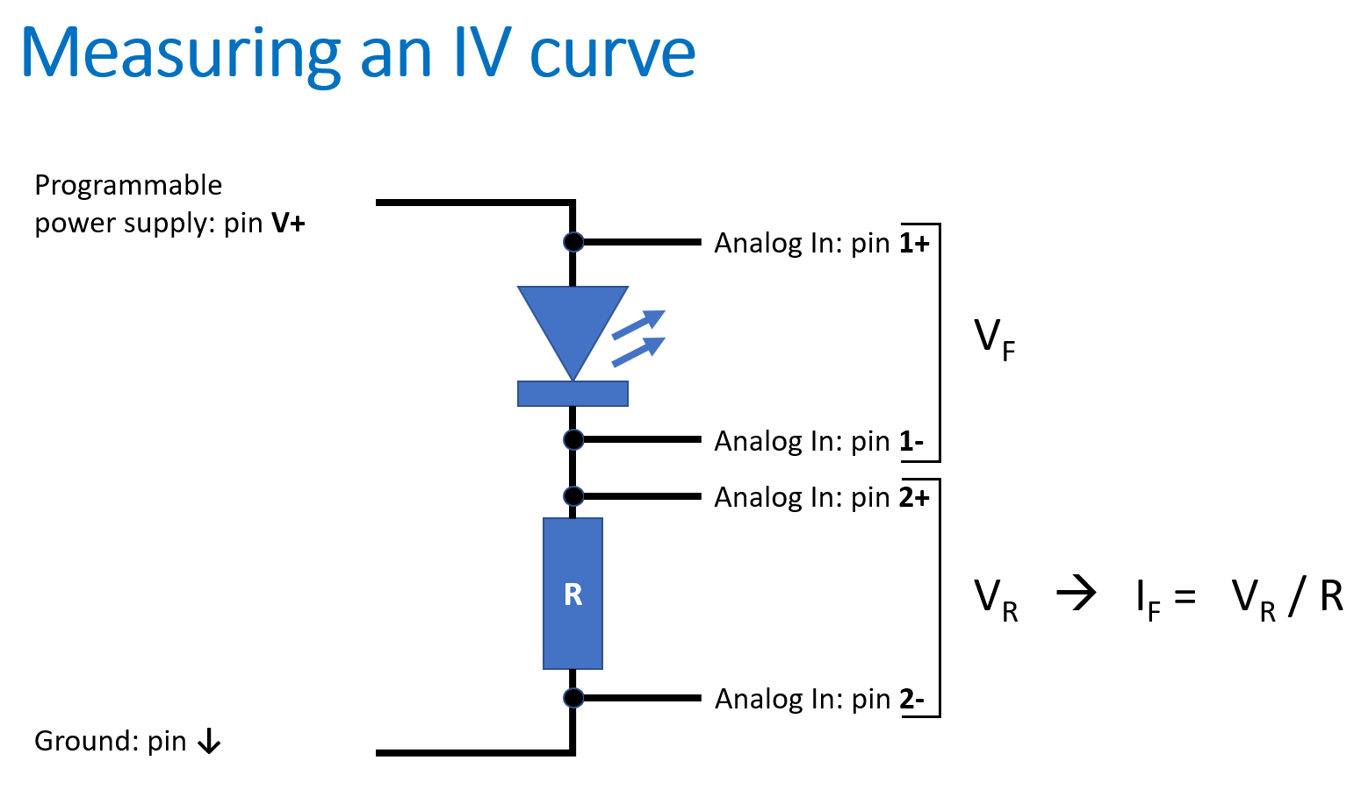
Actions to be performed by the code
Increase V+ voltage in small steps. And for each step:
Record V_{F} and V_{R}
Calculate I_{F}
Plot I_{F} as a function of V_{F} (GUI only)
Optionally, also check if I_{F} exceeds the maximum current rating of the power supply or the LED and terminate the loop if it does
Save all data
Additionally, we might want to modify some parameters from GUI
Let’s start coding

Slide 16
Extra Bits (for you to review by yourself)
Note on Python virtual environments
Tips for coding when collaborating
Important links

Slide 17
a note on python virtual environments
Packages installed in an environments are isolated from those installed in other environments, preventing dependency conflicts
It’s recommended to make a separate environment for each project
It’s possible to create an environment from a file, specifying exact package versions, recreating an identical environment on a different machine
Some examples of virtual environment managers:
conda (package and environment manager)
virtualenv
venv
pipenv
pyenv
poetry

Slide 18
Tips for coding when collaborating
Code is read much more often than it’s written. Always think about someone else having to look through your code. It will not only help others but also yourself when you look at code you’ve written a year ago.
Use descriptive names for variables and objects.
Add in-code documentation to classes and their methods. Describe what they do. If you copy the style used in labphew it is possible to build html documentation from that.
Comments in code can be good. Even better is to use logging statements (see labphew docs for explanation)

Slide 19
Important links
The repository containing the package: https://github.com/SanliFaez/labphew
Documentation https://labphew.readthedocs.io/en/latest/index.html

