Slide 1


Styles of Practicing Research
Egocentric
Networked

Slide 2

Storytelling
Sanli Faez

Slide 3
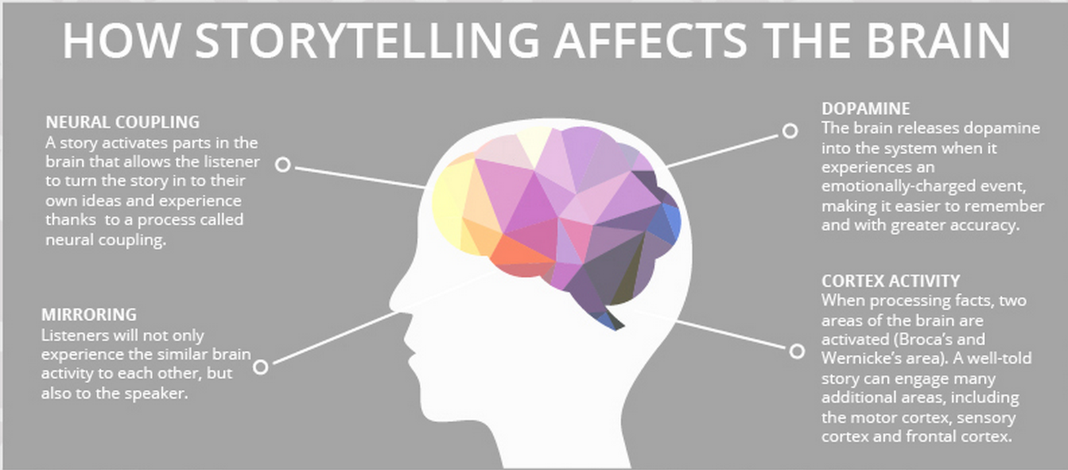
A story can put your whole brain to work

Slide 4
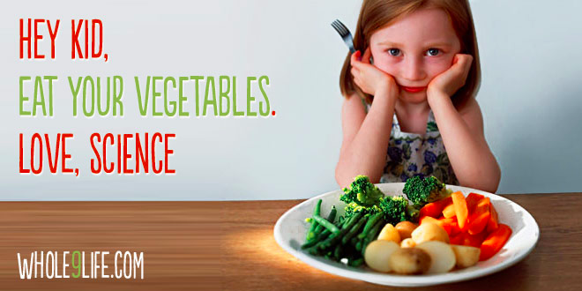
People hate to be told what to do.

Slide 5
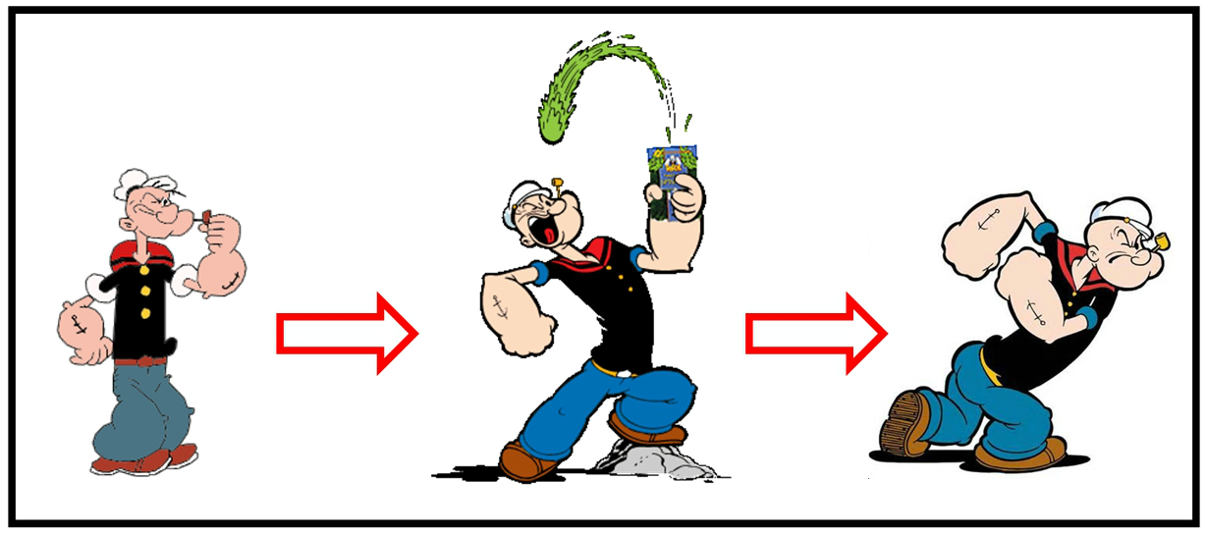
People love to agree with the moral of a story.

Slide 6
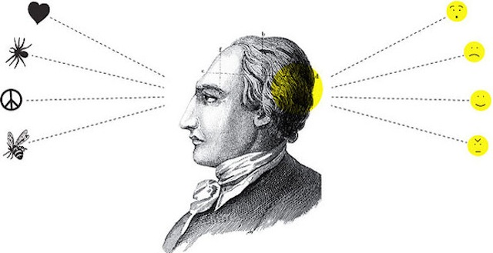
People don’t remember what you say, they remember how you made them feel.

Slide 7
3 Things to Get Started
What’s the GOAL?
Who is the AUDIENCE?
What do you want them to FEEL?

Slide 8
Tell a story (exercise)

Slide 9
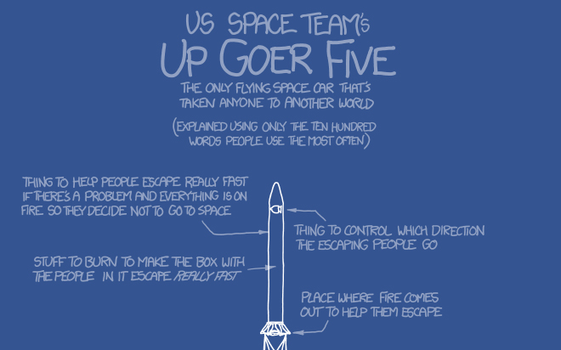
The simple story is more successful than the complicated one

Slide 10
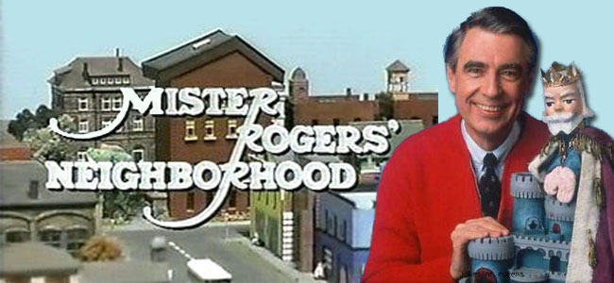
Storytelling is asking questions and then answering them along the way.
https://www.youtube.com/watch?v=fKy7ljRr0AA

