Slide 1
MARKET BASKET ANALYSIS USING APRIORI ALGORITHM ON RETAIL DATASET
BY: PRASHANT
SHRINATH

Slide 2
Overview
Identifies frequently purchased groceries from given transactional data
Implemented in R statistical programming language using “arules” package
Uses “Apriori” algorithm to efficiently search large databases of transactional data for association rules

Slide 3


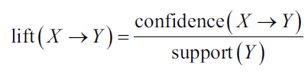
Apriori algorithm
Apriori algorithm employs a simple a priori belief as guideline for reducing the association rule search space: all subsets of a frequent item-set must also be frequent
The support of an item-set or rule measures how frequently it occurs in the data
A rule's confidence is a measurement of its predictive power or accuracy. It is defined as the support of the item-set containing both X and Y divided by the support of the item-set containing only X
Lift is a measure of how much more likely one item is to be purchased relative to its typical purchase rate, given that you know another item has been purchased

Slide 4
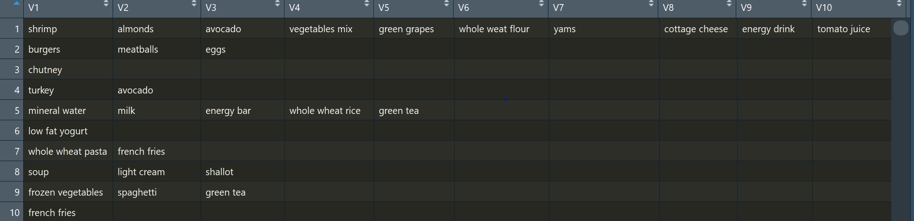
The data
The “Market_Basket_Optimisation” data set contains7 days of real-world point-of-sale transaction data from an online store. The data set contains 7500 transactions and the items are aggregated to 120 categories

Slide 5
Program flow
Load the dataset into R environment
The data is in the form of transactions. The transactions have different item-lengths and the items in a transaction are arranged in no apparent sequence
This dataset contains 20 variables with 7500 observations.7500 customers purchase history on weekly basis.But we are not going to use this dataset because Avril’s package doesn’t take dataset like this as input.It takes input as the sparse matrix
We can observe that 7501 rows and 120 columns and a density of 0.03.Density is proportion of non-zero values is 0.03.3% non-zero and 97% zero.
Apply Apriori algorithms with different support/confidence and lift parameters to generate association rules

Slide 6
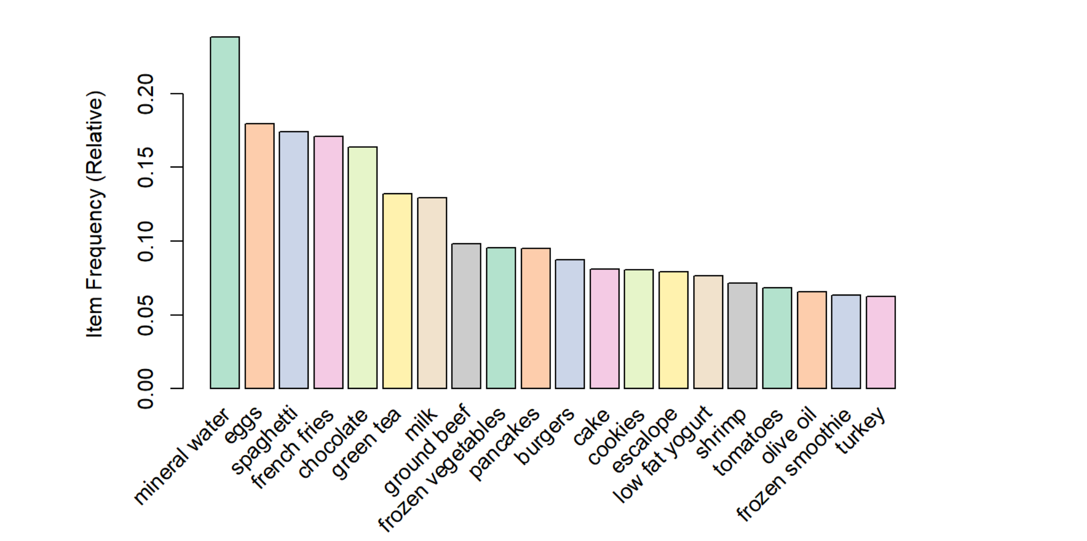
Top 20 most frequent items

Slide 7
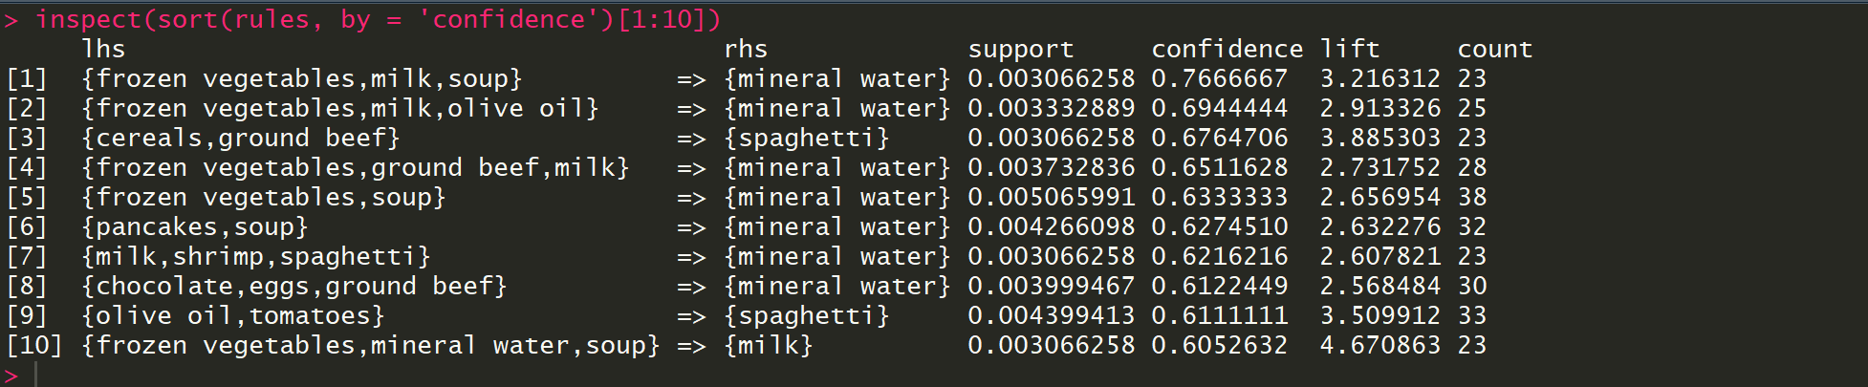
Support is 0.003 and confidence is 0.4
Results: Top 10 rules with highest confidence

Slide 8
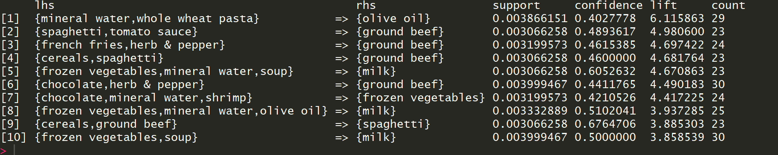
Results: Top 10 rules by “lift”

Slide 9
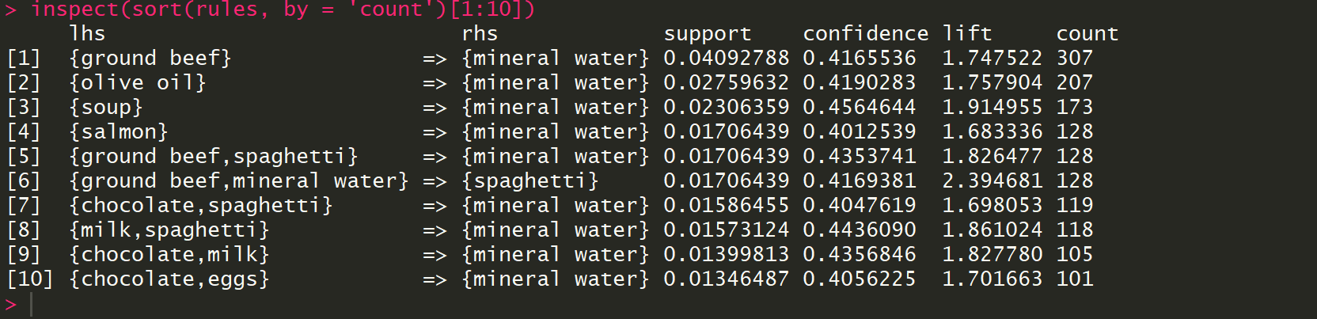
Results: Top 10 rules by “count”

Slide 10
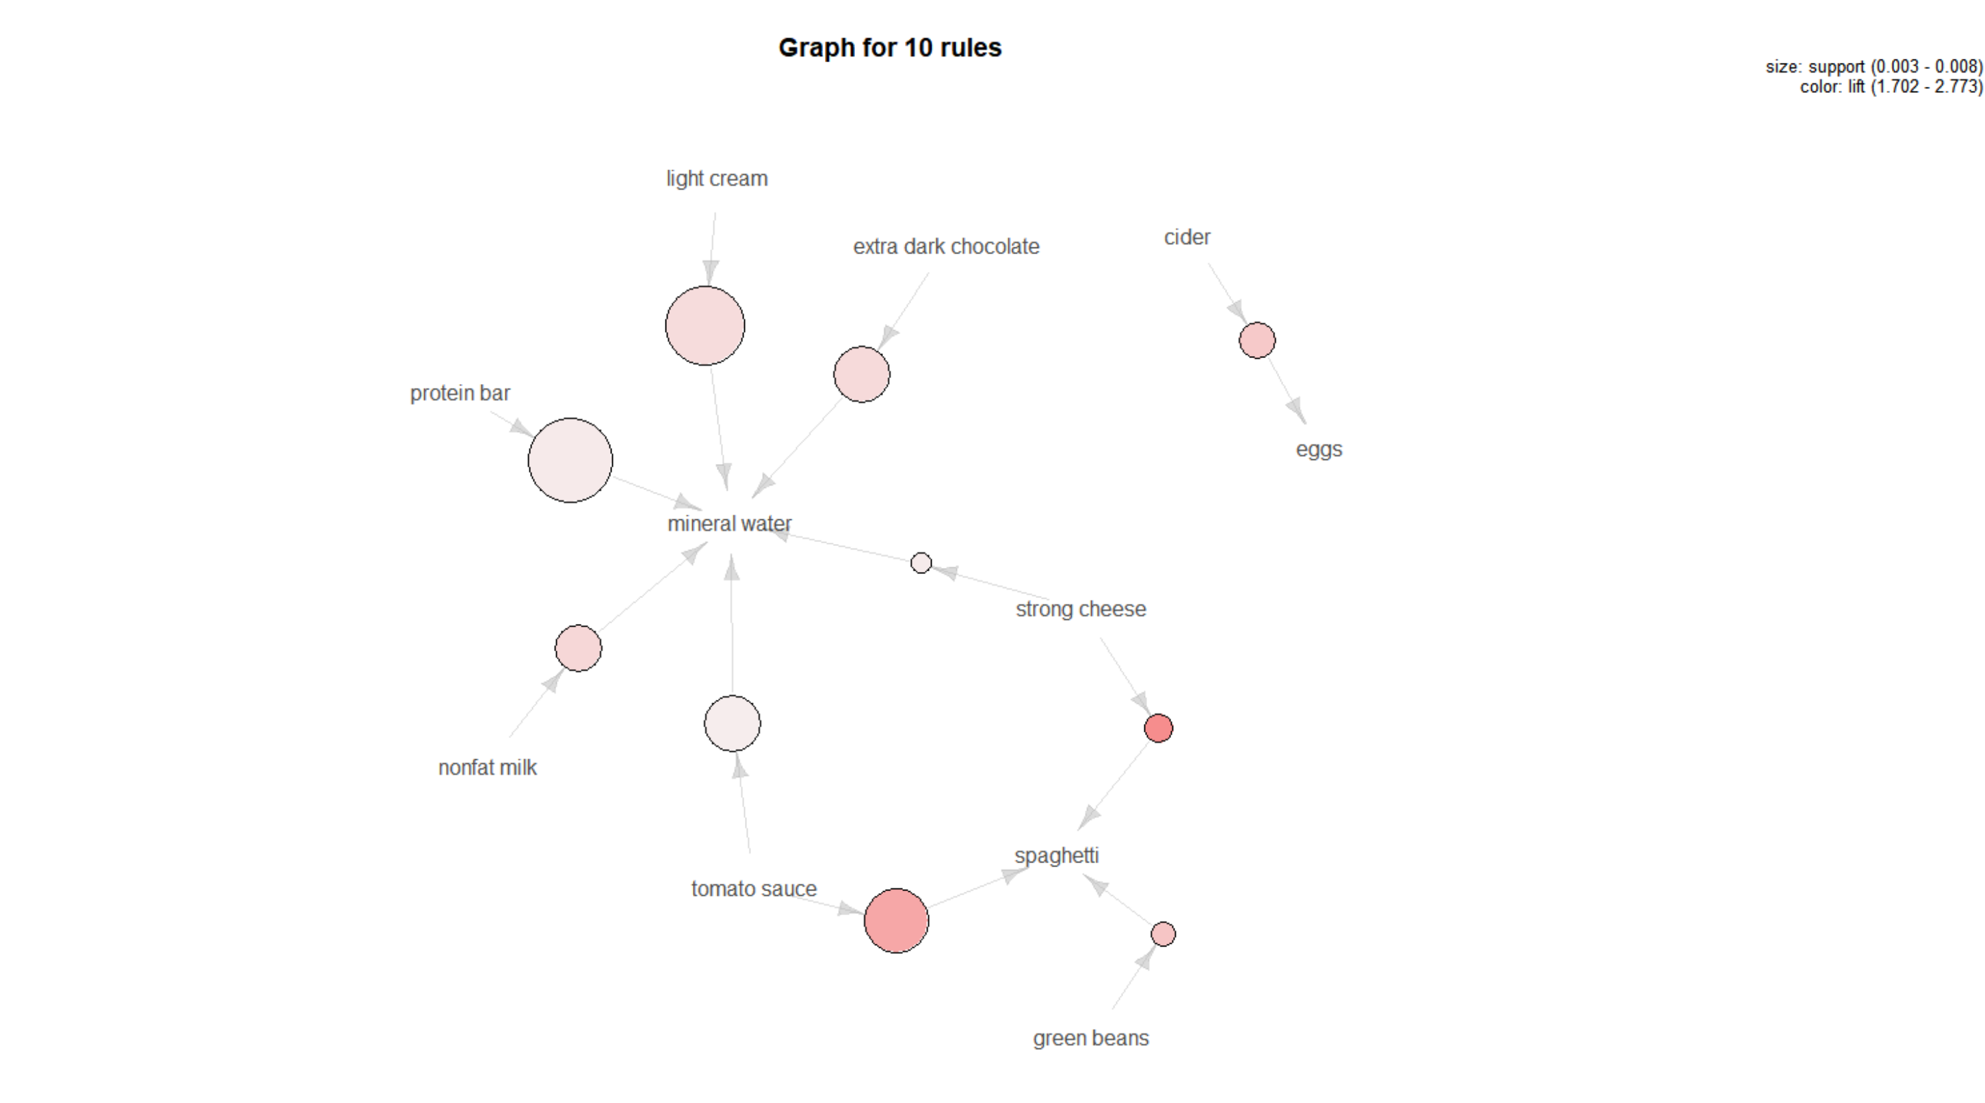
Conclusion 1.

Slide 11
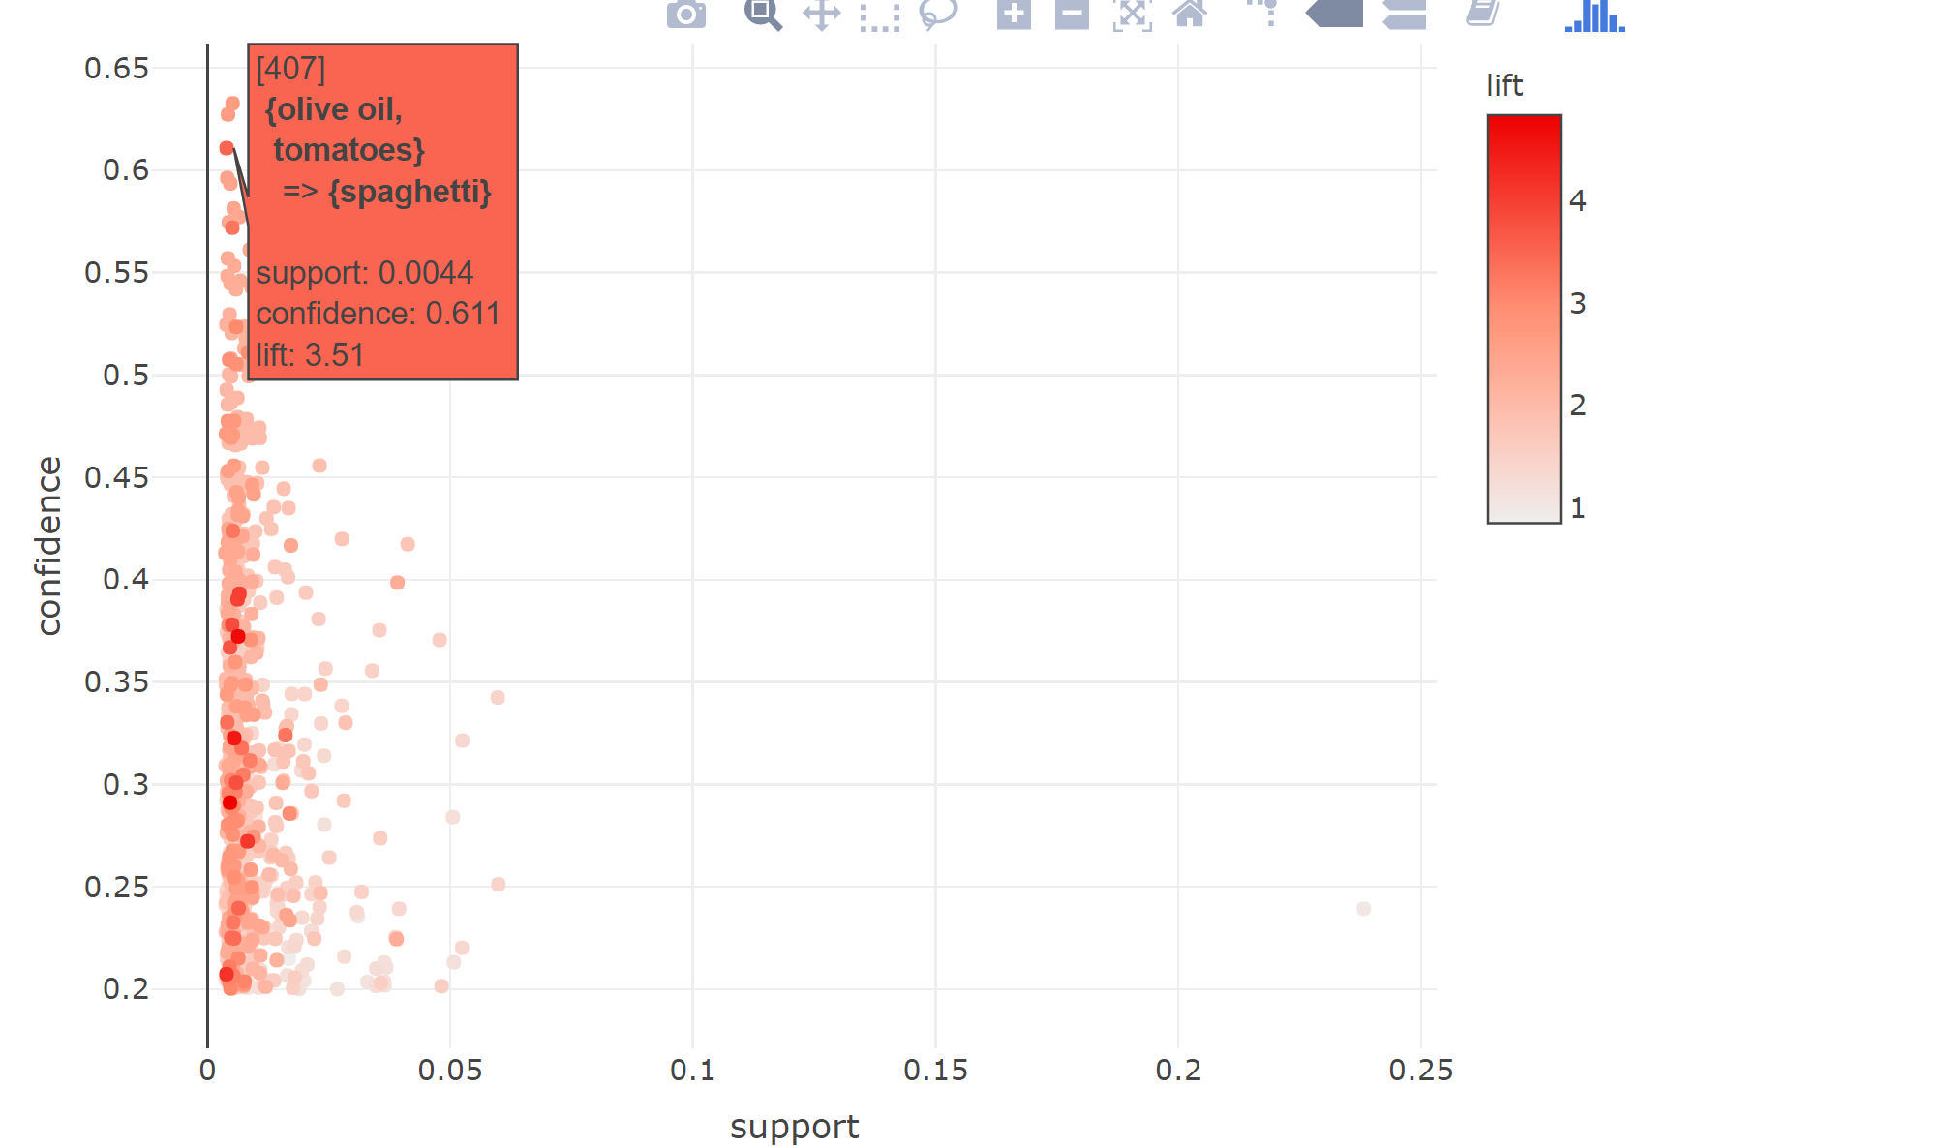
Conclusion 2.

Slide 12
Final Conclusion
By visualising these rules and plots, we can come up with a more detailed explanation of how to make business decisions in retail environments
We can make some specific aisles now in my store to help customers pick products easily from one place and also boost the store sales simultaneously.
This analysis would help us improve our store sales and make calculated business decisions for people both in a hurry and the ones leisurely shopping.

