Slide 1


Medical Insurance Cost Prediction Model
Group-5:
Vijaya Krishna Ande (U01948945)
Shrinidhi Dadheechi (U01932664)
Sravani Koyya (U01921729)
Vaishnavi Chandrasekar (U01921021)

Slide 2

Abstract
This project focuses on predicting medical insurance costs using machine learning models like Linear Regression, Random Forest, and Decision Trees. The dataset includes features such as age, BMI, smoking status, and region, with smoking status and BMI identified as the most significant predictors. The results demonstrate the potential for these models to assist insurers in pricing policies more accurately and efficiently.
2

Slide 3
Providing detailed understanding for individuals and insurance providers of various factors influencing insurance costs.
Introduction
01
Use of variety of factors for prediction such as BMI, Age, Smoking status, etc.
02
Role of AI and Machine learning algorithms like Linear regression and decision trees.
03
Research for deriving insights on future scope and possibilities.
04
1

Slide 4

Data Collection and Dataset Overview
Data Collection
Dataset Overview
Data collected from the Kaggle website.
The dataset includes records of more than 1000 individuals.
Includes information on each individual’s age, sex, BMI, smoking status, number of children, and their region.
The goal is to train a model for accurate predictions using the individual’s detailed info.
Dataset aids in the prediction of medical insurance costs showing the influence of age, BMI, and smoking status which would help insurance providers and also create awareness among individuals.
2

Slide 5

Literature Review
Ajith et al. employed multiple regression algorithms, including Linear Regression and Decision Tree, to predict insurance costs. Their study highlighted the superior performance of Decision Tree with an R² value of 86.78%, demonstrating its ability to handle complex, non-linear relationships effectively
Jessica et al. applied Random Forest and Elastic Net regression to predict health insurance costs, emphasizing the importance of handling multicollinearity among features. Their approach demonstrated that combining feature selection with advanced regularization methods significantly improves model reliability and interpretability
Mohan Gupta et al. focused on integrating additional lifestyle variables, such as alcohol consumption and diabetes, into their predictive models. Using Ridge and Lasso Regression, they achieved enhanced model stability while maintaining an interpretable feature set. Their findings underscored the potential of feature engineering to refine cost predictions​ IJRASET diagnosis system for radiologists.
4

Slide 6
Data Cleaning: Checked for missing or null values in dataset. Removed any duplicates to ensure data quality. Standardized data types across columns for consistency.
Feature Engineering: Converted categorical data such as region, sex, and smoker status into numerical format using encoding techniques. Normalized features like age and BMI to improve model performance. Created interaction features (e.g., smoker status × BMI) for better prediction.
Data Splitting: Divided the dataset into training (80%) and testing (20%) subsets to evaluate model performance.
Handling Outliers:
Identified and treated extreme values in variables like BMI and charges to prevent skewed predictions.
Data Preprocessing Techniques

Slide 7
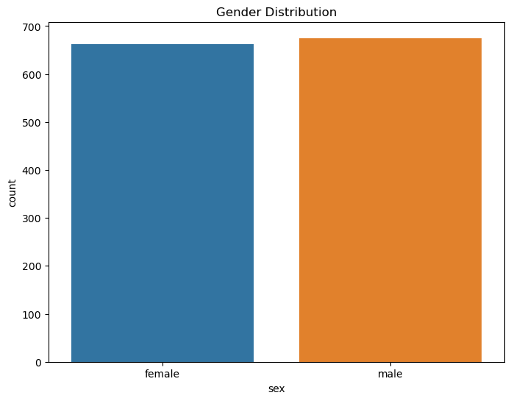
Exploratory Data Analysis(EDA)
Exploratory Data Analysis(EDA)
Checking data set proportions:
The dataset has an almost equal distribution of males and females.
Distribution of Gender(sex column) in the dataset :
The dataset has an almost equal distribution of males and females.

Slide 8
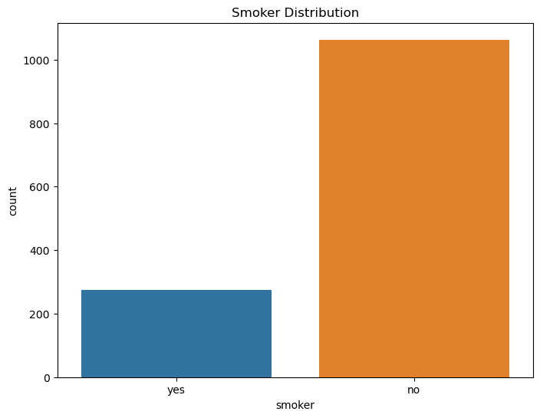
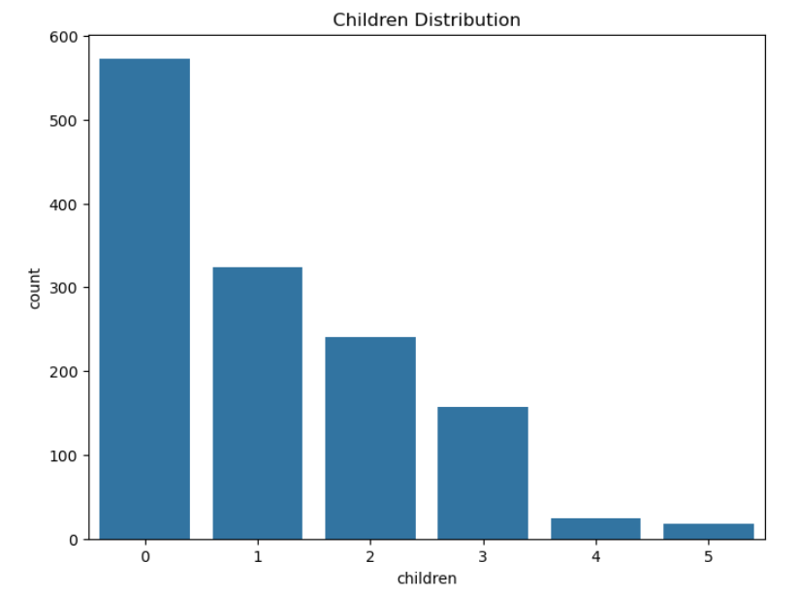
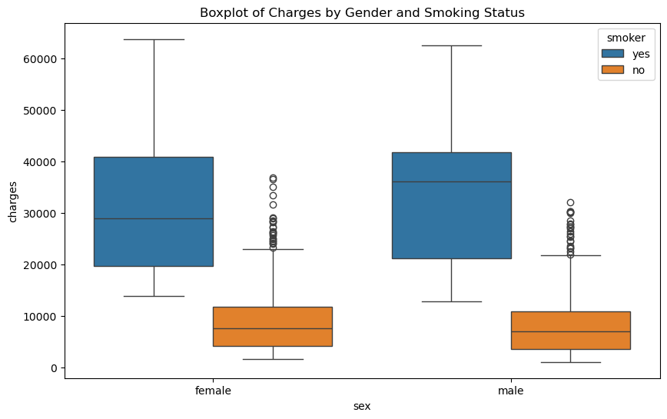
Exploratory Data Analysis(EDA)
Exploratory Data Analysis(EDA)
Charges based on Smoking status between Males and Females.
(Smokers usually get higher charges)
Smoking status distribution overall.
Distribution of Children in the dataset
Smoking status distribution overall.

Slide 9
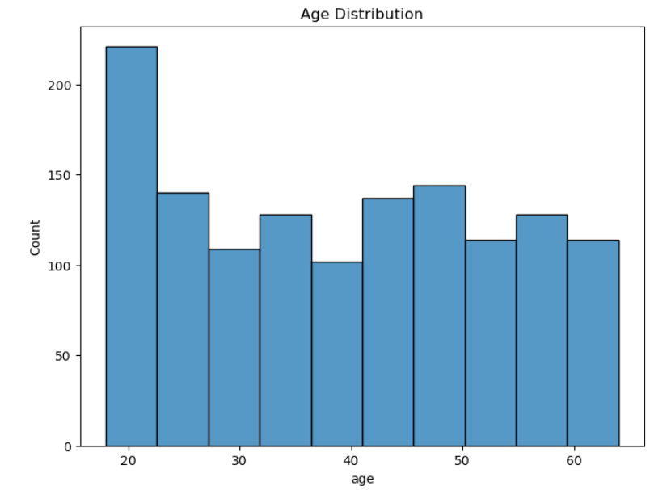
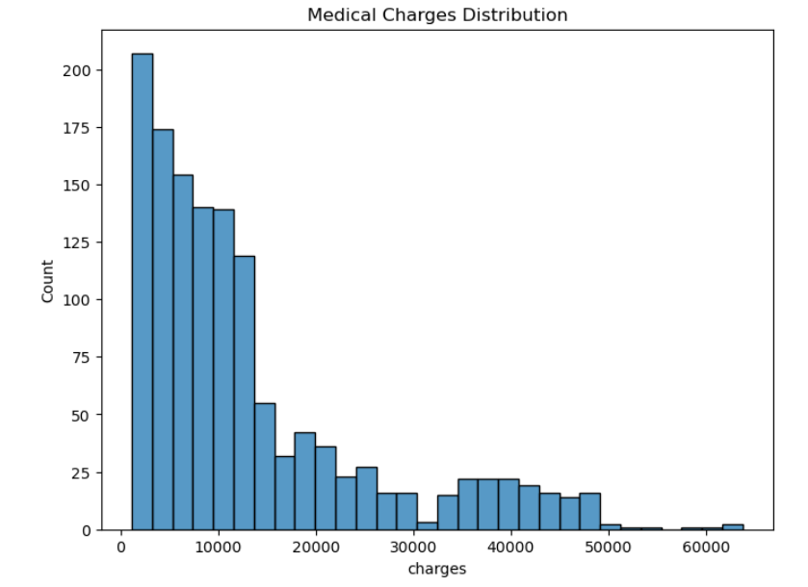
Exploratory Data Analysis(EDA)
Exploratory Data Analysis(EDA)
Exploratory Data Analysis(EDA)
Charges based on Smoking status between Males and Females.
(Smokers usually get higher charges)
Distribution of Medical Charges
Smoking status distribution overall.
Distribution of Children in the dataset
Smoking status distribution overall.
Distribution of overall Age groups in the dataset

Slide 10
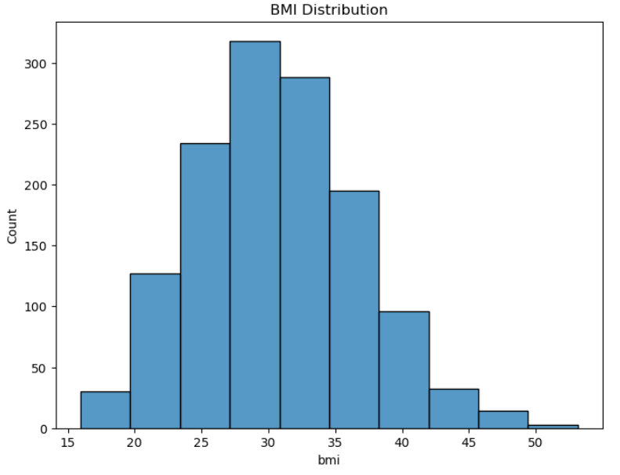
Exploratory Data Analysis(EDA)
Exploratory Data Analysis(EDA)
Exploratory Data Analysis(EDA)
Exploratory Data Analysis(EDA)
Charges based on Smoking status between Males and Females.
(Smokers usually get higher charges)
Distribution of Medical Charges
Medical charges based on gender and smoking status
Smoking status distribution overall.
Distribution of Children in the dataset
Smoking status distribution overall.
Distribution of overall Age groups in the dataset
BMI Distribution

Slide 11
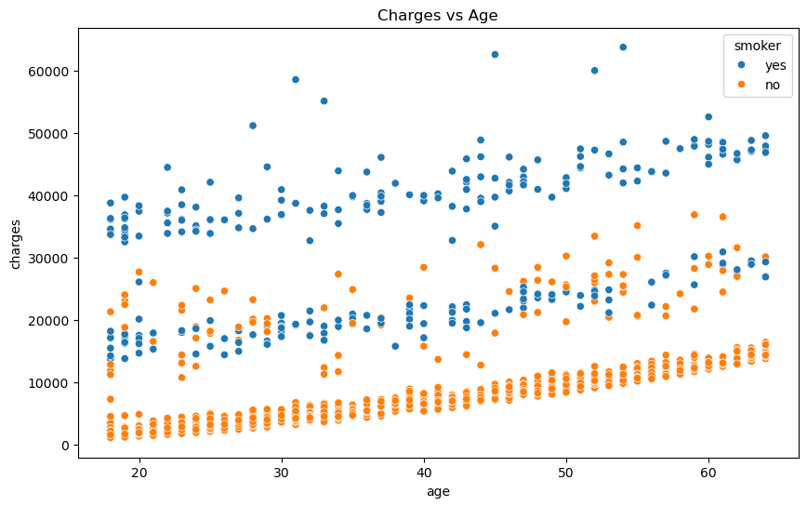
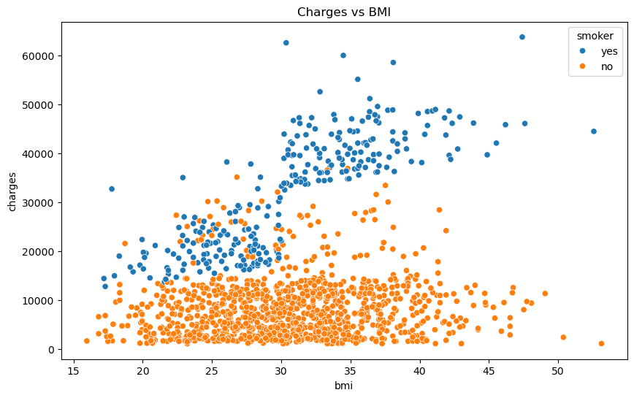
Exploratory Data Analysis(EDA)
Exploratory Data Analysis(EDA)
Exploratory Data Analysis(EDA)
Exploratory Data Analysis(EDA)
Exploratory Data Analysis(EDA)
Relation between medical charges and BMI
Charges based on Smoking status between Males and Females.
(Smokers usually get higher charges)
Distribution of Medical Charges
Relation between medical charges and age
Medical charges based on gender and smoking status
Smoking status distribution overall.
Distribution of Children in the dataset
Smoking status distribution overall.
Distribution of overall Age groups in the dataset
BMI Distribution

Slide 12
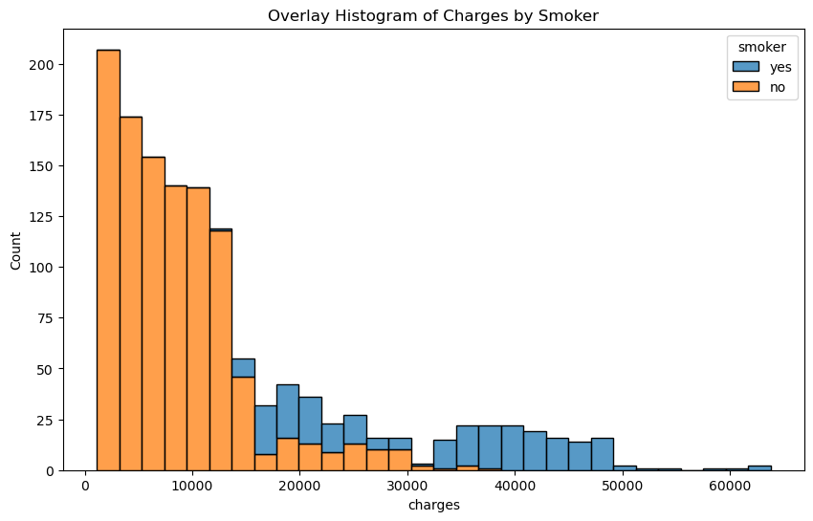
Exploratory Data Analysis
Comparing the medical charges of smokers with non-smokers
This Histogram shows the probable insurance costs and the count only based on the smoking status of individuals.
As seen on the histogram, the insurance costs of smokers are generally higher compared to that of non-smokers irrespective of whether it’s a male or a female.
This Histogram shows the probable insurance charges, and the count only based on the smoking status of individuals.
It can be inferred that smoking adversely affects an individuals’ health and translates to higher medical costs.

Slide 13
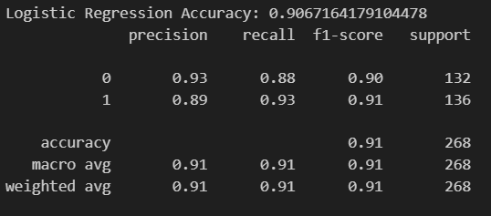

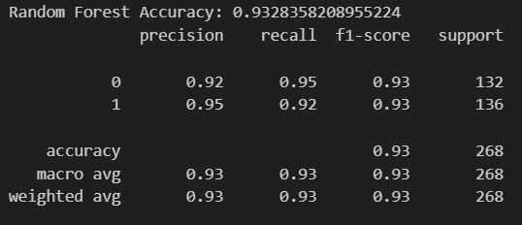
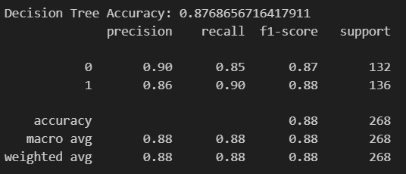
Different ML models that were used, and a comparison of their accuracy.
Logistic Regression
(90.67%)
Linear Regression
(78.3%)
Random Forest
(93.2%)
Decision Tree
(87.68%)

Slide 14
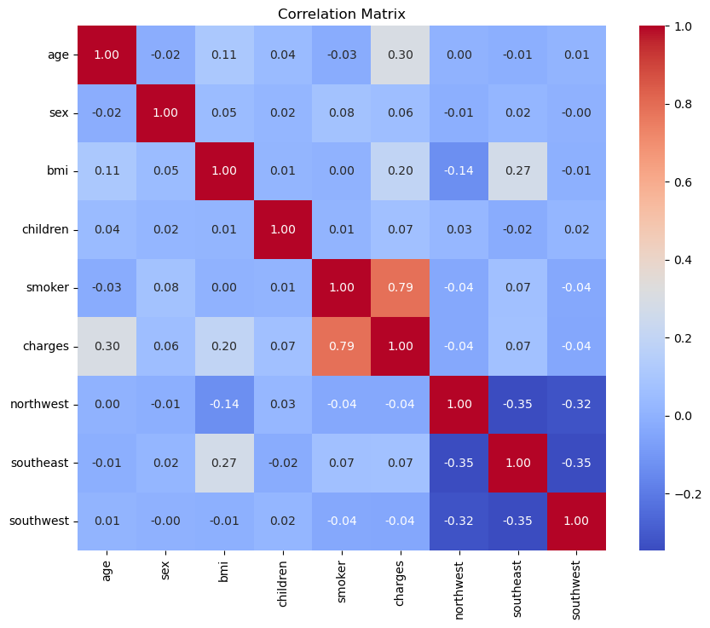
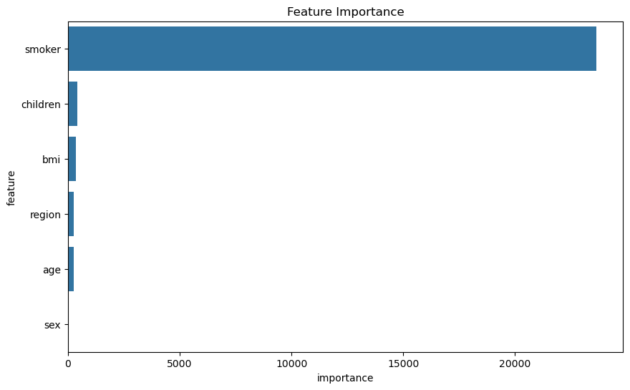
Representation of how much influence each data type makes on the prediction of the insurance cost.
The graph shows that Smoking status is given the highest importance with regard to calculating insurance costs.

Slide 15

Future Implications
Incorporating more detailed geographic data to analyze local trends in insurance costs.
Consider collecting more data on other lifestyle factors to improve predictive power.
Including additional health-related factors such as pre-existing conditions or lifestyle choices beyond smoking.
Conducting a longitudinal study to examine how insurance costs change over time for individuals.
Exploring more advanced machine learning techniques, such as ensemble methods or deep learning, to potentially improve predictive accuracy.
The models could be used to identify high-risk individuals for targeted smoking cessation programs.
7

Slide 16
References
[1] "Factors Influencing Health Insurance Costs," Journal of Predictive Analytics, 2022.
[2] "Application of Linear Regression in Healthcare Cost Prediction," IEEE, 2021.
[3] "The Impact of Lifestyle Choices on Healthcare Costs: A Predictive Modeling Approach," International Journal of Data Science, 2020.
[4] "Machine Learning Applications in Health Insurance Pricing," Springer AI in Healthcare, 2019.
[5] "Evaluating the Effectiveness of Regression Models in Medical Cost Prediction," Journal of Medical Informatics, 2021.
[6] "Predictive Analytics in Insurance: A Comprehensive Review of Algorithms," Journal of Risk and Insurance, 2020.

Slide 17
Thank You

