Slide 1


Detection of COVID-19 using Chest X-RAY
Group-5
Vijaya Krishna Ande (U01948945)
Shrinidhi Dadheechi (U01932664)
Sravani Koyya (U01921729)
Vaishnavi Chandrasekar (U01921021)

Slide 2
The urgency of accurate and quick detection methods
To halt the spread of COVID-19 worldwide.
Introduction
01
Utilization of a variety of instruments
From PCR tests to AI-driven diagnostics, for swift infection identification.
02
AI's role in analyzing medical data
03
Including imaging and clinical data, through machine learning algorithms.
Significance of AI
04
Enhancing COVID-19 diagnosis speed and accuracy, especially in resource-constrained settings.
1

Slide 3

Data Collection and Dataset Overview
Data Collection
Dataset Overview
Data collected from the Kaggle website.
Dataset includes chest X-rays with normal and pneumonia-infected cases.
Patterns like ground glass opacities showcased in the dataset.
Goal is to train a model for accurate predictions using both sets of images.
Dataset aids in early COVID-19 detection and minimizes false negatives.
2

Slide 4
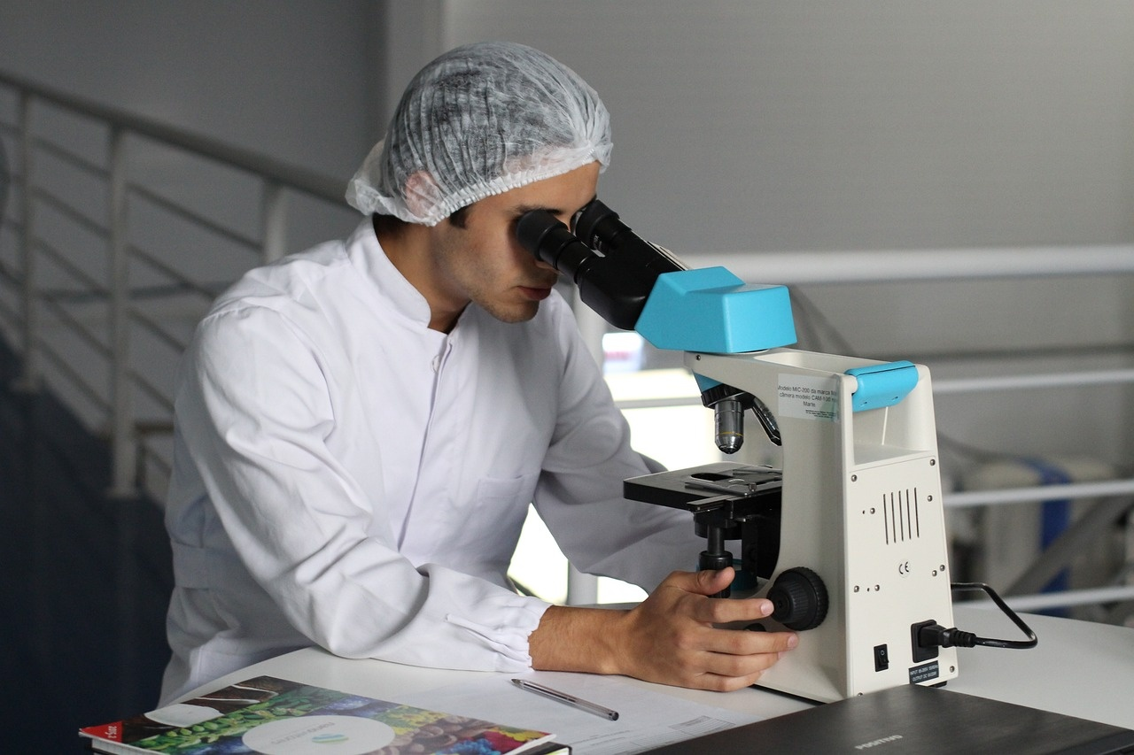
Literature Review on COVID-19 Detection
COVID-19 severely damages lungs, leading to organ failure and death. X-rays are crucial for diagnosis and treatment. Ajaykumar Dhamireddy et al. used CNN, Vgg16, and Mobile net algorithms to improve COVID-19 detection from X-ray images.
Pneumonia is a global health issue, especially affecting children. Harsh Agrawal developed a deep learning technique using transfer learning and image augmentation to identify pneumonia from X-rays, achieving 96% accuracy and 0.974 recall.
Jakub Garstka and Michal Strzelecki used CNN trained on limited data to classify lung X-rays into three categories: healthy, viral pneumonia, and bacterial pneumonia. This uncommon classification achieved 85% accuracy and 0.95 sensitivity.
Madhuri A et al. combined CNN and machine learning classifiers to detect pneumonia in chest X-rays. Their ensemble classifier, including Radial Basis Function, support vector machine, and logistic regression, achieved 97% accuracy. This method was used to develop a web-based computer-aided diagnosis system for radiologists.
4

Slide 5
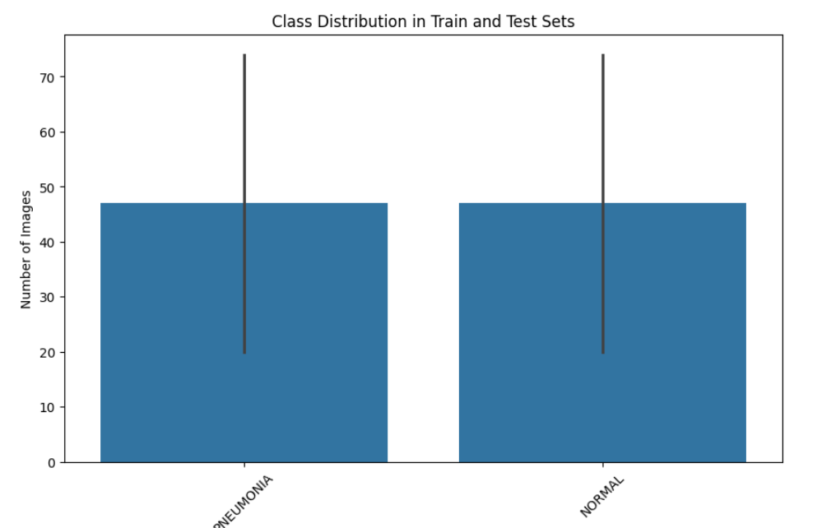
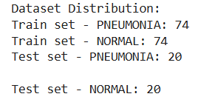
Exploratory Data Analysis(EDA)
Checking data set proportions

Slide 6

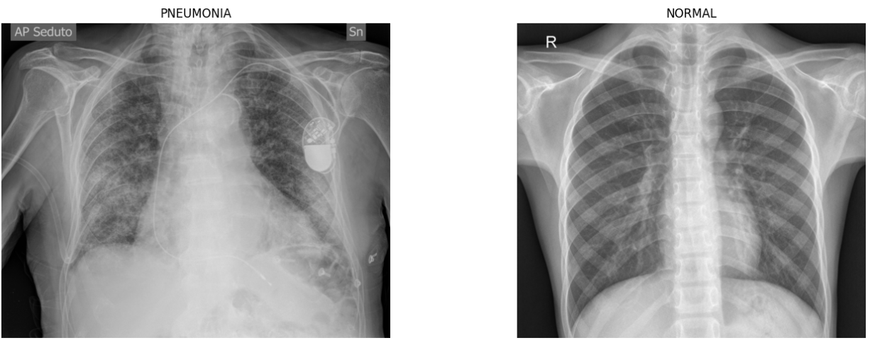
Exploratory Data Analysis(EDA)
Examining Data Types
Visualizing sample images

Slide 7
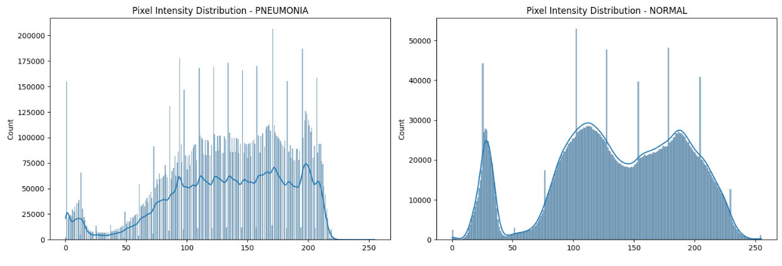
Exploratory Data Analysis(EDA)
Analyzing pixel intensity

Slide 8
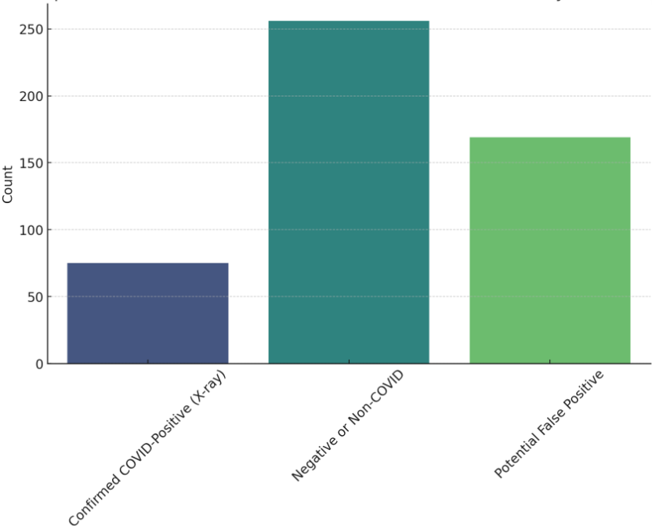
This shows the distribution of COVID-19 test results with and without chest X-ray confirmation. It illustrates:
-Confirmed COVID-Positive (X-ray): Cases where both the test and X-ray are positive for COVID-19.
-Potential False Positive: Cases where the test was positive, but the X-ray did not indicate COVID-19.
-Negative or Non-COVID: Cases that are either negative or non-COVID.
This visualization helps assess the added accuracy from using chest X-rays to avoid false positives in COVID-19 diagnosis.

Slide 9
Import Libraries
Data Preprocessing Techniques
cv2
os
numpy (as np)
scipy.stats (import Entropy)
01
Set Up Directory Paths
02
test_normal
test_pneumonia
train_normal
train_pneumonia
Image Processing with OpenCV
03
cv2.imread to read image color
cv2.cvtColor to convert to grayscale
Store Processed Images
04
test_normal list
test_pneumonia list
train_normal list
train_pneumonia list
Advancements in COVID-19 Detection
3

Slide 10
01
Utilizes Convolutional Layers
Methodology: CNN
Captures spatial hierarchies and patterns in data.
02
Applies Filters
Identifies patterns like edges, textures, and forms.
03
Activation Function
ReLU adds non-linearity to enhance model performance.
Advancements in COVID-19 Detection
5

Slide 11
Results and Model Performance
Precision: CNN
Recall: CNN
Accuracy: CNN
F1 Score: CNN
57%
60%
58%
59%
Precision of the CNN model
Recall of the CNN model
Accuracy of the CNN model
F1 Score of the CNN model
6

Slide 12

Conclusion and Future Implications
Conclusion
Model Performance: The model achieved an accuracy of 57%, with balanced precision and recall for both NORMAL and PNEUMONIA classes.
Pixel Intensity Analysis: Distinct intensity patterns were observed between the two classes, indicating that the model can learn from these differences.
Future Implications
Model Improvement: Use advanced architectures like ResNet or finetune VGG16 for better performance.
Data Augmentation: Increase data variety to improve generalization.
Larger Dataset: Expanding the dataset will help the model capture more diverse patterns.
Explainability Tools: Implement Class Activation Maps (CAMs) to understand where the model focuses in X-ray images.
7

Slide 13
References
Dhamireddy, AjayKumar et al., Detection of COVID-19 from X-RAY Images using Artificial Intelligence (AI).” IEEE, 18 August 2022, https://ieeexplore.ieee.org/document/9847741 .
Agrawal, Harsh.“Pneumonia Detection Using Image Processing And Deep Learning.”, IEEE, 12 April 2021, https://ieeexplore.ieee.org/document/9395895
Garstka, Jakub, and Michal Strzelecki. “Pneumonia detection in X-ray chest images based on convolutional neural networks and data augmentation methods.”, IEEE, 02 November 2020, https://ieeexplore.ieee.org/document/9241305 .
A, Madhuri, et al. “Pneumonia Detection and Classification using Hybrid Convolution Neural Network and Machine Learning Classifiers.”, IEEE, 27 March 2023, https://ieeexplore.ieee.org/document/10073927 .

Slide 14
Thank You

