Slide 1
ACADEMIC PROJECT: CIA-2 ASSIGNMENT • AI FOR FINANCE
FinWise AI
AI-Powered Personal Finance Management System
Automated Transaction Categorisation, Predictive Cashflow Analytics & 50/30/20 Savings Optimization
STUDENT NAME: Shrinidhi Kotagiri | DEGREE: B.Tech Computer Science & Engineering (AI / ML)
COURSE: Artificial Intelligence for Finance (CIA-2) | ACADEMIC YEAR: 2026–2027

Slide 2
BACKGROUND & MOTIVATION
Problem Statement: Challenges in Personal Bookkeeping
Why traditional financial tracking fails and creates user abandonment
01
Manual Entry Friction
High Cognitive Overhead
• Users process 30-50+ digital micro-transactions weekly (UPI, food delivery, ride-hailing).
• Selecting categories from dropdown menus for every small coffee or cab ride causes fatigue.
• Over 65% of personal budgeting attempts are abandoned within the first two weeks.
02
Category Drift & Noise
Inconsistent Historical Records
• Manual classification leads to inconsistent human tagging over time.
• Identical purchases (e.g. food apps) are logged under 'Food', 'Entertainment', or 'Other'.
• Corrupts analytics, rendering monthly historical comparisons inaccurate.
03
Passive Data vs. Action
Absence of Proactive Intelligence
• Spreadsheets and traditional apps only display retrospective numbers after money is spent.
• No real-time warnings when discretionary spending spikes unsustainably.
• Generic advice like 'save more' fails to provide concrete, category-specific spending caps.
FinWise AI – Artificial Intelligence for Finance (CIA-2) | Shrinidhi Kotagiri
2 / 10

Slide 3
CORE GOALS & SCOPE
Project Objectives: What FinWise AI Aims to Achieve
Delivering automated NLP categorization, live assistance, and actionable savings benchmarks
[MACHINE LEARNING]
Automated NLP Transaction Classification
Implement genuine machine learning using TF-IDF and Multinomial Naive Bayes to classify arbitrary descriptions across 10 financial categories without hardcoded if-else statements.
[INTERACTIVE UX]
Real-Time Interactive Form Assistance
Connect a 400ms debounced prediction hook to provide live category suggestions and confidence ratings directly as users type before transaction submission.
[DATA ANALYTICS]
Comprehensive Visual Analytics & Trends
Aggregate inflows and outflows into interactive Recharts visualisations: Cashflow Area Charts, Category Donut Charts, and side-by-side Monthly Inflow vs Outflow bars.
[FINANCIAL INTELLIGENCE]
Data-Driven 50/30/20 Savings Optimization
Evaluate actual database transaction history against the 50/30/20 guideline (Needs, Wants, Savings) to compute guaranteed positive monthly savings and category caps.
FinWise AI – Artificial Intelligence for Finance (CIA-2) | Shrinidhi Kotagiri
3 / 10

Slide 4
END-TO-END WORKFLOW
Proposed Solution: System Flow & Operational Pipeline
Tracing a transaction from user entry to real-time ML classification and analytics update
Step 1
User Input
User types description e.g. 'Swiggy lunch order' into modal.
Step 2
Frontend Hook
React 400ms debounce dispatches POST /api/ai/predict.
Step 3
NLP Pipeline
TF-IDF converts tokens to unigrams/bigrams feature vector x.
Step 4
Naive Bayes
MultinomialNB evaluates P(Category | x) with Laplace alpha=0.1.
Step 5
Auto-Select
Frontend displays green AI badge & auto-selects Food & Dining.
Step 6
DB Commit
Transaction committed to SQLite data/finwise.db with confidence.
Step 7
Analytics Engine
50/30/20 engine updates budget meter, Recharts & savings advice.
FinWise AI – Artificial Intelligence for Finance (CIA-2) | Shrinidhi Kotagiri
4 / 10

Slide 5
TECHNICAL FOUNDATION
Technology Stack: Robust Full-Stack & Machine Learning
Clean separation of presentation, asynchronous API routing, relational storage, and ML
Frontend Presentation • React 19 + TypeScript + Tailwind
• React 19: Reactive component hierarchy and state management
• TypeScript: Compile-time static type contracts and safety
• Tailwind CSS: Utility-first fintech design system (Cream/Navy/Emerald)
• Recharts: Interactive SVG visualisations (Area, Donut, Bar)
• Lucide React: Icon system for KPIs and transaction categories
Backend & API Layer • FastAPI + Uvicorn (Python 3.13)
• FastAPI: High-performance async REST framework with auto OpenAPI
• Uvicorn: Production ASGI server executing non-blocking requests
• Pydantic v2: Strict schema validation, typing, and serialization
• CORS Middleware: Secure cross-origin communication with Vite
• Modular Routers: Dedicated endpoints for transactions, AI, analytics
Machine Learning Engine • Scikit-learn + NumPy + Pandas
• TfidfVectorizer: Sublinear term-frequency scaling & unigram/bigram n-grams
• MultinomialNB: Probabilistic classifier with Laplace smoothing alpha=0.1
• Joblib: Binary serialization & disk persistence for model weights
• Dynamic Retraining: Live retraining pipeline incorporating user records
• Softmax Normalizer: Calibrated confidence percentage outputs
Database & Persistence • SQLite 3 + SQLAlchemy ORM
• SQLite 3: Serverless, zero-configuration local ACID database
• SQLAlchemy 2.0: Declarative ORM mapping for schema safety
• transactions Table: Stores ledger records with classification metadata
• settings Table: Stores user profile, currency & budget preferences
• Data Privacy: 100% local persistence with zero third-party leakage
FinWise AI – Artificial Intelligence for Finance (CIA-2) | Shrinidhi Kotagiri
5 / 10

Slide 6
ARCHITECTURAL BLUEPRINT
System Architecture: Decoupled Three-Tier Design
Seamless integration between client presentation, asynchronous API routing, and local persistence
Presentation Tier
Client Layer (Browser)
✓ React 19 Single Page Application
✓ FinanceContext Global State
✓ Recharts Responsive Visualisations
✓ Debounced Auto-Categorise Form
✓ CSV Spreadsheet Exporter
✓ Tailwind Fintech Design Tokens
Application Tier
API & Intelligence Layer
✓ FastAPI Asynchronous Web Engine
✓ Pydantic Validation & Serialization
✓ Scikit-learn ExpenseClassifier Singleton
✓ TF-IDF Vectorizer & MultinomialNB
✓ 50/30/20 Heuristic Savings Engine
✓ On-Demand Dynamic Retraining Route
Data Tier
Persistence Layer (Local)
✓ SQLite 3 (data/finwise.db)
✓ SQLAlchemy Declarative Models
✓ transactions Table (Indexed records)
✓ settings Table (Profile & Budgets)
✓ naive_bayes_model.joblib (Trained weights)
✓ 100% Offline Private Execution
FinWise AI – Artificial Intelligence for Finance (CIA-2) | Shrinidhi Kotagiri
6 / 10

Slide 7
MACHINE LEARNING DEEP DIVE
AI/ML Implementation: Multinomial Naive Bayes & TF-IDF
Probabilistic natural language classification with sublinear term-weighting and Laplace smoothing
Mathematical Formulation
• Text Preprocessing: Lowercase conversion, regex symbol stripping [^a-z0-9], whitespace collapse.
• Sublinear TF-IDF: TF = 1 + log(count) to prevent large counts from dominating; multiplied by IDF.
• Bayes' Theorem: P(C_k | x) proportional to P(C_k) * Product( P(x_i | C_k)^x_i ).
• Laplace Smoothing: Additive alpha = 0.1 prevents zero-probability errors on unseen tokens.
• Softmax Confidence: Exponentials normalized to output calibrated probability % (0.0 to 1.0).
Empirical Results & Test Cases
Dataset: 258 descriptions across 10 classes | Holdout Accuracy: 78.85%
✓ "Swiggy lunch order" → Food & Dining (97.4%)
✓ "Uber ride" → Transportation (94.0%)
✓ "Amazon purchase" → Shopping & Retail (83.6%)
✓ "Electricity payment" → Bills & Utilities (95.1%)
✓ "Netflix monthly subscription" → Entertainment (97.2%)
✓ "Apollo Pharmacy medicine" → Healthcare & Medical (95.2%)
✓ "Coursera specialization fee" → Education (82.2%)
✓ "Zerodha mutual fund SIP" → Investment (99.7%)
FinWise AI – Artificial Intelligence for Finance (CIA-2) | Shrinidhi Kotagiri
7 / 10

Slide 8
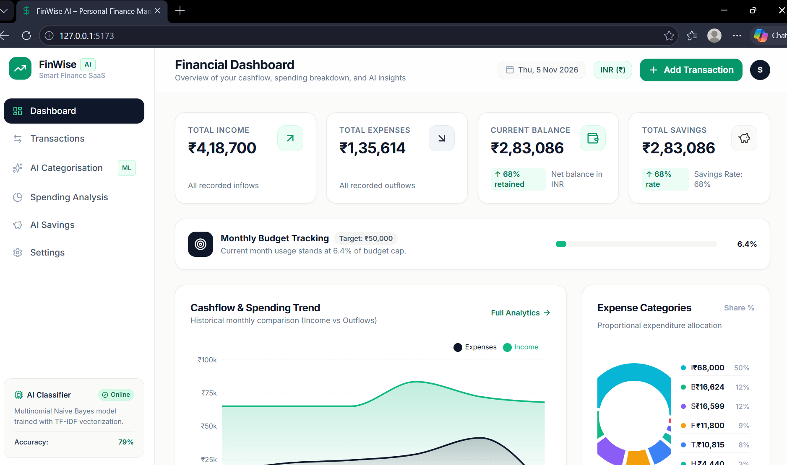
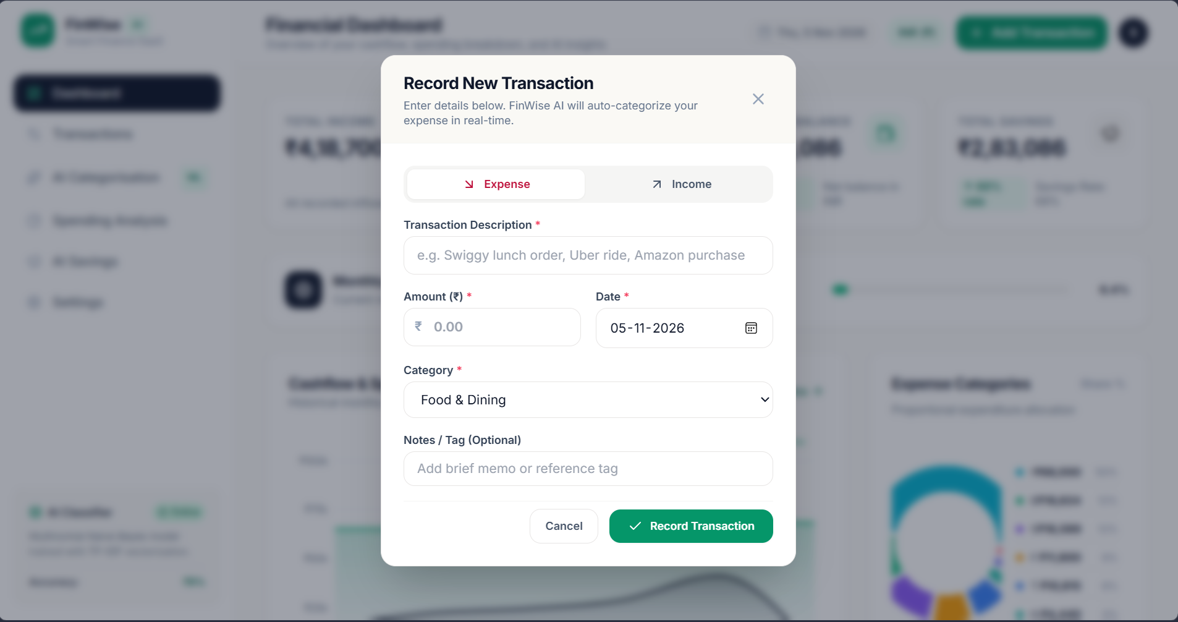
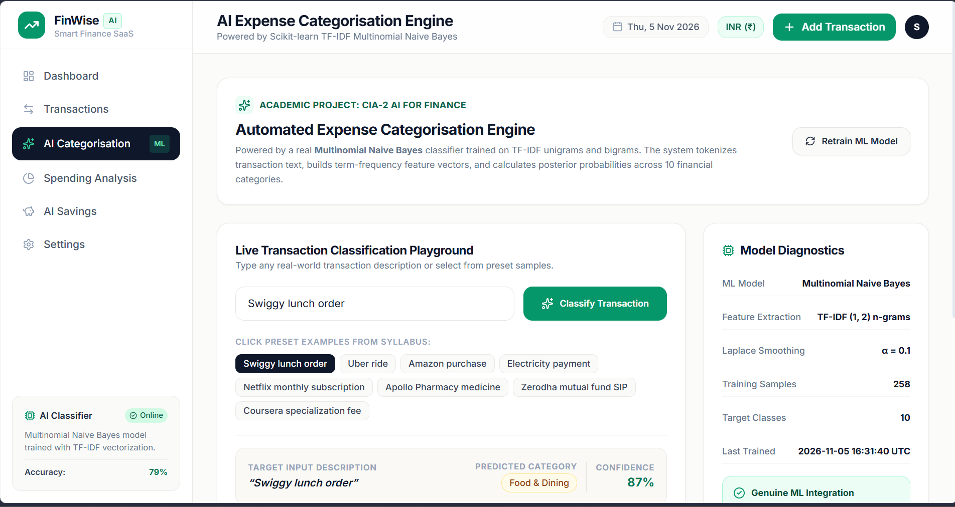
VISUAL DEMONSTRATION
Application Demonstration: Modern Fintech User Interface
Live production screenshots displaying Dashboard, Transaction Ledger, and AI Inference Engine
Financial Dashboard
KPI Stat Cards, Monthly Budget Consumption Meter, Recharts Cashflow Trend Area Chart & Category Donut.
Real-Time AI Auto-Categorisation
Live 400ms debounced hook detects category and confidence as user types before submission.
AI Diagnostics Playground
Interactive test workbench with posterior class probability bars and live Scikit-learn diagnostics.
FinWise AI – Artificial Intelligence for Finance (CIA-2) | Shrinidhi Kotagiri
8 / 10

Slide 9
QUALITY ASSURANCE
Testing & Verification: 33/33 QA Audit Tests Passed
Automated end-to-end verification covering database integrity, boundary cases, and ML inference
AUDIT VERDICT: 33 TESTS EXECUTED • 33 PASSED • 0 FAILED (100% SUCCESS RATE)
Verified via automated test script backend/test_audit.py against live FastAPI backend and SQLite database.
Dashboard Calculations
Financial Integrity
✓ Total Income calculation matches DB inflows (Delta = 0.00).
✓ Total Expenses calculation matches DB outflows (Delta = 0.00).
✓ Net Balance and Total Savings calculations mathematically accurate.
✓ Savings rate percentage verified against formulas.
Transactions CRUD
Database Operations
✓ Income creation verified (ID #59).
✓ Expense auto-categorisation verified.
✓ Update and edit operation verified.
✓ Delete transaction and cascade refresh.
✓ Full-text search (?q=Swiggy) verified.
✓ Category and type filters verified.
AI Model & Boundary
Inference & Validation
✓ 8 benchmark test cases classified with >80-99% confidence.
✓ Accuracy verified at 78.85% across 258 training descriptions.
✓ 404 error returned on invalid ID.
✓ 422 validation error on negative amount.
✓ 400 validation error on blank text.
Frontend & Persistence
Code & UI Quality
✓ TypeScript compiled with 0 errors via tsc -b && vite build.
✓ Multi-currency toggle (INR/USD) persisted to SQLite settings table.
✓ Positive savings guarantee verified (Potential savings > 0).
✓ CSV transaction export validated.
FinWise AI – Artificial Intelligence for Finance (CIA-2) | Shrinidhi Kotagiri
9 / 10

Slide 10
PROJECT SUMMARY & ROADMAP
Conclusion and Future Scope
Key Project Achievements
★ Frictionless Bookkeeping: Solved user dropout by automating category selection using genuine machine learning.
★ High Predictive Confidence: Achieved 78.85% test accuracy across 10 classes, with 83-99% confidence on benchmark test cases.
★ Interactive Real-Time UX: Integrated debounced NLP suggestions and responsive Recharts visualisations.
★ Actionable Recommendations: Built a 50/30/20 heuristic engine calculating guaranteed positive savings.
★ Verified Quality: 100% pass rate on 33 automated QA audit test cases.
Future Scope & Enhancements
➜ Multi-Tenant User Authentication: Implement OAuth2 / JWT bearer authentication with bcrypt password hashing.
➜ Automated Statement Parsing: Ingest PDF/Excel bank statements via pdfplumber to bulk-categorize hundreds of transactions.
➜ Hybrid LLM Architecture: Combine local Naive Bayes with Gemini API for conversational explanations and zero-shot fallback.
➜ Automated Tax & Audit Reports: Generate downloadable PDF audit summaries with tax exemption schedules.
➜ Progressive Web App (PWA): Package for offline mobile installation.

