Slide 1

Emotion Recognition in Images
Akshay Singh - 665369906
Ashish Shinde - 650541070
Shrinivas Kallol - 661625322
Instructor – Dr. Ashkan Sharabiani

Slide 2
Outline
Application
Objective
Dataset
Methodology
- Preprocessing
- Modelling
Comparison
Results
References

Slide 3
Objective
Classifying the images into 7 emotions:
Angry
Disgust
Fear
Happy
Sad
Surprise
Neutral

Slide 4
Application
Medical
E-learning
Monitoring
Entertainment
Law
Marketing

Slide 5
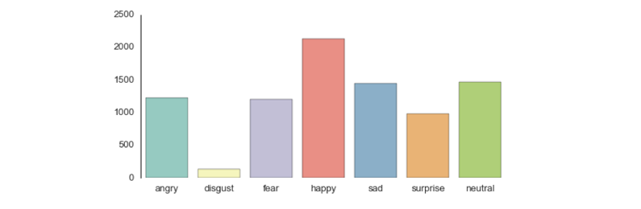
Dataset
30509 pre-cropped, 48*48 pixels gray scale images
7- Classes
Length of validation data = 3509
Length of training data = 27000

Slide 6
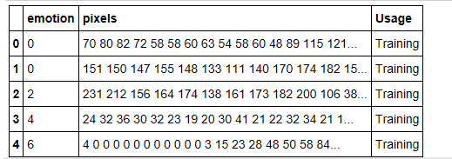
Dataset

Slide 7


Slide 8
Pre-processing and Feature Engineering
CNN | SVM
Subtracted the mean of each image from each pixel in the image. The mean value of pixel across all images is subtracted from the pixel and divided by its variable. | We provided eigen faces as an input to SVM. Mean adjusted the images and performed PCA on these images.
PCA not implemented. | PCA implemented Number of components = 10 70% of Variance was explained.
Learning facial expression from an image @ stanford

Slide 9
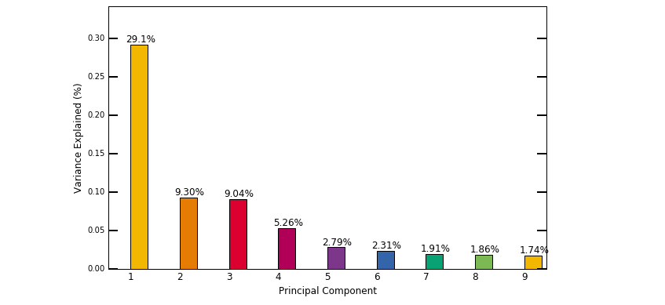
Visual result for PCA

Slide 10
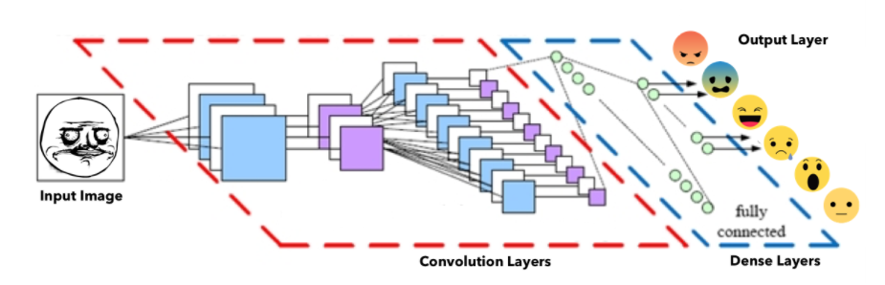
Hyper Parameters of CNN
Convolution
Number of CNN Layers= 2 Fully connected
Number of features = 64 Number of Dense Layers=2
  Number of features = 64 Number of neurons(L1) = 3072
  Size of features = 5*5 Number of neurons(L2) = 1536
Pooling
  Window size = 2*2
  Window stride = 2

Slide 11
Convolutional Neural Networks
Parameters
Learning Rate = .0001 ( K=5 )
Batch size = 50
Iterations = 3000
Dropout = .50
Activation Function = ReLu
Optimizer = Adam Optimizer

Slide 12
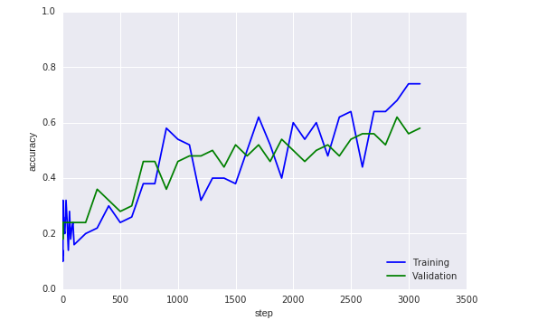
Convolutional Neural Networks : Results
Training accuracy = 74 %
Validation accuracy = 52.6 %

Slide 13
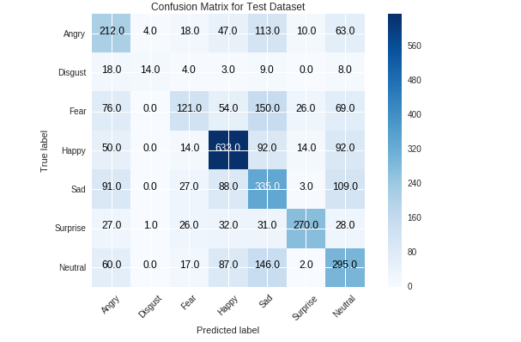
Convolutional Neural Networks : Results
Validation accuracy = 52.13%

Slide 14
Convolutional Neural Networks : Results
 | HAPPY | SUPRISE | SAD
PRECISION | 67.05% | 83.07% | 38.2%

Slide 15
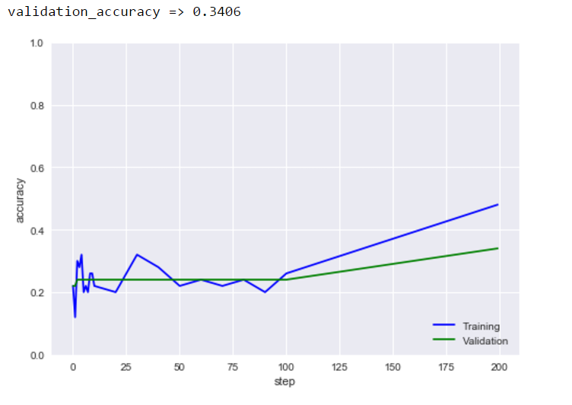
Training on 2000 images
Drop out = 0.4
Batch size = 50
Learning rate = 0.0001

Slide 16
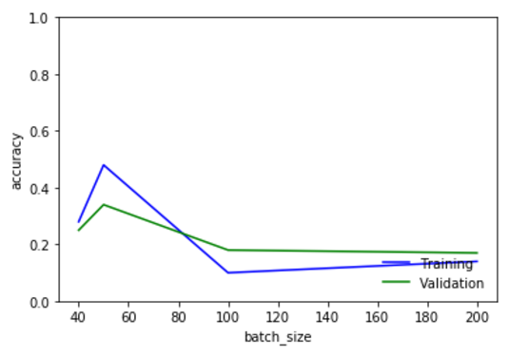
Convolutional Neural Networks : Results
Accuracy vs Batch size

Slide 17
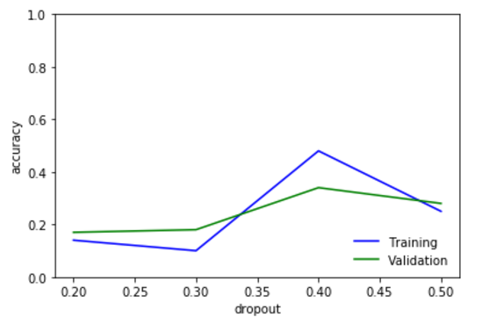
Convolutional Neural Networks : Results
Accuracy vs Dropout

Slide 18
Modelling :Support Vector Classifier
Parameters [Grid Search]
Penalty Parameter (C) = 10
Kernel = RBF (Gaussian Kernel)
Gamma = 0.0001

Slide 19
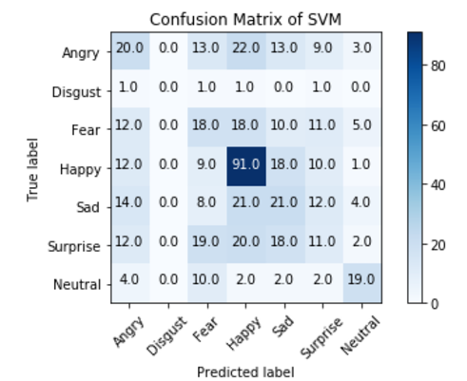
Support Vector Classifier : Results
Training accuracy = 82.3%
Validation accuracy = 34.03%
 | HAPPY | SURPRICE | Disgust
PRECISION | 52% | 56% | 0%

Slide 20
CNN vs SVM
2000 DATA POINTS | CNN Iterations = 200 Learning rate = .0001 Drop-out = 40% Batch-size = 50 | SVM Penalty Parameter (C) = 10 Kernel = RBF (Gaussian Kernel) Gamma = 0.0001
Validation Accuracy | 34.03% | 36.24%
Training Accuracy | 48.4% | 82.3%
TIME(min:sec) | 22:48 | 1:16

Slide 21
References
Kim, Bo-Kyeong, et al. 2015. Hierarchical Committee of Deep CNNs with Exponentially Weighted Decision Fusion for Static Facial Expression Recognition
Ng, Hong-Wei, et al. 2015 Deep Learning for Emotion Recognition on Small Datasets Using Transfer Learning.
Yu, Zhiding, et al. 2015. Image-based Static Facial Expression Recognition with Multiple Deep Network Learning.
Dhall, Abhinav. Third Emotion Recognition in the Wild Challenge results @ ACM ICMI March 5, 2016.

Slide 22
THANK YOU

