Slide 1
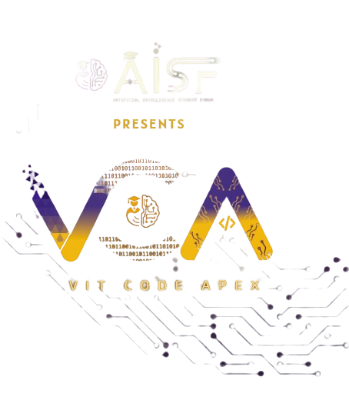

Slide 2

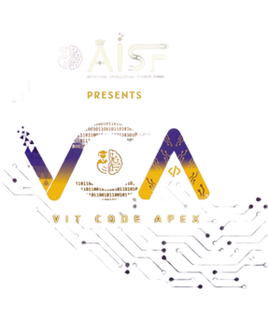

CODE VERSE HACKATHON 2025
Problem Statement Title-Create a "living itinerary" system that dynamically adjusts a traveler's plans in real-time based on live events and user feedback.
Team Name-Byte 4
Team Members-Niraj Gahukar,Apurva Dabhade,Shrinivas Tawde,Swayam Gurunule

Slide 3















IDEA TITLE
Proposed Solution
How it Addresses Problem
Innovation and Uniqueness
Dynamic real-time travel itinerary system
Avoids static non-adaptive itineraries
Feedback loop at every activity
User inputs: destinations, transport, budget
Reduces stress with instant notifications
Blockchain-like QR traveler tracking
Pre-trip alerts: visa, documents, currency
Integrates safety risk intelligence
Provides real-time emergency assistance
Auto itinerary updates: delays, weather, events
Real-time anomaly-based itinerary change
Personalizes plans to user preferences
Safety features: QR, risk scores, hospitals
Ensures monitoring with QR and inspector
Step-by-step guided city/location input
Guide recommendations from static dataset

Slide 4
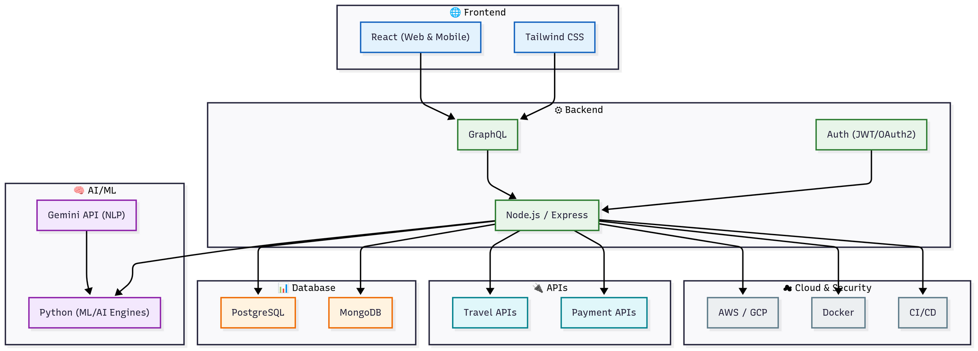








TECHNICAL APPROACH
Machine Learning
Backend
Frontend
Database

Slide 5








FEASIBILITY AND VIABILITY
Technical feasibility is strong because AI and mobile tech enable real-time itinerary updates and safety features
Strong market demand and rapid growth make personalized itinerary systems highly relevant for travelers today
Feasibility
Viability
Operational feasibility is high as automation solves traveler problems and adapts to changes efficiently.
Advanced AI and real-time data reliably deliver convenient, user-centered features.
Economic feasibility is realistic since cost savings, improved satisfaction, and scalability benefit both users and providers.
Integration of community, dynamic design, and deep learning trends supports scalability and long-term sustainability
Ensuring accurate, real-time data updates for flights, weather, and events can be difficult
Use reliable APIs and continuous data validation to maintain real-time accuracy.
Protecting sensitive traveler data from breaches while complying with privacy regulations.
Implement strong encryption, compliance policies, and transparent data handling practices.
Challenges
Overcome Challenges
Integrating AI with existing travel booking systems and scaling the platform smoothly.
Employ modular, cloud-based solutions for flexible integration and scalability.
Providing highly personalized recommendations that adapt effectively to diverse user preferences.
Leverage machine learning with user feedback loops to refine personalization over time

Slide 6








IMPACT AND BENEFITS
IMPACTS
BENEFITS
Reduces travel stress by handling delays and disruptions automatically.
Saves time by automating itinerary planning.
Enhances safety through QR IDs and destination alerts.
Helps control expenses with a live budget tracker.
Provides tailored recommendations for activities and experiences.
Promotes eco-friendly and sustainable tourism practices.
Adapts travel experiences to user preferences dynamically.
Encourages social interaction through sharing tips and experiences.
Influences traveler decisions with personalized suggestions.
Makes trips more enjoyable with gamified challenges and engagement.

