Slide 1
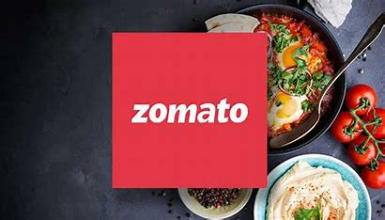
ZOMATO RESTAURANT ANALYSIS
Power BI Calculations & Analysis | Visualization

Slide 2
Presented by Mr. Shriniwas Saraf

Slide 3
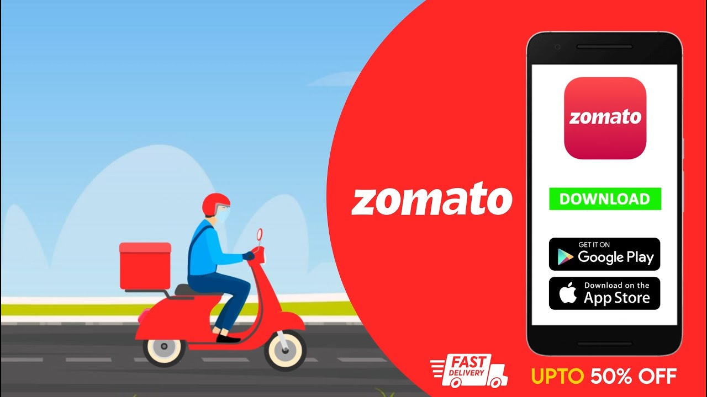
Overview
Introduction
Objective
Data overview
Insights & findings
Dashboard
Conclusion

Slide 4
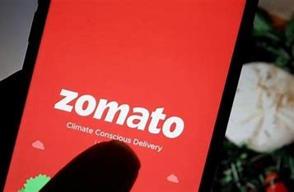
Introduction
Founded: 2008 Headquarters: Gurugram, India
Zomato is a leading online food delivery and restaurant discovery platform that connects customers with restaurants in over 1,000 cities worldwide. It provides services such as food delivery, restaurant reviews, table reservations, and cloud kitchen solutions. With a strong focus on technology and customer experience, Zomato has revolutionized the food industry by offering a seamless ordering experience through its mobile app and website.

Slide 5
objective
The primary goal of this analysis is to derive meaningful insights from Zomato’s restaurant data to understand key trends and performance indicators.
Evaluate Restaurant Performance – Analyze customer ratings, votes, and reviews to assess restaurant quality.
Identify Market Trends – Understand cuisine popularity, pricing patterns, and customer preferences.
Online Delivery & Table Booking Trends – Examine the adoption of online delivery and table reservations.
Cost vs. Customer Engagement – Analyze the relationship between pricing and customer votes.
Geographical Insights – Study restaurant distribution across cities and countries.
Recommendations for Growth – Provide actionable strategies for restaurant owners and Zomato to improve services and increase engagement.

Slide 6
Data overview
The dataset includes:
Restaurant details (ID, Name, Location)
Cuisines and pricing information
Online delivery & table booking availability
Customer ratings and votes
Date of opening

Slide 7
Key metrics
Total Restaurants: 9,551
Countries Covered: 15
Cities Covered: 141
Unique Cuisines: 1,825
Total Votes: 1M
Average Rating: 2.89

Slide 8
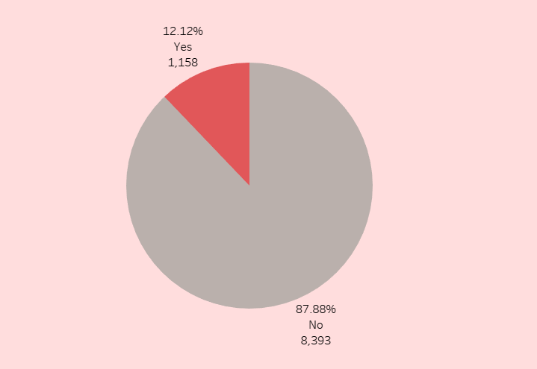

Table booking trend
Only 12.12% of restaurants offer table booking, while 87.88% do not.

Slide 9

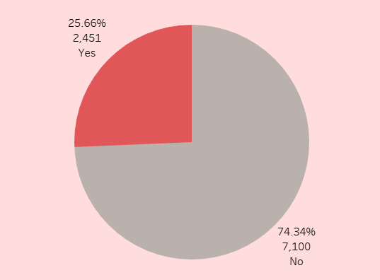
Online Delivery Distribution
25.66% of restaurants provide online delivery, whereas 74.34% do not.

Slide 10
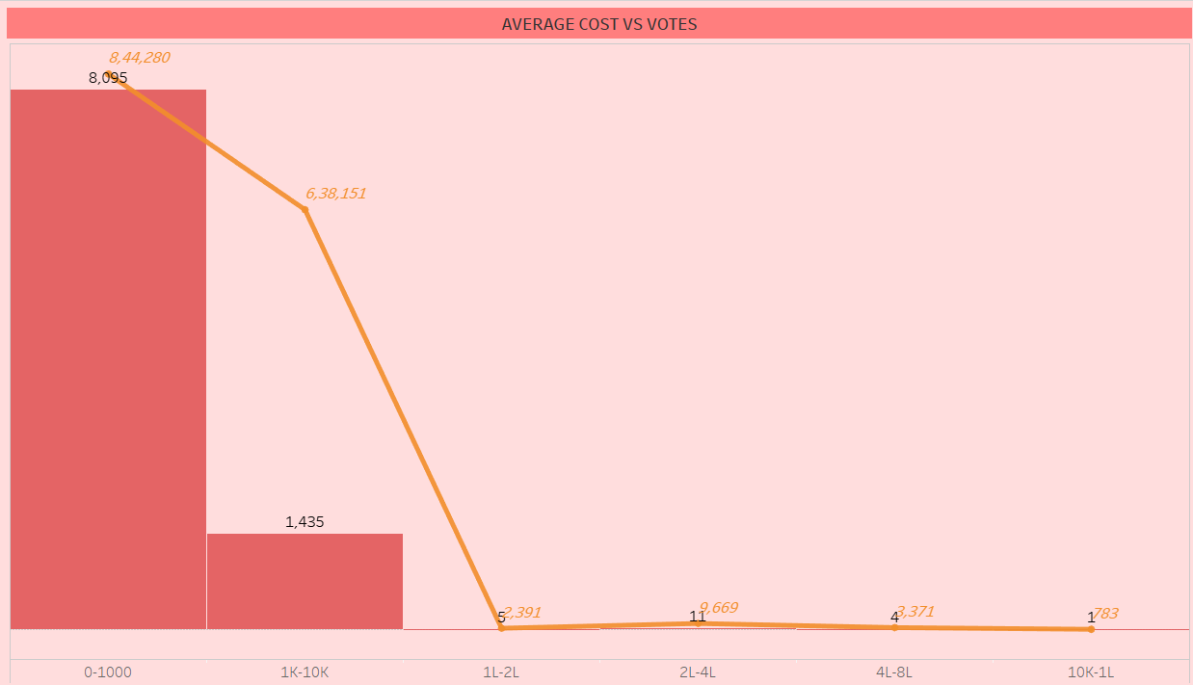
Cost vs Votes Comparison
Higher votes are observed in lower price ranges (0-1000), while expensive restaurants (10K+) receive fewer votes.

Slide 11
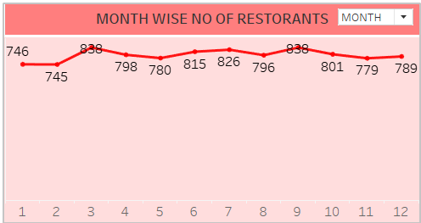
Monthly Restaurant Trends
The number of active restaurants fluctuates slightly across months, with peaks in March and September.

Slide 12
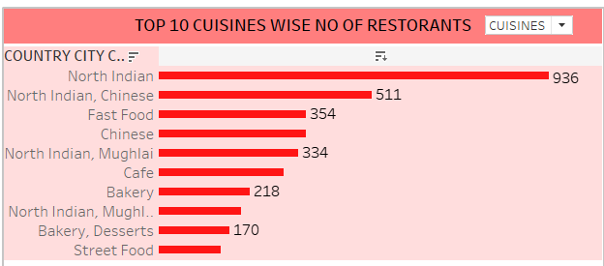
Top Cuisines by Restaurant Count
The most common cuisines among restaurants:
North Indian: 936
North Indian, Chinese: 511
Fast Food: 354
Chinese: 334

Slide 13
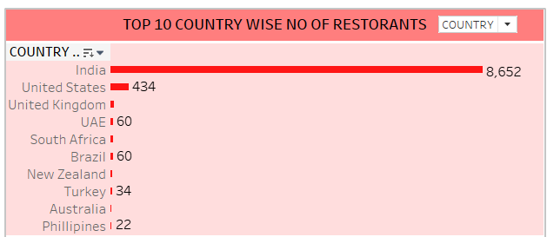
Top country's by Restaurant Count
India: 8,652 restaurants (largest market)
United States: 434 restaurants
Other markets: UK, UAE, South Africa, Brazil, etc., with limited presence
Insight: Zomato has a strong foothold in India but limited expansion in international markets.

Slide 14
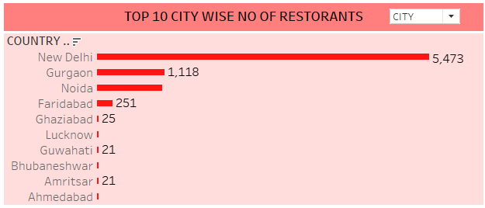
City-wise Restaurant Distribution (India)
New Delhi: 5,473 restaurants (major hub)
Gurgaon: 1,118 restaurants
Other cities: Noida, Faridabad, Ghaziabad, Lucknow, etc., with a declining number
Insight: High concentration in metro cities; lower presence in Tier-2 & Tier-3 cities.

Slide 15
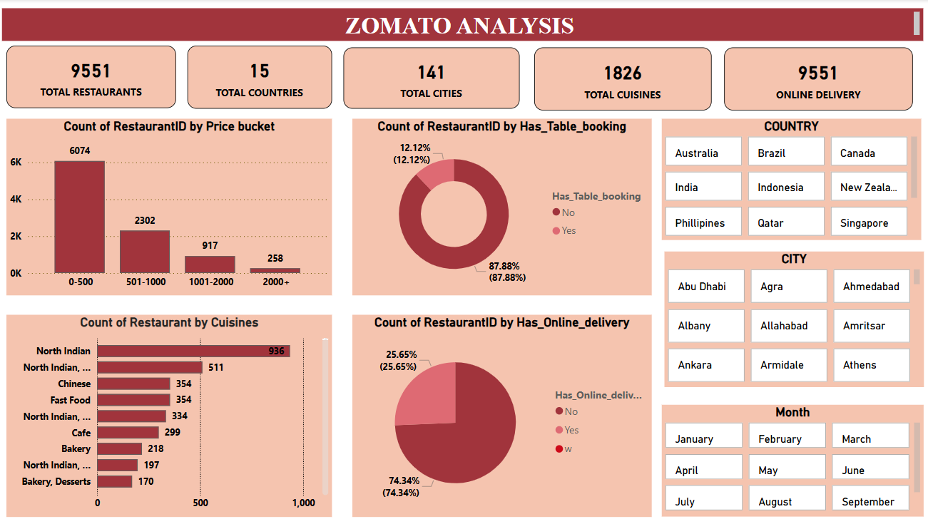
Power Bi dashboard

Slide 16
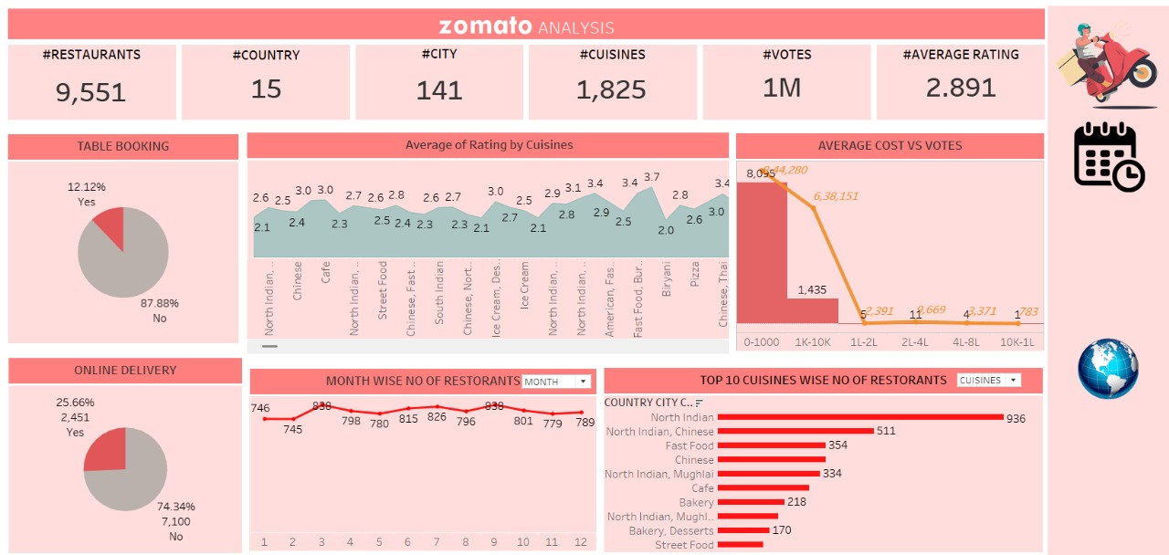
Tableau dashboard

Slide 17
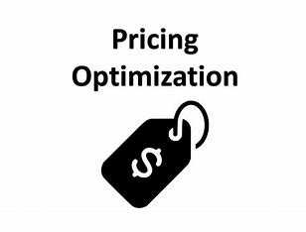
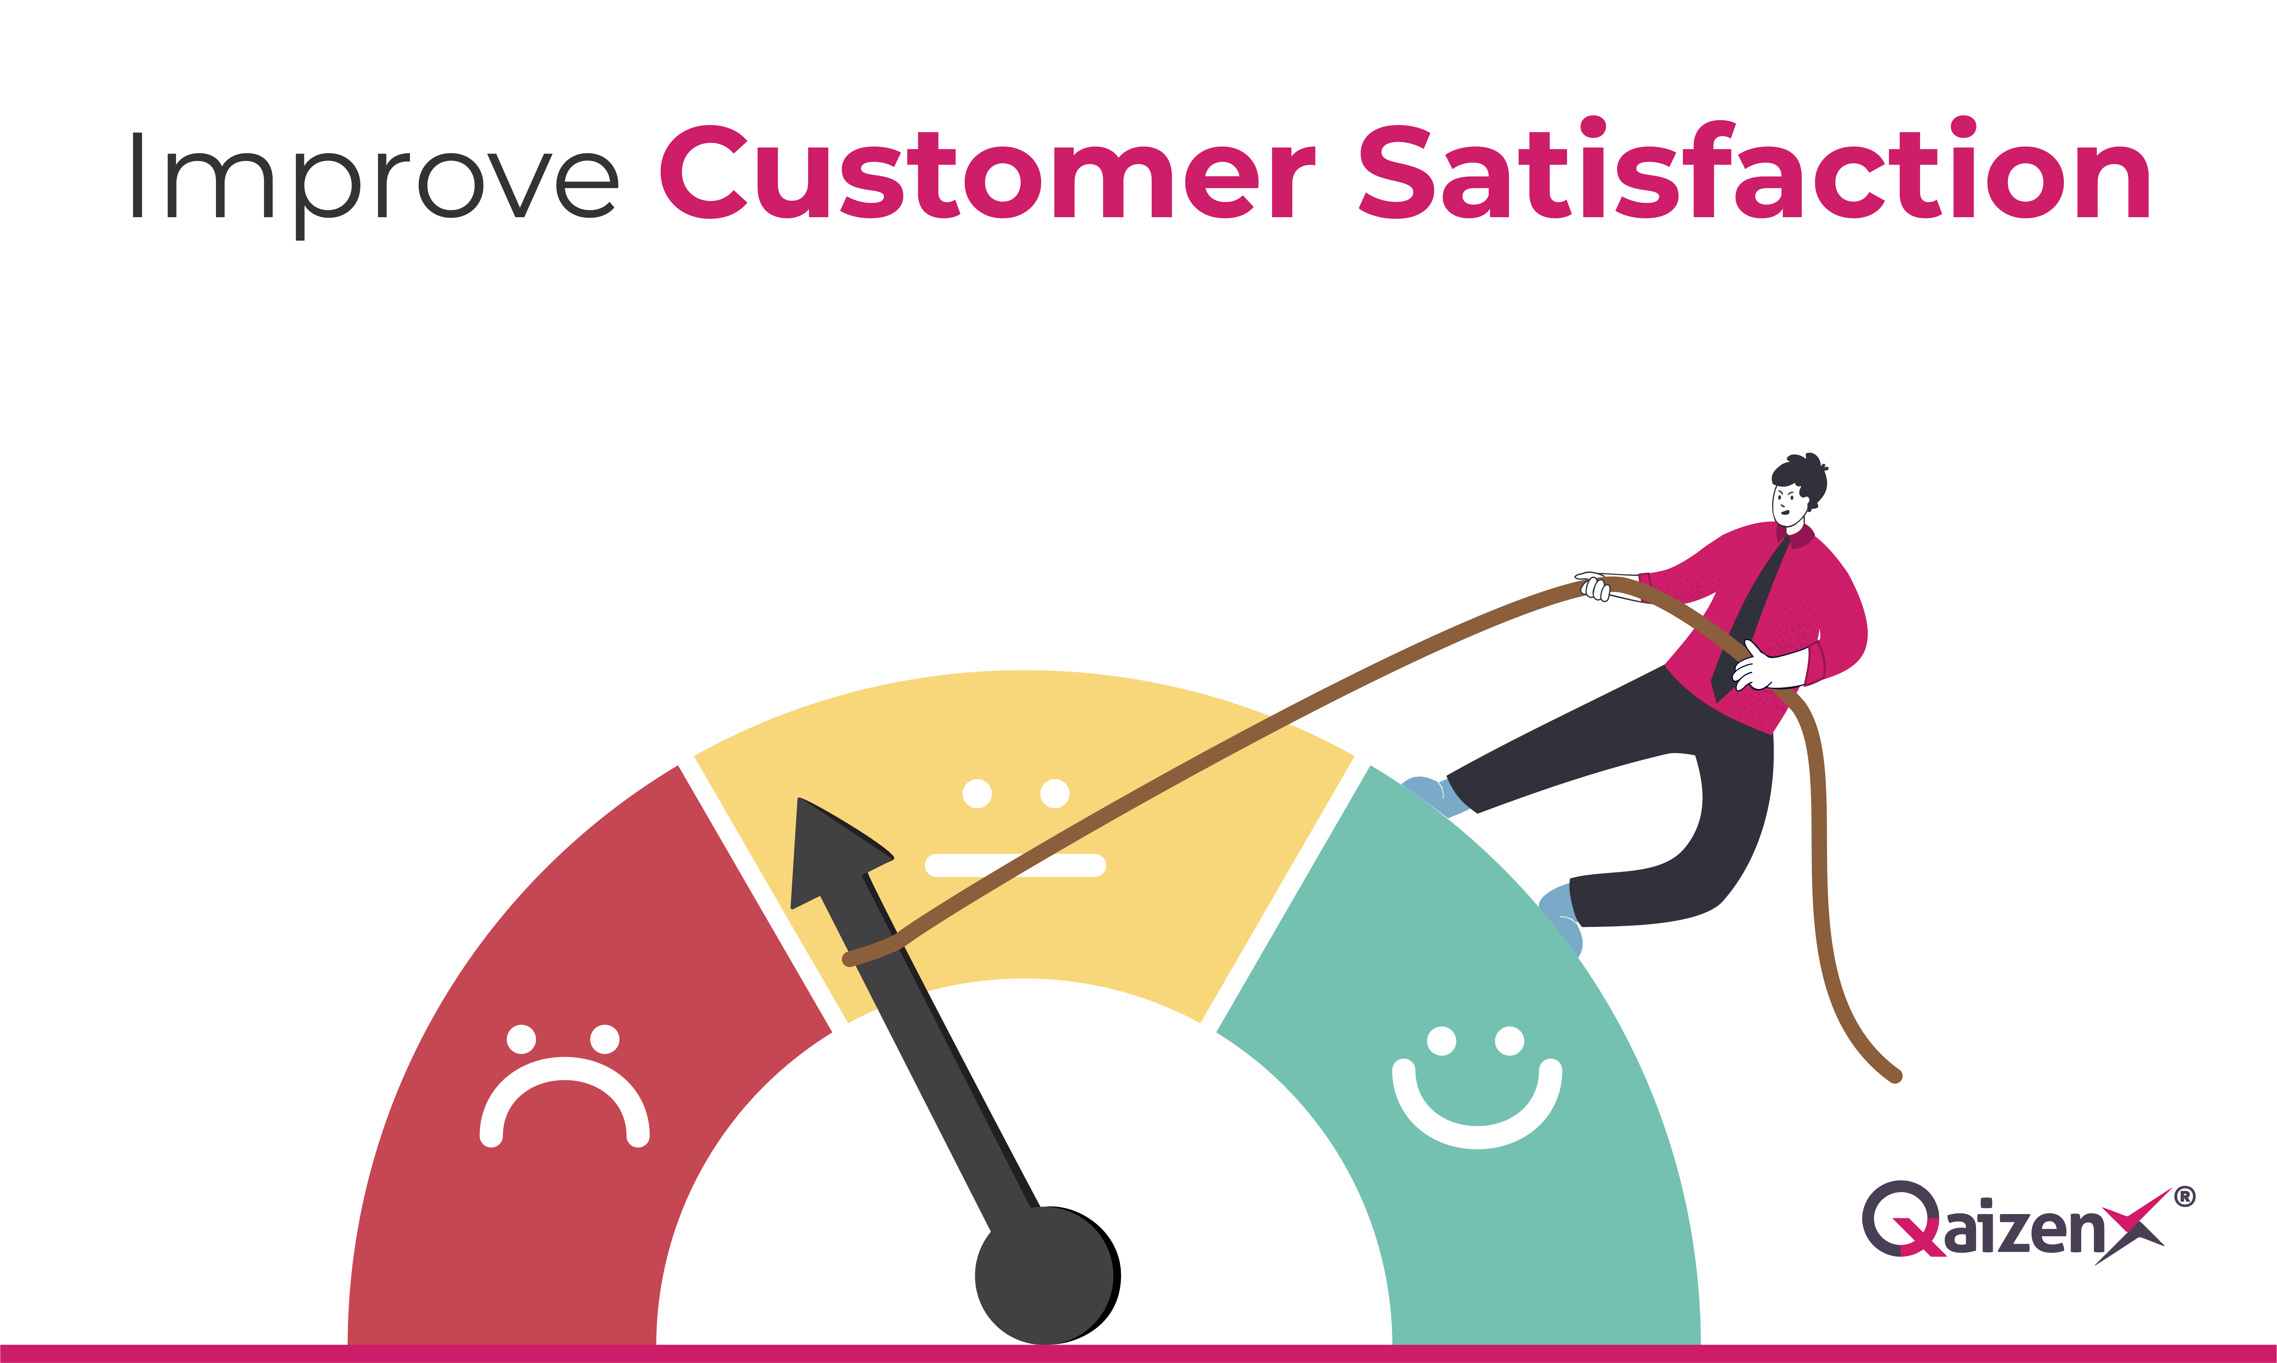
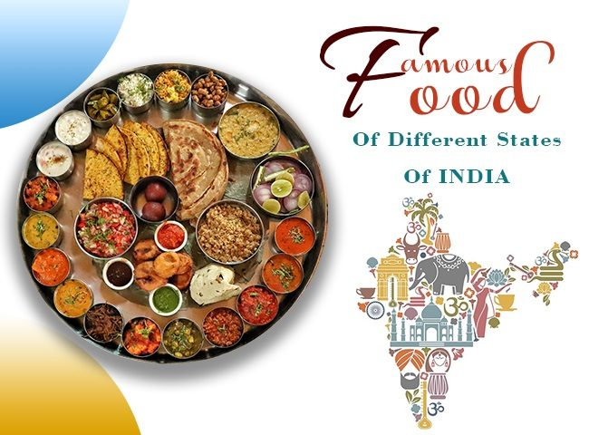
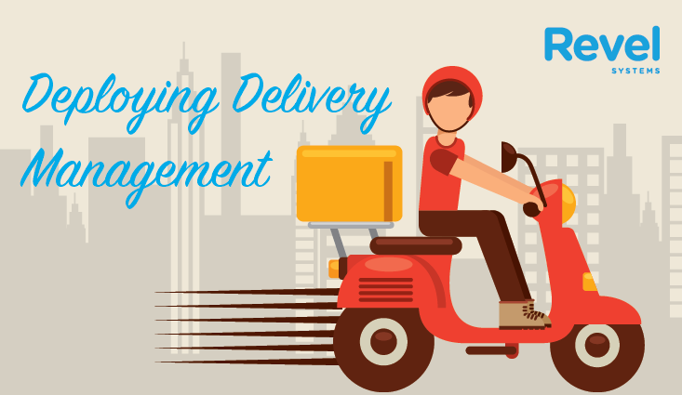
conclusion
Focus on improving customer ratings
Increase online delivery adoption
Optimize pricing strategies
Target popular cuisines for better engagement

Slide 18
Timeline
Mon | Tue | Wed | Thu | Fri | Sat | Sun
04 Feb
Project Kick-off Meeting & Understand the Dataset and KPI’s
11 Feb
Implementation of KPI’s using Excel and MySQL
18 Feb
Implementation of KPI’s using PowerBi
25 Feb
Implementation of KPI’s using T a b l e a u
04 Mar
Final Presentation

