Slide 1
Land Record Digitization using a distributed approach
Akash Kale 4241
Anuj Kanetkar 4242
Shriniwas Nayak 4256

Slide 2
Problem Statement
Land Records and titles are never managed properly in Government offices and the offices are distributed over many locations. Often when land is bought and sold the records are not updated in Government registers. This results in discrepancies in land records.

Slide 3
Objectives
To add, alter, delete, and modify land records in a distributed system.
To develop a highly scalable system.
To develop a fault tolerant and reliable system.
To ensure security and privacy of data.
Ensure database consistency at all times in the system

Slide 4
Characteristics of DS met
Scalability
Fault Tolerance
Transparency
Concurrency

Slide 5
System Functionality
The project UI has four modules –
Home and Login
Registration
Survey
Guest

Slide 6
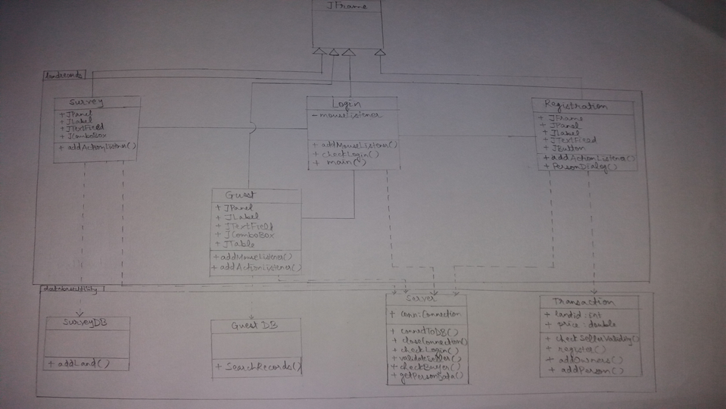
System High Level Design

Slide 7
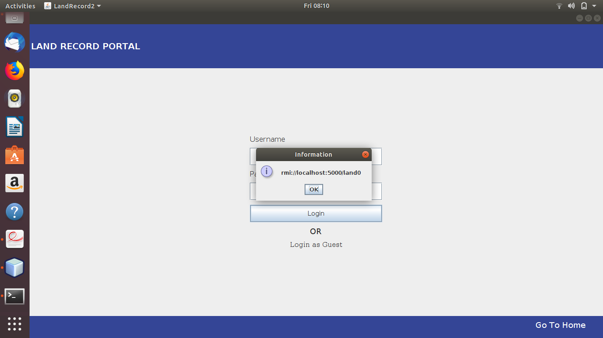
Results

Slide 8
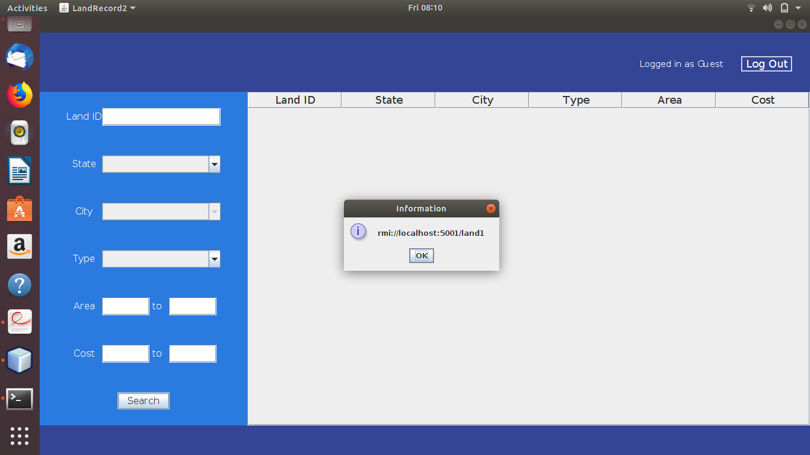

Slide 9
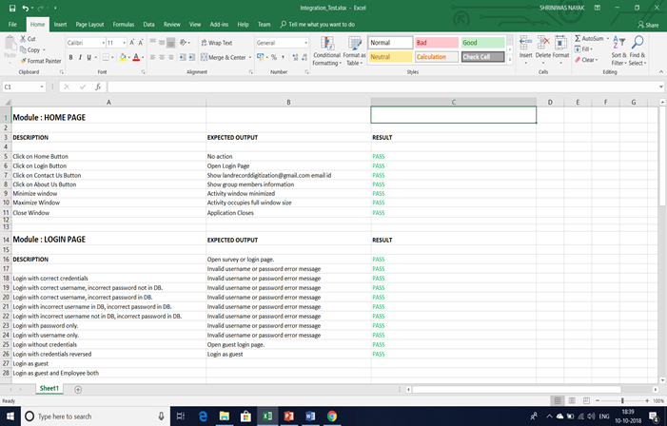
Testing of System

Slide 10
References
[1]https://docs.oracle.com/javase/8/docs/technotes/guides/rmi/hello/hello-world.html (Date visited : 13/9/19 time : 15:30)
[2] https://docs.oracle.com/javase/tutorial/rmi/ (Date visited : 15/9/19 time : 15:30)
[3] “Distributed Systems Principles and Paradigms” by : AS Tanenbaum, Maarten Van Steen, 2nd Edition, Publication : Pearson, ISBN 0-13-239227-5

Slide 11
Thank You !

