Slide 1

Land Record Digitization using a distributed approach
Akash Kale 4241
Anuj Kanetkar 4242
Shriniwas Nayak 4256
Notes:
<number>

Slide 2
Problem Statement
Land Records and titles are never managed properly in Government offices and the offices are distributed over many locations. Often when land is bought and sold the records are not updated in Government registers. This results in discrepancies in land records.
Notes:
<number>

Slide 3
Objectives
To add, alter, delete, and modify land records in a distributed system.
To develop a highly scalable system.
To develop a fault tolerant and reliable system.
To ensure security and privacy of data.
Ensure database consistency at all times in the system
Notes:
<number>

Slide 4
Characteristics of DS met
Scalability
Fault Tolerance
Transparency
Concurrency
Notes:
<number>

Slide 5
System Functionality
The project UI has four modules –
Home and Login
Registration
Survey
Guest
Notes:
<number>

Slide 6
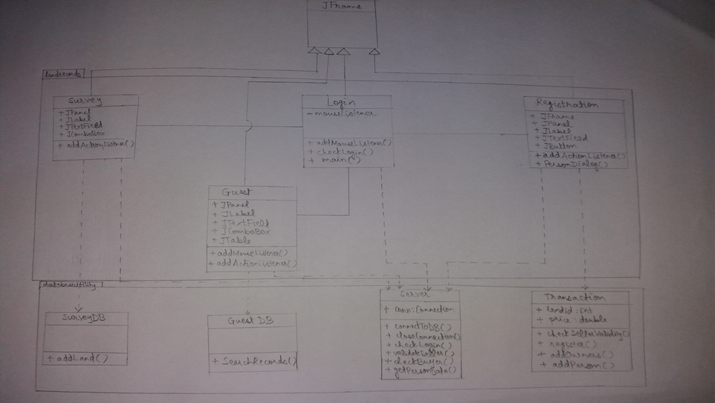
System High Level Design
Notes:
<number>

Slide 7
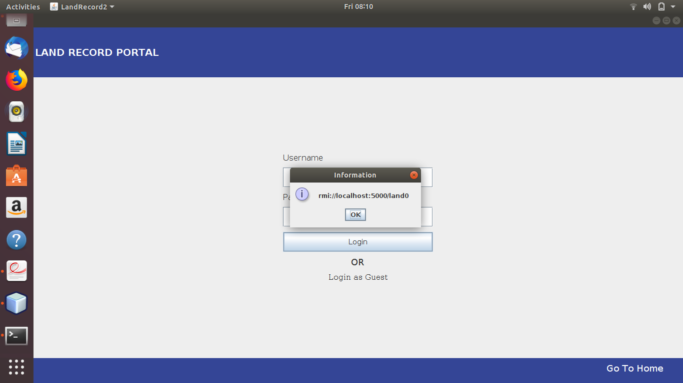
Results
Notes:
<number>

Slide 8
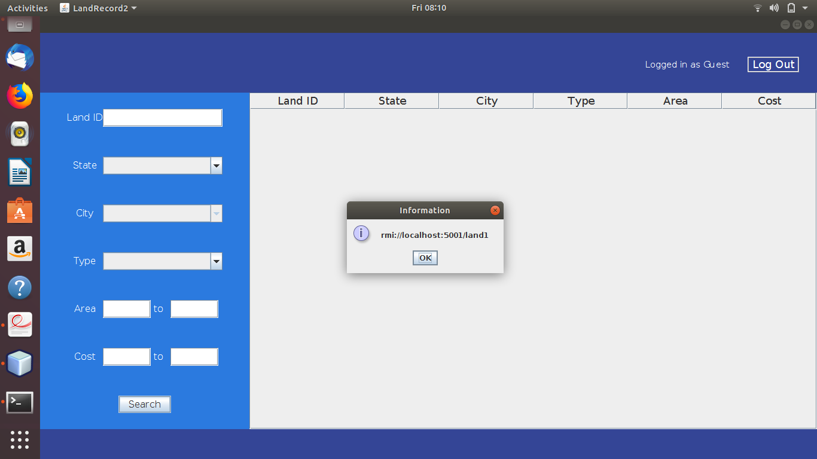
Notes:
<number>

Slide 9
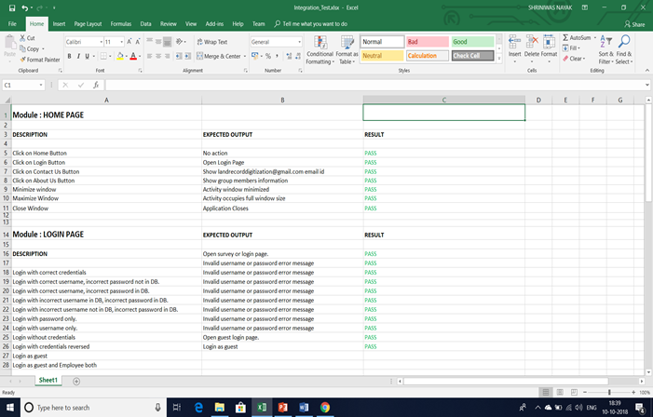
Testing of System
Notes:
<number>

Slide 10
References
[1]https://docs.oracle.com/javase/8/docs/technotes/guides/rmi/hello/hello-world.html (Date visited : 13/9/19 time : 15:30)
[2] https://docs.oracle.com/javase/tutorial/rmi/ (Date visited : 15/9/19 time : 15:30)
[3] “Distributed Systems Principles and Paradigms” by : AS Tanenbaum, Maarten Van Steen, 2nd Edition, Publication : Pearson, ISBN 0-13-239227-5
Notes:
<number>

Slide 11
Thank You !
Notes:
<number>

