Slide 1

PROJECT REVIEW
Hrushabh Hirudkar 4235
Anuj Kanetkar 4242
Shriniwas Nayak 4256
Internal Guide : Dr A S Ghotkar
External Guide : Mr Nikhil Malhotra
Maker’s Lab, Tech Mahindra

Slide 2
Domain : Machine Learning Sub-Domain – Natural Language Processing (Information Retrieval)

Slide 3
Problem Statement
Generating relevant questions for a query using natural language processing techniques

Slide 4
Keywords
Corpus similarity
String similarity
Information retrieval
Text classification
Semantic similarity

Slide 5
Objectives
To find relevant questions for a query
To generate questions for the query

Slide 6
Motivation
Lots of questions asked on Stack Overflow daily
Most voted answer is assigned a green tick, but no suggestions given
Relevant questions introduces inquisitiveness in the user
Going deeper into the relevant question chain enhances knowledge thoroughly

Slide 7
Approaches
Character-Based Similarity
It is a group of approaches which use character used in the sentences to determine the similarity between two sentences.
One of the most common example is Longest Common SubString(LCS).
It also consists of methods which help to find similarity based on the number of operations needed to convert one string to another.

Slide 8
Corpus-Based Similarity
Corpus-Based similarity is a semantic similarity measure that determines the similarity between words according to information gained from large corpora.
Some of the more known example are Hyperspace Analogue to Language (HAL), Latent Semantic Analysis (LSA).
Hyperspace Analogue to Language (HAL) creates a semantic space from word co-occurrences. A word-by-word matrix is formed with each matrix element is the strength of association between the word represented by the row and the word represented by the column.

Slide 9
Knowledge-Based Similarity
Knowledge-Based Similarity is one of semantic similarity measures that bases on identifying the degree of similarity between words using information derived from semantic networks.
Knowledge-Based Similarity is divided into two groups namely : measures of semantic similarity and measures of semantic relatedness.
Semantically similar concepts are deemed to be related on the basis of their likeness.
Semantic relatedness, on the other hand, is a more general notion of relatedness, not specifically tied to the shape or form of the concept.

Slide 10
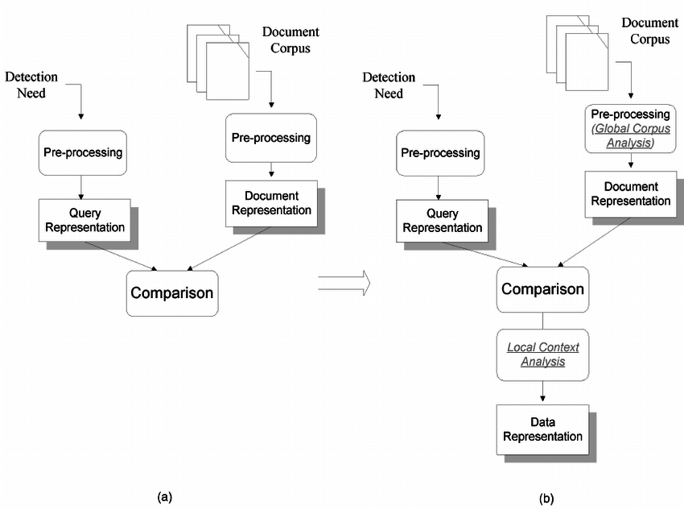
Architecture

Slide 11
Dataset Used
Stack Overflow dataset - BigQuery
https://www.kaggle.com/stackoverflow/stackoverflow

Slide 12
Literature Survey
Title | Description | Dataset used | Result
Unsupervised Sparse Vector Densification for Short Text Similarity - Song et al (2015) | Combining ESA and word2vec for better similarity measure for shorter text | 20 news group dataset for short text similarity | combining yielded better result than individual operations
Computing text similarity using Tree Edit Distance - Sidorov et al (2015) | TED for similarity between n-grams | Simple English Sentences | gives better accuracy as compared to Levenchstein’s SED
Robust semantic text similarity using LSA, machine learning, and linguistic resources - Kashyap et al (2015) | Term alignment algorithm implmentation | Simple paragraphs of literature essays | Best system for sentence-phrase, phrase-word similarity

Slide 13
Challenges
Vague question - inconsistent suggestions
Lack of precise definition of paraphrase
Discrepancy in traditional definition and loose definition of paraphrase
Lots of different metrics to measure similarity

Slide 14
References
Song Y., Roth D. (2015). “Unsupervised Sparse Vector Densification for Short Text Similarity”, Proceedings of the 2015 Conference of the North American Chapter of the Association for Computational Linguistics: Human Language Technologies. DOI:10.3115/v1/N15-1138
Sidorov et.al.(2015). “Computing text similarity using Tree Edit Distance”, 2015 Annual Conference of the North American Fuzzy Information Processing Society (NAFIPS) held jointly with 2015 5th World Conference on Soft Computing (WConSC). DOI: 10.1109/NAFIPS-WConSC.2015.7284129
Kashyap, A., Han, L., Yus, R. et al. Lang Resources & Evaluation (2016) 50: 125. https://doi.org/10.1007/s10579-015-9319-2
Schwarz C. (2019). lsemantica: “A command for text similarity based on latent semantic analysis”.
Gomaa W, Fahmi A. (2013). “A Survey of Text Similarity Approaches”, International Journal of Computer Applications (0975 –8887)Volume 68–No.13

