Slide 1
1
SUGGESTING RELEVANT QUESTIONS FOR A QUERY USING NATURAL LANGUAGE PROCESSING TECHNIQUES
Internal Guide : Dr. A.S. Ghotkar
(Associate Professor, Dept of CE, PICT)
External Guide : Mr. Nikhil Malhotra
(Global Head, Maker’s Lab, Tech Mahindra)
Hrushabh Hirudkar 71700888G
Anuj Kanetkar 71700929H
Shriniwas Nayak 71701044K
PICT, Department of Computer Engineering, 2019-20
17/04/2020

Slide 2
PROBLEM STATEMENT
1
We aim to solve the problem by suggesting similar questions to the query entered by the user. The generation of questions involves finding relevant questions from the existing database as well as generating new questions which are not present in the database.
PICT, Department of Computer Engineering, 2019-20
17/04/2020

Slide 3
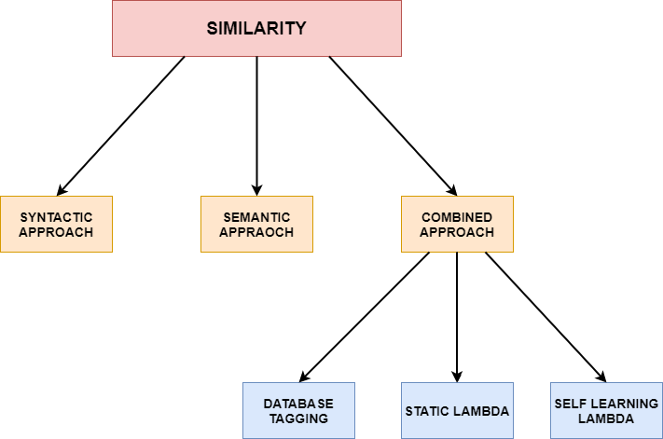
PROJECT HIERARCHY
1
PICT, Department of Computer Engineering, 2019-20
17/04/2020

Slide 4
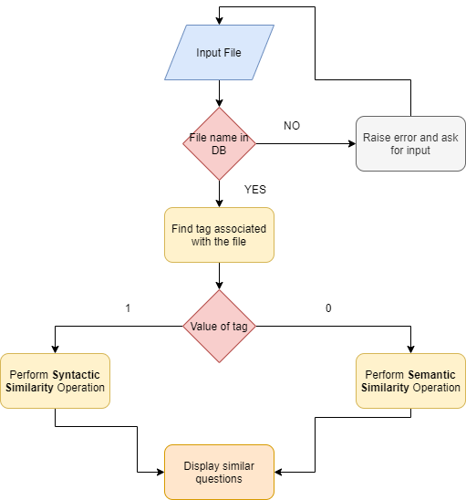
PRODUCT ARCHITECTURE
1
PICT, Department of Computer Engineering, 2019-20
17/04/2020

Slide 5
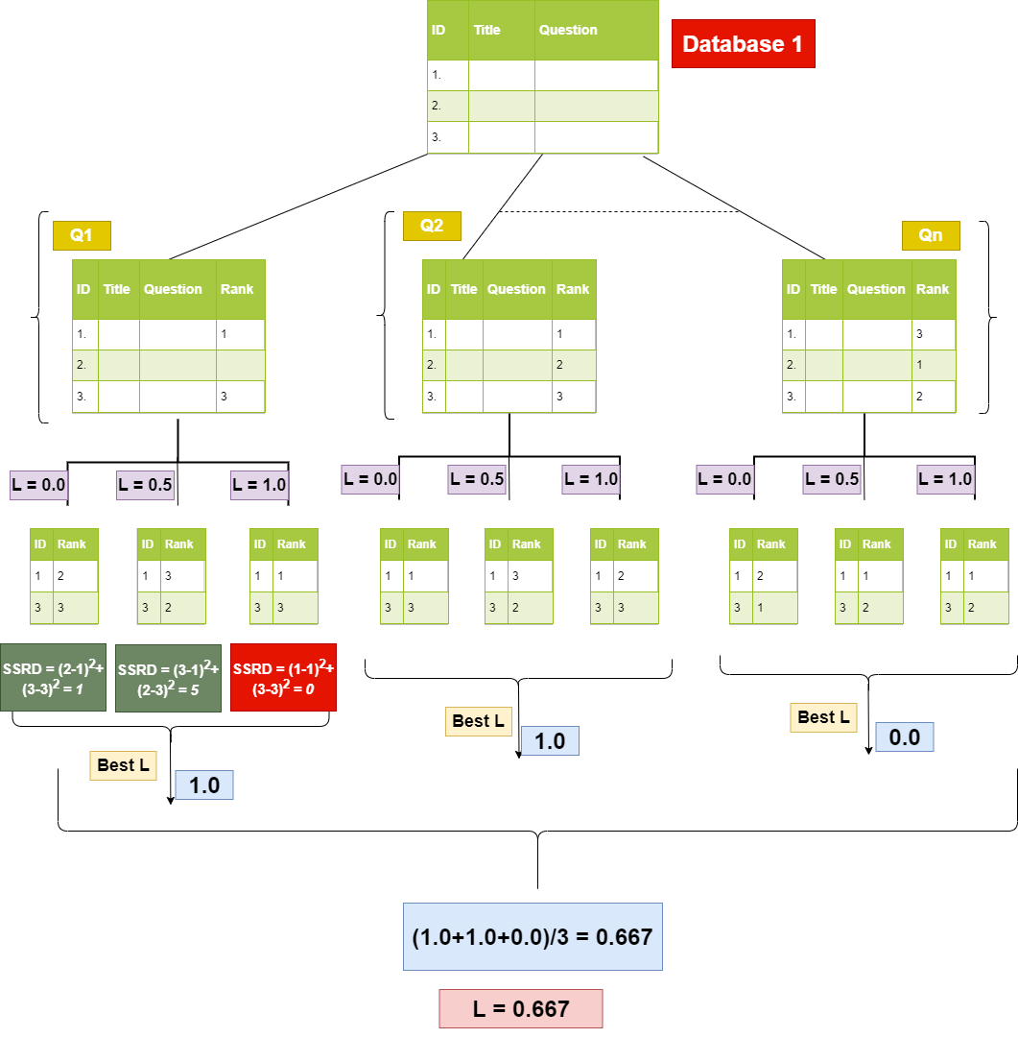
SELF LEARNING LAMBDA ARCHITECTURE
1
PICT, Department of Computer Engineering, 2019-20
17/04/2020

Slide 6

IMPLEMENTATION RESULTS
1
PICT, Department of Computer Engineering, 2019-20
17/04/2020

Slide 7
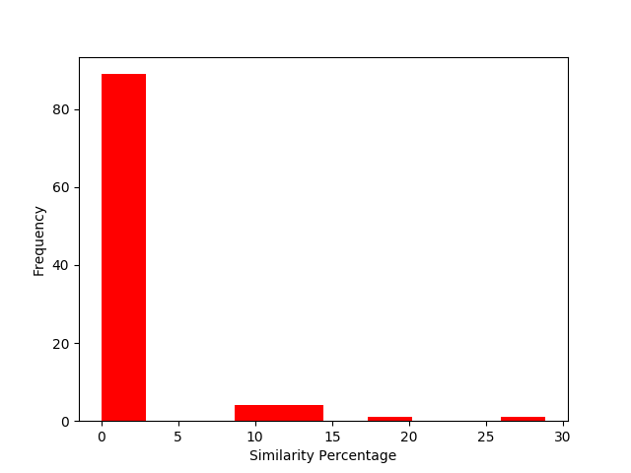
1
PICT, Department of Computer Engineering, 2019-20
17/04/2020

Slide 8
CONCLUSION AND FUTURE SCOPE
1
Syntactic similarity has good rejection capacity but fails to accept semantically similar sentences.
Semantic similarity is good at accepting similar sentences but bad at rejecting the dissimilar ones.
The future plan for the project can be summarized as follows:
Complete the UI implementation (20% work left)
Complete the Project report (30% work left)
PICT, Department of Computer Engineering, 2019-20
17/04/2020

Slide 9
REFERENCES
1
[1] Y. Song and D. Roth, “Unsupervised sparse vector densification for shorttext similarity,” inProceedings of the 2015 Conference of the North AmericanChapter of the Association for Computational Linguistics: Human LanguageTechnologies, pp. 1275–1280, 2015.
[2] G. Sidorov, H. G ́omez-Adorno, I. Markov, D. Pinto, and N. Loya, “Computingtext similarity using tree edit distance,” in2015 Annual Conference of theNorth American Fuzzy Information Processing Society (NAFIPS) held jointlywith 2015 5th World Conference on Soft Computing (WConSC), pp. 1–4,IEEE, 2015.
[3] C. Schwarz, “lsemantica: A command for text similarity based on latentsemantic analysis,”The Stata Journal, vol. 19, no. 1, pp. 129–142, 2019.
[4] R. Mihalcea, C. Corley, C. Strapparava,et al., “Corpus-based and knowledge-based measures of text semantic similarity,” inAaai, vol. 6, pp. 775–780, 2006.
[5] A. Kashyap, L. Han, R. Yus, J. Sleeman, T. Satyapanich, S. Gandhi, andT. Finin, “Robust semantic text similarity using lsa, machine learning, andlinguistic resources,”Language Resources and Evaluation, vol. 50, no. 1,pp. 125–161, 2016.
[6] A. Islam and D. Inkpen, “Semantic text similarity using corpus-based wordsimilarity and string similarity,”ACM Transactions on Knowledge Discoveryfrom Data (TKDD), vol. 2, no. 2, p. 10, 2008.
[7] W. H. Gomaa and A. A. Fahmy, “A survey of text similarity approaches,”International Journal of Computer Applications, vol. 68, no. 13, pp. 13–18,2013.
[8] X. Wan, “A novel document similarity measure based on earth mover’s dis-tance,”Information Sciences, vol. 177, no. 18, pp. 3718–3730, 2007.
[9] J. Mueller and A. Thyagarajan, “Siamese recurrent architectures for learningsentence similarity,” inThirtieth AAAI Conference on Artificial Intelligence,2016.
[10] A. M. Gliozzo, “Latent semantic analysis for application in a question answersystem,” Apr. 28 2015. US Patent 9,020,810.
PICT, Department of Computer Engineering, 2019-20
17/04/2020

Slide 10
<number>
THANK YOU!!
PICT, Department of Computer Engineering, 2019-20
17/04/2020

