Slide 1
Text Vectorization
Shriniwas Nayak
spnayak@usc.edu
MS CS
University of Southern California

Slide 2
Schedule & Housekeeping
PART 1: 10:00 – 10:55 -> Why Vector?, Use of Vectors, Setup, Count Vector
PART 2: 11:00 – 11:55 -> TF-IDF, Word2Vec
PART 3: 12:00 – 12:55 -> Doc2Vec, BERT Intro, Spacy, Application, QnA
Please Talk! I have PTSD XDD

Slide 3
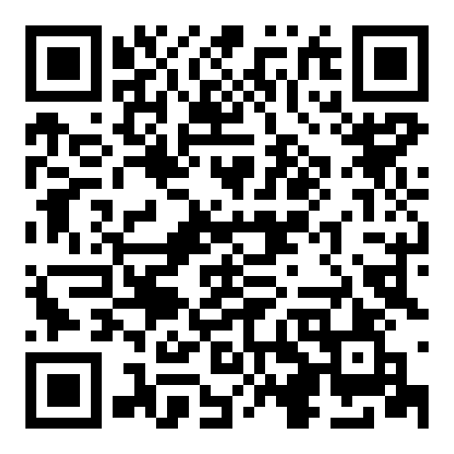
Git Repo QR Code

Slide 4
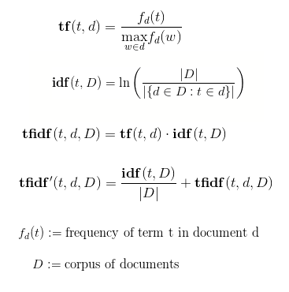
TF-IDF
Term Frequency – Frequency of a term in 1 document
Document Frequency – Frequency of documents with a particular term

Slide 5
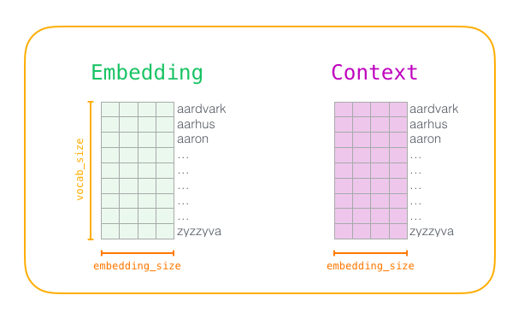
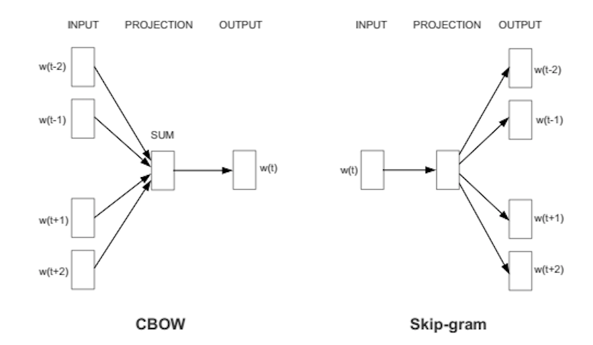
Word 2 Vec
Word Embedding
Skip Gram
Noise-contrastive estimation

Slide 6
References
TFIDF Medium Article
Word 2 Vec – Jay Alammar
BERT Embeddings
GloVe
Transformer Journey
Kaggle Dataset

Slide 7

Thank you All !!!
Shriniwas Nayak
spnayak@usc.edu
shriniwasnayak1@gmail.com

