Slide 1


Introduction
Amritsar Group of Colleges
NAAC - A grade, NBA accredited courses(2009-12, 2016-18), UGC Autonomous College
Streamlining Hostel Operation with efficient admin and student functionalities
Hostel Management System
Submitted To:- HOD CSE
Submitted By:- Shobit Arora (2131943)
Shrinu Shrey (2131944)
Vicky Kumar (2131969)
Vikrant (2131971)
2021 - 25

Slide 2
Introduction
The Hostel Management System is a web-based solution streamlining
hostel operations by automating
room allocations, leave approvals, and student records.
It ensures efficiency, data accuracy, and secure access, providing administrators with centralized control and students with convenient digital services.

Slide 3



Admin
Tutee
Set-Up
Objective
To develop a web-based application that simplifies hostel operation for administrators and students.
Access to Information
Simplified Leave Requests
Updates and Notification:
Reduce Manual Process
User-Friendly Interface
Scalability:
Centralized Management
Data Security:
Space Optim
Leave Request Handling

Slide 4
Admin
Tutee
Set-Up
User-Friendly Interface
Leave Management
Student Portal
Admin Dashboard
Centralized Management
Data Security
Space Optimization
Leave Request Handling
Access to Information
Simplified Leave Requests
Updates and Notification
Reduce Manual Process
User-Friendly Interface
Scalability
Responsive Design
Interactive Elements
Real-Time Updates
Leave Request
Approval Flow
Leave History
Notification
Secure Student Login
Personalize Dashboard
Stay Updates on Announcement
Centralize System
Easy Navigation
One Stop Solution

Slide 5
Feature
Set-Up
Admin
Tutee
Admin Dashboard
Student Portal
Leave Management
User-Friendly Interface
Reduce Manual Process
User-Friendly Interface
Scalability:
Access to Information
Simplified Leave Requests
Updates and Notification:
Centralize System
Easy Navigation
One Stop Solution
Secure Student Login
Personalize Dashboard
Stay Updates on Announcement
Leave Request
Approval Flow
Leave History
Notification
Responsive Design
Interactive Elements
Real-Time Updates
Centralized Management
Data Security:
Space Optim
Leave Request Handling

Slide 6
Tech Used
Frontend
40%
Backend
60%
HTML
CSS
JavaScript
AJAX
PHP
MySQL
XAMPP
API

Slide 7




Frontend
Structures the content and layout of the web pages
Styles and Visually enhances the application for user appeal
Adds interactivity and handles dynamic function on the site
Enables smooth data exchange with the
server without reloading pages

Slide 8





Backend
Manages server-side processing, user
input handling and system logic
Stores and organizes data i.e. Stu. Info , room allocation
Provides a local server environment for development and testing
Facilitates communication between frontend and backend

Slide 9

Problem
Statement
Manual processes for room
allocation and leave approvals
Difficult in managing large
volume of student records
Need for a centralized, accessible platform for both admins and student

Slide 10




Solution
Provides an integrated system
Easy student access
Simplifies Room Assignment
Optimize the Leave Tracking
Shift to manual to automation

Slide 11
Key Modules
Student Module
Leave Module
Admin Module
Room Management

Slide 12
Admin Module
Secure Login for administrator
Access to Records
Room Status
Leaves Request
Management
Authorization & Authentication

Slide 13
Key Modules
Student Module
Leave Module
Admin Module
Room Management

Slide 14
Student Module
View Room Allocation
Personal Info
Leave Status
Monitor the Updates

Slide 15
Key Modules
Student Module
Leave Module
Admin Module
Room Management

Slide 16
Room Management
Assign, Update & Track Room
Real-Time Room Status
History and Filters for Room
Complaint Tracking

Slide 17
Key Modules
Student Module
Leave Module
Admin Module
Room Management

Slide 18

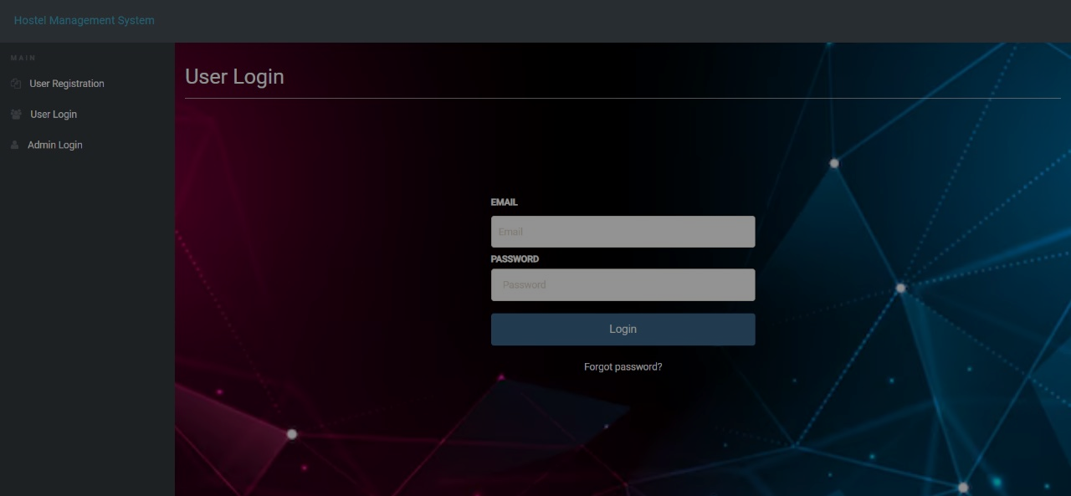
SnapShots
Leave Module
Accelerate the Leave Verification process
Leave Request with duration and reason
Three way Authentication
Admin can approve or reject
Notification & leave history

Slide 19
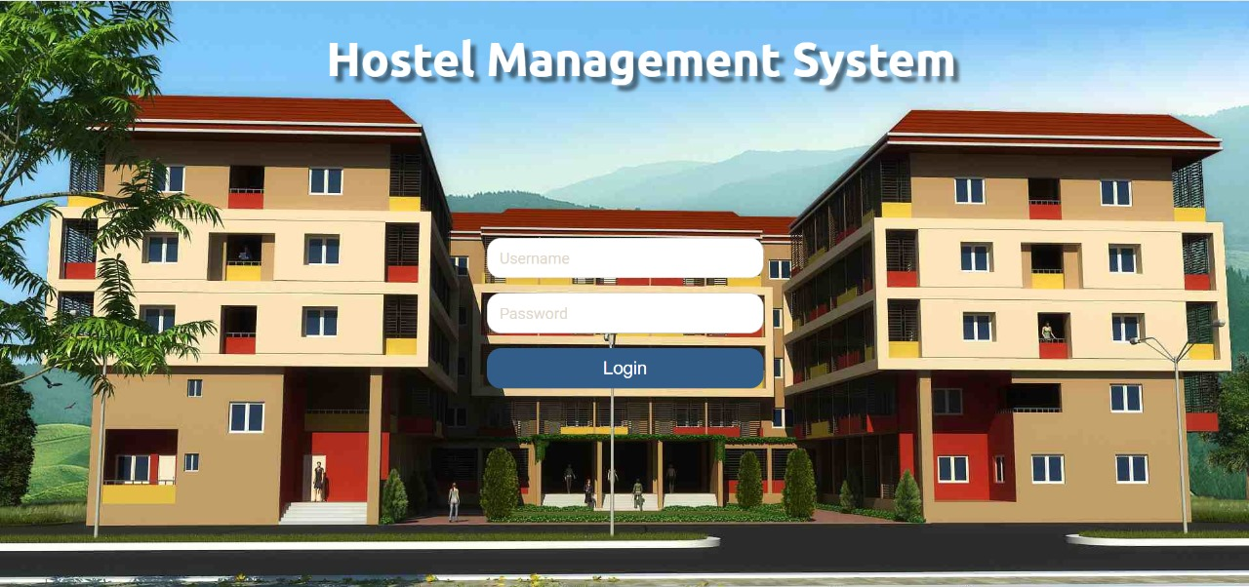
Leave Module
Accelerate the Leave Verification process
Leave Request with duration and reason
Three way Authentication
Admin can approve or reject
Notification & leave history
SnapShots
Admin Login

Slide 20
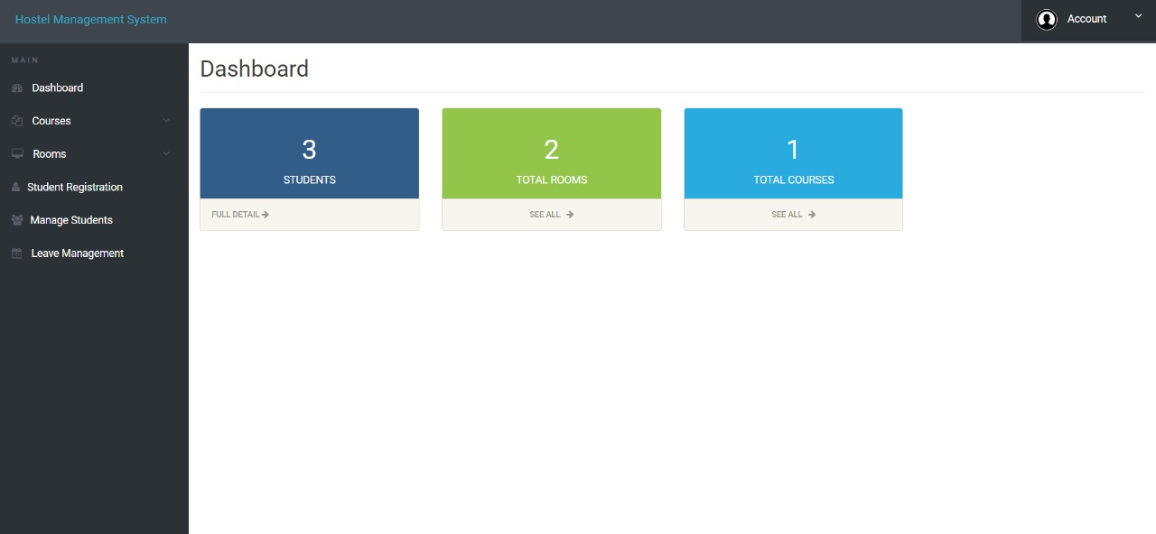
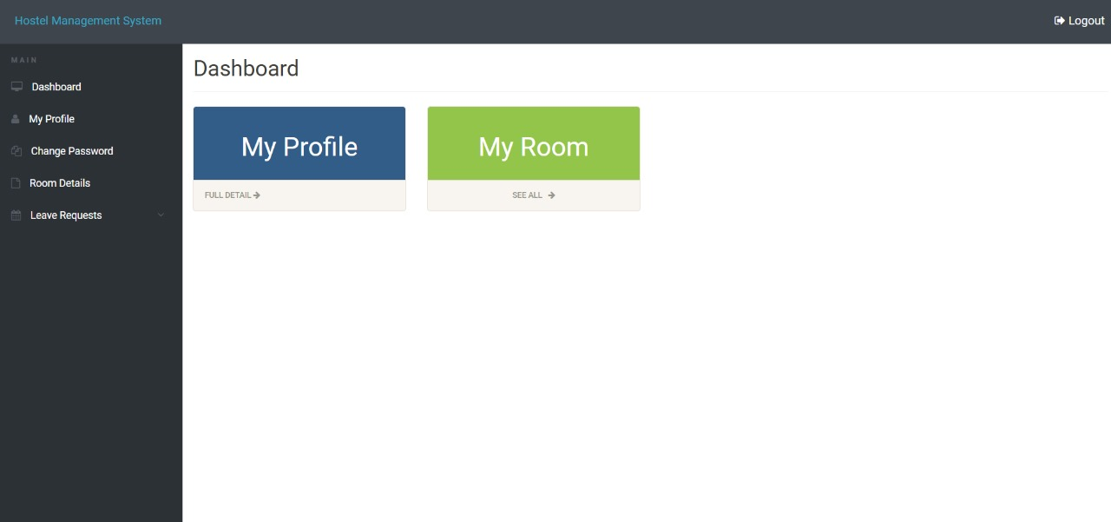
Admin Dashboard

Slide 21
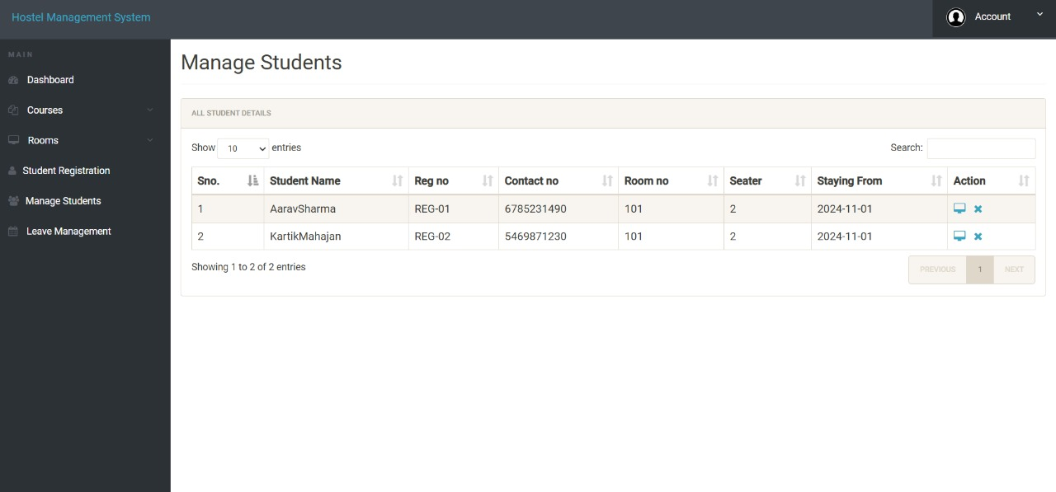
Leave Module
Accelerate the Leave Verification process
Leave Request with duration and reason
Three way Authentication
Admin can approve or reject
Notification & leave history
User Login

Slide 22
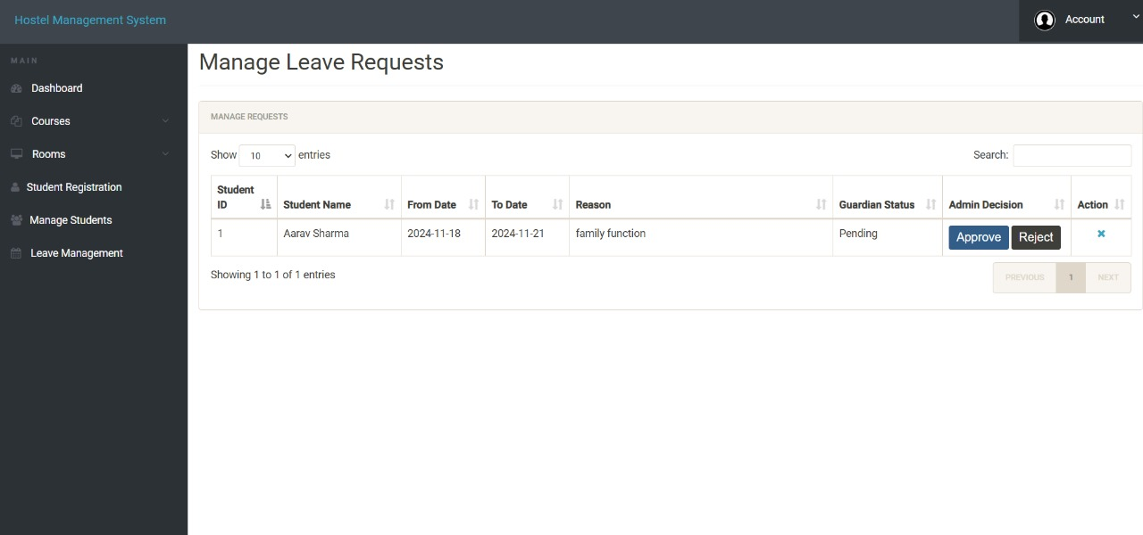
Leave Module
Accelerate the Leave Verification process
Leave Request with duration and reason
Three way Authentication
Admin can approve or reject
Notification & leave history
User Dashboard

Slide 23
Leave Module
Accelerate the Leave Verification process
Leave Request with duration and reason
Three way Authentication
Admin can approve or reject
Notification & leave history
Manage Students

Slide 24
Leave Module
Accelerate the Leave Verification process
Leave Request with duration and reason
Three way Authentication
Admin can approve or reject
Notification & leave history
Manage Leave Request

Slide 25
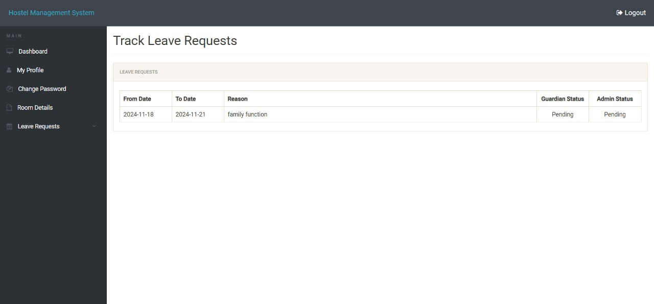
Leave Module
Accelerate the Leave Verification process
Leave Request with duration and reason
Three way Authentication
Admin can approve or reject
Notification & leave history
Track Leave Request

Slide 26
Conclusion
Streamline Hostel Administration
Enhance Student Access
Improve Data Accuracy
Real-Time Updates
Secure and Scalable Solution
Make Accountable to the
Authority

