Slide 1

DEATH!
Project 3: Group 4
Ahmed Abusamra
Shridhar Kamat
Cecilia Rosete
Irfan Senyurt
Nolan Tonthat
Vinayak Shankar
Image source: https://www.npr.org/2023/01/16/1149232763/

Slide 2
OBJECTIVE
Visualize top 10 causes of death by US State over time

Slide 3
Demo

Slide 4



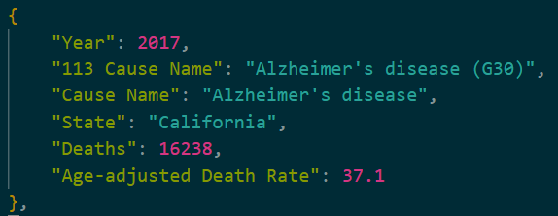

Data sources and database

Slide 5



7 Flask ROUTES
render_html
Data for visualizations
Bonus

Slide 6
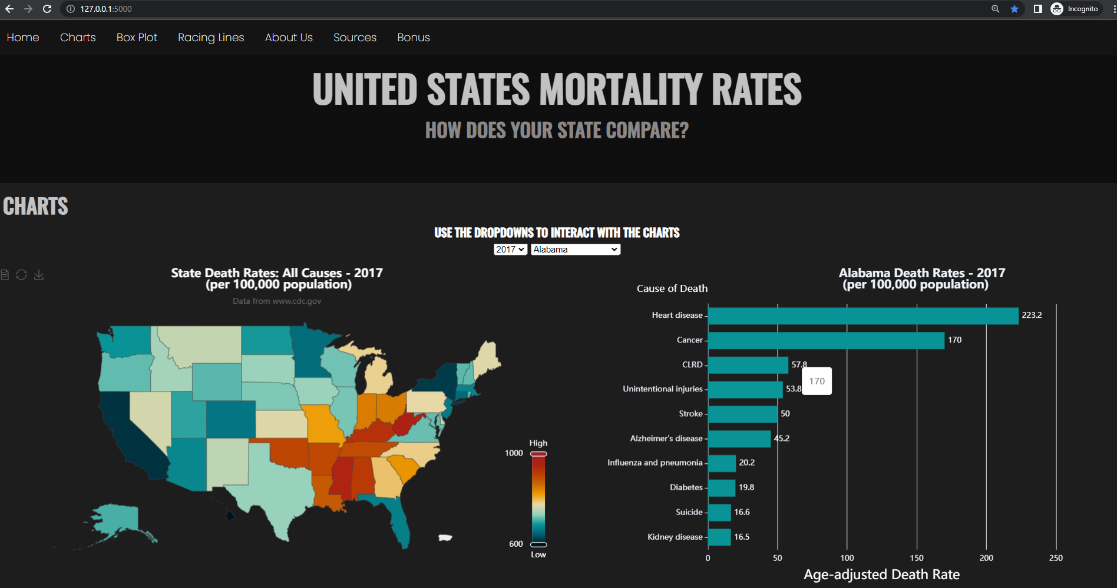
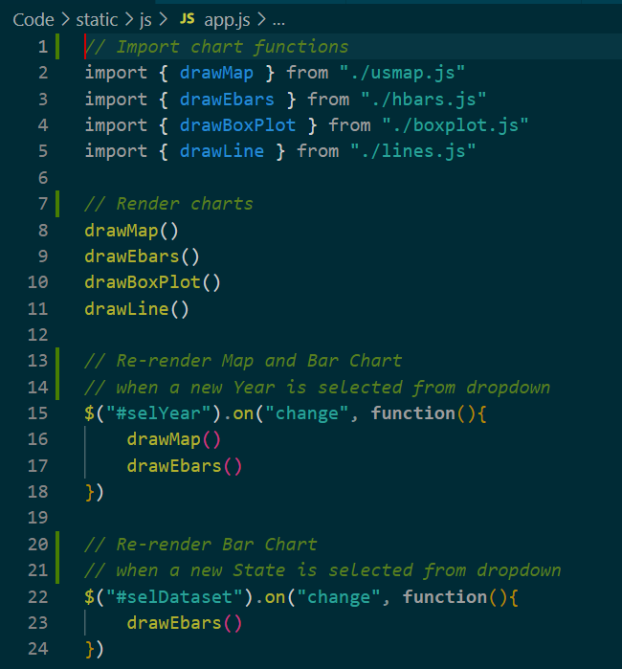
FRONT END

Slide 7
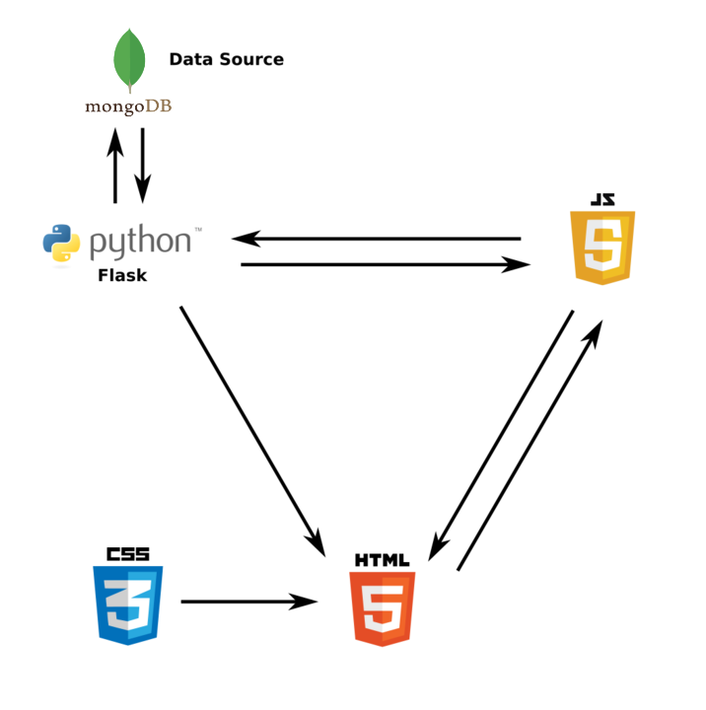
Architecture

Slide 8


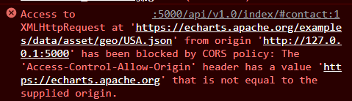

Challenges

Slide 9

Future steps

Slide 10
Bonus.js
(then Q&A)

