Slide 1

DEATH!
Project 3: Group 4
Ahmed Abusamra
Shridhar Kamat
Cecilia Rosete
Irfan Senyurt
Nolan Tonthat
Vinayak Shankar
Image source: https://www.npr.org/2023/01/16/1149232763/

Slide 2
Our topic
Top 10 Causes of Death by US State (1999-2017)

Slide 3
Demo

Slide 4
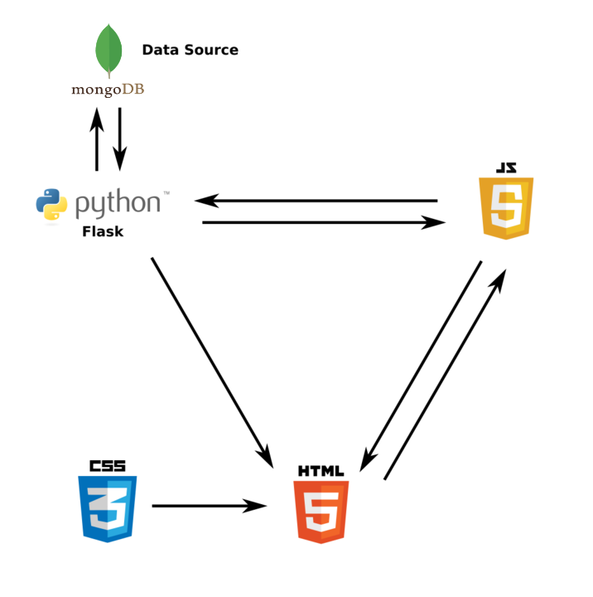
Architecture

Slide 5
HTML Sources
jQuery, ECharts, D3, Plotly

