Slide 1
DEATH!
Team Members

Slide 2
Tech Stack
Database: MongoDB
API: Python Flask
Front-end: HTML, CSS, JavaScript
Visuals: Leaflet, echarts

Slide 3
Demo

Slide 4
Intro – Our Data
10,000+ records
US Deaths
For each state
For each year 1999-2017
For each “Cause”

Slide 5
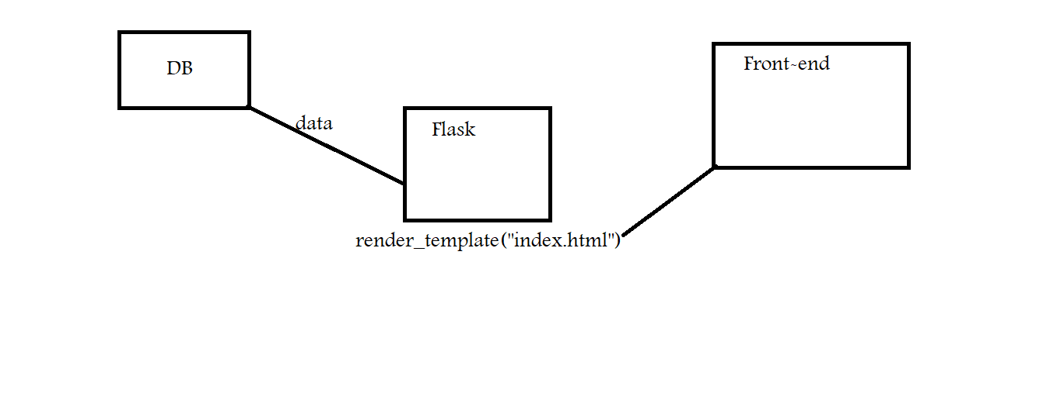
Architecture

