Slide 1

DEATH!
Project 3: Group 4
Ahmed Abusamra
Shridhar Kamat
Cecilia Rosete
Irfan Senyurt
Nolan Tonthat
Vinayak Shankar
Image source: https://www.npr.org/2023/01/16/1149232763/

Slide 2
OBJECTIVE
Visualize top 10 causes of death by US State over time

Slide 3
Demo

Slide 4
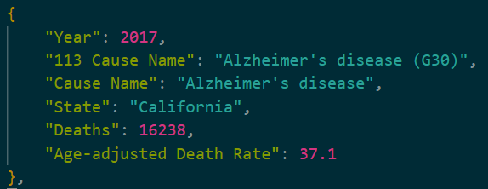
Data sources and database
CDC csv
JSON
MongoDB

Slide 5


Flask ROUTES
render_html
1 data route per visual
Bonus

Slide 6
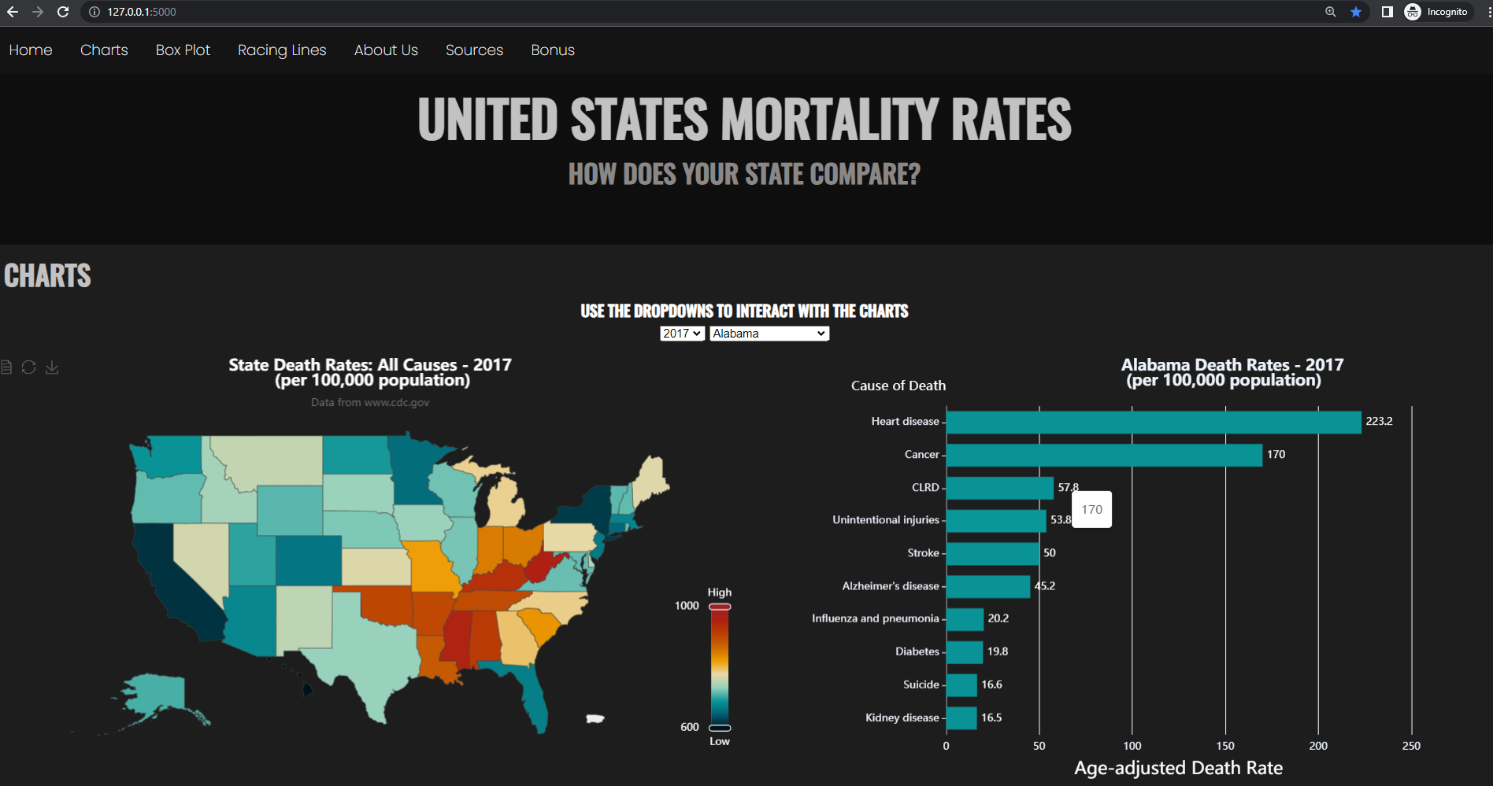
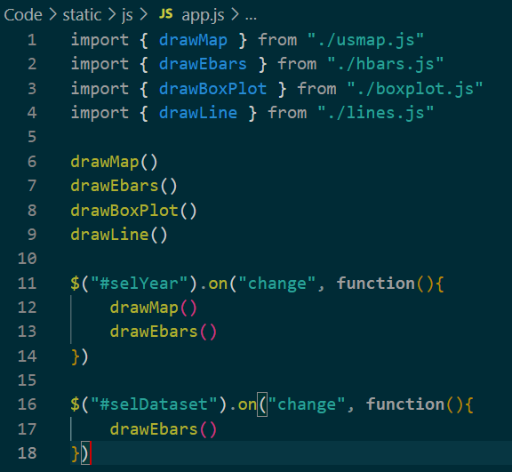
FRONT END

Slide 7
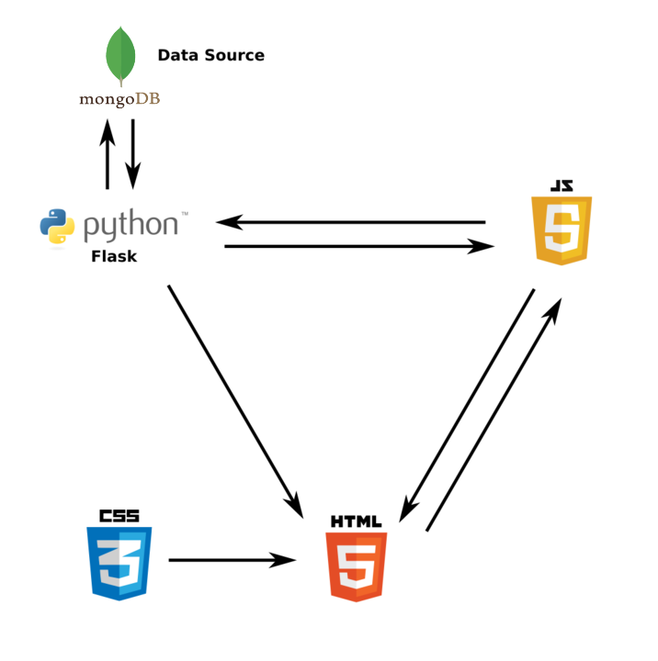
Architecture

Slide 8
Challenges
Transforming data to the format expected by ECharts
Understanding HTML, CSS, JS, Flask interaction

Slide 9
Future steps
Get data for 2018-2022 including effects of COVID-19

Slide 10
Bonus.js

