Slide 1
Enum

Slide 2
What is Enum
A Java Enum is a special Java type used to define collections of constants.
More precisely, a Java enum type is a special kind of Java class.
An enum can contain constants, methods etc. Java enums were added in Java 5.

Slide 3
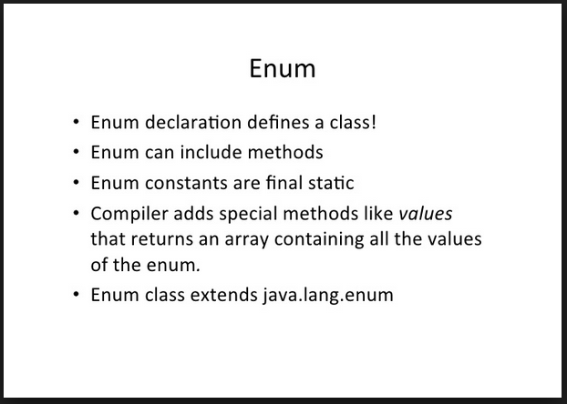

Slide 4
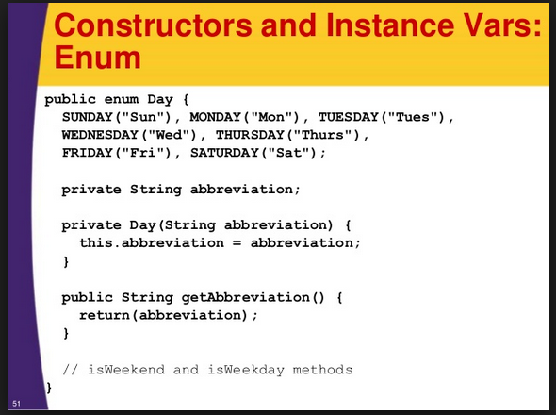

Slide 5
Enum Example
In the Java programming language, you define an enum type by using the enum keyword.
For example, you would specify a days-of-the-week enum type as:
public enum Day {
SUNDAY, MONDAY, TUESDAY, WEDNESDAY,
THURSDAY, FRIDAY, SATURDAY
}

Slide 6
Example
package com.polaris;
public class MonthEnum {
enum Month
{
January(31), February(28), March(31),April(30),
May(31),Jun(30), July(31),August(30), September(31),
October(31),November(30),December(31);
private int maxDays;
Month(int maxDays)
{
this.maxDays=maxDays;
}
} }

Slide 7
Testing Enum
public static void main(String[] args) {
Month m = Month.January;
System.out.println("m : " +m);
System.out.println("max days: " +m.maxDays);
}

Slide 8
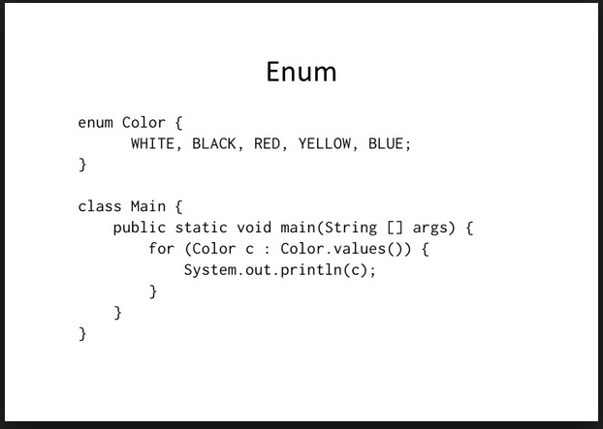
Looping Enum

Slide 9
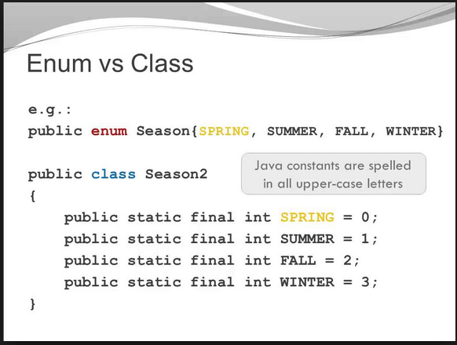
Enum Vs Class

Slide 10
What if we used static final in class?
1) No Type-Safety: First of all it’s not type-safe; you can assign any valid int value.
2) No Meaningful Printing: printing value of any of these constant will print its numeric value instead of meaningful name.
3) No namespace: to access the constant we need to prefix class name e.g. Season2.SPRING instead of just using SPRING though this can also be achieved by using static import in JDK 1.5

Slide 11
Benefits of Enums in Java
1) Enum is type-safe you can not assign anything else other than predefined Enum constants to an Enum variable. It is compiler error to assign something else unlike the public static final variables used in Enum int pattern and Enum String pattern.
2) Enum has its own name-space.
3) Best feature of Enum is you can use Enum in Java inside Switch statement like int or char primitive data type.we will also see example of using java enum in switch statement in this java enum tutorial.
4) Adding new constants on Enum in Java is easy and you can add new constants without breaking existing code.

Slide 12
Important points about Enum in Java
1) Enums in Java are type-safe and has there own name-space.
It means your enum will have a type for example "Currency" in below example and you can not assign any value other than specified in Enum Constants.
public enum Currency {PENNY, NICKLE, DIME, QUARTER};
Currency coin = Currency.PENNY;
coin = 1; //compilation error

Slide 13
Important points about Enum in Java
2) Enum in Java are reference type like class or interface and you can define constructor, methods and variables inside java Enum which makes it more powerful than Enum in C and C++ as shown in next example of Java Enum type.

Slide 14
Important points about Enum in Java
3) You can specify values of enum constants at the creation time as shown in below example:
public enum Currency {PENNY(1), NICKLE(5), DIME(10), QUARTER(25)};
But for this to work you need to define a member variable and a constructor because PENNY (1) is actually calling a constructor which accepts int value , see below example.
public enum Currency {
PENNY(1), NICKLE(5), DIME(10), QUARTER(25);
private int value;
private Currency(int value) {
this.value = value;
}
};

Slide 15
Important points about Enum in Java
Constructor of enum in java must be private any other access modifier will result in compilation error.
Now to get the value associated with each coin you can define a public getValue() method inside java enum like any normal java class.
You can not create instance of enums by using new operator in Java because constructor of Enum in Java can only be private and Enums constants can only be created inside Enums itself.
Instance of Enum in Java is created when any Enum constants are first called or referenced in code.

Slide 16
Important points about Enum in Java
4) Enum constants are implicitly static and final and can not be changed once created. For example below code of java enum will result in compilation error:
Currency.PENNY = Currency.DIME;
The final field EnumExamples.Currency.PENNY cannot be re assigned.

Slide 17
Important points about Enum in Java
5) Enum in java can be used as an argument on switch statment and with "case:" like int or char primitive type.
This feature of java enum makes them very useful for switch operations.

Slide 18
Important points about Enum in Java
6) Since constants defined inside Enum in Java are final you can safely compare them using "==" equality operator as shown in following example of Java Enum:
Currency usCoin = Currency.DIME;
if(usCoin == Currency.DIME){
System.out.println("enum in java can be compared using ==");
}

Slide 19
Important points about Enum in Java
7) Java compiler automatically generates static values() method for every enum in java.
Values() method returns array of Enum constants in the same order they have listed in Enum and you can use values() to iterate over values of Enum in Java as shown in below example:
for(Currency coin: Currency.values()){
System.out.println("coin: " + coin);
}

Slide 20
Important points about Enum in Java
8) Enum in Java can implement the interface and override any method like normal class It’s also worth noting that Enum in java implicitly implement both Serializable and Comparable interface.

