Slide 1
Operators in JAVA

Slide 2
Operator
An operator is a symbol that operates on one or more arguments to produce a result.
Java provides a rich set of operators to manipulate variables.

Slide 3
Operands
An operands are the values on which the operators act upon.
An operand can be:
A numeric variable - integer, floating point or character
Any primitive type variable - numeric and boolean
Reference variable to an object
A literal - numeric value, boolean value, or string.
An array element, "a[2]“
char primitive, which in numeric operations is treated as an unsigned two byte integer

Slide 4
Types of Operators
Assignment Operators
Increment Decrement Operators
Arithmetic Operators
Short Hand Operator
Bitwise Operators && Shift Operators
Relational Operators
Logical Operators
Ternary Operators
Comma Operators
Instanceof Operators

Slide 5
Assignment Operators
The assignment statements has the following syntax:
<variable> = <expression>

Slide 6
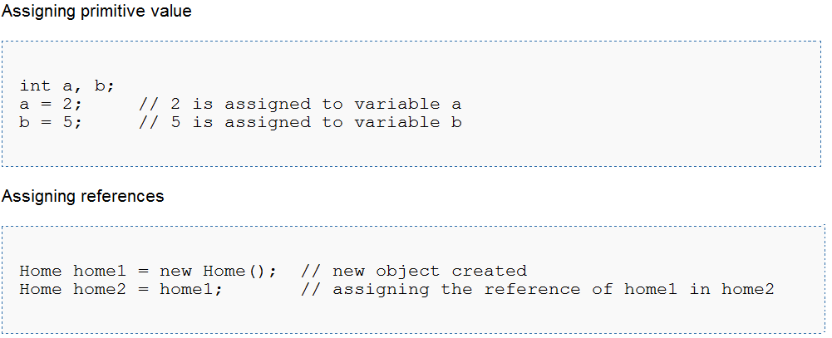
Assigning values Example

Slide 7
Increment and Decrement operators
++ and --
The increment and decrement operators add an integer variable by one.
increment operator:
two successive plus signs, ++
decrement operator: --

Slide 8
Increment and Decrement operators
++ and --
Common Shorthand
a = a + 1; a++; or ++a;
a = a - 1; a--; or --a;

Slide 9
Example of ++ and -- operators
public class Example
{
public static void main(String[] args)
{
}
}
int j, p, q, r, s;
j = 5;
p = ++j; // j = j + 1; p = j;
System.out.println("p = " + p);
q = j++; // q = j; j = j + 1;
System.out.println("q = " + q);
System.out.println("j = " + j);
r = --j; // j = j -1; r = j;
System.out.println("r = " + r);
s = j--; // s = j; j = j - 1;
System.out.println("s = " + s);
> java example
p = 6
q = 6
j = 7
r = 6
s = 6
>

Slide 10
Arithmetic Operators
The arithmetic operators are used to construct mathematical expressions as in algebra.
Their operands are of numeric type.

Slide 11
Arithmetic Operators
Operator | Result
+ | Addition
- | Subtraction (also unary minus)
* | Multiplication
/ | Division
% | Modulus
++ | Increment
+= | Addition assignment
-= | Subtraction assignment
*= | Multiplication assignment
/= | Division assignment
%= | Modulus assignment
-- | Decrement

Slide 12
Simple Arithmetic
public class Example {
public static void main(String[] args) {
int j, k, p, q, r, s, t;
j = 5;
k = 2;
p = j + k;
q = j - k;
r = j * k;
s = j / k;
t = j % k;
System.out.println("p = " + p);
System.out.println("q = " + q);
System.out.println("r = " + r);
System.out.println("s = " + s);
System.out.println("t = " + t);
}
}
> java Example
p = 7
q = 3
r = 10
s = 2
t = 1
>

Slide 13
Shorthand Operators
+=, -=, *=, /=, %=
Common Shorthand
a = a + b; a += b;
a = a - b; a -= b;
a = a * b; a *= b;
a = a / b; a /= b;
a = a % b; a %= b;

Slide 14
Shorthand Operators
public class Shorthand {
public static void main(String[] args) {
int j, p, q, r, s, t;
j = 5;
p = 1; q = 2; r = 3; s = 4; t = 5;
p += j;
q -= j;
r *= j;
s /= j;
t %= j;
System.out.println("p = " + p);
System.out.println("q = " + q);
System.out.println("r = " + r);
System.out.println("s = " + s);
System.out.println("t = " + t);
}
}
> java Example
p = 6
q = -3
r = 15
s = 0
t = 0
>

Slide 15
Bitwise Operators
Java's bitwise operators operate on individual bits of integer (int and long) values.
If an operand is shorter than an int, it is promoted to int before doing the operations.

Slide 16
Bitwise Operators
Operator | Name | Description
a & b | and | 1 if both bits are 1.
a | b | or | 1 if either bit is 1.
a ^ b | xor | 1 if both bits are different.
~a | not | Inverts the bits.
n << p | left shift | Shifts the bits of n left p positions. Zero bits are shifted into the low-order positions.
n >> p | right shift | Shifts the bits of n right p positions. If n is a 2's complement signed number, the sign bit is shifted into the high-order positions.
n >>> p | right shift | Shifts the bits of n right p positions. Zeros are shifted into the high-order positions.

Slide 17
Twos Complement Numbers
Base 10 A byte of binary
+127 01111111
+4 00000100
+3 00000011
+2 00000010
+1 00000001
+0 00000000
-1 11111111
-2 11111110
-3 11111101
-4 11111100
-128 10000000

Slide 18
Adding Twos Complements
Base 10 Binary
+3 00000011
-2 11111110
+1 00000001
Base 10 Binary
+2 00000010
-3 11111101
-1 11111111

Slide 19
Logical Operators (Bit Level)
& | ^ ~
int a = 10; // 00001010 = 10
int b = 12; // 00001100 = 12
a 00000000000000000000000000001010 10
b 00000000000000000000000000001100 12
a & b 00000000000000000000000000001000 8
&
AND
|
OR
a 00000000000000000000000000001010 10
b 00000000000000000000000000001100 12
a | b 00000000000000000000000000001110 14
^
XOR
a 00000000000000000000000000001010 10
b 00000000000000000000000000001100 12
a ^ b 00000000000000000000000000000110 6
~
NOT
a 00000000000000000000000000001010 10
~a 11111111111111111111111111110101 -11

Slide 20
Logical (bit) Operator Examples
public class Example {
public static void main(String[] args) {
int a = 10; // 00001010 = 10
int b = 12; // 00001100 = 12
int and, or, xor, na;
and = a & b; // 00001000 = 8
or = a | b; // 00001110 = 14
xor = a ^ b; // 00000110 = 6
na = ~a; // 11110101 = -11
System.out.println("and " + and);
System.out.println("or " + or);
System.out.println("xor " + xor);
System.out.println("na " + na);
}
}
> java Example
and 8
or 14
xor 6
na -11
>

Slide 21
Shift Operators (Bit Level)
<< >> >>>
Shift Left << Fill with Zeros
Shift Right >> Based on Sign
Shift Right >>> Fill with Zeros

Slide 22
Shift Operators << >>
int a = 3; // ...00000011 = 3
int b = -4; // ...11111100 = -4
a 00000000000000000000000000000011 3
a << 2 00000000000000000000000000001100 12
b 11111111111111111111111111111100 -4
b << 2 11111111111111111111111111110000 -16
<<
Left
a 00000000000000000000000000000011 3
a >> 2 00000000000000000000000000000000 0
b 11111111111111111111111111111100 -4
b >> 2 11111111111111111111111111111111 -1
>>
Right

Slide 23
Shift Operator >>>
int a = 3; // ...00000011 = 3
int b = -4; // ...11111100 = -4
a 00000000000000000000000000000011 3
a >>> 2 00000000000000000000000000000000 0
b 11111111111111111111111111111100 -4
b >>> 2 00111111111111111111111111111111 +big
>>>
Right 0

Slide 24
Shift Operator Examples
public class Example {
public static void main(String[] args) {
int a = 3; // ...00000011 = 3
int b = -4; // ...11111100 = -4
System.out.println("a<<2 = " + (a<<2));
System.out.println("b<<2 = " + (b<<2));
System.out.println("a>>2 = " + (a>>2));
System.out.println("b>>2 = " + (b>>2));
System.out.println("a>>>2 = " + (a>>>2));
System.out.println("b>>>2 = " + (b>>>2));
}
}
> java Example
a<<2 = 12
b<<2 = -16
a>>2 = 0
b>>2 = -1
a>>>2 = 0
b>>>2 = 1073741823
>

Slide 25
Shift Operator >>> and
Automatic Arithmetic Promotion
byte a = 3; // 00000011 = 3
byte b = -4; // 11111100 = -4
byte c;
c = (byte) a >>> 2
c = (byte) b >>> 2
a 00000011 3
a >>> 2 00000000000000000000000000000000 0
c = (byte) 00000000 0
b 11111100 -4
b >>> 2 00111111111111111111111111111111 1073741823
c = (byte) Much to big for byte 11111111 -1
>>>
Right
Fill 0

Slide 26
Relational Operators
A relational operator compares two values and determines the relationship between them.
For example, != returns true if its two operands are unequal.
Relational operators are used to test whether two values are equal, whether one value is greater than another, and so forth.

Slide 27
Relational Operators
Operator | Description
== | Checks if the value of two operands are equal or not, if yes then condition becomes true.
!= | Checks if the value of two operands are equal or not, if values are not equal then condition becomes true.
> | Checks if the value of left operand is greater than the value of right operand, if yes then condition becomes true.

Slide 28
Relational Operators
Operator | Description
< | Checks if the value of left operand is less than the value of right operand, if yes then condition becomes true.
>= | Checks if the value of left operand is greater than or equal to the value of right operand, if yes then condition becomes true.
<= | Checks if the value of left operand is less than or equal to the value of right operand, if yes then condition becomes true.

Slide 29
Example of Relational Operators
public LessThanExample
{
public static void main(String args[])
{
int a = 5; int b = 10;
if(a < b)
{
System.out.println("a is less than b");
}
}
}

Slide 30
Logical Operators
These logical operators work only on boolean operands. Their return values are always boolean.

Slide 31
Logical Operators
Operator | Description
&& | Called Logical AND operator. If both the operands are non zero then then condition becomes true.
|| | Called Logical OR Operator. If any of the two operands are non zero then then condition becomes true.
! | Called Logical NOT Operator. Use to reverses the logical state of its operand. If a condition is true then Logical NOT operator will make false.

Slide 32
Example of Logical Operators
public class ANDOperatorExample{
public static void main(String[] args){
char ans = 'y';
int count = 1;
if(ans == 'y' & count == 0){
System.out.println("Count is Zero.");}
if(ans == 'y' & count == 1) { System.out.println("Count is One."); }
if(ans == 'y' & count == 2) { System.out.println("Count is Two.");
} } }

Slide 33
Ternary Operators
Java has a short hand way by using ?: the ternary aka conditional operator for doing ifs that compute a value.
Unlike the if statement, the conditional operator is an expression which can be used for

Slide 34
Example of Ternary Operator
// longhand with if:
int answer;
if ( a > b )
{
answer = 1;
}
else
{
answer = -1;
}
// can be written more tersely with the ternary operator as: int answer = a > b ? 1 : -1;

Slide 35
Comma Operators
Java has an often look past feature within it’s for loop and this is the comma operator.
Usually when people think about commas in the java language they think of a way to split up arguments within a functions parameters

Slide 36
Example of Comma Operator
public class CommaOperator {
public static void main(String[] args) {
for(int i = 1, j = i + 10; i < 5;
i++, j = i * 2) {
System.out.println("i= " + i + " j= " + j);
}
}
}

Slide 37
Instanceof Operators
This operator is used only for object reference variables. The operator checks whether the object is of a particular type(class type or interface type).
InstanceOf operator is wriiten as:
( Object reference variable ) instanceOf (class/interface type)

Slide 38
Example of instanceof Operator
class Vehicle {} public class Car extends Vehicle { public static void main(String args[]) { Vehicle a = new Car(); boolean result = a instanceof Car; System.out.println( result); } }

Slide 39
Which Operators Operate On What
Operators
Floating Point
Integral
Logical
Any
Object
double
float
long
int
short
char
byte
boolean
Unary
+ - ++ --
Automatic
Promotion
Except ++ - -
Automatic
Promotion
Except ++ - -
Automatic
Promotion
Except ++ - -
+ - * / %
Automatic
Promotion
Except ++ - -
Automatic
Promotion
Except ++ - -
Automatic
Promotion
Except ++ - -
+ with
String
Only
> < >= <=
== !=
Reference
Only
Not Content
=
op= etc.
<< >> >>>
& | ^ ~
Automatic
Promotion
Automatic
Promotion
Automatic
Promotion
&& || !

Slide 40
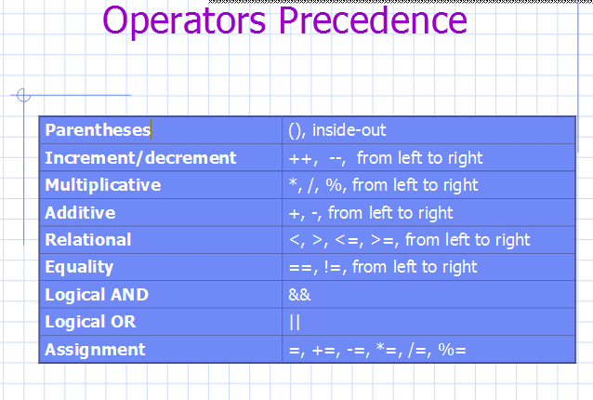

Slide 41
Order of Operations - Precedence
Precedence Level | Operator | Operation | Associates
1 | + - ++,-- | unary plus unary minus shortcut | R to L
2 | * / % | multiplication division modulus | L to R
3 | + - + | addition subtraction concatenation | L to R
4 | = +=,-=,... | assignment | R to L

Slide 42
A Change of Topic
Arithmetic
Operators
l
i
int
32 bit
long
64 bit
Casting

Slide 43
Moving Between Buckets
"Casting"
i = (int)l;
Narrowing
l = (long)i;
l = i;
Widening
l
l
long l;
int i;
i
i
long
64 bit
int
32 bit
long
64 bit
int
32 bit

Slide 44
The Primitive Numbers
Declaration Size and Type Number Range
byte b; // 8 bit integer -2⁻⁷ to +2⁺⁷-1
short s; // 16 bit integer -2⁻¹⁵ to +2⁺¹⁵-1
char c; // 16 bit Unicode 0 to +2⁺¹⁶
int i; // 32 bit integer -2⁻³¹ to +2⁺³¹-1
long l; // 64 bit integer -2⁻⁶³ to +2⁺⁶³-1
float f; // 32 bit floating point IEEE754 Standard
double d; // 64 bit floating point IEEE754 Standard

Slide 45
Casting the Primitives
c = (char)b;
c = (char)s;
c = (char)i;
c = (char)l;
c = (char)f;
c = (char)d;
c = (char)b;
c = (char)s;
c = (char)i;
c = (char)l;
c = (char)f;
c = (char)d;
Positive Only
Positive Only
b = (byte)s;
b = (byte)c;
b = (byte)i;
b = (byte)l;
b = (byte)f;
b = (byte)d;
b = (byte)s;
b = (byte)c;
b = (byte)i;
b = (byte)l;
b = (byte)f;
b = (byte)d;
s = (short)b;
s = (short)c;
s = (short)i;
s = (short)l;
s = (short)f;
s = (short)d;
s = b;
s = (short)c;
s = (short)i;
s = (short)l;
s = (short)f;
s = (short)d;
i = (int)b;
i = (int)s;
i = (int)c;
i = (int)l;
i = (int)f;
i = (int)d;
i = b;
i = s;
i = c;
i = (int)l;
i = (int)f;
i = (int)d;
l = (long)b;
l = (long)s;
l = (long)c;
l = (long)i;
l = (long)f;
l = (long)d;
l = b;
l = s;
l = c;
l = i;
l = (long)f;
l = (long)d;
2's Complement
2's Complement
f = (float)b;
f = (float)s;
f = (float)c;
f = (float)i;
f = (float)l;
f = (float)d;
f = b;
f = s;
f = c;
f = i;
f = l;
f = (float)d;
d = (double)b;
d = (double)s;
d = (double)c;
d = (double)i;
d = (double)l;
d = (double)f;
d = b;
d = s;
d = c;
d = i;
d = l;
d = f;
Floating Point
Floating Point

Slide 46
Acceptable Implicit Casts
char
16 bit
byte
8 bit
short
16 bit
int
32 bit
long
64 bit
float
32 bit
double
64 bit
Illegal
b = l;
l = f;
c = s;
OK
l = b;
i = c;
f = l

Slide 47
Automatic Promotion with Arithmetic
Arithmetic is never done
in 8 or 16 bit containers.
char
16 bit
char
16 bit
byte
8 bit
byte
8 bit
short
16 bit
short
16 bit
int
32 bit
int
32 bit
long
64 bit
long
64 bit
float
32 bit
float
32 bit
double
64 bit
double
64 bit
Illegal Casts
s = s + b;
s = s + s;
OK
s = (short)(s + b);
s = (short)(s + s);

Slide 48
Arithmetic Promotion with Mixed Primitives
Arithmetic is done
in the "widest" type.
char
16 bit
byte
8 bit
short
16 bit
int
32 bit
long
64 bit
float
32 bit
double
64 bit
Illegal Casts
i = i + l;
f = f + d;
l = l + f;
OK
i = (int)(i + l);
d = (double)(f + d);
l = (long)(l + f);

Slide 49
Implicit Casts in Method Calls
char
16 bit
byte
8 bit
short
16 bit
int
32 bit
long
64 bit
float
32 bit
double
64 bit
For: String st; and,
public int indexOf(int ch);
Illegal
i = st.indexOf(f);
OK
i = st.indexOf(c);
i = st.indexOf(b);

Slide 50
The End
….. Thank You …..

