Slide 1
Non-blocking I/O
Or
New I/O

Slide 2
NIO
Non-blocking I/O (usually called NIO, and sometimes called "New I/O") is a collection of Java programming language APIs that offer features for intensive I/O operations.
It was introduced with the J2SE 1.4 release of Java by Sun Microsystems to complement an existing standard I/O.
An extension to NIO that offers a new file system API, called NIO2, was released with Java SE 7 ("Dolphin").

Slide 3
public void readingFileWithoutNIO
{
BufferedReader br = null;
String sCurrentLine = null;
try
{
br = new BufferedReader(new FileReader("test.txt"));
while ((sCurrentLine = br.readLine()) != null)
{
System.out.println(sCurrentLine);
}
}
catch (IOException e)
{
e.printStackTrace();
}
finally
{
try
{
if (br != null)
br.close();
} catch (IOException ex)
{
ex.printStackTrace();
}
}
}
public void readFileWithFileSizeBuffer
{
try
{
RandomAccessFile aFile = new RandomAccessFile(
"test.txt","r");
FileChannel inChannel = aFile.getChannel();
long fileSize = inChannel.size();
ByteBuffer buffer = ByteBuffer.allocate((int) fileSize);
inChannel.read(buffer);
//buffer.rewind();
buffer.flip();
for (int i = 0; i < fileSize; i++)
{
System.out.print((char) buffer.get());
}
inChannel.close();
aFile.close();
}
catch (IOException exc)
{
System.out.println(exc);
System.exit(1);
}
}
}

Slide 4
Read a large file in chunks with fixed size buffer
public class ReadFileWithFixedSizeBuffer
{
public static void main(String[] args) throws IOException
{
RandomAccessFile aFile = new RandomAccessFile("test.txt", "r");
FileChannel inChannel = aFile.getChannel();
ByteBuffer buffer = ByteBuffer.allocate(1024);
while(inChannel.read(buffer) > 0)
{
buffer.flip();
for (int i = 0; i < buffer.limit(); i++)
{
System.out.print((char) buffer.get());
}
buffer.clear(); // do something with the data and clear/compact it.
}
inChannel.close();
aFile.close();
}
}

Slide 5
Faster file copy with mapped byte buffer
public class ReadFileWithMappedByteBuffer
{
public static void main(String[] args) throws IOException
{
RandomAccessFile aFile = new RandomAccessFile("test.txt", "r");
FileChannel inChannel = aFile.getChannel();
MappedByteBuffer buffer = inChannel.map(FileChannel.MapMode.READ_ONLY, 0, inChannel.size());
buffer.load();
for (int i = 0; i < buffer.limit(); i++)
{
System.out.print((char) buffer.get());
}
buffer.clear(); // do something with the data and clear/compact it.
inChannel.close();
aFile.close();
}
}

Slide 6
Java NIO: Channels and Buffers
In the standard IO API you work with byte streams and character streams.
In NIO you work with channels and buffers.
Data is always read from a channel into a buffer, or written from a buffer to a channel.

Slide 7
Java NIO: Non-blocking IO
Java NIO enables you to do non-blocking IO.
For instance, a thread can ask a channel to read data into a buffer.
While the channel reads data into the buffer, the thread can do something else.
Once data is read into the buffer, the thread can then continue processing it.
The same is true for writing data to channels.

Slide 8
Java NIO: Selectors
Java NIO contains the concept of "selectors".
A selector is an object that can monitor multiple channels for events (like: connection opened, data arrived etc.).
Thus, a single thread can monitor multiple channels for data.

Slide 9
NIO - core components:
Java NIO consist of the following core components:
Channels
Buffers
Selectors
Java NIO has more classes and components than these, but the Channel, Buffer and Selector forms the core of the API.
The rest of the components, like Pipe and FileLock are merely utility classes to be used in conjunction with the three core components.

Slide 10
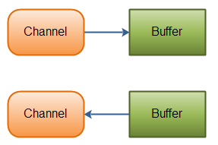
Channels and Buffers
Typically, all IO in NIO starts with a Channel.
A Channel is a bit like a stream. From the Channel data can be read into a Buffer.
Data can also be written from a Buffer into a Channel. Here is an illustration of that:
Java NIO: Channels read data into Buffers, and Buffers write data into Channels

Slide 11
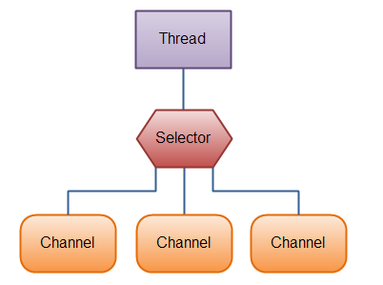
Selectors
A Selector allows a single thread to handle multiple Channel's.
This is handy if your application has many connections (Channels) open, but only has low traffic on each connection. For instance, in a chat server.
Here is an illustration of a thread using a Selector to handle 3 Channel's:
To use a Selector you register the Channel's with it.
Then you call it's select() method.
This method will block until there is an event ready for one of the registered channels.
Once the method returns, the thread can then process these events.
Examples of events are incoming connection, data received etc.
Java NIO: A Thread uses a Selector to handle 3 Channel's

Slide 12
Basic Channel Example
RandomAccessFile aFile = new RandomAccessFile("data/nio-data.txt", "rw");
FileChannel inChannel = aFile.getChannel();
ByteBuffer buf = ByteBuffer.allocate(48);
int bytesRead = inChannel.read(buf);
while (bytesRead != -1) {
System.out.println("Read " + bytesRead);
buf.flip();
while(buf.hasRemaining()){
System.out.print((char) buf.get());
}
buf.clear();
bytesRead = inChannel.read(buf);
}
aFile.close();

