Slide 1
Multithreaded Programming in Java

Slide 2
A single threaded program
class ABC
{
….
  public void main(..)
  {
  …
  ..
  }
}
begin
body
end

Slide 3
A Multithreaded Program
Main Thread
start
start
start
Thread A
Thread B
Thread C
Threads may switch or exchange data/results

Slide 4
What are Threads?
A piece of code that run in concurrent with other threads.
Each thread is a statically ordered sequence of instructions.
Threads are being extensively used express concurrency on both single and multiprocessors machines.

Slide 5
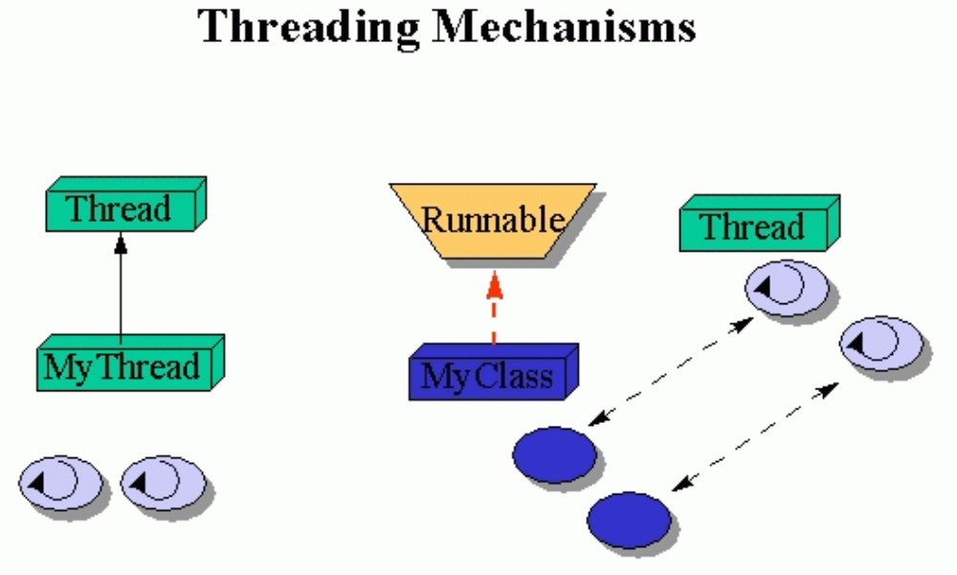
Threading Mechanisms...
Create a class that extends the Thread class
Create a class that implements the Runnable interface

Slide 6
1st method: Extending Thread class
Threads are implemented as objects that contains a method called run()
class MyThread extends Thread
{
public void run()
{
// thread body of execution
}
}
Create a thread:
MyThread thr1 = new MyThread();
Start Execution of threads:
thr1.start();

Slide 7
An example
class MyThread extends Thread { // the thread
public void run() {
System.out.println(" this thread is running ... ");
}
} // end class MyThread
class ThreadEx1 { // a program that utilizes the thread
public static void main(String [] args ) {
MyThread t = new MyThread();
// due to extending the Thread class (above)
// I can call start(), and this will call
// run().
//start() is a method in class Thread.
t.start();
} // end main()
} // end class ThreadEx1

Slide 8
2nd method: Threads by implementing Runnable interface
class MyThread implements Runnable
{
.....
public void run()
{
// thread body of execution
}
}
Creating Object:
MyThread myObject = new MyThread();
Creating Thread Object:
Thread thr1 = new Thread( myObject );
Start Execution:
thr1.start();

Slide 9
An example
class MyThread implements Runnable {
public void run() {
System.out.println(" this thread is running ... ");
}
} // end class MyThread
class ThreadEx2 {
public static void main(String [] args ) {
Thread t = new Thread(new MyThread());
// due to implementing the Runnable interface
// I can call start(), and this will call run().
t.start();
} // end main()
} // end class ThreadEx2

Slide 10
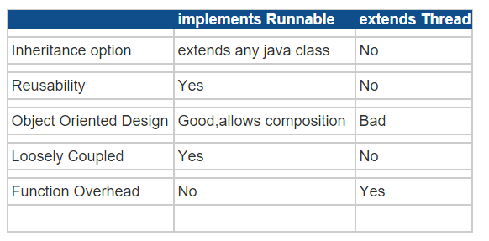

Slide 11
Life Cycle of Thread
new
wait()
sleep()
suspend()
blocked
start()
runnable
non-runnable
notify()
resume()
unblocked
stop()
dead

Slide 12
Thread Class API

Slide 13
run()
  If this thread was constructed using a separate Runnable run object, then that Runnable object's run method is called;
  otherwise, this method does nothing and returns.
start()
  Causes this thread to begin execution; the Java Virtual Machine calls the run method of this thread.
setName(String name)
  Changes the name of this thread to be equal to the argument name.
getId()
  Returns the identifier of this Thread.
getName()
  Returns this thread's name.

Slide 14
getPriority()
  Returns this thread's priority.
setPriority(int newPriority)
  Changes the priority of this thread.
getState()
  Returns the state of this thread.
Ex: NEW, RUNNABLE, TERMINATED
isAlive()
  Tests if this thread is alive.
isDaemon()
  Tests if this thread is a daemon thread.
setDaemon(boolean on)
  Marks this thread as either a daemon thread or a user thread.

Slide 15
join()
Waits for this thread to die.
join(long millis)
Waits at most millis milliseconds for this thread to die.
join(long millis, int nanos)
Waits at most millis milliseconds plus nanos nanoseconds for this thread to die.
sleep(long millis)
Causes the currently executing thread to sleep (temporarily cease execution) for the specified number of milliseconds, subject to the precision and accuracy of system timers and schedulers.
sleep(long millis, int nanos)
Causes the currently executing thread to sleep (temporarily cease execution) for the specified number of milliseconds plus the specified number of nanoseconds, subject to the precision and accuracy of system timers and schedulers.

Slide 16
currentThread()
Returns a reference to the currently executing thread object.
Destroy() && resume()
Deprecated.
This method was originally designed to destroy this thread without any cleanup.
This method was never implemented.
If it were to be implemented, it would be deadlock-prone in much the manner of suspend(). If the target thread held a lock protecting a critical system resource when it was destroyed, no thread could ever access this resource again.
If another thread ever attempted to lock this resource, deadlock would result.
Such deadlocks typically manifest themselves as "frozen" processes.

Slide 17
Shared Resources
If one thread tries to read the data and other thread tries to update the same date, it leads to inconsistent state.
This can be prevented by synchronising access to data.
In Java: “Synchronized” method:
  syncronised void update()
  {
    …
  }

Slide 18
Threads sharing the same object
class InternetBankingSystem {
public static void main(String [] args ) {
Account accountObject = new Account ();
Thread t1 = new Thread(new DepositThread(accountObject));
Thread t2 = new Thread(new WithdrawThread(accountObject));
Thread t3 = new Thread(new EnquiryThread(accountObject));
t1.start();
t2.start();
t3.start();
// DO some other operation
} // end main()
}

Slide 19
Program with 3 threads and shared object
class DepositThread implements Runnable {
Account account;
public DepositThread (Account s) { account = s;}
public void run() { account.deposit(); }
} // end class DepositThread
class WithdrawThread implements Runnable {
Account account;
public WithdrawThread (Account s) { account = s; }
public void run() { account.withdraw(); }
} // end class WithdrawThread
class EnquiryThread implements Runnable {
Account account;
public EnquiryThread (Account s) { account = s; }
public void run() {account.enquire(); }
} // end class EnquiryThread
account

Slide 20
Monitor (shared object) example
class Account { // the 'monitor'
// DATA Members
int balance;
// if 'synchronized' is removed, the outcome is unpredictable
public synchronized void deposit( ) {
// METHOD BODY : balance += deposit_amount;
}
public synchronized void withdraw( ) {
// METHOD BODY: balance -= deposit_amount;
}
public synchronized void enquire( ) {
// METHOD BODY: display balance.
}
}

Slide 21
Thread Priority
In Java, each thread is assigned priority, which affects the order in which it is scheduled for running. The threads so far had same default priority (ORM_PRIORITY) and they are served using FCFS policy.
  Java allows users to change priority:
    ThreadName.setPriority(intNumber)
      MIN_PRIORITY = 1
      NORM_PRIORITY=5
      MAX_PRIORITY=10

