Slide 1
The String Class

Slide 2
Objectives:
Learn about literal strings
Learn about String constructors
Learn about commonly used methods
Understand immutability of strings
Learn to format numbers into strings

Slide 3
String class facts
An object of the String class represents a string of characters.
The String class belongs to the java.lang package, which does not require an import statement.
Like other classes, String has constructors and methods.
Unlike other classes, String has two operators, + and += (used for concatenation).

Slide 4
Literal Strings
are anonymous objects of the String class
are defined by enclosing text in double quotes. “Hello World”
don’t have to be constructed.
  “Hello World”;
can be assigned to String variables.
  String s = “Hello World”;

Slide 5
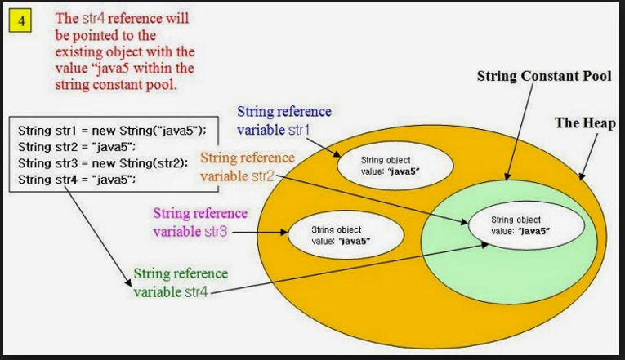

Slide 6
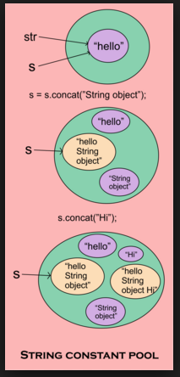

Slide 7
Literal Strings
can be passed to methods and constructors as parameters.
  add(“Hello”, “ World “)
have methods you can call.
  “Hello”.charAt(0)

Slide 8
Literal String examples
//assign a literal to a String variable
String name = “Polaris”;
//calling a method on a literal String
char firstChar = “Polaris”.charAt(0);
//calling a method on a String variable
char firstChar = name.charAt(0);

Slide 9
Immutability
Once created, a string cannot be changed: none of its methods changes the string.
Such objects are called immutable.
Immutable objects are convenient because several references can point to the same object safely: there is no danger of changing an object through one reference without the others being aware of the change.

Slide 10
Advantages Of Immutability
Uses less memory.
String word1 = "Java";
String word2 = word1;
String word1 = “Java";
String word2 = new String(word1);
word1
word1
“Java"
“Java"
word2
“Java"
word2
Less efficient: wastes memory
OK

Slide 11

Disadvantages of Immutability
Less efficient — you need to create a new string and throw away the old one even for small changes.
String word = “Java";
word = word + “Tech”;
word
“Java"
“Java Tech"

Slide 12
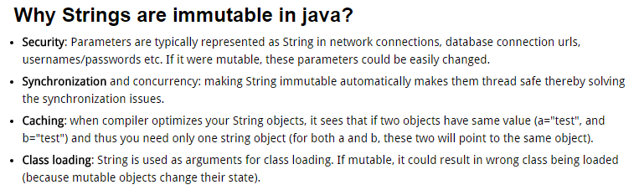

Slide 13
Empty Strings
An empty String has no characters. It’s length is 0.
Not the same as an uninitialized String.
String word1 = "";
String word2 = new String();
Empty strings
private String errorMsg;
errorMsg is null

Slide 14
No Argument Constructors
No-argument constructor creates an empty String. Rarely used.
A more common approach is to reassign the variable to an empty literal String. (Often done to reinitialize a variable used to store input.)
String empty = new String();
String empty = “”;//nothing between quotes

Slide 15
Copy Constructors
Copy constructor creates a copy of an existing String. Also rarely used.
Not the same as an assignment.
Copy Constructor: Each variable points to a different copy of the String.
String word = new String(“Java”);
String word2 = new String(word);
word
“Java"
word2
“Java"
Assignment: Both variables point to the same String.
String word = “Java”;
String word2 = word;
word
“Java"
word2

Slide 16
Other Constructors
Most other constructors take an array as a parameter to create a String.
char[] letters = {‘J’, ‘a’, ‘v’, ‘a’};
String word = new String(letters);//”Java”

Slide 17
Methods — length, charAt
int length();
char charAt(i);
Returns the number of characters in the string
Returns the char at position i.
Character positions in strings are numbered starting from 0 – just like arrays.
Returns:
”Problem".length();
”Window".charAt (2);
7
’n'

Slide 18
Methods — substring
Returns a new String by copying characters from an existing String.
String subs = word.substring (i, k);
  returns the substring of chars in positions from i to k-1
String subs = word.substring (i);
  returns the substring from the i-th char to the end
television
i k
television
i
Returns:
”television".substring (2,5);
“immutable".substring (2);
“bob".substring (9);
“lev"
“mutable"
"" (empty string)

Slide 19
Methods — Concatenation
String word1 = “re”, word2 = “think”; word3 = “ing”;
int num = 2;
String result = word1 + word2;
  //concatenates word1 and word2 “rethink“
String result = word1.concat (word2);
  //the same as word1 + word2 “rethink“
result += word3;
  //concatenates word3 to result “rethinking”
result += num; //converts num to String
//and concatenates it to result “rethinking2”

Slide 20
Methods — Find (indexOf)
0 2 6 10 15
String name =“President George Washington";
name.indexOf (‘P'); 0
name.indexOf (‘e'); 2
name.indexOf (“George"); 10
name.indexOf (‘e', 3); 6
name.indexOf (“Bob"); -1
name.lastIndexOf (‘e'); 15
Returns:
(starts searching at position 3)
(not found)
Notes:
String has four overloaded versions of indexOf and four versions of lastIndexOf.
lastIndexOf(ch, fromPos) starts looking at fromPos and goes backward towards the beginning of the string.

Slide 21
Methods — Equality
boolean b = word1.equals(word2);
  returns true if the string word1 is equal to word2
boolean b = word1.equalsIgnoreCase(word2);
  returns true if the string word1 matches word2, case-blind
b = “Hello”.equals(“Hello”);//true
b = “Hello”.equals(“hello”);//false
b = “Hello”.equalsIgnoreCase(“hello”);//true
Notes:
You cannot use relational operators for comparing the contents of strings.
word1.compareTo(word2) returns an int. Basically if word1 is “smaller” than word2, the result is negative, and if word1 is “larger” the result is positive. compareTo returns 0 whenever equals returns true.
Here is how Java docs describe compareTo:
Compares two strings lexicographically. The comparison is based on the Unicode value of each character in the strings. The character sequence represented by this String object is compared lexicographically to the character sequence represented by the argument string. The result is a negative integer if this String object lexicographically precedes the argument string. The result is a positive integer if this String object lexicographically follows the argument string. The result is zero if the strings are equal; compareTo returns 0 exactly when the equals(Object) method would return true.
This is the definition of lexicographic ordering. If two strings are different, then either they have different characters at some index that is a valid index for both strings, or their lengths are different, or both. If they have different characters at one or more index positions, let k be the smallest such index; then the string whose character at position k has the smaller value, as determined by using the < operator, lexicographically precedes the other string. In this case, compareTo returns the difference of the two character values at position k in the two string — that is, the value:
this.charAt(k)-anotherString.charAt(k)
If there is no index position at which they differ, then the shorter string lexicographically precedes the longer string. In this case, compareTo returns the difference of the lengths of the strings — that is, the value:
this.length()-anotherString.length()

Slide 22
Methods — Comparisons
int diff = word1.compareTo(word2);
  returns the “difference” word1 - word2
int diff = word1.compareToIgnoreCase(word2);
  returns the “difference” word1 - word2,
  case-blind
Usually programmers don’t care what the numerical “difference” of word1 - word2 is, just whether the difference is negative (word1 comes before word2), zero (word1 and word2 are equal) or positive (word1 comes after word2). Often used in conditional statements.
if(word1.compareTo(word2) > 0){
//word1 comes after word2…
}
Notes:
You cannot use relational operators for comparing the contents of strings.
word1.compareTo(word2) returns an int. Basically if word1 is “smaller” than word2, the result is negative, and if word1 is “larger” the result is positive. compareTo returns 0 whenever equals returns true.
Here is how Java docs describe compareTo:
Compares two strings lexicographically. The comparison is based on the Unicode value of each character in the strings. The character sequence represented by this String object is compared lexicographically to the character sequence represented by the argument string. The result is a negative integer if this String object lexicographically precedes the argument string. The result is a positive integer if this String object lexicographically follows the argument string. The result is zero if the strings are equal; compareTo returns 0 exactly when the equals(Object) method would return true.
This is the definition of lexicographic ordering. If two strings are different, then either they have different characters at some index that is a valid index for both strings, or their lengths are different, or both. If they have different characters at one or more index positions, let k be the smallest such index; then the string whose character at position k has the smaller value, as determined by using the < operator, lexicographically precedes the other string. In this case, compareTo returns the difference of the two character values at position k in the two string — that is, the value:
this.charAt(k)-anotherString.charAt(k)
If there is no index position at which they differ, then the shorter string lexicographically precedes the longer string. In this case, compareTo returns the difference of the lengths of the strings — that is, the value:
this.length()-anotherString.length()

Slide 23
Comparison Examples
//negative differences
diff = “apple”.compareTo(“berry”);//a before b
diff = “Zebra”.compareTo(“apple”);//Z before a
diff = “dig”.compareTo(“dug”);//i before u
diff = “dig”.compareTo(“digs”);//dig is shorter
//zero differences
diff = “apple”.compareTo(“apple”);//equal
diff = “dig”.compareToIgnoreCase(“DIG”);//equal
//positive differences
diff = “berry”.compareTo(“apple”);//b after a
diff = “apple”.compareTo(“Apple”);//a after A
diff = “BIT”.compareTo(“BIG”);//T after G
diff = “huge”.compareTo(“hug”);//huge is longer

Slide 24
Methods — trim
String word2 = word1.trim ();
  returns a new string formed from word1 by removing white space at both ends
  does not affect whites space in the middle
String word1 = “ Hello “;
String word2 = word1.trim();
//word2 is “Hello” – no spaces on either end
//word1 is still “ Hello “ – with spaces
Notes:
Note that these methods do not change the string word1 but create and return a new string.
trim() only removes whitespace at the ends of the string, not in the middle.

Slide 25
Methods — replace
String word2 = word1.replace(oldCh, newCh);
  returns a new string formed from word1 by replacing all occurrences of oldCh with newCh
String word1 = “rare“;
String word2 = “rare“.replace(‘r’, ‘d’);
//word2 is “dade”, but word1 is still “rare“
Notes:
Note that these methods do not change the string word1 but create and return a new string.
trim() only removes whitespace at the ends of the string, not in the middle.

Slide 26
Methods — Changing Case
String word2 = word1.toUpperCase();
String word3 = word1.toLowerCase();
  returns a new string formed from word1 by converting its characters to upper (lower) case
String word1 = “HeLLo“;
String word2 = word1.toUpperCase();//”HELLO”
String word3 = word1.toLowerCase();//”hello”
//word1 is still “HeLLo“
Notes:
Note that these methods do not change the string word1 but create and return a new string.
trim() only removes whitespace at the ends of the string, not in the middle.

Slide 27
Replacements
Example: to “convert” word1 to upper case, replace the reference with a new reference.
A common bug:
word1 = word1.toUpperCase();
word1 remains unchanged
word1.toUpperCase();
Notes:
word1.toUpperCase();
doesn’t do anything. The correct statement is:
word1 = word1.toUpperCase();
The variable word1 is changed to refer to the new string returned by word1.toUpperCase(); the old string is disposed of.

Slide 28
Numbers to Strings
Three ways to convert a number into a string:
  1. String s = "" + num;
  2. String s = Integer.toString (i);
  String s = Double.toString (d);
  3. String s = String.valueOf (num);
Integer and Double are “wrapper” classes from java.lang that represent numbers as objects. They also provide useful static methods.
s = “” + 123;//”123”
s = Integer.toString(123);//”123”
s = Double.toString(3.14); //”3.14”
s = String.valueOf(123);//”123”
Notes:
You can also convert a char to a string by using
String s = "" + ch;
or
String s = ch + "";
By convention, a static method valueOf in a class converts something (its arguments) into an object of this class. For example:
public class Fraction
{
public static Fraction valueOf(double x) {...}
should take a double and return a corresponding Fraction.
Here String.valueOf(x) returns a string.

Slide 29
String Comparision
==
Equals
EqualsIgnoreCase
Overriding equals method - DEMO

Slide 30
String – String Bufer – String Builder

Slide 31
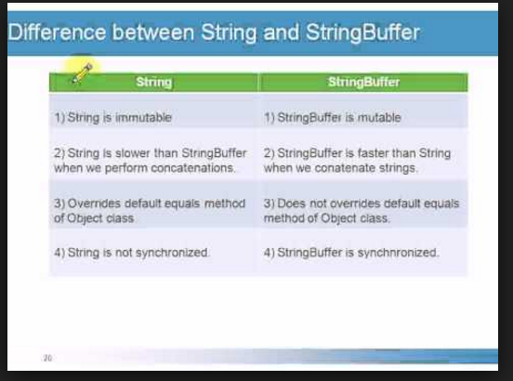

Slide 32
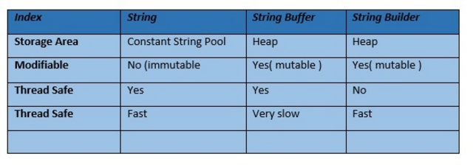
String – String Bufer – String Builder

Slide 33
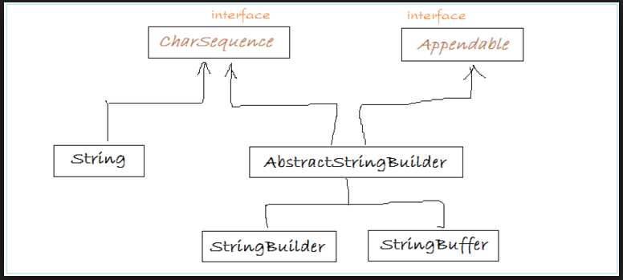

Slide 34
Questions???

Slide 35
Review Questions:
The String class is part of what package?
What does the String class have that other classes do not have?
“Text enclosed in quotes is called ?”
What is the returned value for “Rumplestiltskin”.length()?
Define immutable objects.
Notes:
What makes the String class unusual?
+ and += operators and literal strings
How can you include a double quote character into a literal string?
\"
Is "length".length() allowed syntax? If so, what is the returned value?
Yes, it is valid and returns 6.
Define immutable objects.
Objects that cannot be changed by calling their methods (nor by directly manipulating their fields).
Does immutability of strings make Java more efficient or less efficient?
It depends. It may be more efficient if the code involves making many copies of strings. It is less efficient if the code involves changing characters in strings or assembling strings from separate items (chars or numbers). Actually the latter situation is more common. You should then use the StringBuffer class rather than String.

Slide 36
Review (cont’d):
String city = "Bloomington“;
What is returned by city.charAt (2)?
By city.substring(2, 4)?
By city.lastIndexOf(‘o’)?
By city.indexOf(3)?
What does the trim method do?
Notes:
What do the indexOf methods do? Name a few overloaded versions.
Find a character or a substring in a string. indexOf(char), indexOf(String), indexOf(char, int fromPos), indexOf(String, int fromPos)
What is more efficient for strings: == and other relational operators or equals and compareTo methods?
This is not a matter of efficiency: you must use equals and compareTo to compare the contents of strings; == compares references, which are equal only if they refer to exactly the same string.
What does the trim method do?
It returns a new string which contains this string with whitespace removed at the ends.
What does s.toUpperCase() do to s?
Nothing: s is immutable.
What does the toString method return for a String object?
This string.

Slide 37
Review (cont’d):
How does immutability of Strings make Java more efficient?
How does immutability of Strings make Java less efficient?
How do you declare an empty string?
Why are String constructors not used very often?
“Bob” + “ “ + “Smith” is called ____ ?
Notes:
How do you declare an empty string?
String s = "";
Why are String constructors not used very often?
Because you can simply assign a literal string to a variable, so there is no need to make copies of strings.
If the value of String city is "Boston", what is returned by city.charAt(2)? By city.substring(2,4)?
's' and "st", respectively.
How come String doesn’t have a setCharAt method?
To keep it immutable. StringBuffer has setCharAt(ch,pos).
Is s1 += s2 the same as s1 = s1 + s2 for strings?
Yes.

Slide 38
Review (cont’d):
“sam”.equals(“Sam”) returns ?
What kind of value does “sam”.compareTo(“Sam”) return?
What will be stored in s?
s = “mint”.replace(‘t’, ‘e’);
What does s.toUpperCase() do to s?
Name a simple way to convert a number into a string.
Notes:
Name a simple way to convert a number into a string
"" + num;
Which class has a method for converting a String into an int?
Integer (the method parseInt)
Name a few Character methods that help identify the category to which a given char belongs.
isDigit, isLetter, isUpperCase, isLowerCase, isWhitespace.
What is the difference between the String and StringBuffer classes?
StringBuffer objects are mutable; StringBuffer is more efficient for assembling a string from pieces. It has methods for inserting, appending, and deleting characters.

