Slide 1
CS 5330 · FINAL PROJECT
Transfer Learning vs.
Random Initialization
“How much of transfer learning’s advantage is the pretrained features — and how much is just fewer knobs to turn?”
Pretrained-Frozen
Random-Frozen
Random-Full
PRESENTER
DATASET
BACKBONE
Shriman Raghav Srinivasan
Intel Image Classification · 6 classes
ResNet-18
Northeastern University · Khoury College
01

Slide 2
THE PROBLEM
One comparison, two hidden variables
▪ The usual move: take an ImageNet-pretrained network, freeze the early layers, fine-tune the rest.
▪ It beats training from scratch — but why?
▪ Freezing changes two things at once: the quality of the frozen features and the number of trainable parameters.
▪ A naive pretrained-vs-scratch test confounds them — you can’t tell which one earned the win.
FACTOR A
Feature quality
Pretrained weights encode edges, textures, shapes learned from a million images.
FACTOR B
Trainable capacity
Freezing early layers also shrinks how many parameters the optimizer can move.
Goal: a design that isolates Factor A from Factor B.
Transfer Learning vs. Random Init
02

Slide 3
THE DESIGN
Three conditions, one controlled variable
Pretrained-Frozen
θf = ImageNet weights, frozen · train θt
ResNet-18
Random-Frozen CONTROL
split into early θf + late θt
θf = random weights, frozen · train θt
Random-Full
everything random · train all layers
PT-F vs R-F → isolates feature quality (capacity matched)
R-F vs R-FL → isolates trainable capacity (both random)
Transfer Learning vs. Random Init
03

Slide 4
METHOD
Where the network is cut
Freeze the generic early layers; train only the task-specific tail. PT-F and R-F share the exact same trainable count — that’s what makes them a fair fight.
conv1
layer1
layer2
layer3
layer4
fc
+bn1
6-class
θf · frozen 2,782,784 params · BN forced to eval()
θt · trainable 8,396,806 params
The subtle bug I avoided: if frozen BatchNorm layers keep updating their running stats, the representation drifts and training collapses. In both frozen conditions BN stays in eval mode. In Random-Full nothing is frozen, so BN updates normally — different by design, not by accident.
Transfer Learning vs. Random Init
04

Slide 5
SETUP
Same data, same recipe, three seeds
DATA
TRAINING
RIGOR
Intel Scenes
Identical for all
Reproducible
▪ 6 classes: buildings, forest, glacier, mountain, sea, street
▪ 12,631 train / 1,403 val / 3,000 test (held out)
▪ Resize 224, center-crop, ImageNet normalize
▪ SGD · lr 1e-3 · momentum 0.9 · wd 1e-4
▪ Batch 32 · cross-entropy on θt
▪ Early stop on val loss, patience 5
▪ 3 seeds: 42, 100, 2026
▪ Test split touched only once, after model selection
▪ Report mean ± std, not single runs
Transfer Learning vs. Random Init
05

Slide 6
RESULTS
Pretrained wins — on accuracy and speed
TEST ACCURACY · mean of 3 seeds
PT-F
93.3%
CONVERGENCE & COST
Pretrained-Frozen
8.0 epochs · ~103s
R-FL
84.7%
Random-Frozen
8.7 epochs · ~113s
Random-Full
15.0 epochs · ~426s
R-F
66.5%
Training from scratch pays ~4× the wall-clock.
Capacity-matched gap: +26.7 points. PT-F vs R-F — identical trainable parameters and recipe, the only difference is pretrained vs random frozen features. That gap is pretraining, cleanly isolated. Unfreezing everything (R-FL) recovers accuracy but never reaches the pretrained ceiling.
Mean test accuracy over 3 seeds · std ≤ 4%
06

Slide 7
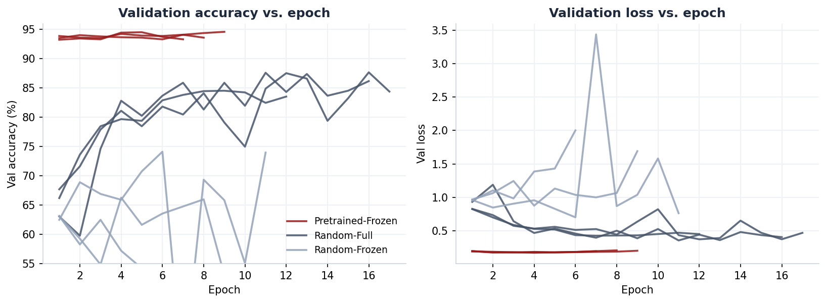
RESULTS
Pretrained converges instantly; scratch crawls
Pretrained-frozen starts near its ceiling and flatlines in ~4 epochs; random-full climbs for 12–17 epochs; random-frozen is noisy and low.
Per-epoch validation metrics · 3 seeds
07

Slide 8
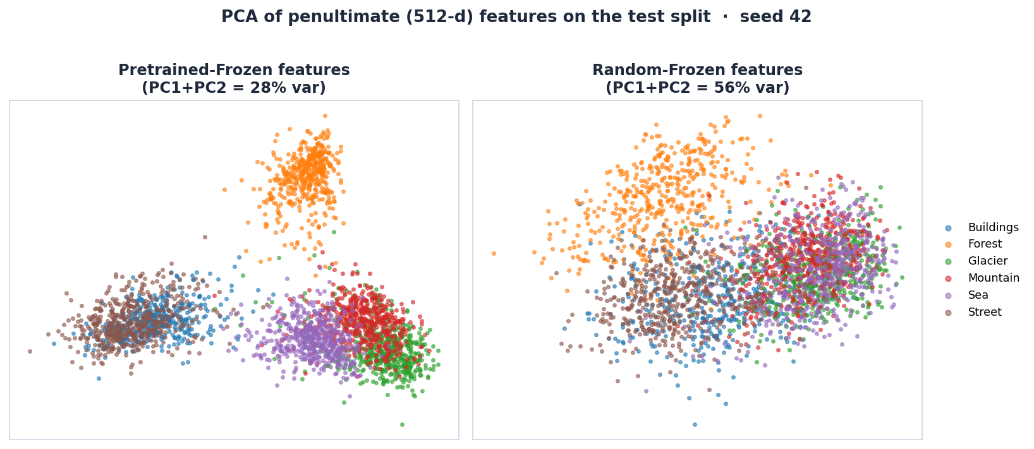
WHY IT WORKS
Pretrained features are already separable
PCA of the 512-d penultimate features: pretrained-frozen splits the classes (overlaps match the confusion matrix); random-frozen stays entangled.
Test split · seed 42
08

Slide 9
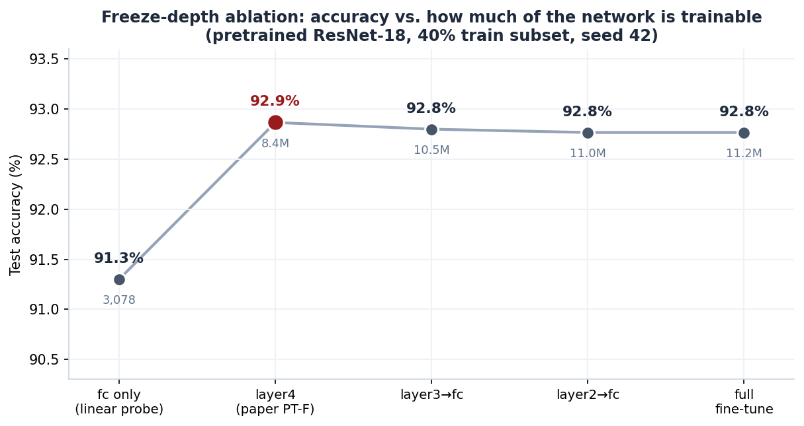
ABLATION
How much fine-tuning do you actually need?
▪ A bare linear probe already hits 91.3% — frozen ImageNet features are nearly linearly separable.
▪ Unfreezing layer4 adds ~1.6 pts: the boundary used in the main experiments.
▪ layer3, layer2, full fine-tune: flat at 92.8% — 3.6× the params, no gain.
▪ Most of pretraining’s value needs almost no fine-tuning.
Pretrained ResNet-18 · 40% train subset · seed 42
09

Slide 10
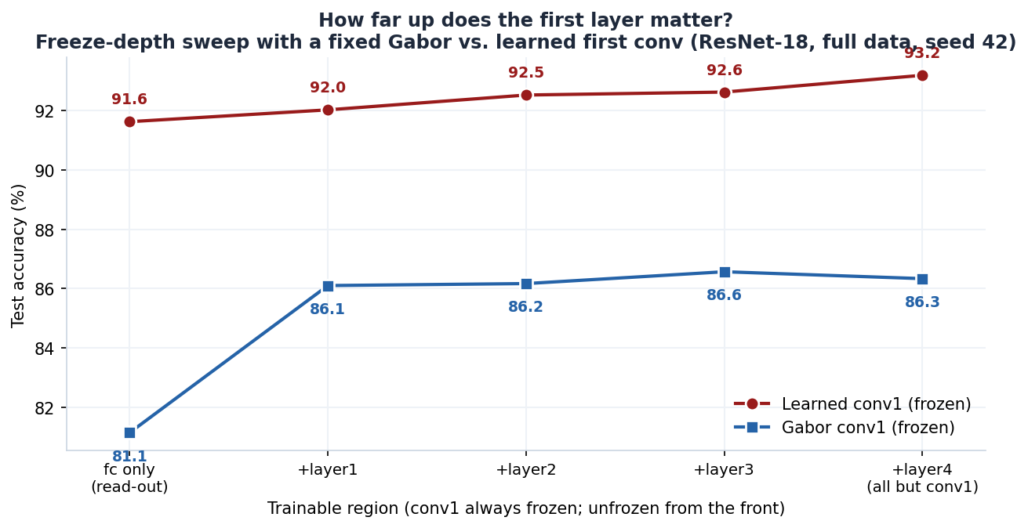
EXTENSION
How far up does the first layer reach?
▪ Swap conv1 for a fixed Gabor bank (8 orientations × 4 freqs × 2 phases), freeze it, then unfreeze deeper stages one at a time.
▪ Gabor read-out: 81.1% — about 10 pts below the learned first layer.
▪ Unfreezing just layer1 recovers +5 pts to 86.1%; layer2–4 add almost nothing.
▪ First-layer influence reaches ~one stage up. A ~7-pt gap to learned features never closes, even fully trainable.
Gabor vs. learned conv1 · full data · seed 42
10

Slide 11
ERROR ANALYSIS
The mistakes are the dataset’s, not the method’s
Pretrained-Frozen · test confusion (seed 100)
B
F
G
M
Se
St
▪ Glacier ↔ Mountain (71 errors): shared snow, ridges, rock texture — genuinely ambiguous.
▪ Buildings ↔ Street (26–28): streets contain buildings and vice-versa.
▪ The same confusions appear in all three conditions — just far larger for random init.
▪ Errors track visual overlap in the data, not a broken training setup.
B
408
0
0
0
1
28
F
0
471
0
1
0
2
G
1
4
458
71
16
3
M
1
2
28
484
9
1
Se
2
0
2
3
503
0
St
26
0
0
2
0
473
B buildings · F forest · G glacier · M mountain · Se sea · St street
11

Slide 12
CONCLUSION
What the control actually proved
01
Pretraining is the feature quality, not the parameter count
Capacity-matched, pretrained features add +26.7 points over random frozen features. The win is the representations themselves.
02
Capacity helps, but can’t close the gap
Unfreezing everything (Random-Full) recovers to 84.7% — better than random-frozen, yet still ~9 points short of pretraining, at ~4× the compute.
03
For small data + tight budgets, transfer learning wins outright
Best accuracy and fastest convergence. The random-frozen control is what lets me say that with confidence.
Thank you · Questions welcome
12

