Slide 1
NeuFlow v3
A queryable, uncertainty-aware flow decoder
for edge robotics
The decoder works and is measured. It costs 2.6 percent of mean accuracy, buys three capabilities the baseline cannot express, and has one diagnosed limitation that is not yet closed.
Shriman Raghav Srinivasan | MS Robotics, Northeastern University
Field Robotics Lab | Status review, August 2026
Notes:
This is where the project stands rather than a full presentation of it. I will do the scorecard first so you know immediately what is and is not done, then seven results, then the one thing I have not solved, then what I would do next and the handful of places where I would like your judgement. Stop me anywhere.

Slide 2
Two of the three objectives I set are not met.
Three capabilities were not on the list
Objective set at the start
Verdict
Evidence
Better accuracy than v2
not met
2.384 against 2.324; like-for-like 7.6% behind
Less compute than v2
partly
dense 10% slower; repeat query 27x cheaper
Runs on edge devices
unproven
every figure is from a RTX 4060 laptop
DELIVERED, AND MEASURED
Queryable output
flow at any continuous coordinate;
sparse reproduces dense exactly
Cheap repeat access
1.25 ms per further query batch
against a cached frame
Calibrated confidence
a per-query error estimate,
monotonic against real error
Accuracy on 1,174 held-out Virtual KITTI 2 pairs, 460,573,660 valid pixels. Timings on a RTX 4060 laptop, fp16, 384 x 1248.
2
Notes:
Starting with the scorecard because it is the honest summary. Against the three objectives I wrote down at the start, two are not met and one is partly met. Better accuracy than v2: not met, and I will show you exactly how much and why. Less compute: it depends entirely on which mode, dense is slower and repeat queries are twenty-seven times cheaper. Edge capable: unproven, because every number I have is from a laptop GPU. What the project did deliver is the three things at the bottom, none of which were on the original list, and all three are measured rather than asserted.

Slide 3
The change is confined to the last stage,
and the front end is verified unchanged
Phase 1, once per frame pair. v2 exactly as published, up to its 1/8 coarse flow. 33 ms, and the result is cached.
Phase 2, once per query batch. A coordinate goes in, a convex blend of the nine neighbouring coarse-flow values plus a bilinear sample comes out. 1.25 ms, and cost scales with the number of queries rather than with image area.
The control. All 137 tensors shared with v2 are verified bit-identical per checkpoint, and both evaluation scenes are held out of every training set.
Because the blend is convex,
the decoder cannot predict motion
its inputs do not locally support.
Zero-initialised, the decoder is
exactly bilinear upsampling.
Because Phase 1 is cached, a second question about a frame already processed costs 1.25 ms instead of 33.3. That is the property the rest of this deck turns on.
Convex-weight formulation follows AnyFlow (2023). Gated multi-scale fusion follows InfiniDepth (2025).
3
Notes:
A one-slide reminder of what actually changed. Everything in v2 that understands motion is frozen and verified: all 137 shared tensors bit-identical to v2, checked per checkpoint, so any difference you see in the results is the decoder and nothing else. The new part is phase two, which takes a coordinate and returns a convex blend of the neighbouring coarse flow values. Two properties matter. Convexity means it cannot invent motion, and zero-initialised it is exactly bilinear upsampling, so it starts from a known-good operating point. And phase one being cached is what makes repeat queries cheap, which is the thread through the whole deck.

Slide 4
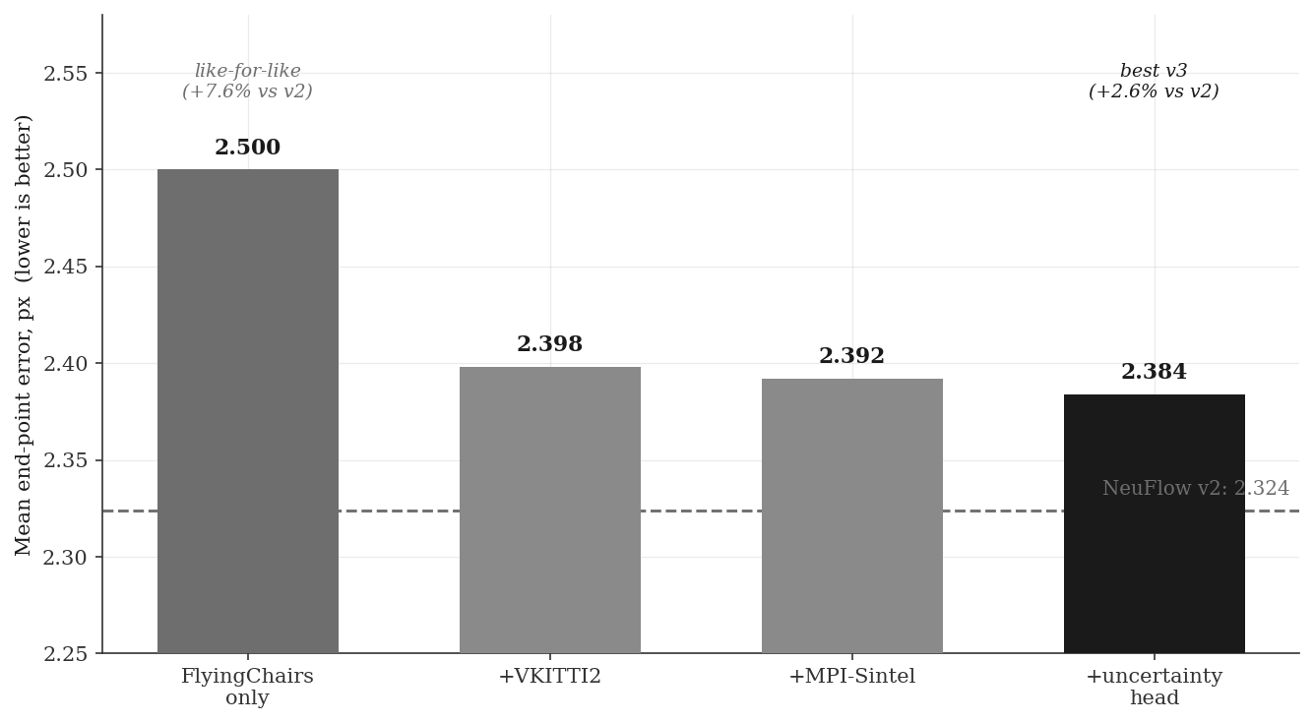
The price is 2.6% of mean error, from a
model 13% smaller
THE COST, STATED FIRST
Every configuration sits above v2. The best is 2.384 against 2.324.
Like-for-like, trained on FlyingChairs alone as v2 was trained on FlyingThings alone: 2.5, or 7.6% behind.
7.83 M parameters against 9.03 M.
2.384
against 2.324
Mean end-point error per pixel, 1,174 held-out VKITTI 2 pairs. Lower is better.
4
Notes:
The cost, and I would rather lead with it than have you find it. Every v3 configuration is less accurate than the baseline on mean end-point error. The best is 2.384 against 2.324, so 2.6 percent worse. The honest comparison is the like-for-like one, chairs only against v2's things only, and that is 7.6 percent behind. The model is thirteen percent smaller, which is worth something but does not excuse it. I know the mechanism and it is on the open-problem slide.

Slide 5
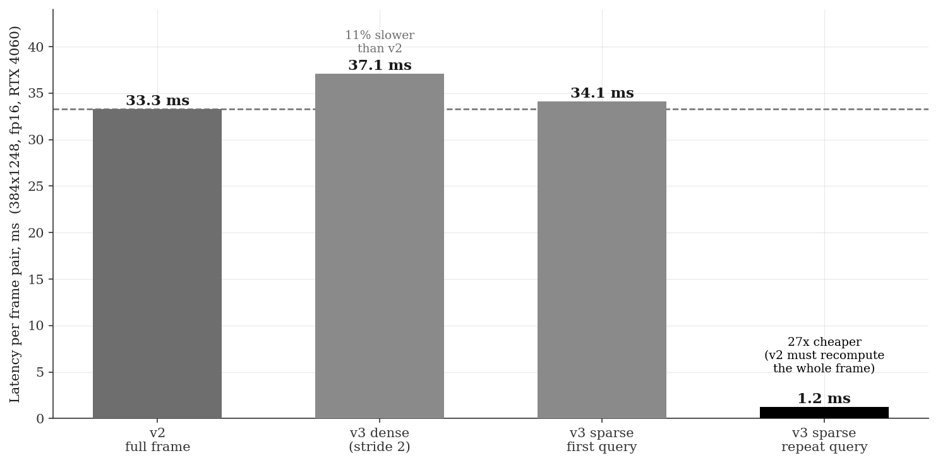
State reuse is the win: a repeat query costs
1.25 ms against 33.3 ms
WHICH CLAIM I AM MAKING
Dense output is 10% slower than v2. That mode is not what the decoder is for.
A first sparse query is level with v2: 96% of the cost is the coarse pass, which both pay and which cannot be skipped.
The win is the second question about the same frame. v2 keeps no state, so it recomputes everything.
27x on repeat access
RTX 4060 laptop, fp16, 384 x 1248, median of 50 runs after warm-up.
5
Notes:
On speed I want to be precise about which claim I am making, because there are three numbers here and only one of them is a win. Dense output is ten percent slower than v2. A first sparse query is level with v2, because ninety-six percent of the cost is the coarse pass and both models pay it. The win is repeat access: asking a second question about a frame you have already processed costs one and a quarter milliseconds against thirty-three, because v2 keeps nothing between calls. Anything that revisits a frame gets that, and that is structural rather than a margin.

Slide 6
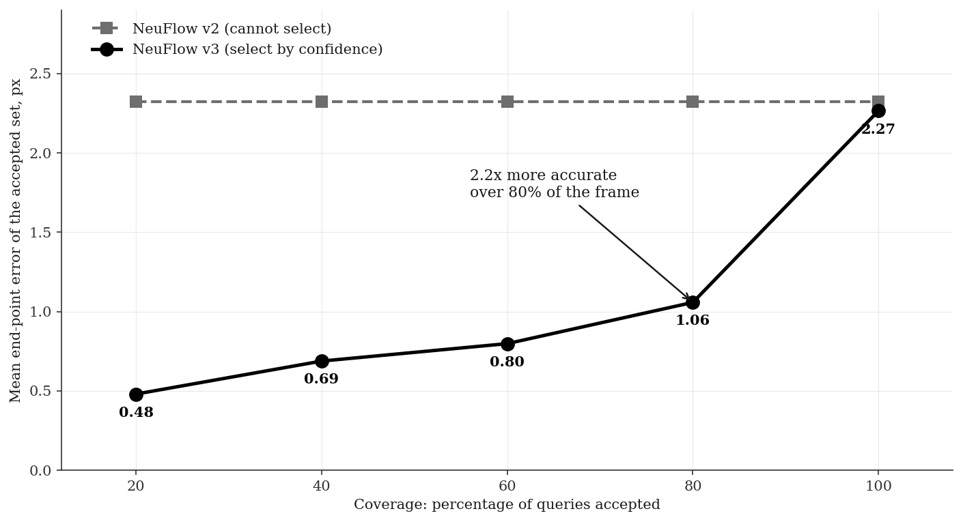
Confidence is the capability v2 cannot express,
and it buys accuracy back
CALIBRATION BEHIND THE CURVE
Real error rises monotonically across five bins, 0.48 px to 7.10 px, over 2,348,000 queries.
Pearson r = 0.318: informative rather than tight, and usable for weighting or rejecting matches.
v2 emits flow alone, so it has one operating point where v3 has a curve.
1.058 px over 80%
of the frame
Per-query error scale under a Laplace likelihood. Coverage is the share of queries answered. Same 2,348,000 queries as the calibration bins.
6
Notes:
This is the result I would most like your reaction to, so I have put the calibration and what it buys on one slide. The head predicts an error scale for every query, trained under a Laplace likelihood. Binned by predicted uncertainty, actual error rises monotonically across all five bins, a fifteen-fold span over 2.35 million queries. What that buys is the curve: mean error over all pixels is one operating point and it is the only one v2 has, because it cannot tell you which outputs to trust. Discard the least confident fifth and error on the remainder is 1.06 pixels. The reason I do not think this is a selection trick is that for registration and mapping you are choosing a few hundred points anyway.

Slide 7
Flowing 14% of the frame costs 0.034 px
and runs 4.4x faster
Region processed
Area
Latency
Speedup
EPE in region
Design rule
margin ≈ expected motion
≈ speed / frame rate
Full frame
100%
33.3 ms
1.0x
0.657
Region, no margin
7.9%
7.8 ms
4.3x
1.089
Region + 32 px margin
13.8%
7.6 ms
4.4x
0.691
Region + 64 px margin
20.1%
8.1 ms
4.1x
0.667
Region + 128 px margin
34.2%
9.9 ms
3.4x
0.655
The margin is not optional. Without one, error rises 65 percent and a quarter of large-motion pixels fail outright, because global matching loses the context it uses to locate distant correspondences.
Applies to any network in this family, v2 included. A platform technique, not a property of the decoder.
7
Notes:
This is the enabling result for the whole fast-platform framing. Keep full resolution, process fourteen percent of the frame, and it costs thirty-four thousandths of a pixel and runs four and a half times faster. The margin is the part worth dwelling on: without one, error jumps sixty-five percent and a quarter of the large-motion pixels fail completely, because this network locates large displacement with attention over the whole image and a tight crop takes that away. I should be clear that this applies to any flow network including v2 unchanged, so it is a platform technique rather than something the decoder provides.

Slide 8
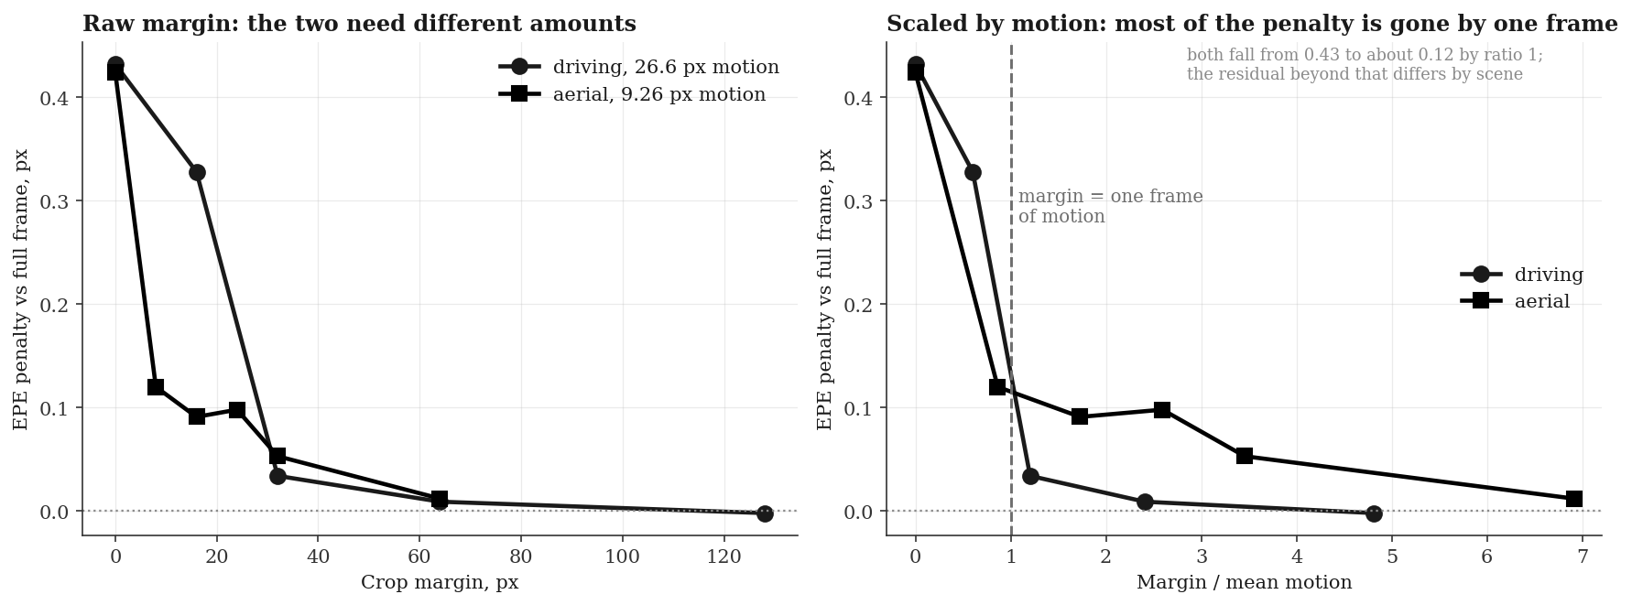
The margin needed is set by motion,
not by image size
Driving averages 26.6 px of motion and needs about 32 px of margin. Aerial averages 9.26 px and needs about 8 px. Both shed most of the penalty by one frame of motion, so a margin can be sized from speed and frame rate before anything is run.
Measured with the baseline network. Agreement holds to a ratio of one; residuals beyond that differ by scene.
8
Notes:
I wanted to know whether the margin rule was fitted to one dataset or was something more general, so I tested it on aerial sequences, which move about a third as fast. The prediction was that the required margin scales with motion, so the knee should move from thirty-two pixels down to about nine. It did. On the right, divided by mean motion, both domains start at the same penalty and both have shed most of it by the point where the margin equals one frame of motion. To be precise about the limit: this predicts the scale rather than the exact curve, because the residuals beyond a ratio of one differ by scene. It is still enough to size a margin in advance.

Slide 9
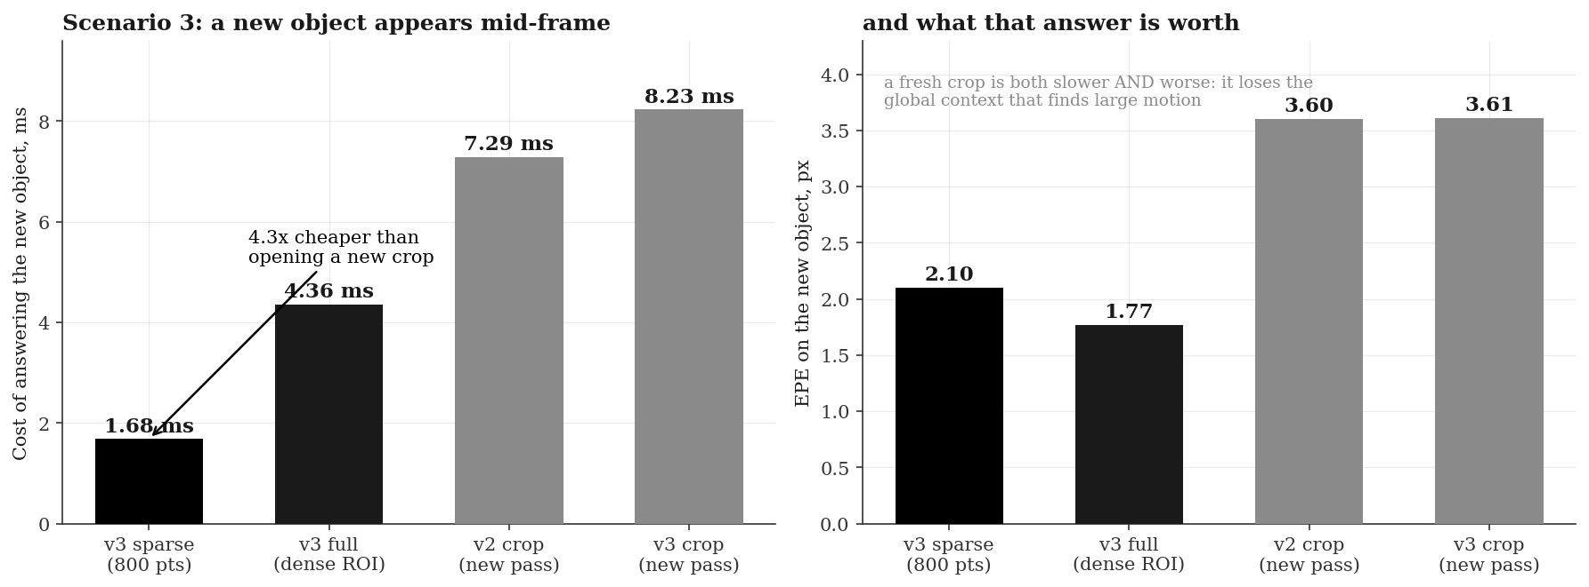
A region found mid-frame costs 1.7 ms,
against 7.3 ms for a fresh crop
The cached coarse state answers a question the platform did not have when the frame arrived. A cropped pipeline must run an entire new pass, and is less accurate doing it. Two disjoint crops cost more than one full frame: crop once, or not at all.
Held-out VKITTI 2. The second region is disjoint from the first, so nothing computed for the first can be reused by a cropped pipeline.
9
Notes:
This is the one result that is specific to the architecture rather than to cropping, and it is the case I think is most relevant to a moving platform. A frame is already in flight when a new object enters the field of view. Because the coarse pass is cached, answering about it costs one point seven milliseconds. A cropped pipeline cannot reuse anything, because the new object is outside its box, so it runs a whole new pass at seven point three milliseconds and the answer is worse, three point six pixels against two point one, because a fresh crop has lost the surrounding context. The general point is that this buys the ability to answer a question you did not know you would have when the frame arrived.

Slide 10
On a domain neither model trained for,
v3 leads at all seven margin settings
HOW MUCH IT COUNTS
Crop margin
NeuFlow v2
NeuFlow v3
The only unconfounded comparison I have. Every other table is on a domain v3 trained on and v2 did not.
Consistent rather than large: 0.004 to 0.029 px, over 40 pairs and one seed.
v3 is still worse on large-motion failures, 7.2% against 6.5%.
full frame
0.781
0.777
0 px
1.205
1.176
8 px
0.901
0.881
16 px
0.872
0.865
24 px
0.879
0.854
32 px
0.834
0.814
64 px
0.793
0.778
Mean end-point error, px. v2 trained on FlyingThings; v3 on FlyingChairs, VKITTI 2 and Sintel. Neither trained on aerial imagery.
10
Notes:
One result I did not expect. Everything else is measured on driving sequences, where v3 trained on driving data and v2 did not, which is a confound I have flagged throughout. Aerial is neutral ground: neither model has seen anything like it. There v3 comes out ahead at all seven margin settings. My guess at the reason is that the decoder saw three datasets where v2 saw one, and the convex head is bounded so it cannot invent motion, which should degrade more gracefully out of domain. I want to be careful how much weight this carries: the margins are small, it is forty pairs and one seed, and v3 is still worse on the large-motion pixels. What makes it worth showing is that it is consistent across seven independent settings.

Slide 11
One diagnosed cause, three experiments
converging on it, not yet fixed
The cause. The decoder’s finest input is at 1/8 resolution, so the evidence available to it barely varies inside an 8x8 cell. The upsampler it replaces reads the full-resolution frame directly.
Three independent nulls. A Fourier positional encoding, sub-pixel querying, and reduced-resolution querying all returned null, and all three are explained by that one mechanism.
What it also explains. Querying between pixels is presently closer to interpolation than inference. The interface is exact; the extra information recoverable is small.
Proposed remedy
A full-resolution stem: a cheap
stride-8 convolution over the
full-resolution image, fed to
the decoder. Roughly 1 to 2 ms.
This is the only candidate that is specific to v3. The baseline’s upsampler already reads full resolution, so nothing here transfers to it.
Other limitations: no embedded measurement, one evaluation domain, and one seed per configuration, so differences below about 0.05 px are not resolved.
11
Notes:
This is the part I have not solved, and it is one mechanism rather than a list of unrelated weaknesses. The decoder never sees full-resolution features. Its finest input is at one-eighth resolution, so inside an eight by eight cell it is looking at almost the same evidence wherever you query. That single fact explains the accuracy gap, and it explains why three separate experiments returned null: the Fourier encoding, sub-pixel querying, and reduced-resolution querying. Three nulls with one explanation is what makes me confident in the diagnosis rather than merely suspicious. The remedy I would try is a cheap full-resolution stem, and it is the only candidate on my list that is specific to this architecture.

Slide 12
What I would do next, in priority order,
with what each costs
Next experiment
Why it is next
Cost
Full-resolution stem
the direct attack on the one diagnosed cause
half a day, 5 h train
Repeat uncertainty run, new seed
the 2.392 to 2.384 gain is inside checkpoint noise
5 h train
Jetson measurement
the word edge is currently a design target, not a result
hardware dependent
Spring 4K evaluation
the one test the baseline structurally cannot take
1 h, script exists
Tiled refinement
roughly 2x, but it would benefit the baseline equally
not built
Only the first is a claim about this architecture. The second decides whether the uncertainty head’s accuracy gain is real. The third decides whether the edge premise can be stated at all.
Training costs are on the Explorer cluster; evaluation on the laptop GPU.
12
Notes:
Next steps in the order I would take them, with costs, so you can tell me if you disagree with the ordering. The full-resolution stem is first because it is the only one that attacks the diagnosed cause and the only one specific to this architecture. Second is repeating the uncertainty run with a different seed, because the apparent gain from the uncertainty head is inside the checkpoint-to-checkpoint variation I measured, so at the moment I cannot claim it. Third is a Jetson measurement, because edge is in the title and I have no embedded number. Fourth is the Spring four-K evaluation, which is the one test v2 structurally cannot take, and the script is already written. Tiled refinement is last because it would help the baseline just as much.

Slide 13
Four places where your judgement would
change what I do
Is selective prediction a fair reframing of the accuracy result, or does it need a different baseline?
It is the strongest thing I have and the thing I am least certain is being presented correctly.
Full-resolution stem first, or embedded measurement first?
The stem closes the scientific gap. The measurement closes the claim in the title. There is not time for both to be leisurely.
Is one seed per configuration acceptable for the write-up?
It is what I have. It means nothing below about 0.05 px is resolved, and I have said so wherever a difference is smaller than that.
Is the aerial result worth foregrounding, given it is 40 pairs?
It is the only comparison in the study without a training-domain confound, but it is also the smallest sample.
13
Notes:
Rather than a generic questions slide, these are the four decisions where what you say actually changes what I do next. The first is the one I care most about: selective prediction is the strongest result I have and it is also the one I am least sure I am presenting correctly, so I would rather you push on it here than in the defence. The second is a genuine fork given the time left. The third and fourth are about how much weight to put on results I have flagged as thin.

Slide 14
Appendix: every number in this deck, in one place
Full result table
Model
Training data
EPE
1 px
Params
NeuFlow v2
FlyingThings
2.324
77.63
9.03 M
NeuFlow v3
FlyingChairs
2.500
72.81
7.83 M
NeuFlow v3
+ VKITTI 2
2.398
75.74
7.83 M
NeuFlow v3
+ MPI-Sintel
2.392
75.83
7.83 M
NeuFlow v3
+ uncertainty head
2.384
76.13
7.83 M
COMPUTE, SAME DEVICE THROUGHOUT
Mode
Latency
Note
v2, full frame
33.3 ms
its only mode
v3 sparse, first query on a new pair
34.1 ms
equivalent to v2
v3 sparse, repeat query on a cached pair
1.25 ms
27x cheaper
v3 dense output, stride 2
37.1 ms
not the intended mode
1,174 held-out VKITTI 2 pairs, 460,573,660 valid pixels. RTX 4060 laptop, fp16, 384 x 1248.
14
Notes:
The full table, kept here so that the results slides could each carry one claim rather than a grid of numbers. Two things worth pointing at if we end up here. The ordering is monotonic as training data is added, which is what you would expect and is a weak check that nothing is broken. And the gap between the uncertainty row and the row above it is 0.008, which is smaller than the checkpoint-to-checkpoint variation, so I do not claim the uncertainty head improves accuracy.

