Slide 1
Optical flow you can query:
calibrated confidence and 27x cheaper repeat
access for 2.6% of mean accuracy
Shriman Raghav Srinivasan
MS Robotics, Northeastern University | Field Robotics Lab
Final project presentation | 12 August 2026
Notes:
I replaced NeuFlow v2's fixed upsampler with a decoder you can query at any coordinate. The headline is that this buys three capabilities v2 cannot express, and costs 2.6 percent of mean accuracy. I will show you both sides. The result I would most like your reaction to is selective accuracy, which is slide eleven, so I will keep the earlier material tight.

Slide 2
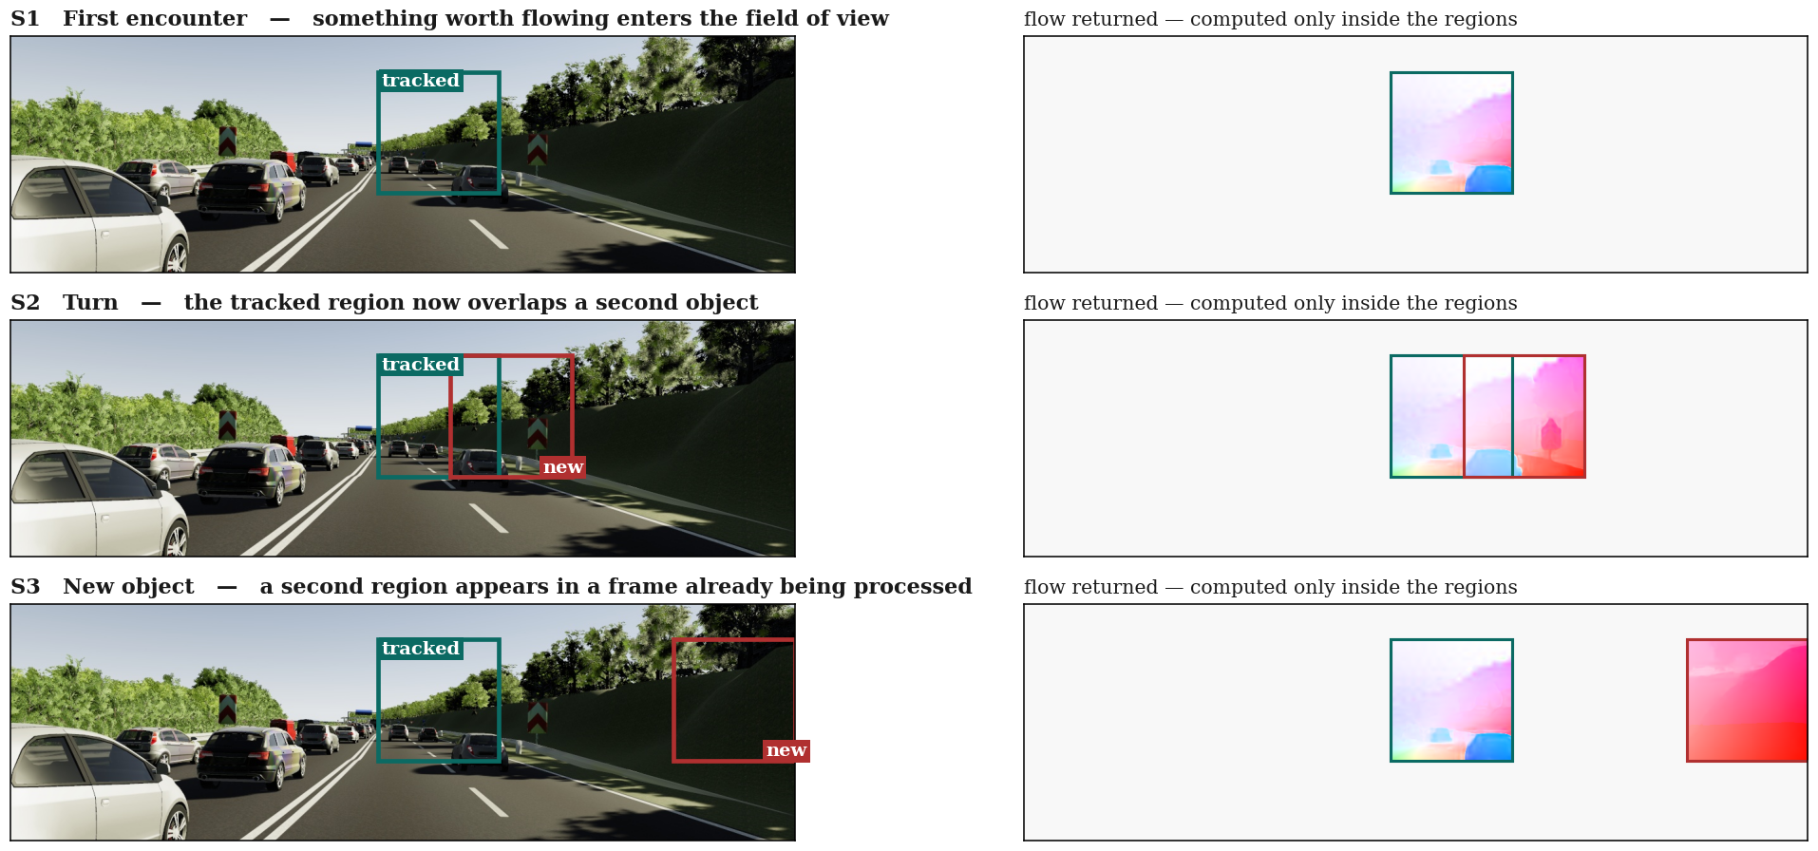
A fast platform cannot afford the frame
it is given
Left: the region a tracker nominates. Right: the flow returned. The grey area is never computed. Held-out Virtual KITTI 2.
2
Notes:
Start with the situation rather than the network. A drone or a fast vehicle has a millisecond budget per frame and a dense flow field does not fit in it. So it flows only the region that matters. Three situations it meets. First, something worth tracking enters the field of view. Second, the platform turns and that region now overlaps a second object. Third, a new object appears in a frame you are already part way through processing. On the right is what the model actually computes: flow inside the marked regions only. Everything in this deck is in service of that third case, which is the one a dense network cannot answer cheaply.

Slide 3
A dense output forecloses the two questions
that platform actually asks
Where exactly? A corner tracked to (312.7, 188.2) cannot be requested. The pixel grid is a sampling artefact; the motion underneath it is continuous.
And again, on a frame already processed? A second question about the same pair costs the entire computation a second time, because nothing is kept between calls.
Meanwhile every consumer discards most of the answer. Registration, sparse tracking and survey mosaicking each select a few hundred points and throw away the other 478,000.
On constrained hardware, computing 479,232 correspondences in order to consume 800 is the difference between operating in real time and not.
Frame size 384 x 1248. Baseline: Zhang, Gupta, Jiang and Singh (2024), NeuFlow v2.
3
Notes:
Every modern flow network computes a displacement for every pixel at one fixed resolution, and that contract is rarely questioned. It forecloses two things the platform on the last slide needs. It cannot be asked for a position between pixels, and it cannot be asked a second question about a frame it has already processed without paying for the whole thing again. On top of that, the consumers that matter here select a few hundred points themselves and discard the rest. On a small GPU that waste is the difference between real time and not.

Slide 4
Can the output stage be made queryable
without surrendering accuracy or speed?
Can NeuFlow v2’s fixed upsampler be replaced by a decoder evaluated at
arbitrary continuous coordinates, and what does that cost?
Approach. Freeze everything in v2 that understands motion. Change only the last stage.
Consequence. Cost scales with the number of queries, O(N), not with image area, O(HxW).
Test. One variable per training run, and a front end verified unchanged.
Evaluated on 1,174 held-out Virtual KITTI 2 pairs, 460,573,660 valid pixels, and on TartanAir aerial sequences.
4
Notes:
So the question, stated precisely. Not whether I can build a better flow network, but whether the final stage of a real-time one can be made queryable, and what that costs. The approach is to keep everything that understands motion frozen and change only the output, so that any difference you see is attributable to one thing.

Slide 5
v3 keeps NeuFlow v2 frozen and replaces
only its fixed upsampler
Phase 1 once per frame pair, 33 ms, cached
Image pair
CNN backbone
1/8 and 1/16
Cross-attention
global match
Refinement
1x s16, 8x s8
Coarse flow
at 1/8
>
>
>
>
Phase 2 once per query batch, 1.25 ms, O(N)
Query (x, y)
continuous
Sample 3x3
four sources
Gated fusion
MLP
Convex blend
nine plus one
Flow and
confidence
>
>
>
>
The output is a convex combination of neighbouring coarse-flow values, so the decoder cannot predict motion its inputs do not locally support.
Convex-weight formulation follows Jung et al. (2023), AnyFlow. Gated fusion follows InfiniDepth (2025).
5
Notes:
The change is confined to the last stage. Phase one is v2 exactly as published, run once and cached. Phase two takes a coordinate, samples feature windows around it, and predicts weights that blend the nine neighbouring coarse flow values plus a bilinear sample. Because it is a convex blend it cannot hallucinate motion. And because phase one is cached, asking a second question about the same frame is cheap. That caching turns out to be the property that matters most, and it is the second of the two foreclosures from the previous slide.

Slide 6
The front end is verified bit-identical to v2,
so the comparison isolates the decoder
Frozen front end. All 137 shared tensors verified bit-identical, per checkpoint.
Disjoint splits. Both evaluation scenes are excluded from every training set, checked at pair and frame level before each run.
One variable per run. Same seed, schedule, batch size and query budget throughout.
Evaluation
Held-out pairs
1,174
Valid pixels
460.6 M
Cross-domain
TartanAir
Hardware
RTX 4060
Precision
fp16
Zero-initialised, the decoder is exactly bilinear upsampling: training can only move away from a known-good operating point by learning something.
Cabon et al. (2020), Virtual KITTI 2. Wang et al. (2020), TartanAir.
6
Notes:
Two things make the rest of the deck interpretable. First, the front end is frozen and I verify per checkpoint that all 137 shared tensors are bit-identical to v2, so any difference you see is the decoder and nothing else. Second, both evaluation scenes are held out of every training set, checked at pair and frame level before each run. The zero-initialisation property is worth noting too: an untrained decoder is exactly bilinear upsampling, so it starts from a known-good operating point.

Slide 7
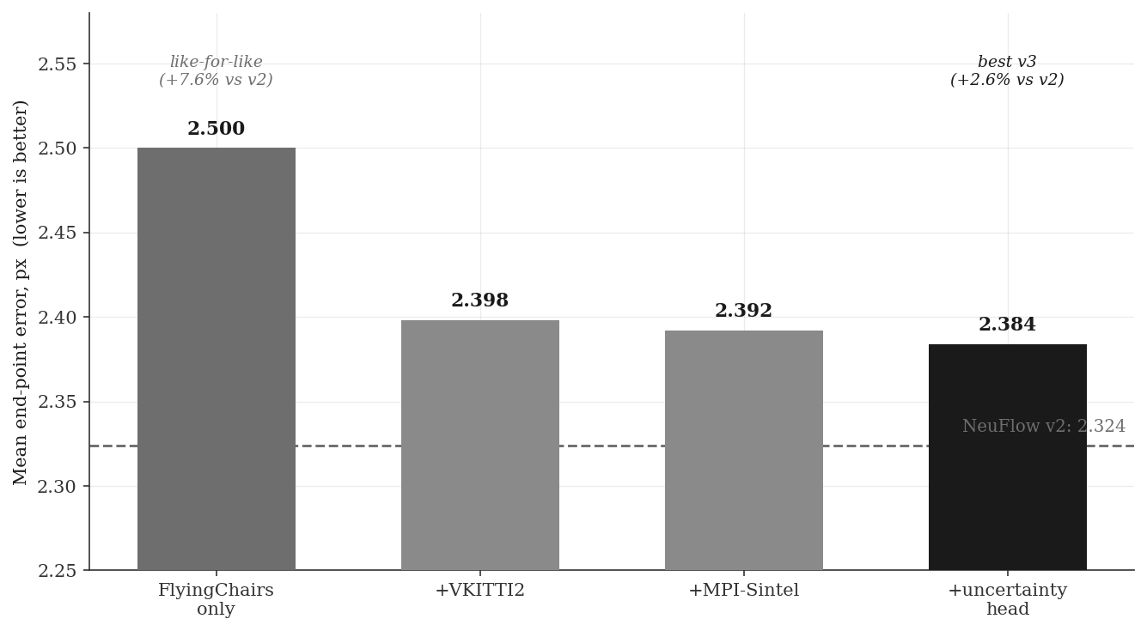
The decoder costs 2.6 percent of mean error,
from a model 13 percent smaller
THE COST, STATED FIRST
Every v3 configuration sits above v2.
Like-for-like on FlyingChairs alone: 2.500, or 7.6% behind.
7.83 M parameters against 9.03 M.
2.384
against 2.324
Mean end-point error per pixel, 1,174 held-out VKITTI 2 pairs. Lower is better.
7
Notes:
Here is the central cost, and I am leading with it rather than burying it. Every v3 configuration is less accurate than the baseline on mean end-point error. The best is 2.384 against 2.324, so 2.6 percent worse. The like-for-like comparison, trained on FlyingChairs alone as v2 was trained on FlyingThings alone, is 7.6 percent behind. The model is 13 percent smaller, which is worth something but does not excuse it. Four slides on, the same model is more than twice as accurate as v2 over most of the frame, once it is allowed to abstain. That is the argument.

Slide 8
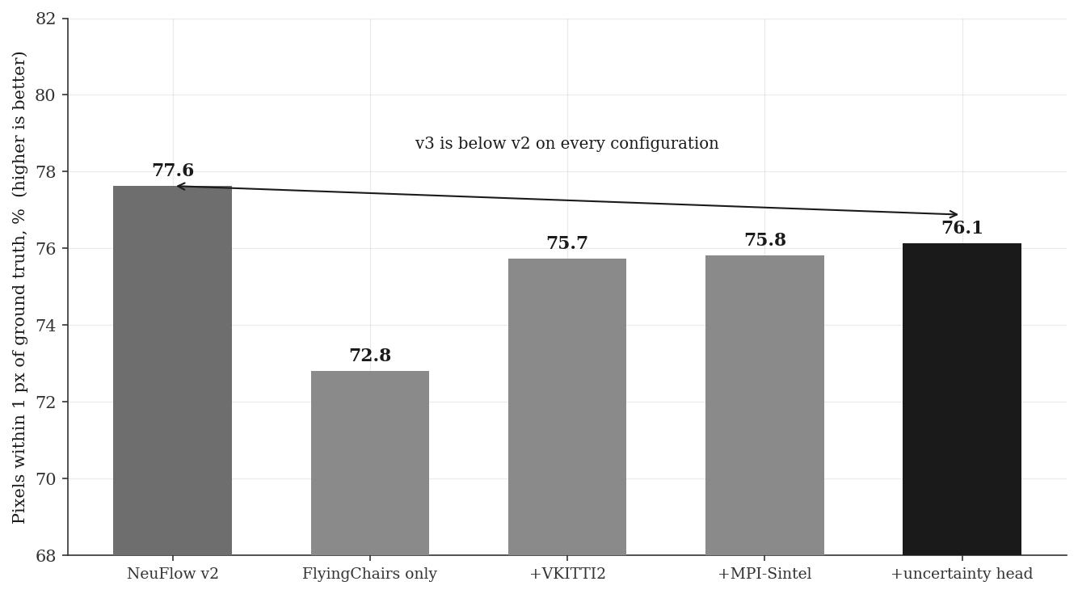
The cost concentrates in sub-pixel precision,
not in large errors
DIAGNOSED CAUSE
The decoder’s finest input is 1/8 scale, so evidence barely varies inside an 8x8 cell. The upsampler it replaces reads the full-resolution frame.
A Fourier positional encoding changed nothing, which rules out a missing position signal.
1.5 points below v2
on 1 px accuracy
Percentage of pixels with end-point error below 1 px. Higher is better.
8
Notes:
This is where the cost actually sits. On one-pixel accuracy v3 is below v2 in every configuration. Mean error partly hides it, because v3 makes fewer catastrophic errors, which drags the average down while it is less exact on the majority of pixels. I know the mechanism: the decoder's finest input is at one-eighth resolution, so inside an eight by eight cell it is looking at almost the same evidence wherever you query, while the v2 upsampler reads the full-resolution frame directly. I tested the competing explanation, that it was simply missing positional information, by adding a Fourier encoding. It changed nothing, which rules that out.

Slide 9
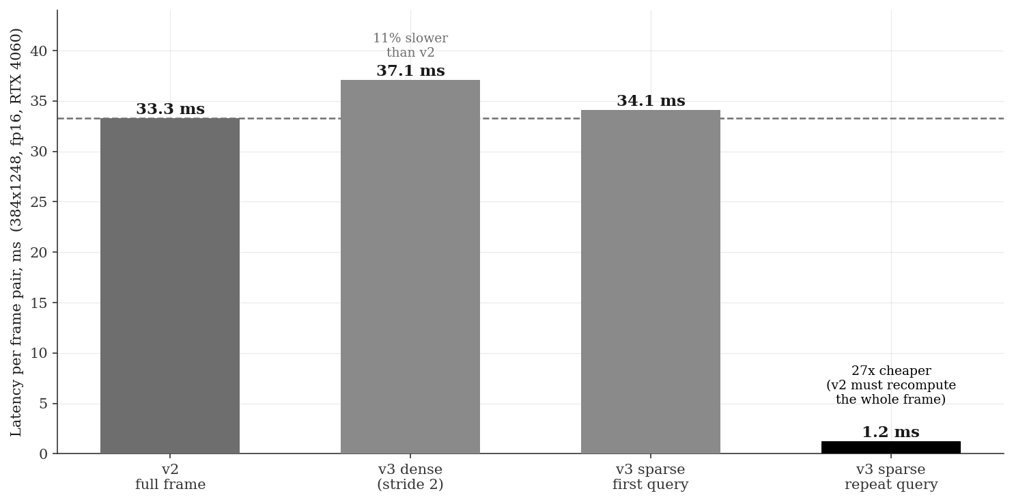
A repeat query on a cached frame costs
1.25 ms, against 33.3 ms for a fresh pass
WHERE THE WIN IS
A first sparse query is level with v2: both pay the coarse pass, and global matching needs the whole image, so it cannot be skipped.
v2 keeps no state, so a second question costs a full recomputation.
27x on repeat access
RTX 4060 laptop, fp16, 384 x 1248, median of 50 runs after warm-up.
9
Notes:
On speed I want to be precise about which claim I am making. Dense output is ten percent slower than v2, and that mode is not what the decoder is for. A first sparse query is level with v2, because 96 percent of the cost is the coarse pass, which both share and which cannot be skipped since global matching needs the whole image. The win is repeat access. Asking a second question about a frame you have already processed costs 1.25 milliseconds against 33.3, because v2 keeps no state and has to redo everything. Anything that revisits a frame gets that: iterative registration, RANSAC refinement, an operator inspecting a scene. That is structural, not a margin.

Slide 10
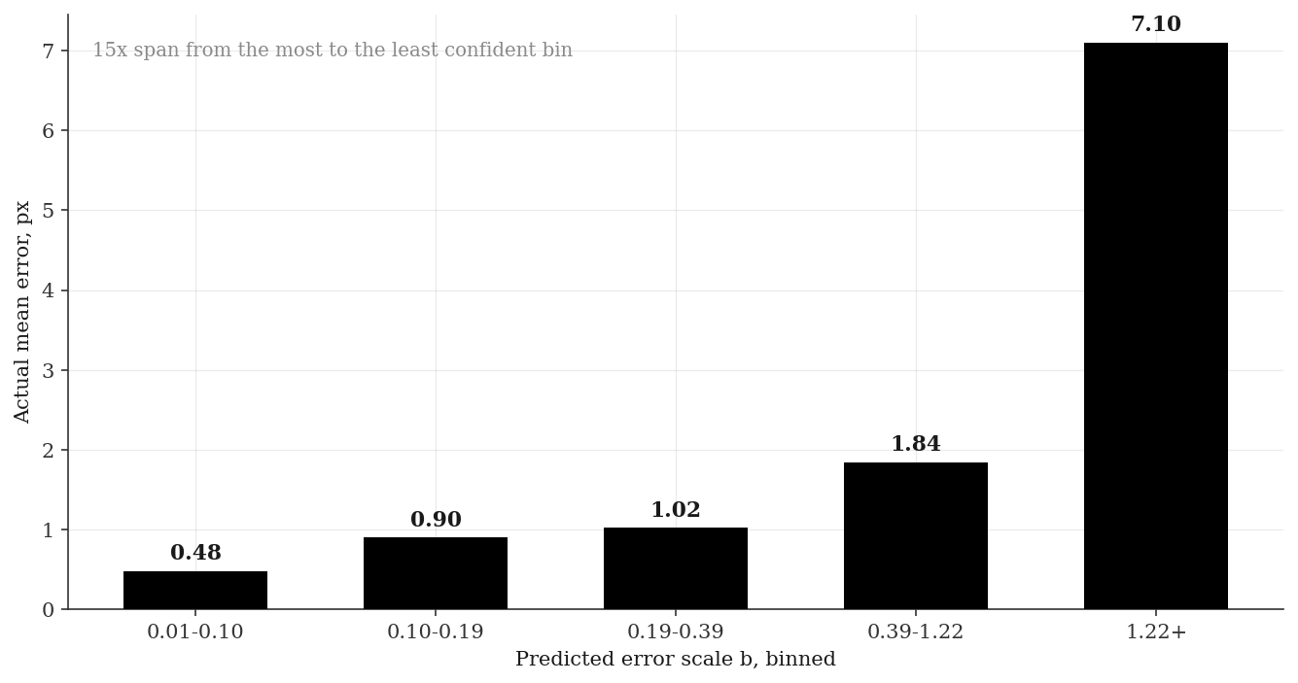
Predicted confidence tracks real error
monotonically across a 15-fold span
WHY IT IS USABLE
Weight correspondences in RANSAC by predicted scale.
Reject unreliable matches before they reach a solver.
v2 emits flow alone. There is no equivalent quantity to compare against.
0.48 px to 7.10 px
across five bins
Per-query error scale under a Laplace likelihood. 2,348,000 queries, Pearson r = 0.318.
10
Notes:
The head predicts an error scale for every query alongside the flow itself, trained under a Laplace likelihood. When you bin queries by predicted uncertainty, actual error rises monotonically across all five bins, from 0.48 pixels in the most confident to 7.10 in the least, a fifteen-fold span, over 2.35 million queries. It is not perfectly correlated, r is 0.318, but it is clearly informative and directly usable: weight correspondences, drop unreliable ones, or send more queries where the model is unsure. v2 has no equivalent output, so there is nothing to compare against.

Slide 11
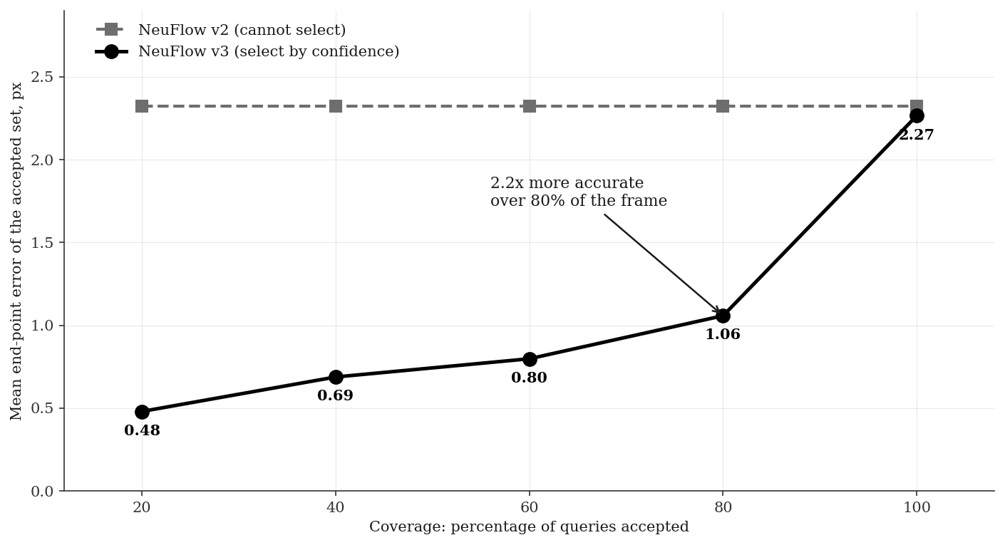
Abstaining on 20 percent of queries makes
v3 2.2x more accurate than v2
WHY THIS IS THE RIGHT COMPARISON
Mean error over all pixels is one operating point, and the only one a model without confidence has.
Registration picks a few hundred points anyway, so declining to answer costs nothing it would have used.
1.06 px at 80% coverage
against v2 at 2.32
Same 2,348,000 queries as the calibration bins. Coverage is the share of queries answered.
11
Notes:
This is the slide I would most like your reaction to. The accuracy table earlier reports mean error over every pixel, which is the only operating point v2 has, because it cannot tell you which of its outputs to trust. v3 can, so instead of a point it has a curve. Discard the least confident fifth and error on what remains falls to 1.06 pixels against v2's 2.32 over the whole frame. More than twice as accurate over eighty percent of the image. Keep only the most confident fifth and it is 0.48. Why this is not a statistical trick: for registration and mapping you are choosing a few hundred points anyway, so declining to answer where the model is unsure costs you nothing you would otherwise have used.

Slide 12
Processing 14 percent of the frame costs
0.034 px and runs 4.4x faster
Region processed
Area
Latency
Speedup
EPE in region
Design rule
margin ≈ expected motion
≈ speed / frame rate
Full frame
100%
33.3 ms
1.0x
0.657
Region, no margin
7.9%
7.8 ms
4.3x
1.089
Region + 32 px margin
13.8%
7.6 ms
4.4x
0.691
Region + 64 px margin
20.1%
8.1 ms
4.1x
0.667
Region + 128 px margin
34.2%
9.9 ms
3.4x
0.655
The margin is not optional. Without one, error rises 65 percent and a quarter of large-motion pixels fail outright, because global matching loses the context it uses to locate distant correspondences.
Applies to any network in this family, v2 included. A platform technique, not a property of the decoder.
12
Notes:
Here is what flowing only a region actually buys. Keep full resolution, process fourteen percent of the frame, and it costs thirty-four thousandths of a pixel. That is the enabling result for the whole scenario. The margin is the part worth dwelling on. Without one, error jumps sixty-five percent and a quarter of the large-motion pixels fail completely, because this network finds large displacement using attention over the whole image and a tight crop takes that away. I should be clear that this applies to any flow network including v2 unchanged. It is a platform technique, not something my decoder provides. What the decoder adds comes two slides from here.

Slide 13
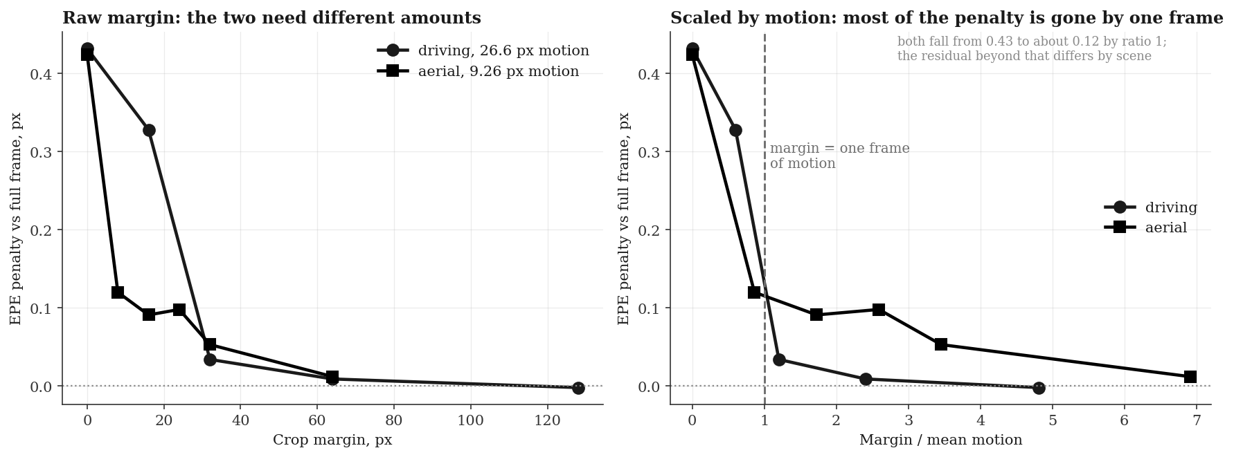
The margin a region needs is set by motion,
not by image size
Driving averages 26.6 px of motion and needs about 32 px of margin. Aerial averages 9.26 px and needs about 8. Both shed most of the penalty by one frame of motion.
Measured with the baseline network. Agreement holds to a ratio of one; residuals beyond that differ by scene.
13
Notes:
I wanted to know whether the margin rule was a curve fitted to one dataset or something more general, so I tested it on aerial sequences, which move very differently: nine point three pixels per frame against twenty-six point six for driving. The prediction was that the required margin should scale with motion, so the knee should move from thirty-two pixels down to about nine. It did. On the left the two need different absolute margins. On the right, divided by mean motion, both start at the same penalty and both have lost most of it by the point where the margin equals one frame of motion. I will be precise about the limits: the agreement is good up to that point and residuals differ beyond it, so this predicts the scale rather than the exact curve. That is still enough to size a margin from speed and frame rate before running anything.

Slide 14
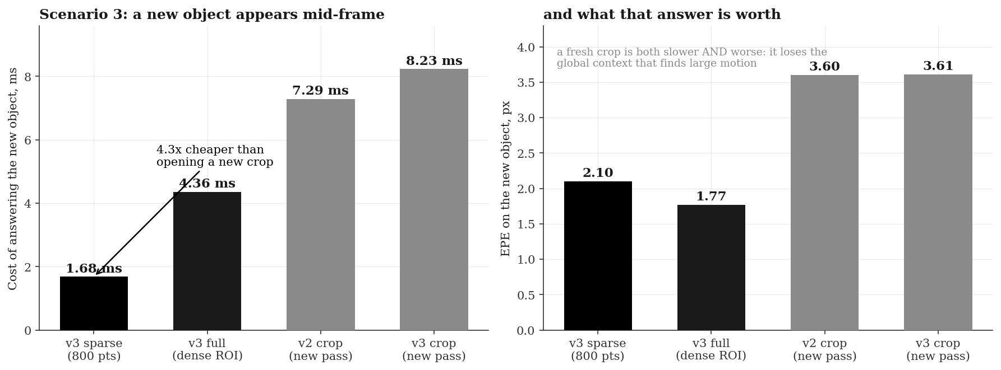
A region discovered mid-frame costs 1.7 ms,
against 7.3 ms for a fresh crop
The cached coarse state answers a question the platform did not have when the frame arrived. A cropped pipeline must run a whole new pass, and is less accurate doing it.
Two disjoint crops cost more than one full frame, which gives a simple policy: crop once, or not at all.
14
Notes:
This is the third situation from the opening slide, and the one result specific to this architecture rather than to cropping. A frame is already in flight when a new object enters the field of view. Because the coarse pass is cached, answering costs one point seven milliseconds. A cropped pipeline cannot reuse anything, since the new object is outside its box, so it runs a whole new pass at seven point three milliseconds, four times more, and the answer is worse, three point six pixels against two point one, because a fresh crop has lost the surrounding context. v2 keeps no state at all between calls. The general point is that this buys the ability to answer a question you did not know you would have when the frame arrived, which on a moving platform is most of them.

Slide 15
On a domain neither model trained for,
v3 leads at all seven margin settings
HOW MUCH IT COUNTS
Crop margin
NeuFlow v2
NeuFlow v3
The only unconfounded comparison in the deck. Every other table is on a domain v3 trained on and v2 did not.
Consistent rather than large: 0.004 to 0.029 px, over 40 pairs and one seed.
v3 is still worse on large-motion failures, 7.2% against 6.5%.
full frame
0.781
0.777
0 px
1.205
1.176
8 px
0.901
0.881
16 px
0.872
0.865
24 px
0.879
0.854
32 px
0.834
0.814
64 px
0.793
0.778
Mean end-point error, px. v2 trained on FlyingThings; v3 on FlyingChairs, VKITTI 2 and Sintel. Neither trained on aerial imagery.
15
Notes:
One result I did not expect, and I am putting it last in the evidence because it is the cleanest. Everything else in this deck is measured on driving sequences, and v3 trained on driving data while v2 did not, which is a confound I have flagged throughout. Aerial data is neutral ground: neither model has seen anything like it. On that neutral ground v3 comes out ahead at all seven margin settings. Appendix E has the same three situations from the opening slide in that domain, with the region geometry and decoder configuration held identical, if anyone wants to see them. The likely reason v3 leads is that the decoder saw three datasets where v2 saw one, and the convex head is bounded so it cannot invent motion its inputs do not support, which should degrade more gracefully out of domain. I want to be careful about how much weight this carries: the margins are small, it is forty pairs and one seed, and v3 is still slightly worse on the large-motion pixels. What makes it worth showing is that it is consistent across seven independent settings.

Slide 16
The decoder earns its place when the
consumer chooses its own points
USE THE DECODER WHEN
USE THE BASELINE WHEN
The consumer selects its own query points.
A frame is revisited after it has been processed.
Each correspondence needs a confidence value.
A position between pixels is required.
One complete dense field per frame is consumed, and nothing else is needed.
v2 is more accurate and 10% faster in exactly that mode, and remains the correct choice for it.
Selective prediction reframes the comparison: mean error over all pixels is the metric the decoder loses on, and the only one a model without confidence can report.
16
Notes:
So what is the contribution. It is an operating point, not a leaderboard position. For an application that consumes one complete dense field per frame and nothing else, v2 remains the correct choice and I will say so plainly: it is more accurate and ten percent faster in that mode. The decoder earns its place when the consumer picks its own points, revisits a frame, needs a position between pixels, or needs a confidence value. And the selective prediction result reframes the whole accuracy comparison, because mean error over all pixels is exactly the metric a model without confidence is stuck with.

Slide 17
The accuracy gap has a single cause, and
three experiments converge on it
Accuracy. The decoder’s finest input is 1/8 resolution; the upsampler it replaces reads the full-resolution frame.
Sub-pixel querying. For the same reason, evaluation between pixels is presently closer to interpolation than inference. The interface is exact; the extra information recoverable is small.
Embedded validation. All latency is from a laptop GPU. The edge premise is a design target, not a result.
Statistical resolution. One seed per configuration. Differences below about 0.05 px are not resolved by this study.
Three independent nulls point at the same mechanism: Fourier encoding, sub-pixel querying, and reduced-resolution querying. The remedy is a full-resolution stem.
17
Notes:
Limitations, stated plainly rather than buried. The accuracy gap is structural: the decoder never sees full-resolution features. Three separate experiments returned null for the same reason, which is what makes me confident in the diagnosis rather than merely suspicious. Sub-pixel querying is thinner than it sounds for the same reason: the interface is exact but the extra information recoverable between pixels is small until the decoder gets full-resolution input. There is no embedded measurement at all, so the word edge is a design target. And one seed per configuration, so please do not read much into differences below about five hundredths of a pixel.

Slide 18
Conclusions
1. Queryable output is affordable. Arbitrary continuous coordinates in O(N), for 2.6% of mean accuracy, from a model 13% smaller.
2. Confidence is worth more than the mean. Abstaining on 20% of queries gives 2.2x lower error over the remaining 80% of the frame.
3. Region margins are predictable in advance. Margin ≈ speed / frame rate, verified across a threefold difference in motion scale.
Next: a full-resolution feature stem, then embedded measurement.
srinivasan.shrim@northeastern.edu | Code and report: github.com/shrirag10/Neuflowv3
18
Notes:
Three conclusions. Queryable output is affordable: arbitrary continuous coordinates for 2.6 percent of mean accuracy, from a smaller model. Confidence is worth more than the mean, because abstaining on a fifth of queries more than halves the error on the rest. And the region margin a fast platform needs is predictable from speed and frame rate before any flow is computed. The next experiment is the full-resolution stem, which is the direct attack on the one gap I have not closed. I will stop there. Are there questions or feedback?

Slide 19
References
Zhang, Z., Gupta, A., Jiang, H., & Singh, H. (2024). NeuFlow v2: High-Efficiency Optical Flow Estimation on Edge Devices. arXiv:2408.10161.
Jung, H., Hui, Z., Luo, L., Yang, H., Liu, F., Yoo, S., Ranjan, R., & Demandolx, D. (2023). AnyFlow: Arbitrary Scale Optical Flow with Implicit Neural Representation. CVPR.
Teed, Z., & Deng, J. (2020). RAFT: Recurrent All-Pairs Field Transforms for Optical Flow. ECCV.
Yu et al. (2025). InfiniDepth: Implicit Neural Upsampling for Monocular Depth Estimation.
Kendall, A., & Gal, Y. (2017). What Uncertainties Do We Need in Bayesian Deep Learning for Computer Vision? NeurIPS.
Cabon, Y., Murray, N., & Humenberger, M. (2020). Virtual KITTI 2. arXiv:2001.10773.
Wang, W., Zhu, D., Wang, X., Hu, Y., Qiu, Y., Wang, C., Hu, Y., Kapoor, A., & Scherer, S. (2020). TartanAir: A Dataset to Push the Limits of Visual SLAM. IROS.
19
Notes:
The work this builds on. NeuFlow v2 is the baseline and the frozen front end, and it comes from this lab. AnyFlow is where the convex-weight formulation comes from, the part that stops the decoder predicting motion its inputs do not support. InfiniDepth is where the gated multi-scale fusion comes from. Kendall and Gal is the uncertainty loss. Virtual KITTI 2 and TartanAir are the two evaluation datasets.

Slide 20
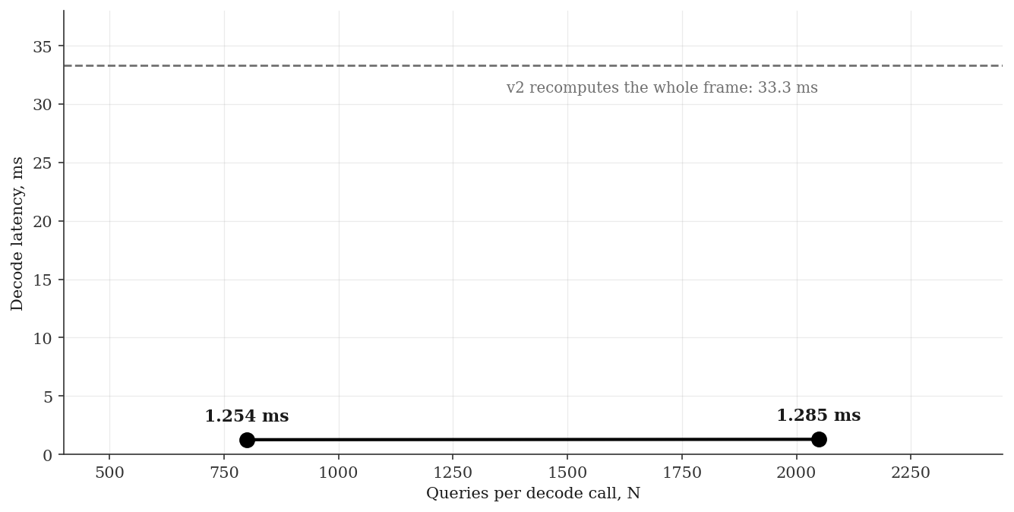
Appendix A: query cost and interface
Decode cost is flat to 2,048 queries:
2,048 points cost what 800 do
THE ENTIRE API
state = model.infer_coarse_state(
img0, img1)
flow = model.decode_queries(
state, query_coords=q)
flow, b = ... return_uncertainty=True
Launch-overhead bound below roughly 10,000 points, compute-bound above, where dense decoding is the better choice.
1.254 ms at N = 800; 1.285 ms at N = 2,048. RTX 4060 laptop, fp16.
20
Notes:
The interface is two calls: one coarse pass per frame pair, then as many decode calls as you like against it. The plot shows decode cost is flat between 800 and 2,048 queries, which tells you it is dominated by kernel launch overhead rather than arithmetic, so you get two thousand points for the price of eight hundred. Above about ten thousand points it becomes compute bound and dense mode is the better choice.

Slide 21
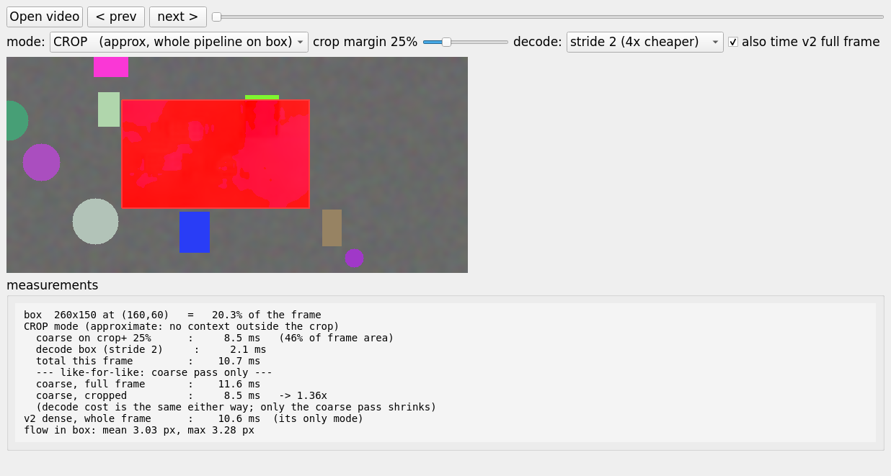
Appendix B: working implementation
The decoder runs as an interactive tool:
draw a region, get flow there
TWO TIMED MODES
QUERY decodes only inside the box against a full-frame coarse pass. Exact, and identical to the full-frame result inside the box.
CROP feeds only the box through the pipeline, so cost scales with area, at the price of the lost context.
The panel reports the measured breakdown live, including where the decoder is not the faster option.
21
Notes:
This is a working tool, not a mock-up. Load a video, step to a frame, drag a box, and it computes flow in that box. Query mode runs the full coarse pass and decodes only inside the box, which is exact. Crop mode feeds just the box through the whole pipeline, so cost scales with the area requested but it loses the surrounding context that global matching uses. The panel shows the actual breakdown live, including the parts where v3 is not the faster option.

Slide 22
Appendix C: objectives set at the start
Two of three original objectives were not met;
the project delivers three others
Objective
Verdict
Evidence
Better accuracy than v2
not met
best 2.384 against 2.324; like-for-like 7.6% behind
Less compute than v2
partly
dense 10% slower; repeat query 27x cheaper
Runs on edge devices
unproven
every figure is from a laptop RTX 4060
WHAT IT DOES DELIVER
Queryable output
any continuous coordinate;
sparse equals dense exactly
Cheap repeat access
1.25 ms per further query
batch on a cached frame
Calibrated confidence
a per-query error estimate,
monotonic against real error
Sparse queries reproduce the dense field to 0.00057 px maximum deviation.
22
Notes:
The scorecard against what I set out to do, and two of three are not met. Better accuracy: not met. Less compute: partly, dense is slower, a first query is level, but repeat queries are twenty-seven times cheaper. Edge capable: unproven, everything is on a laptop 4060. What the project does deliver is the three things at the bottom, and those are measured.

Slide 23
Appendix D: anticipated questions
Four questions I expect, answered
Why is flow defined between pixels at all?
Motion is continuous and the pixel grid is a sampling artefact. A corner tracked to (312.7, 188.2) is a real answer, and registration consumes it directly.
Why freeze the backbone?
To make the decoder the only variable. Any difference between v2 and v3 is then attributable to the output stage and nothing else.
Why is dense v3 slower than v2?
v2 upsamples with one convolution that shares work across neighbouring pixels. v3 answers each query independently, which gives up that sharing.
Is 2.6 percent worth the added complexity?
Not on its own. It is worth it if you need queryability, cheap repeat access, or a confidence value. For plain dense flow, v2 remains the better choice.
23
Notes:
Four questions I expect, with the answers on a slide rather than recalled under pressure. The first is the one I most want to get right: the pixel grid is a sampling decision, not a property of the motion, so asking for a position between pixels is a well-posed request even though the current decoder answers it less fully than I would like. The last one is the honest summary of the whole project: 2.6 percent is not worth paying for nothing, and it is worth paying for the three capabilities on the scorecard.

Slide 24
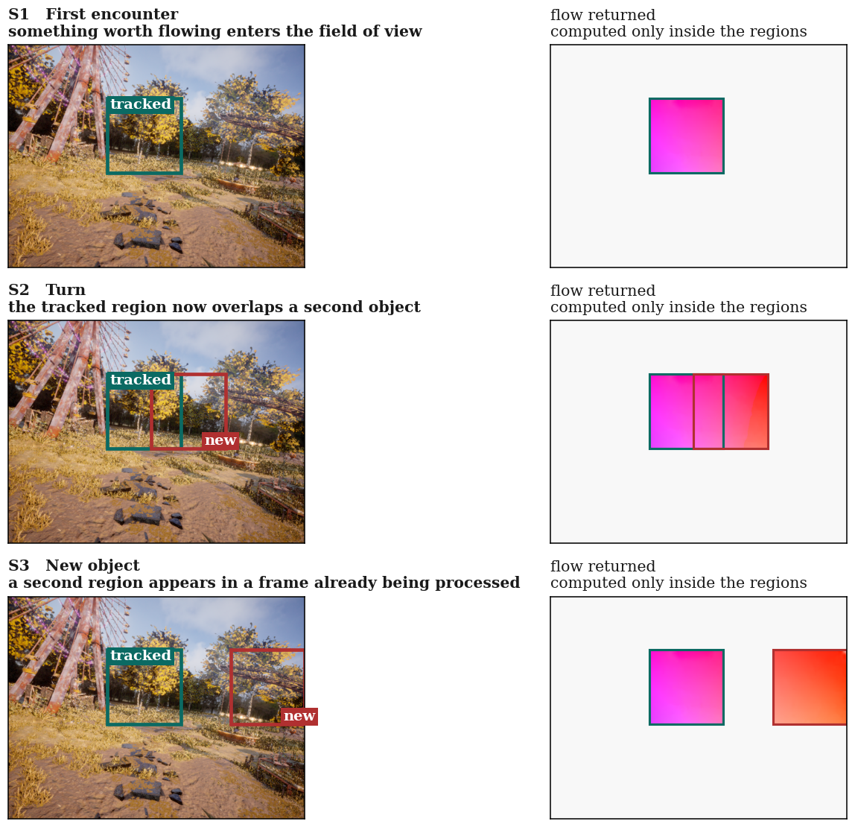
Appendix E: the three situations in the aerial domain
Same region geometry, same decoder, only
the domain changes
What is held fixed. Region geometry, margin, decode stride and checkpoint are identical to the driving figure on slide 2.
What changes. Mean inter-frame motion falls from 26.6 px to 9.26 px, about a third.
What to notice. Flow inside each region is much closer to uniform than in the driving frames, because a drone rotating through a static scene produces near-constant displacement across a small window.
Why it matters. No model in this study trained on this imagery, which is what makes the head-to-head on slide 15 worth having.
TartanAir aerial sequences. Flow colour encodes direction, so these two panels stay in colour where the rest of the deck does not.
24
Notes:
The same three situations on aerial data, held here rather than in the main line because it is context rather than a claim. Region geometry and decoder configuration are identical to the driving figure; only the domain changes. Two things to notice. The flow inside each region is much closer to uniform than in the driving frames, because a drone rotating through a static scene produces near-constant displacement over a small window. And no model in this study trained on this imagery, which is exactly what makes the seven-margin comparison on slide fifteen the cleanest number in the deck.

