Slide 1
NeuFlow v3
Implicit neural decoding for optical flow
A progress update: a frozen-backbone implicit decoder inspired by InfiniDepth, evaluated against the NeuFlow v2 baseline on Virtual KITTI 2.
Shriman Raghav Srinivasan
MS Robotics, Northeastern University

Slide 2
MOTIVATION
The problem worth solving
Optical flow is computed as a dense, fixed-resolution map. For image registration and mapping that is the wrong tool.
You usually need accurate correspondences only at well-textured points, often on imagery far too large to run dense flow on.
NeuFlow v2's convex upsampler can only produce that one dense grid, at one resolution, at a fixed cost.
Idea: make flow queryable. One backbone pass, then ask for flow at any points, at any resolution, at a cost that scales with queries, not image size.
Core problem
Flow where dense flow is wasteful or impossible: large survey and mapping imagery, and compute-limited field robots.
Turn flow from a full-frame product into an on-demand correspondence engine.
Takeaway The contribution is a new accuracy / compute / resolution operating point, not a lower EPE.
NeuFlow v3 · progress update
2

Slide 3
APPROACH
Method: what changed from v2
Frozen v2 backbone.
The CNN encoder, cross-attention and GRU refinement are unchanged. Only the upsampling head is replaced.
New implicit decoder.
Samples three scales: ctx_s8 (64d), feat_s8 (128d), feat_s16 (128d).
Hierarchical gated-residual fusion, then an MLP predicts a correction on top of the coarse flow.
Adds warped img1 features for cross-frame correspondence, which single-image depth never needs.
Output layer is zero-initialised, so at step 0 it reproduces v2 exactly.
Queryable by construction.
One backbone pass caches the state; flow is then decoded at any N points or any resolution. Decode cost is O(N), not O(H x W).
Frozen v2 backbone
Multi-scale features (ctx_s8 · feat_s8 · feat_s16)
Warped img1 features
Implicit MLP decoder
Residual flow correction
Takeaway The backbone is untouched; all the new capability lives in a small queryable head.
NeuFlow v3 · progress update
3

Slide 4
SCENE18 + SCENE20, 1174 PAIRS
Results on Virtual KITTI 2
Final model vs baseline
Checkpoint sweep (mean EPE)
Model | Mean EPE | Median | 1px acc | 3px acc
NeuFlow v2 (baseline) | 2.23 px | 1.08 px | 46.2% | 78.4%
NeuFlow v3 (step 10k) | 3.15 px | 1.87 px | 7.2% | 71.1%
Step | Mean EPE
5k | 3.29
10k (best) | 3.15
15k | 3.47
20k | 3.16
25k | 3.56
30k | 3.69
How to read this
EPE here is a sanity check that the pipeline is sound, not the target. v3 is behind v2 on raw EPE because training is VKITTI2-only (~2.1k pairs, overfits after 10k).
Unfreezing the backbone diverged on a single GPU; the frozen backbone is the only stable option at this compute scale.
The contribution is queryable flow for mapping, shown next, not a leaderboard number. Data and compute are the blocker, not the architecture.
NeuFlow v3 · progress update
4

Slide 5
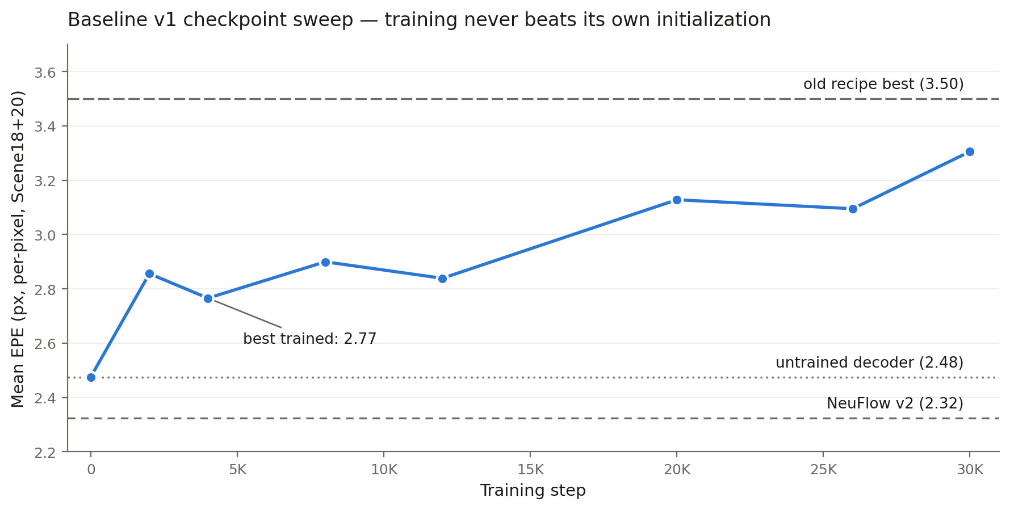
UPDATE · BASELINE V1 (V1-DEV BRANCH)
Corrected evaluation and a controlled baseline
What changed
Per-pixel metrics (old numbers were per-frame statistics)
Train/eval refinement iterations matched (1+8, was 4+7 vs 1+8)
RAFT loss weighting (gamma 0.8) and OneCycle LR schedule
GT sampled at exact pixels (no interpolation blur at boundaries)
Corrected reference points (per-pixel, 460M px)
NeuFlow v2: 2.32 px EPE · 77.6% 1px · 89.8% 3px
v3 untrained decoder (bilinear): 2.48 px · 74.7% · 88.2%
v3 best trained: 2.77 px @ 4K steps
Finding: no trained checkpoint beats the untrained decoder.
Direct delta regression (x1248 amplification) adds noise faster
than signal; small dataset overfits late checkpoints.
Takeaway Queryable flow already costs only +0.16 px over v2 with zero decoder training. Next: bounded convex-weight head (AnyFlow-style) + 6x training data from same-trajectory VKITTI2 variants (v2-dev).
NeuFlow v3 · progress update
8

Slide 6
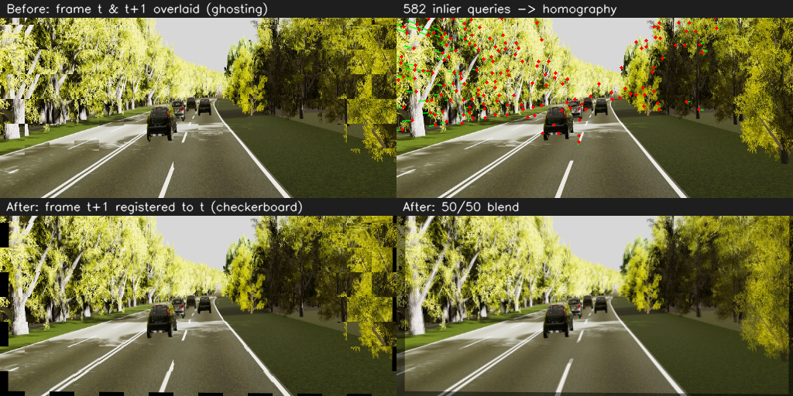
WORKING DEMO
Sparse-query registration in action
What the numbers say
0.6%
of a dense field queried (800 points)
0.00 px
sparse query vs dense decoder (exact, O(N) cost)
-32%
photometric error vs no registration
VKITTI2 Scene18 (~14 px mean motion). Flow decoded at 800 textured points, no dense flow, then a RANSAC homography (73% inliers) registers frame t+1 to frame t. Per-point flow is still noisy (~6 px EPE); robust fitting absorbs it to align the dominant scene.
NeuFlow v3 · progress update
5

Slide 7
WHAT I NEED, 1 OF 2
Validation plan and dataset
Direction is set, I am committed to this for the thesis. I plan to validate on two tiers:
Tier 1, flow accuracy.
A standard benchmark with ground-truth flow (KITTI-2015, Sintel, or TartanAir) to show the flow itself improves: queried-point EPE and accuracy vs query budget.
Tier 2, mapping capability.
A registration or mapping dataset to show queryable flow aligns overlapping imagery at a fraction of dense-flow compute. This is the thesis differentiator.
Where I need you
Which domain should Tier 2 target? Do you have lab data (marine, aerial, field) I can validate on?
If not, which public registration / mapping dataset would you trust for a thesis?
Any accuracy benchmark beyond KITTI / Sintel a committee would expect?
Takeaway Two tiers: a standard benchmark for accuracy, a domain dataset for the mapping claim.
NeuFlow v3 · progress update
6

Slide 8
WHAT I NEED, 2 OF 2
Improving NeuFlow v3
Current bottleneck: ~6 px flow at queried points, overfits after 10k steps on ~2.1k VKITTI2 pairs. Frozen backbone is stable; end-to-end diverges on one GPU.
Levers I plan to try
Data curriculum: FlyingChairs to FlyingThings3D, then fine-tune. The standard fix, needs compute.
Stronger correspondence signal: add local cost-volume / correlation features at each query point, not just warped img1 features.
Stable unfreeze: warmup, gradient clipping, low-LR backbone or adapter layers instead of a full unfreeze.
Augmentation and boundary-weighted query sampling to fight overfitting before more data.
Where I need you
Which lever would you prioritise first?
University GPU or HPC access for the pretraining curriculum?
Is the implicit-decoder design sound, or would you change how correspondence is represented?
Takeaway Biggest single lever I see: an explicit cost-volume at the query point.
NeuFlow v3 · progress update
7

