Slide 1
Cryptocurrency Analysis
#_Problem_Statement_02

Slide 2
Table of contents
01
02
03
04
05
06
Introduction
Motivation
Features & Objective
Investigation Tools
Solutions
Conclusion

Slide 3
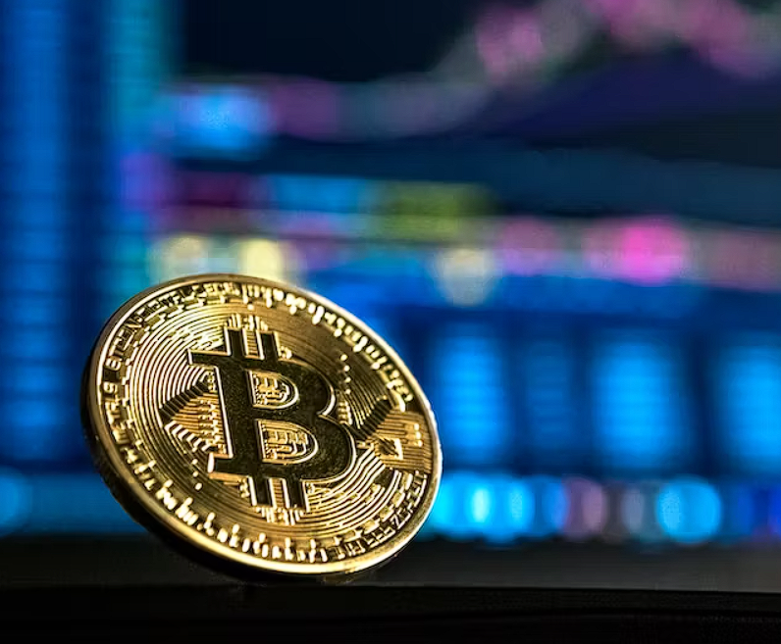
01
Introduction
Cryptocurrency is a decentralized digital currencies using blockchain, are transforming finance. Operating on a peer-to-peer network, they facilitate secure and transparent transactions, eliminating the need for intermediaries.
As cryptocurrency adoption rises, the demand for robust security measures grows. Cryptocurrency Flow Investigation is vital for transaction integrity, threat identification, and user trust. Our presentation explores investigation methodologies, recent incidents, and challenges in securing the dynamic cryptocurrency landscape.

Slide 4
Motivation
Uncovering Anonymity Factors
Understand and assess the privacy features in cryptocurrency transactions.
Address concerns related to regulatory compliance and identification of illicit activities.
Analyzing Transaction Volume
Assess the market activity, liquidity, and adoption of cryptocurrencies.
Identify potential market manipulation through the study of transaction volumes.
Detecting Illegal Activities
Investigate known or suspected illegal activities associated with cryptocurrencies.
Contribute to building a safer and more transparent financial ecosystem.
Regulatory Compliance
Ensure compliance with existing regulations in the cryptocurrency space.
Contribute insights to inform the creation of new regulatory frameworks.

Slide 5
Objectives
API Integration Code to fetch cryptocurrency transaction data from relevant APIs
Data Cleaning and Preprocessing Techniques to clean and preprocess raw transaction data for analysis.
Visualization Tools Graphs or charts to visually represent transaction flows
Machine Learning Models If applicable, machine learning models for predictive analysis or anomaly detection.
Compliance Check Mechanism Tools or checks to ensure compliance with regulatory frameworks.
Educational Content Creation Resources for creating educational content based on project findings.
User Interface (UI) If the project includes a user interface, design elements for ease of use and accessibility.
Documentation Comprehensive documentation for the entire project, including code comments, user guides, and technical documentation.

Slide 6
Features
01
02
03
Fraud Detection Using SVM Algo
Address Details
Visualization
06
05
04
Address Clustering
Suspecious Address
Token Balance Monitor

Slide 7
Solutions
Solution 1
Solution 2
Solution 3
The Python script loads transaction data, preprocesses it, trains an SVM classifier with SMOTE for class imbalance, evaluates its performance, saves it, and detects fraud transactions. Total fraud transactions are then displayed. Libraries used include Pandas, Scikit-learn, and Matplotlib for data processing, modeling, and visualization.
This Tool fetches transaction history for Ethereum or Bitcoin addresses using respective APIs. It calculates various metrics like first and last transaction dates, total transactions, ETH sent and received, and unique addresses involved. It prompts users to enter an address, distinguishes between Ethereum and Bitcoin formats, then executes accordingly.
This Tool fetches internal Ethereum transactions for a given address using Etherscan API, then visualizes the transaction path on a graph. It maps addresses to exchanges, displays transaction details, and renders a network graph with nodes representing addresses and edges connecting transactions.

Slide 8
Solutions
Solution 4
Solution 5
Solution 6
This feature file creates a web page for checking Ethereum token balances. Users input an Ethereum address, click a button to fetch balances via Etherscan API, and display results in a table. It includes styling for table layout, input fields, and a back button for navigation.
This Feature code parses a CSV file containing transaction data, analyzes the transactions to count occurrences for each sender and recipient, filters out those with more than 10 transactions, and displays the results in an HTML table. It uses PapaParse for CSV parsing and manipulates the DOM to show the results.
This Feature handles file uploads, parses CSV data, and creates a 3D scatter plot using Plotly.js. It reads uploaded CSV files, extracts transaction data, and visualizes transaction value, gas used, and time. The plot includes K-Means clusters for data insight.

Slide 9
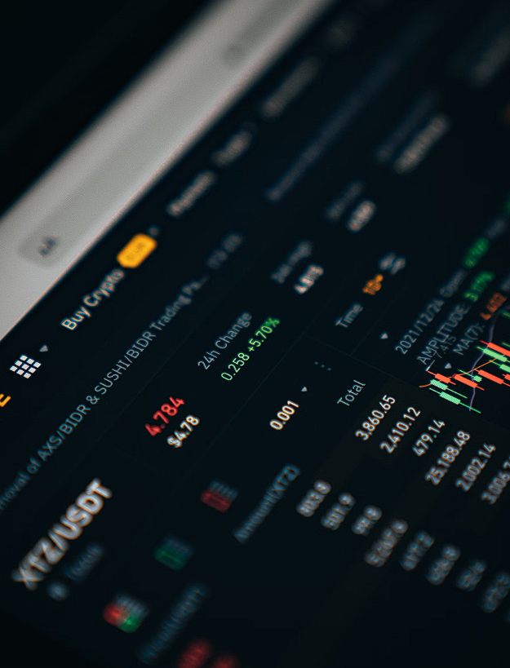
Conclusion
our cryptocurrency flow investigation project has provided valuable insights into enhancing transaction integrity, identifying potential threats, and fortifying security measures within the cryptocurrency landscape. By addressing recent incidents, exploring methodologies, and acknowledging challenges, we contribute to the ongoing efforts to secure digital assets and ensure the robustness of the cryptocurrency infrastructure.

Slide 10
Thank You!

