Slide 1
Team Introduction
Clinical decision support for women’s health
Breast screening · Cervical screening · PCOS assessment
TEAM ONCOCATCH
S Shriram
Shreedevi S
Sidharthan H
Sanjay Kanna A B
Team lead
Backend & models
Frontend &
application integration
UX design &
patient workflow
Quality assurance &
demo preparation
Python · FastAPI
PyTorch · model fusion
React · API integration
Doctor workspace
Interaction design
Patient portal · accessibility
Workflow testing
Documentation · release checks
OncoCatch / AuraMed
01 / 11
Notes:
Audience: hackathon judges assessing clarity, execution and technical credibility. Message: OncoCatch assigns clear ownership across models, application engineering, UX and quality. Responsibilities were assigned for this presentation at the team lead’s request; skills identify the relevant work areas, not verified employment history or certifications. Team lead: S Shriram. Working title: AuraMed — Clinical decision support for women’s health.

Slide 2
Problem Statement
2.3 million
Illustrative clinic scenario
A patient’s scan, clinical history and next
appointment sit in separate steps.
new breast cancer cases worldwide
in 2022
Doctor
Needs image findings and risk factors together.
Early detection and timely care matter.
Patient
Needs an understandable report and next step.
Clinic
Needs a record of review, sharing and follow-up.
IARC, 2025 analysis of 2022 estimates
OncoCatch / AuraMed
02 / 11
Notes:
Message: the build targets the hand-off between assessment and follow-up. The clinic scenario is illustrative, not a surveyed prevalence claim. Source for the statistic: IARC, 24 February 2025, https://www.iarc.who.int/wp-content/uploads/2025/02/pr361_E.pdf — estimated 2.3 million new breast cancer cases worldwide in 2022. The statistic describes disease burden; it does not quantify fragmentation or demonstrate AuraMed effectiveness. Users are doctors reviewing screening evidence, patients receiving reports, and clinic administrators coordinating records.

Slide 3
Proposed Solution
Image evidence and clinical context meet before the report is finalized.
01
02
03
04
Prepare
Analyze
Review
Follow up
Select patient
Scan + clinical inputs
Image quality check
Models + clinical scoring
Findings + heatmap
Doctor reviews & signs
PDF + patient portal
Appointment planning
Why this approach
The image score is only one input. Clinical factors, visible explanations
and doctor review connect the prediction to the care workflow.
OncoCatch / AuraMed
03 / 11
Notes:
Message: a multimodal, clinician-reviewed workflow carries evidence into reporting and follow-up. Differentiation is the integration of image scores, explicit clinical scoring, visual attention, report sign-off and patient access, compared with a standalone classifier output or a disconnected PDF workflow. This is a product-design distinction, not a claim of being the first system or having superior clinical accuracy. Heatmaps show model attention and do not establish a diagnosis. PCOS is an endocrine condition and is not presented as cancer. Source: frontend ScanModule, ScanResults, ScanReport, ScanShare; backend model and scoring implementation.

Slide 4
Tech Stack & Architecture
JavaScript / React / Vite / Tailwind
Role-based portals
FastAPI / Python
PyTorch inference
Clinical scoring
Doctor · Patient · Admin
JWT authentication
Workflow endpoints
Breast / PCOS: ResNet-50
Cervical: ViT (timm)
Module formulas
Weighted fusion
Data & reporting
SQLAlchemy · PostgreSQL / SQLite fallback · stored scans · PDF generation
LOCAL APP
PUBLIC VERCEL DEMO
Runs trained models, persists records
and supports report review.
Nine saved examples; no online inference.
Signing and sharing are simulated.
OncoCatch / AuraMed
04 / 11
Notes:
Message: the local application performs real model inference; the public deployment intentionally uses immutable examples. Source: frontend/package.json; backend/requirements.txt; backend/app/ml/models/breast_model.py (ResNet-50 binary head), pcos_model.py (ResNet-50), cervical_model.py (ViT-Base-Patch16-224 via timm); backend/app/core/database.py; frontend/src/services/hostedDemoAdapter.js. Model inference and clinical scoring run within the Python backend, not separate deployed services. PyTorch/torchvision/timm, NumPy, Pillow and OpenCV support the image pipeline. SQLAlchemy supports PostgreSQL with local SQLite fallback. ReportLab/WeasyPrint implement PDF export. No external LLM API is required for this workflow. Technical challenge: public hosting could not provide the full model/backend environment for free; the team separated the online saved-example demonstration from local inference. Next production requirements: external validation, robust deployment, access/data-governance review, and operational monitoring. No clinical performance or regulatory approval claim is made.

Slide 5
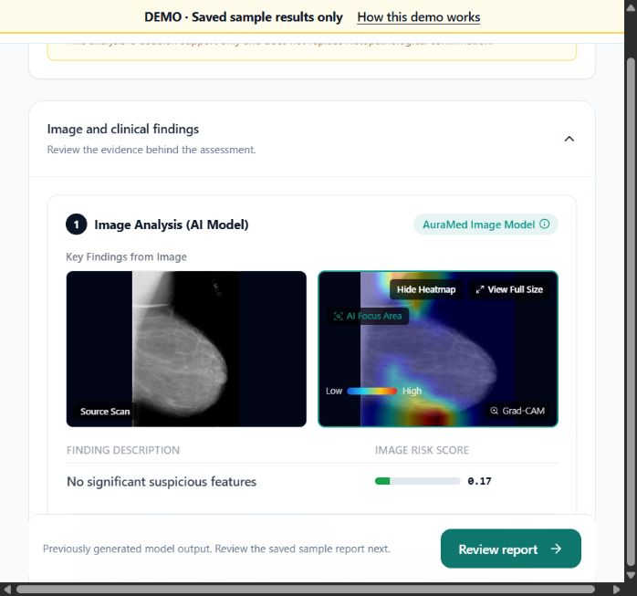
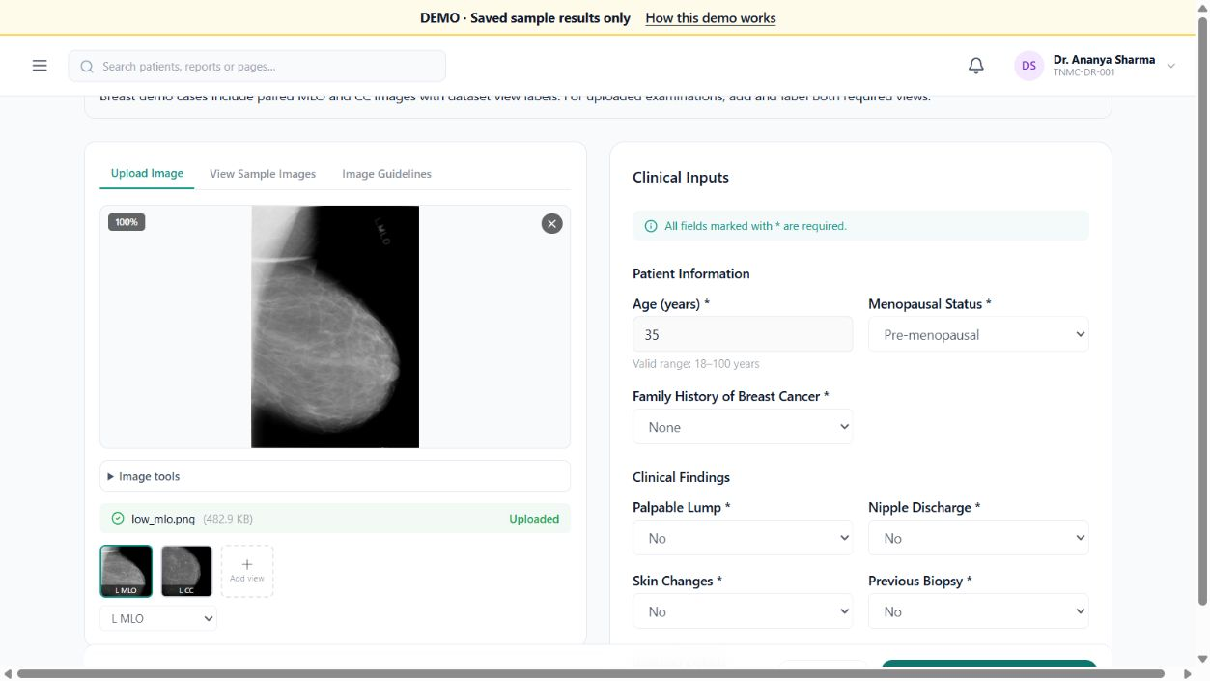
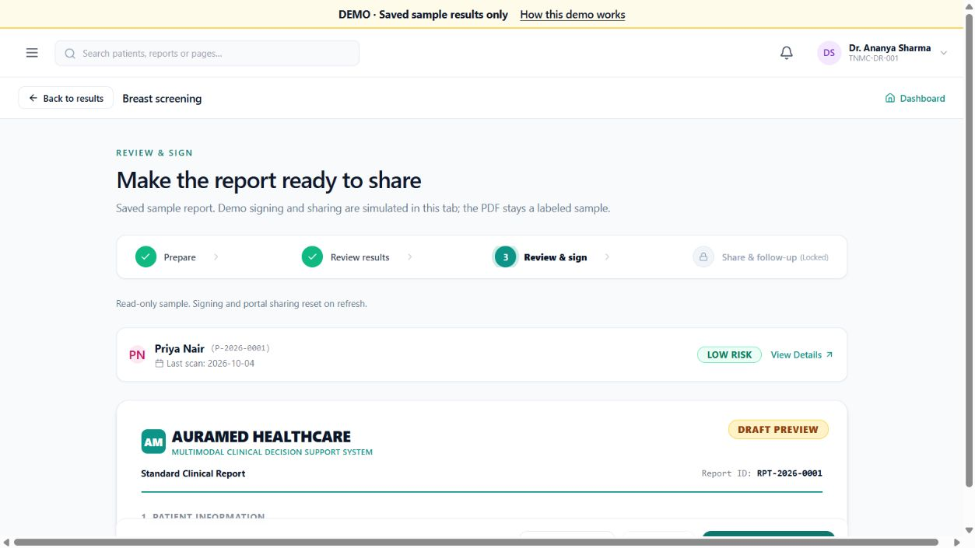
Prototype / Demo Walkthrough
Prepare an examination → inspect evidence → review the report
01 Scan + clinical inputs
02 Findings + heatmap
03 Report review
Screens: public saved-example demo. Live presentation: local model inference.
Watch the recorded demo: youtu.be/Dbne7Zs1pR8
OncoCatch / AuraMed
05 / 11
Notes:
One message: the prototype demonstrates a coherent examination-to-report journey. Screenshots are genuine captures from https://auramed-theta.vercel.app and contain public fictional sample data. They are saved-example UI evidence, not proof of fresh online inference. In the live local demonstration, continue from report review to signing, portal sharing and follow-up; then switch to the patient portal. Public signing and sharing are simulated. The public demo link is the fallback if the local presentation fails.

Slide 6
Innovation & Uniqueness
A standalone prediction stops at a score. AuraMed carries it into a reviewed care workflow.
Common starting point
AuraMed’s approach
Image classifier output
Image score + explicit clinical scoring
Clinical checklist in another step
Heatmap + clinical contributions
Report handed off separately
Doctor review → report → patient portal
The distinction is the integrated workflow, not a claim of superior clinical accuracy.
OncoCatch / AuraMed
06 / 11
Notes:
Message: AuraMed combines evidence and workflow in one examination context. Comparison is against generic standalone image-classification tools, separate clinical checklists and document hand-offs, not a measured evaluation of a named competitor. Technical distinction: separate image and clinical outputs, module-specific weighted fusion and model-attention overlays are exposed before clinician sign-off. Do not claim novelty of Grad-CAM or weighted fusion themselves. No first-in-market claim. Source: app model pipeline and the reviewed UI implementation.

Slide 7
Implementation Feasibility
Local application
Public demonstration
Production requirements
Trained model inference
Image + clinical assessment
Report review and PDF export
Patient and admin portals
Nine saved examples
Matching sample heatmaps
Downloadable sample PDFs
Simulated signing / sharing
External clinical validation
Protected data and access
Reliable model hosting
Monitoring and pilot approval
Current boundary
Prototype decision support. No clinical accuracy, regulatory approval
or real-world outcome claims are established by this demo.
OncoCatch / AuraMed
07 / 11
Notes:
Message: core local functionality exists, while production readiness remains a separate milestone. Implemented libraries and source were inspected for architecture and workflow. Public fixture generation used local trained models on test cases in an isolated database. No live hospital data, external medical device or EHR integration is claimed. Data inputs are scans and clinical fields; records use SQLAlchemy with PostgreSQL or SQLite fallback. Email/SMS requires provider configuration and is not part of the public demo. Production needs external validation, security and privacy review, access controls, backups and operational monitoring.

Slide 8
Impact & Scalability
Illustrative capacity scenario — not current adoption
5
10
20
1,000
×
×
=
participating clinics
examinations / clinic / day
working days / month
workflows
per month
Measure benefit
Review time • follow-up completion • user comprehension
Scale responsibly
Add model workers and durable storage as validated clinic demand grows.
OncoCatch / AuraMed
08 / 11
Notes:
Message: quantify potential operational reach through explicit assumptions, then measure outcomes in a supervised pilot. Arithmetic: 5 clinics x 10 examinations per clinic per day x 20 working days per month = 1,000 examination workflows per month. These are hypothetical capacity assumptions, not users, unique patients, contracts or actual adoption. Intended beneficiaries: clinicians organizing evidence, patients understanding next steps and clinic staff managing follow-up. Potential benefit is improved continuity and less repetitive administration; no measured efficiency gain, cost saving or mortality reduction is claimed. Scale plan: authenticated frontend/API, queued model workers when needed, protected durable storage and monitoring.

Slide 9
Challenges & Learnings
Challenge
Response and learning
Model hosting
on a free public site
Kept live inference in the local backend.
Published nine labeled, saved examples online.
Learning: make the boundary between live and simulated behavior visible.
Consistency across
results and reports
Corrected image paths, heatmap display and
module-specific fusion labels in demo reports.
Next: broaden regression checks across modules and collect clinician feedback.
OncoCatch / AuraMed
09 / 11
Notes:
Message: the team adapted to concrete deployment and consistency issues. Evidence in project history: hosted-demo adapter isolates public saved examples from local inference; missing image display was fixed by correcting static paths and using saved pre-blended overlays; fixture/report fusion weights were aligned with pipeline values. Breast 60/40, cervical 55/45, PCOS 50/50 for the recorded examples. Distinguish image risk scores from confidence. These are implementation lessons, not validation of clinical safety. With more time, add broader cross-module regression coverage and clinician-led usability testing.

Slide 10
Future Roadmap & Ask
01
02
03
Validate
Deploy securely
Pilot and learn
Independent test cohort
Calibration and error review
Clinician usability sessions
Hosted model execution
Protected persistent records
Backups and monitoring
Small clinic partnership
Review-time measurement
Follow-up completion
OUR ASK
Clinical mentorship, a pilot partner and compute support
OncoCatch / AuraMed
10 / 11
Notes:
Message: AuraMed has a specific next step beyond the prototype. Roadmap is proposed, not scheduled or complete. Validation should define endpoints, dataset permissions, subgroup performance, calibration and failure analysis with qualified clinical input. Secure hosting requires protected persistent records, backups, reliable inference and monitoring. Only then consider a supervised pilot with appropriate approvals. Request judges and mentors to connect the team with a clinical advisor, a potential pilot clinic and compute resources; ask for feedback on evaluation design.

Slide 11
Thank You Slide
AuraMed
Clinical decision support for women’s health
Team OncoCatch · Team lead: S Shriram
shriram0981234@gmail.com
Public prototype
Phone: 9345598380
auramed-theta.vercel.app
Thank you to our judges, mentors and organizers.
Recorded demo
Questions welcome
youtu.be/Dbne7Zs1pR8
OncoCatch / AuraMed
11 / 11
Notes:
Close by inviting questions about the model pipeline, clinical workflow and deployment boundaries. Team members: S Shriram, Shreedevi S, Sidharthan H and Sanjay Kanna A B. Public demo: https://auramed-theta.vercel.app. User-supplied contact: shriram0981234@gmail.com; phone 9345598380. Recorded demo: https://youtu.be/Dbne7Zs1pR8. No verified GitHub repository was supplied.

