Slide 1



AI ASCEND 2026

Slide 2

AI ASCEND 2026
COLLEGE NAME : Easwari Engineering College
Team Name : AuraMed
Team Member Details
1) S Shriram (310624104308@eec.srmrmp.edu.in)
2) Santhosh K (310624104295@eec.srmrmp.edu.in)
3) Srijith T (310624104325@eec.srmrmp.edu.in)
4) Sai Sruthi R (310623148038@eec.srmrmp.edu.in)

Slide 3
AI ASCEND 2026
Agenda
  Problem Statement
  Expected Solution
  Technical Architecture
  How is Cloud Service Used (Minimum 1 aws service to be used)
  Tech Diagram, Stack & GitHub Repo Link

Slide 4
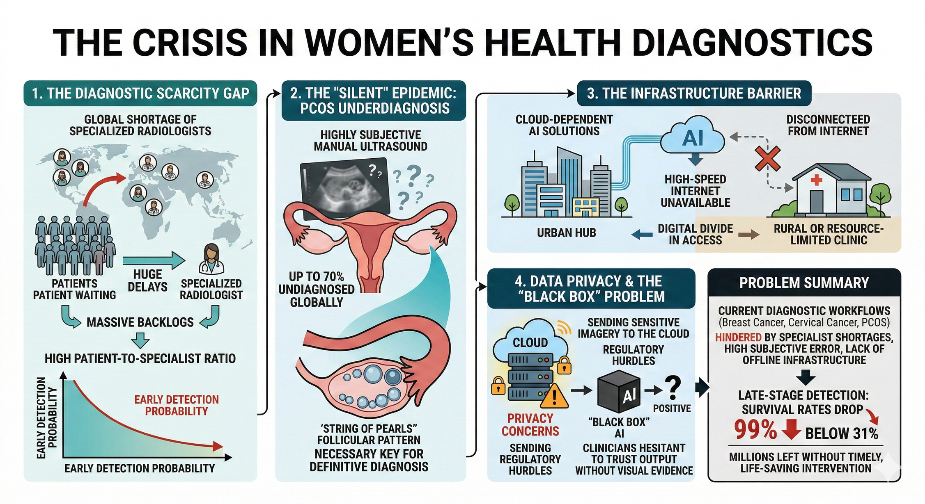
AI ASCEND 2026
Problem Statement

Slide 5
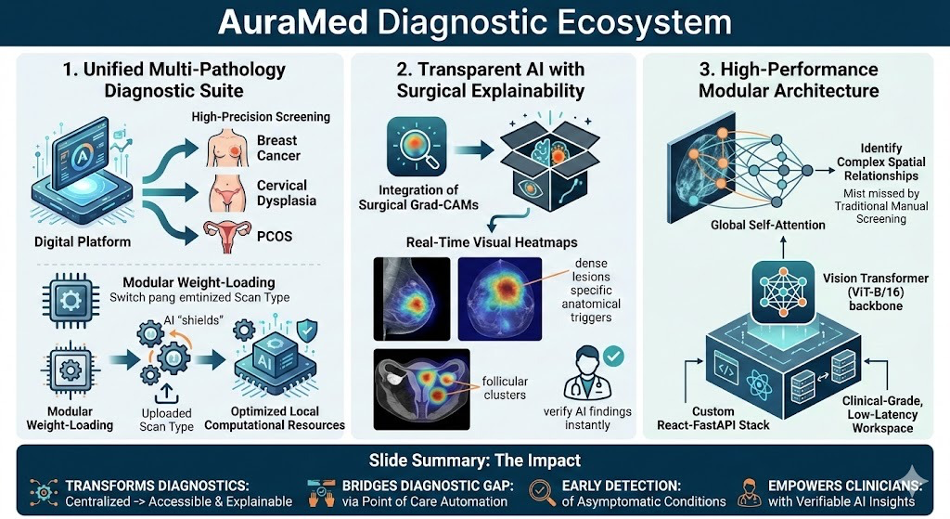
AI ASCEND 2026
Expected Solution

Slide 6
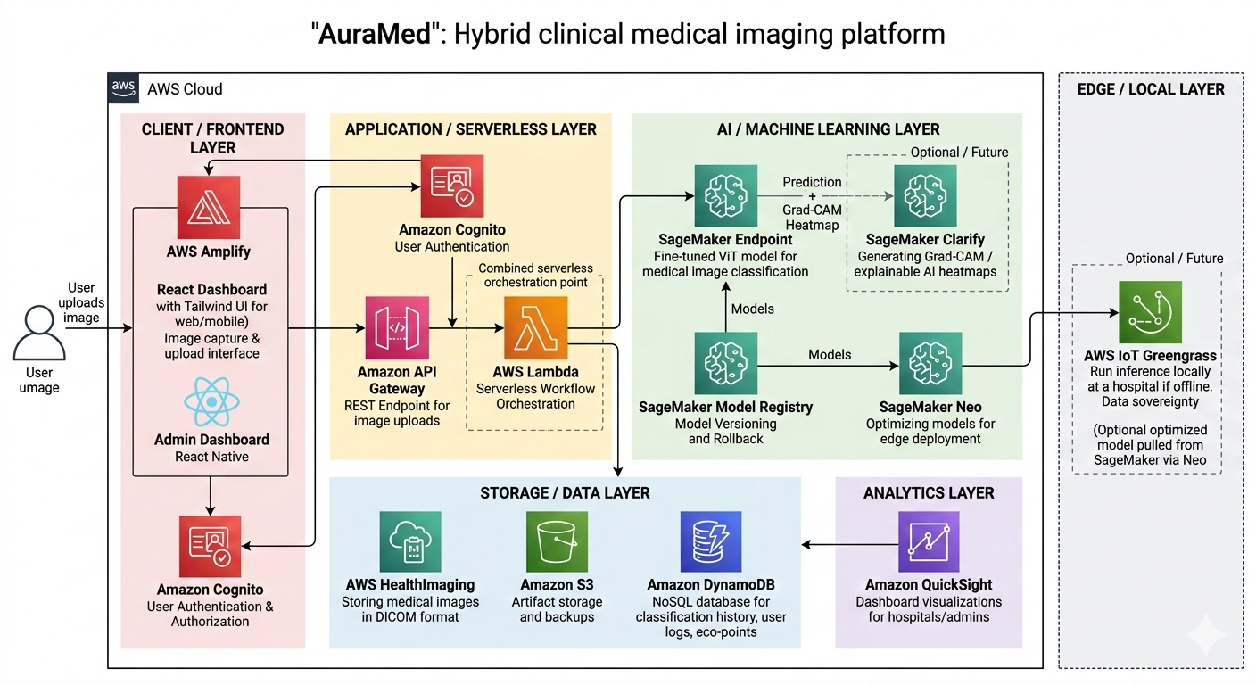
AI ASCEND 2026
Technical Architecture

Slide 7
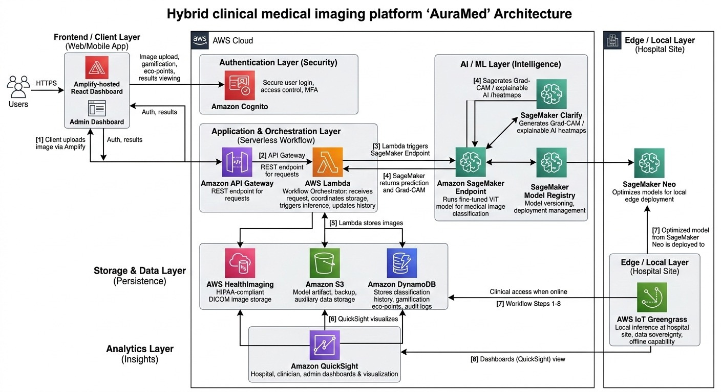
AI ASCEND 2026
How is Cloud Service Used (Minimum 1 aws service to be used)

Slide 8
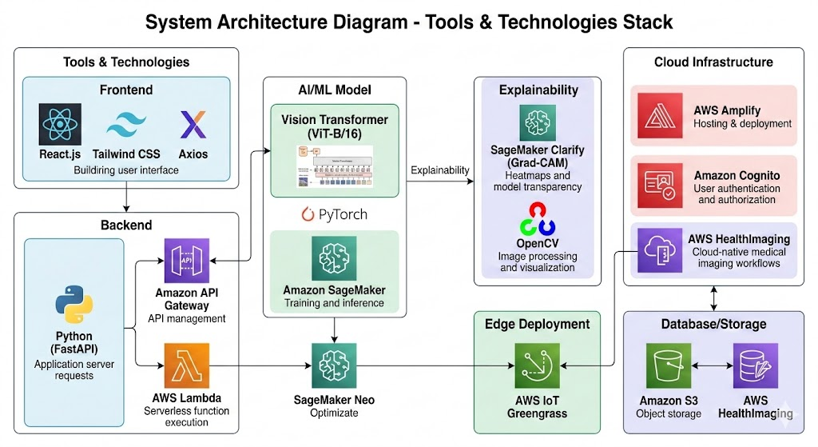

AI ASCEND 2026
Tech Diagram, Stack & GitHub Repo Link
AWS
HealthImaging
https://github.com/srijithtamil/AuraMed

