Slide 1




CRYPTIQ | HACKATHON PRESENTATION · TECH SQUAD
01 Team & Big Idea
CryptIQ
THE ONE-LINE IDEA
Scan
Understand the exposure. Verify the repair.
Show the exposure
BUILT BY TECH SQUAD
Repair
Verify
Findings a business owner can actually read.
Share evidence
Supported repairs — with proof the app still works.
A fictional shop + synthetic customers — one controlled, inspectable example.
TECH SQUAD
S Shriram · Santhosh K · Shreedevi S · Sanjay Kanna A B
TECH SQUAD / CRYPTIQ / WORKING PROTOTYPE
1 / 12
Notes:
CryptIQ connects a technical security finding with a business owner's next decision: we show the problem, review a supported repair, and run checks before publishing the improved result.
The demonstration uses a fictional shop (Chennai Organics) and synthetic customers. No real customer data is involved.
Avoid saying 'India's first', 'fully autonomous', or 'production-ready' — this is a working prototype with bounded, inspectable evidence.
Evaluation: Technical 60 / Business 40.

Slide 2

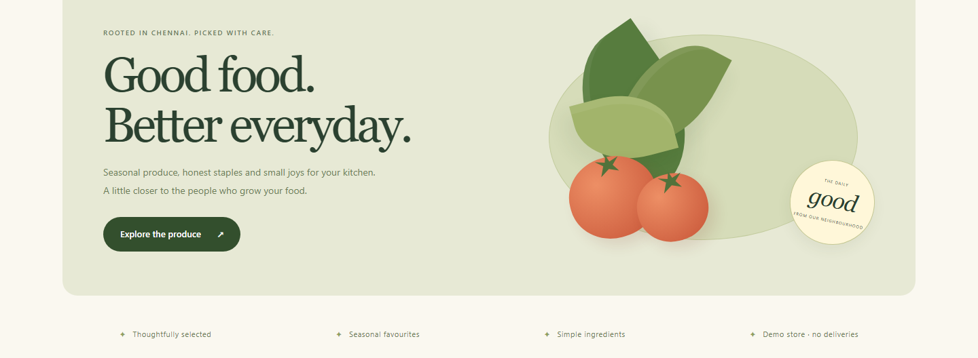

CRYPTIQ | HACKATHON PRESENTATION · TECH SQUAD
02 Problem Statement
A NORMAL-LOOKING SHOP
Weak password hashing
Customers register. The shop works.
Unsalted MD5 — fast to guess
Readable contact fields
Email, phone, address in plain text
Storage risks stay hidden behind a working storefront.
Secret in source code
Owners need clear findings and evidence that a repair worked.
Payment key hardcoded in the app
TECH SQUAD / CRYPTIQ / WORKING PROTOTYPE
2 / 12
Notes:
The storefront is intentionally functional. The risk concerns how data is stored and configured behind it.
This is one controlled, inspectable example — we do NOT claim every small business has these exact problems.
Chennai Organics is a deliberately vulnerable demonstration shop: weak password hashing, readable contact fields, and a secret embedded in source.
Evaluation: Technical 60 / Business 40.

Slide 3
CRYPTIQ | HACKATHON PRESENTATION · TECH SQUAD
03 Target Users & Validation
User | What they need
Business owner | Understand the risk and approve the next step
Developer | Inspect evidence and review supported repairs
Advisory partner | Follow client findings and overall health (read-only)
ONE PRODUCT, DIFFERENT ROLES
The company owns its application.
Its developer performs repairs.
The partner observes and advises — a portfolio view, not another repair dashboard.
VALIDATION Engineering validated — the connected demo workflow is tested. Market not yet validated — no paid pilots or retention data. Plan: interview 10 owners + 3 providers, then recruit 5 pilot businesses.
TECH SQUAD / CRYPTIQ / WORKING PROTOTYPE
3 / 12
Notes:
The partner console gives a portfolio view across client workspaces — it is not a second repair dashboard.
The current demo has one connected shop plus sample companies. Do NOT present the sample companies as real customers.
Engineering vs market evidence are separate: the demo workflow is tested; there are no verified interviews, paid pilots or retention figures yet.
Proposed validation plan (targets, not results): interview 10 owners and 3 service providers, then recruit 5 pilot businesses.
Evaluation: Technical 60 / Business 40.

Slide 4



CRYPTIQ | HACKATHON PRESENTATION · TECH SQUAD
04 Proposed Solution
A clear path from a finding to a verified improvement
1
2
3
4
→
→
→
Scan
Controlled attack
Repair
Verify
Identify supported weaknesses and explain why they matter.
Test a synthetic account to reveal the exposure.
Review and apply the supported repair bundle.
Re-run checks before publishing the evidence.
A clean-looking finding screen does not prove the app is protected — verification tests the repaired state and real application behavior.
TECH SQUAD / CRYPTIQ / WORKING PROTOTYPE
4 / 12
Notes:
The prototype separates discovery from proof.
Individual repair cards support review/selection, but the four dependent backend repairs execute together as one atomic operation.
Actors in the demo: CryptIQ (scan, findings, repair, verification, report), Chennai Organics (customer activity), the Hacker view (controlled attack demonstration), and the Partner (client oversight).
Evaluation: Technical 60 / Business 40.

Slide 5
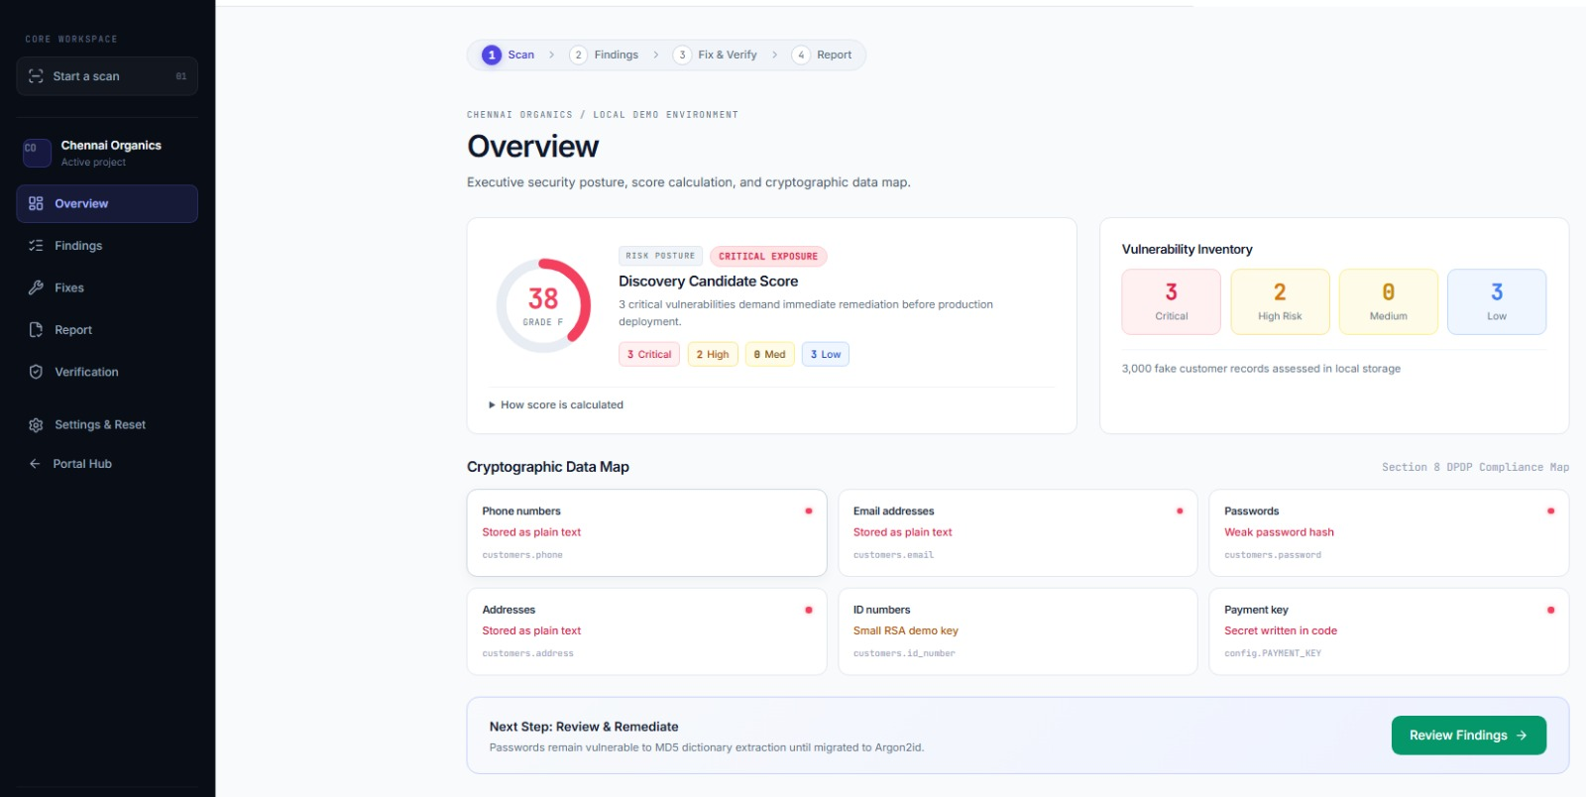
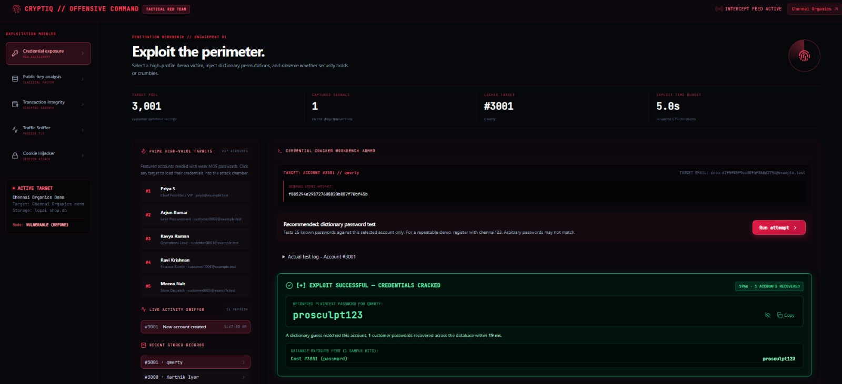
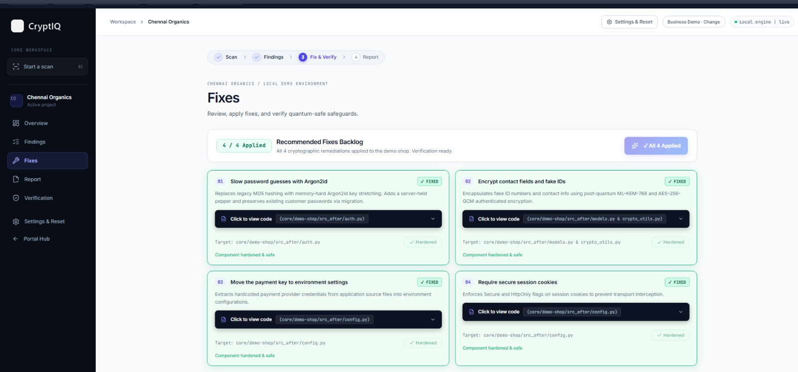
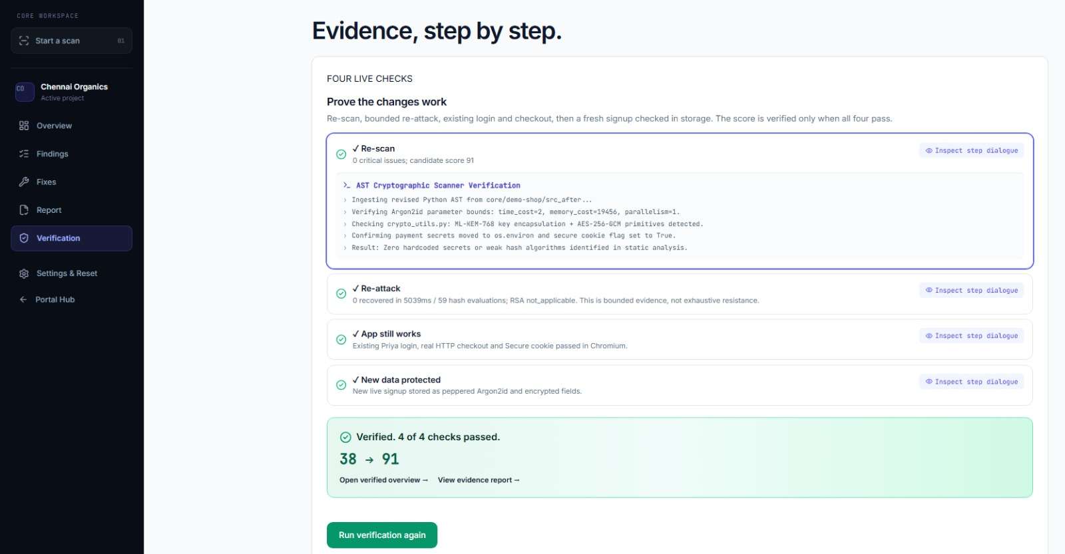
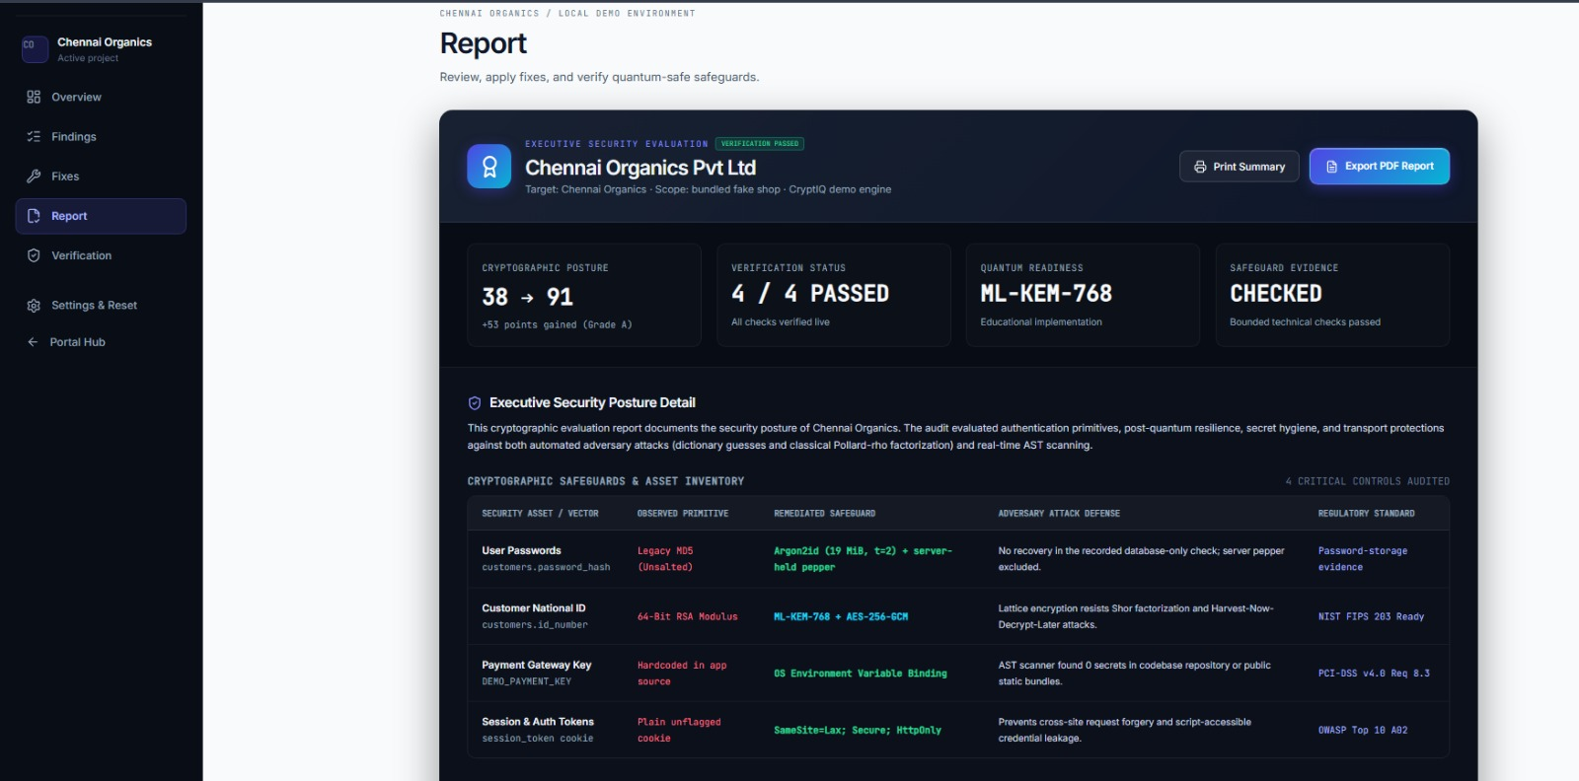

CRYPTIQ | HACKATHON PRESENTATION · TECH SQUAD
05 Prototype / Demo
The Business demo — the same password, before and after
1 · Scan — baseline score 38 (3 critical)
2 · Before repair — password recovered
3 · Repairs applied — 4 / 4 hardened
4 · Verify — 4 / 4 checks, 38 → 91
5 · Report — exportable evidence
Click to view GitHub
Click to open CryptIQ
TECH SQUAD / CRYPTIQ / WORKING PROTOTYPE
5 / 12
Notes:
Visible flow: select Business, scan Chennai Organics, register a synthetic customer, open the Hacker view and run the password test, apply repairs, re-test, verify, and export evidence.
IMPORTANT distinction:
• The password demonstration is a REAL bounded dictionary test (25 known candidates against the selected synthetic account).
• The transaction attack is scripted demonstration behavior; some other tools are previews. Do NOT present these as implemented exploit coverage.
Use fictional accounts only (e.g. test password prosculpt123, an unused test phone). Do not fabricate or edit attack output — these are actual captured results.
Exact sequence lives in the brief (open home → plans → Business → bundled demo → consent → scan → Hacker tab → register → run dictionary attempt → show recovered password → apply 4/4 repairs → re-test, no recovery → verify → report → PDF → partner console).
Evaluation: Technical 60 / Business 40.
Click the logos or labels to open GitHub and the full current demo sharing URL. The demo is a temporary PC-backed tunnel. Repository access is private.

Slide 6
CRYPTIQ | HACKATHON PRESENTATION · TECH SQUAD
06 Technical Architecture
Connected layers: experience, orchestration, inspection and evidence
React interfaces
Owner, developer, Hacker and Partner
↓
FastAPI workflow service
Runs scan, repair and verification jobs
↓
↓
Python AST rules
Flask shop + SQLite
Source inspection without execution
Events and sampled storage evidence
↓
↓
Verification and evidence publication
Both inputs feed rescan, reattack, app and storage checks. Report unlocks on success.
Coverage: 8 rule families. First 100 customer rows sampled. URL scanning remains a preview.
TECH SQUAD / CRYPTIQ / WORKING PROTOTYPE
6 / 12
Notes:
The scanner uses Python's abstract syntax tree (AST) to inspect supported structures without executing uploaded code: e.g. hashlib.md5 calls, specific config assignments, recognized crypto imports, the demo's contact-protection function, and expected policy/contact files.
The database check samples the first 100 customer rows and separately counts the full customer population.
This is targeted source-pattern + storage inspection, not interprocedural data-flow analysis or comprehensive pen-testing. Local ZIP inspection is supported; URL scanning is a preview; public uploads are restricted.
Reference — Python AST docs: https://docs.python.org/3/library/ast.html
Evaluation: Technical 60 / Business 40.

Slide 7
CRYPTIQ | HACKATHON PRESENTATION · TECH SQUAD
07 Build Evidence & Engineering
Research translated into inspectable rules and evidence
STAGE 1
STAGE 2
STAGE 3
Source & storage evidence
→
Rule evaluation
→
Findings & inventory
Enumerate files, parse Python, read supported DB fields
Match code/config patterns, record file + line, deduplicate
Owner-readable findings, demo score, CycloneDX export
RESEARCH REFERENCES — CLICK TO OPEN
SOURCE CODE
OWASP: password storage
MITRE CWE: risky cryptography
NIST FIPS 203: ML-KEM
CycloneDX: crypto inventory
Click to inspect the source
References support concepts; implemented rules define actual coverage.
Review engine/simple_rules.py and pipeline.py for exact coverage.
TECH SQUAD / CRYPTIQ / WORKING PROTOTYPE
7 / 12
Notes:
Engineering pipeline: enumerate supported files → parse Python → match explicit code/config patterns → record evidence + affected assets → inspect supported DB fields → deduplicate by rule family → add owner-readable explanations → calculate the demo score → export findings + crypto inventory → bind later verification evidence to the relevant app state.
CryptIQ combines established libraries with repository-specific code. Do NOT describe the scanner as a trained AI model or claim it imports a large external vulnerability corpus.
GitHub: https://github.com/shriram-s7/cryptiq
References — Bandit (AST security analysis): https://github.com/PyCQA/bandit · Semgrep rules: https://github.com/semgrep/semgrep-rules (review its license before reuse) · CycloneDX CBOM: https://cyclonedx.org/capabilities/cbom/
Evaluation: Technical 60 / Business 40.

Slide 8
CRYPTIQ | HACKATHON PRESENTATION · TECH SQUAD
08 Security, Privacy & Scale
What changes after repair — and what the test proves
BEFORE
AFTER
Unsalted MD5 password hashes
→
Server-held pepper + Argon2id
Readable contact fields
→
AES-256-GCM encrypted fields
Tiny demo RSA for fake IDs
→
ML-KEM-768 protects the data key
Secret embedded in source
→
Secret loaded from environment config
VERIFIED Re-scan · Re-attack · Application behavior · Fresh-account storage. Seeded demo score 38 → 91. New activity can invalidate earlier evidence.
TECH SQUAD / CRYPTIQ / WORKING PROTOTYPE
8 / 12
Notes:
Password protection uses a server-held secret (pepper) stored outside the DB before Argon2id hashing. The demonstrated attacker receives DB contents without that secret. Existing accounts migrate without recovering plaintext; new accounts use the repaired path.
AES-GCM protects field contents. ML-KEM is a key-encapsulation mechanism protecting the data key — it is NOT a password-hashing algorithm.
The RSA example uses classical factoring of a deliberately tiny key. Do NOT claim quantum hardware or production RSA compromise. The educational PQ implementation must be replaced before production.
Show 38 → 91 only as the seeded demo's scoring outcome. All four checks must pass before fresh evidence is published.
Scale evidence is currently synthetic; production tenant isolation, hosting, key management and load testing remain future work.
References — OWASP Password Storage: https://cheatsheetseries.owasp.org/cheatsheets/Password_Storage_Cheat_Sheet.html · OWASP Cryptographic Storage: https://cheatsheetseries.owasp.org/cheatsheets/Cryptographic_Storage_Cheat_Sheet.html · CWE-916: https://cwe.mitre.org/data/definitions/916.html · CWE-312: https://cwe.mitre.org/data/definitions/312.html · CWE-327: https://cwe.mitre.org/data/definitions/327.html · CWE-798: https://cwe.mitre.org/data/definitions/798.html · CWE-614: https://cwe.mitre.org/data/definitions/614.html · NIST FIPS 203 (ML-KEM): https://csrc.nist.gov/pubs/fips/203/final · kyber-py (educational): https://github.com/GiacomoPope/kyber-py
Evaluation: Technical 60 / Business 40.

Slide 9
CRYPTIQ | HACKATHON PRESENTATION · TECH SQUAD
09 Market Opportunity & Competitors
A focused workflow for smaller businesses
Approach | Focus
Semgrep | Source-code security analysis
OWASP ZAP | Web-application testing
CryptIQ prototype | Owner-facing repair + verification workflow
WHERE WE FIT
Initial buyers
Small online shops with developer or IT support.
Why this workflow
Understandable findings, supported repairs and repeatable evidence.
Measure onboarding time, repair completion and willingness to pay.
PILOT TARGET
5 businesses + 2 advisory partners
Established tools are broader in their own domains — we differentiate on the connected user experience.
TECH SQUAD / CRYPTIQ / WORKING PROTOTYPE
9 / 12
Notes:
Established tools have broader capabilities in their domains. The proposed differentiation is the connected user experience, not a claim competitors lack remediation features.
Proposed first pilots: 5 businesses and 2 advisory partners. Measure onboarding time, usefulness of findings, repair acceptance and willingness to pay.
Avoid a large market-size chart — no independently sourced data supplied.
References — Semgrep: https://docs.semgrep.dev/ · OWASP ZAP: https://www.zaproxy.org/
Evaluation: Technical 60 / Business 40.
Market relevance: small shops with outside technical support are an initial hypothesis. The owner needs understandable evidence, while the partner needs oversight. Semgrep and ZAP are category comparisons, not equal-coverage claims. Pilot numbers are targets, not traction. Measure onboarding time, repair completion and willingness to pay. Sources: https://docs.semgrep.dev/ and https://www.zaproxy.org/ .

Slide 10
CRYPTIQ | HACKATHON PRESENTATION · TECH SQUAD
10 Business Model & GTM
Plan | Price / mo | Demonstrated scope
Free | ₹0 | Discovery · one project · one scan
Starter | ₹999 | One project · 4 scans · repair + verification
Business | ₹2,999 | One project · 12 scans · full evidence workflow
Partner | ₹1,199 | Read-only portfolio · 3 active client workspaces
+ extra client | ₹500 | Each additional active workspace / month
ACQUISITION
Free discovery
↓
Guided review
↓
Repeat use
↓
Partner referrals
Prices are pilot proposals shown in the product — payments are not connected and demo limits are not production billing.
TECH SQUAD / CRYPTIQ / WORKING PROTOTYPE
10 / 12
Notes:
Prices are pilot proposals displayed in the product. Payments are not connected; current demo limits are not production billing enforcement.
An 'active partner client' = a client workspace enabled for tracking during the billing period. Example: 3 active clients ₹1,199/mo; 5 active clients ₹2,199/mo.
The partner observes and advises; the company + its developer handle repairs. The partner fee pays for portfolio management and evidence visibility, not unlimited cross-client repair execution.
Evaluation: Technical 60 / Business 40.

Slide 11
CRYPTIQ | HACKATHON PRESENTATION · TECH SQUAD
11 Financial Model & Team Cost
PLANNING ASSUMPTIONS — NOT MEASURED RESULTS
₹90,000
₹24,985
₹1,985
~14
Proposed 90-day budget
Illustrative monthly revenue
Illustrative monthly surplus
Accounts to break even
90-day budget
Founder time | ₹60,000
Hosting & tools | ₹15,000
Security review | ₹10,000
Outreach | ₹5,000
Total | ₹90,000
Example month
10 Starter | ₹9,990
5 Business | ₹14,995
− Variable (15 × ₹200) | −₹3,000
− Fixed cash costs | −₹20,000
Operating surplus | ₹1,985
TECH SQUAD / CRYPTIQ / WORKING PROTOTYPE
11 / 12
Notes:
Budget: Founder time ₹60,000 (3 roles × 80 hrs × ₹250/hr — proposed responsibilities, not named hires: product/frontend; API & security integration; QA & pilot onboarding), hosting & tools ₹15,000, security review ₹10,000, outreach ₹5,000 = ₹90,000. If founders draw no salary, assumed cash expenses ≈ ₹30,000. Validate all estimates before spending.
Monthly scenario: 10 Starter (₹9,990) + 5 Business (₹14,995) = ₹24,985 revenue. Variable 15 × ₹200 = ₹3,000 → contribution ₹21,985. Assumed fixed cash ₹20,000 → operating surplus ₹1,985. Excludes founder salaries, taxes and recovery of the initial dev budget.
Illustrative CAC: ₹5,000 / 5 new paying accounts = ₹1,000 per account. No defensible LTV until retention is measured.
Evaluation: Technical 60 / Business 40.

Slide 12





CRYPTIQ | HACKATHON PRESENTATION · TECH SQUAD
12 Roadmap, Ask & Closing
30 days
60 days
90 days
Pilot feedback and persistent hosting.
Stronger access control, tenant isolation, broader repair coverage.
Evaluate production crypto dependencies, CI integration, paid pilots.
THE ASK Pilot introductions and an independent security review.
Click to view GitHub
Click to open the live CryptIQ app
Click in presentation mode. Temporary demo: presenter PC must stay online.
“CryptIQ connects an understandable risk with a supported repair and evidence of the result.”
TECH SQUAD / CRYPTIQ / WORKING PROTOTYPE
12 / 12
Notes:
Closing ask: pilot introductions and an independent security review.
GitHub: https://github.com/shriram-s7/cryptiq
Temporary demo origin: https://usual-orbit-national-mazda.trycloudflare.com/
ACCESS NOTE: new visitors need the complete private access link supplied by the presenter; the presenter's laptop and tunnel must remain running. Do NOT place the private access token in a publicly uploaded deck.
Closing sentence: “CryptIQ connects an understandable risk with a supported repair and evidence of the result.”
Evaluation: Technical 60 / Business 40.
Click the logos or labels to open GitHub and the full current demo sharing URL. The demo is a temporary PC-backed tunnel. Repository access is private.

