Slide 1
Whispering Village
Cognitive NPCs that remember, gossip, and change the game
Innovation Mission 5 • Conversational Dialogue Systems • 48-hour Hackathon
Team of 4 • Pygame + Gemini + SQLite • Pure software build
Whispering Village • Cognitive NPCs — Conversational Dialogue Systems

Slide 2
Problem Statement
• Mission 5: Cognitive NPCs. Build game characters that hold natural conversations instead of fixed dialogue trees.
• Stage 1 — Foundation: an NPC that takes free-text input and replies in character.
• Stage 2 — Functional: conversations must change quests, prices, objectives, progression.
• Stage 3 — Innovation: memory, personality and adaptive behaviour across sessions.
• Constraint: pure software, 48 hours, basic project/API experience, demo-or-die reliability.
Whispering Village • Cognitive NPCs — Conversational Dialogue Systems

Slide 3
Our Solution: a Village That Talks Back
• Gruff the blacksmith — gruff, honest, hates liars. Gives the Iron-Ore quest at trust ≥ 20.
• Mira the merchant — chatty gossip who sells potions; prices react to trust (30% off friends, +50% enemies).
• Rex the guard — strict gatekeeper; opens the Old Forest gate at trust ≥ 15, slams it at ≤ −30.
• Core loop: explore → talk in natural language (or voice) → AI suggests → game validates → NPC remembers.
• Golden rule: the AI suggests, the game decides — no invented rewards, no skipped quests.
Whispering Village • Cognitive NPCs — Conversational Dialogue Systems

Slide 4
Architecture
• Pygame client (main.py + art.py) — twilight 2D world, dialogue panel, trust bar, portraits, mic button; AI calls on background threads.
• npc.py — personality prompts, mood/trust/memory state, structured JSON replies, offline fallback when AI is down.
• world.py — map, quest state, gate, shop pricing; validates every AI-proposed action against trust thresholds.
• memory.py + SQLite — FTS5 facts, daily summaries, rolling profile; prompt = profile + summary + top-k facts.
• voice.py — mic → speech-to-text → prosody analysis → vocal expression → trust delta.
• Secrets: API key lives only in backend .env — never in the game or repo.
Whispering Village • Cognitive NPCs — Conversational Dialogue Systems

Slide 5
Stage 1 — Foundation: One NPC That Talks
• Free-text chat with Gruff in the terminal (chat_terminal.py) — no fixed options.
• Strict JSON contract: { reply, mood, trust_change (−15…15), learned_fact, action }.
• In-character + multilingual: gruff forge-voice; understands Hinglish/code-switched input, mirrors the player's style.
• Trust from tone: boasts punished, apologies rewarded — verified live against Gemini.
Whispering Village • Cognitive NPCs — Conversational Dialogue Systems

Slide 6
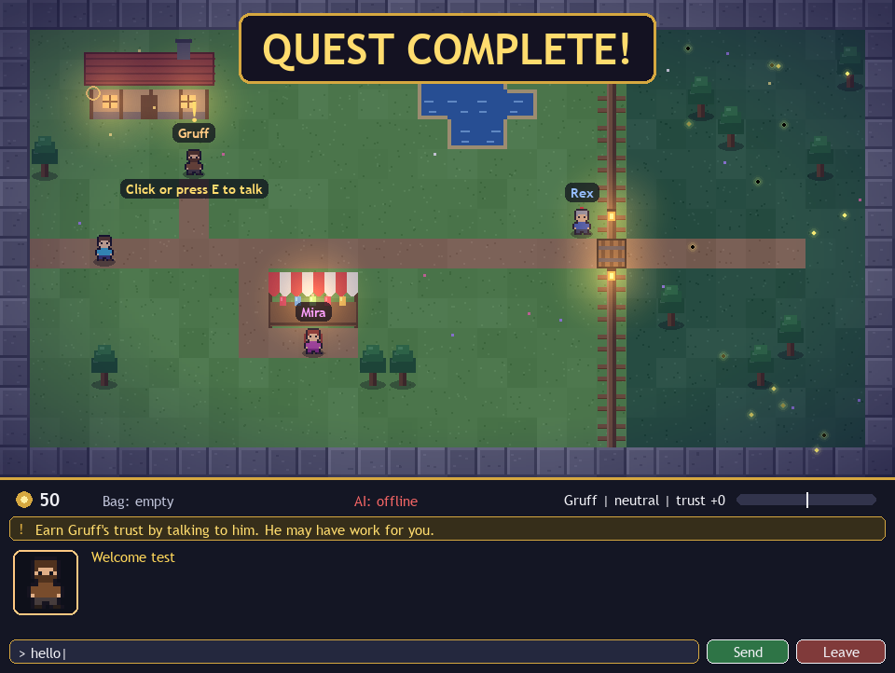
Stage 2 — Functional: Talk Changes the World
• Dialogue-driven quest: earn Gruff's trust → fetch Iron Ore past Rex's gate → Iron Sword + 30 gold.
• Living economy: Mira's potion price follows her opinion of you.
• Consequences: insult Rex and the gate slams shut; be polite and it opens.
• Demo-proof: every rule unit-tested with stubbed AI (quest gating, pricing, gate lock, bad-AI guard).
Whispering Village • Cognitive NPCs — Conversational Dialogue Systems

Slide 7
Uniqueness: a Rumor-Immunity Simulator
• Real-world problem: misinformation spreads faster than facts (Bad News game, N=15k, Nature).
• Our twist: the Stage-3 gossip engine that spreads lies between NPCs becomes the mechanic that teaches verification.
• Quest: Rex plants a fake ‘poisoned well’ rumor — the quest completes only after cross-checking with 2 NPCs.
• Second layer: Hinglish merchant = low-pressure language practice (Duolingo Max precedent); empathy-gated quests reward kindness.
• Pitch line: “The NPC doesn't just parse words — the village teaches you whom to trust.”
Whispering Village • Cognitive NPCs — Conversational Dialogue Systems

Slide 8
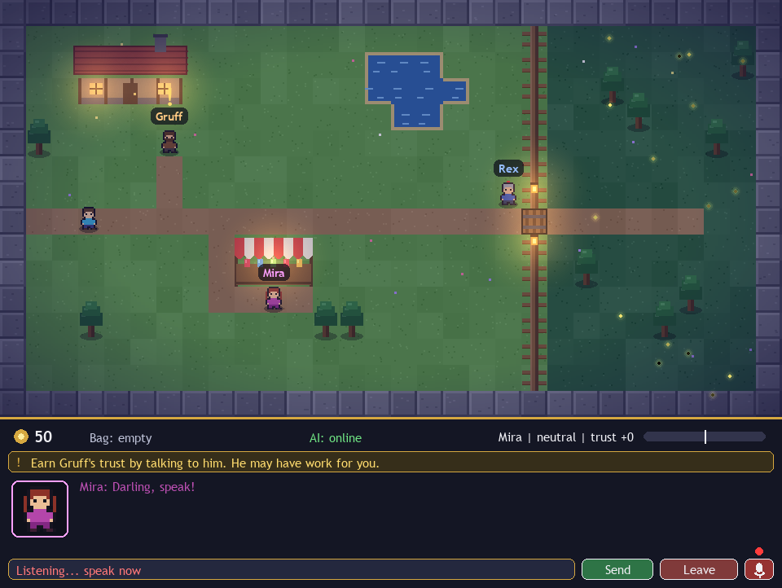
Voice Expression Detection
• Pipeline: mic → free speech-to-text → numpy prosody (pitch, energy, pace, pauses, jitter) → expression.
• 7 expressions: kind, genuine, overconfident, nervous, sad, rude, deceptive — each moves trust (−6…+6).
• Research-backed cues: rising pitch + slow = uncertain; raised pitch-max + hesitations = shifty.
• UI: mic button + V key, pulsing REC dot, transcript arrives as ‘You (voice, kind): …’.
• Fallbacks: no mic / offline → typed text; per-player calibration for personal thresholds.
Whispering Village • Cognitive NPCs — Conversational Dialogue Systems

Slide 9
Persistent Memory That Scales
• Problem: 10,000 conversations can't fit in a prompt — so we never send history.
• Design: short-term buffer (last 8 turns) + SQLite long-term: FTS5 facts, daily summaries, rolling profile.
• Nightly reflection: each in-game day, every NPC dreams the day into durable facts (Generative-Agents pattern).
• Retrieval: relevance + importance + recency → top-4 facts per reply; proven persistent across restarts.
Whispering Village • Cognitive NPCs — Conversational Dialogue Systems

Slide 10
Live Demo (3 minutes)
• 1. Talk: greet Gruff, tell him your name — he remembers it after a restart.
• 2. Quest: earn trust, take the Iron-Ore quest, convince Rex, fetch the glowing ore.
• 3. Voice: speak kindly to Mira (trust jumps) vs arrogantly to Rex (gate stays shut).
• 4. Memory: /sleep → NPCs summarize the day; /status shows the diary.
• 5. Rumor: verify Rex's well rumor with two villagers to complete the immunity quest.
Whispering Village • Cognitive NPCs — Conversational Dialogue Systems

Slide 11
Thank You
• Stack: Python + Pygame + Gemini + SQLite — all free-tier, all offline-capable.
• Proof: unit-tested rules, headless render tests, live-API verified, check_api.py diagnostics.
• Next: full rumor map UI, pixel-font polish, Vosk offline speech-to-text.
• Whispering Village — where every conversation changes the game.
Whispering Village • Cognitive NPCs — Conversational Dialogue Systems

