Slide 1
Whispering Village — Stage 2
A playable village where conversations change the game
Talk • earn trust • sleep • watch rumors spread
Whispering Village • Stage 2 build • Cognitive NPCs

Slide 2
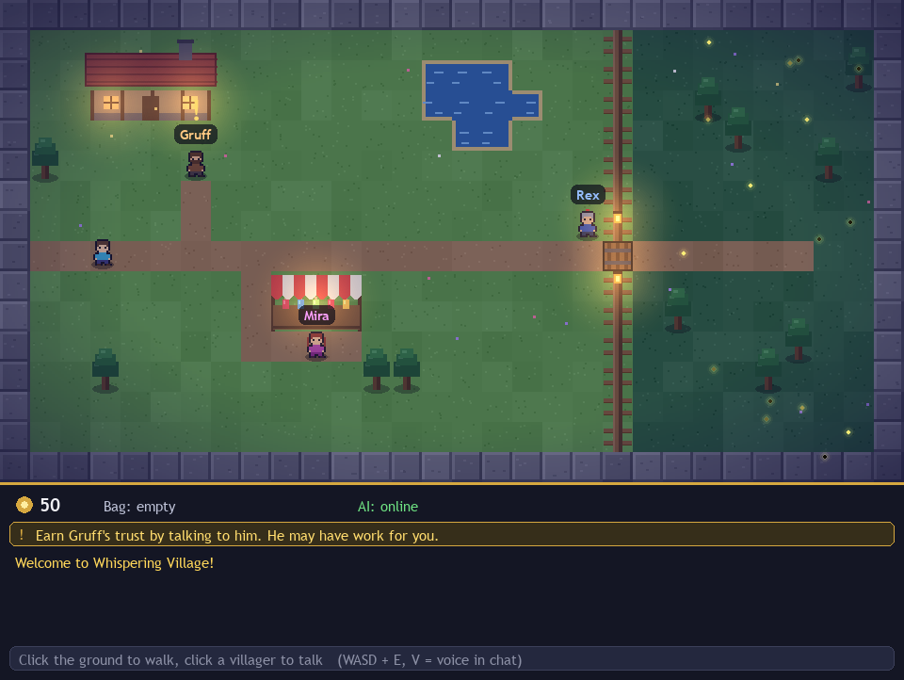
Stage 2 — what we built and verified
• Playable twilight village: walk, talk to Gruff / Mira / Rex, quest, shop, gate
• Trust engine: one score drives quests, prices, secrets and the gate
• SQLite memory: facts + nightly summaries, survives restarts (19-check suite green)
• Voice mode: mic button + V key, tone shifts trust, Hinglish understood
• Stage 3 gossip engine + rumor map already live on top of it
• Every rule unit-tested with stubbed AI — zero quota burned in tests
Whispering Village • Stage 2 build • Cognitive NPCs

Slide 3
How it works — AI suggests, game decides
• Player types/speaks → LLM replies in character + proposes an action (JSON)
• world.py validates against trust + quest state — the AI can never invent rewards
• Night: gossip.py retells memories villager-to-villager, distorted by personality
• Offline fallback at every layer — the full loop demos with no internet
• Keys live only in .env; check_api.py diagnoses the AI link in seconds
Whispering Village • Stage 2 build • Cognitive NPCs

Slide 4
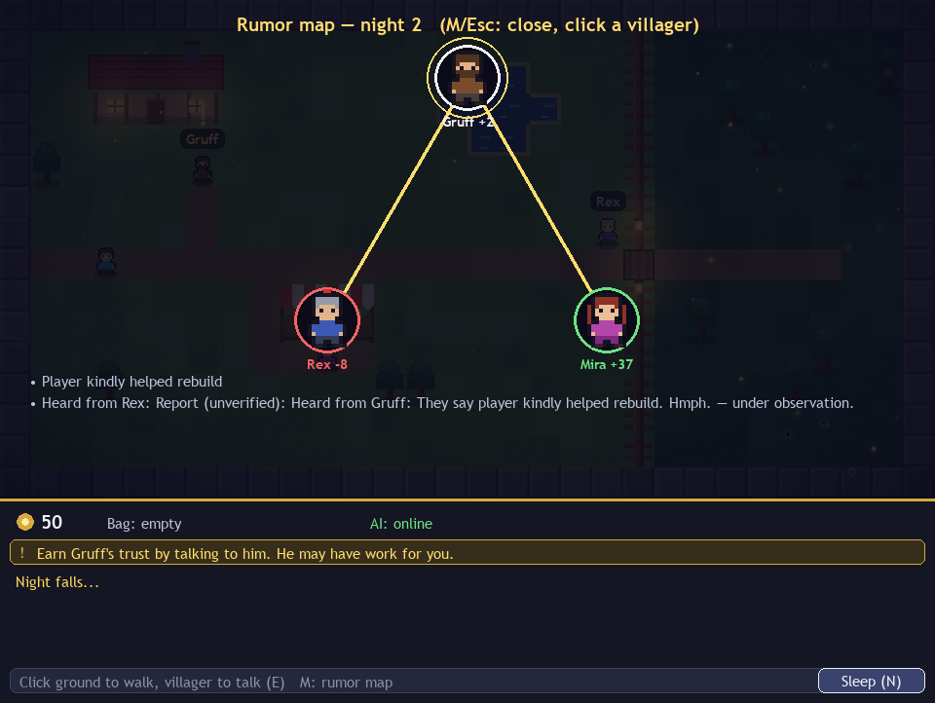
What makes it unique
• Mutating gossip: Mira doubles numbers, Gruff grunts, Rex files reports — lies evolve
• Rumor map: live graph of who-believes-what, click any villager to inspect
• Tone-aware NPCs: loud/fast reads rude (−6), quiet/slow reads sad (+3 sympathy)
• Forgetting-proof memory: 10 or 10,000 chats cost the same prompt
• Trust economy: kindness is literally currency (prices, quests, gates, secrets)
Whispering Village • Stage 2 build • Cognitive NPCs

Slide 5
Real-world problem it solves
• Misinformation: rumors outrun facts — our village is a playable inoculation lab (Bad News game precedent, N=15k)
• Language access: code-switched players get spoken-back Hinglish, not broken English (Duolingo Max precedent)
• Empathy practice: kindness-gated quests reward how you treat people, safely rehearsable
• Low-literacy play: voice-first input, icon buttons, short sentences
Whispering Village • Stage 2 build • Cognitive NPCs

Slide 6
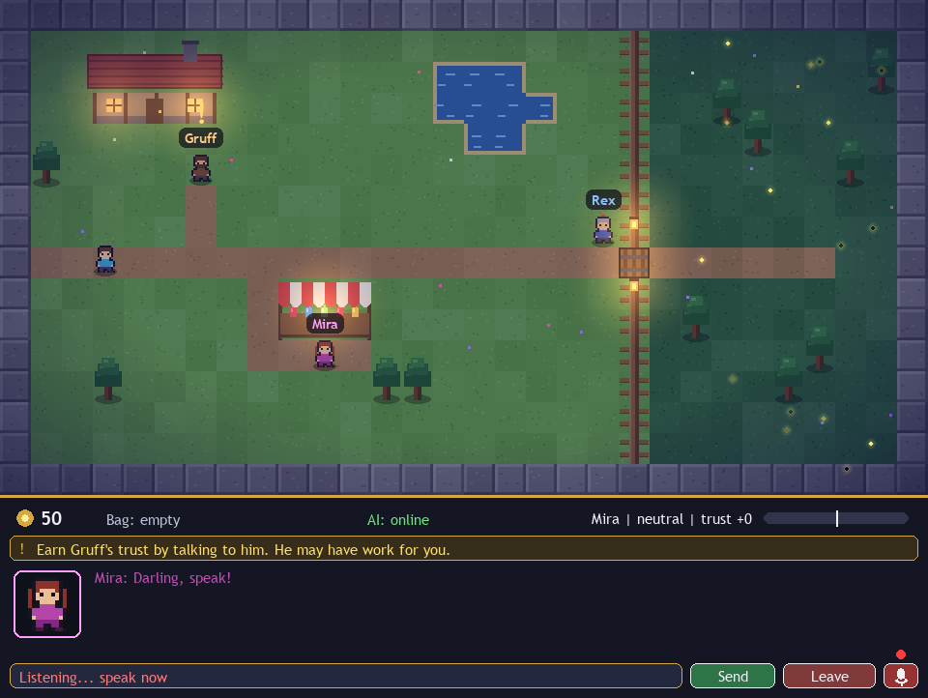
How we built Stage 2 differently
• Deterministic core, AI at the edges: rules tested headless, LLM only flavors
• Unity-to-Pygame art pipeline: characters batch-rendered in Unity 6, chroma-keyed in (SpriteBaker.cs)
• Mic you can see: procedural mic button + REC pulse + device diagnostics, no assets
• Proof over promises: GOSSIP_OK, BACKEND_OK, THREAD_OK suites + rendered screenshots from real code
Whispering Village • Stage 2 build • Cognitive NPCs

Slide 7
Live demo + what is next
• Demo: greet Mira → earn Gruff's quest → open Rex's gate → fetch ore → Sleep → open the rumor map
• Contrast: kind voice vs arrogant voice — same words, different village
• Proof: /status diary, restart persistence, offline mode with wifi killed
• Next: pixel font, Vosk offline speech-to-text, 2 more villagers, rumor-map overlay polish
Whispering Village • Stage 2 build • Cognitive NPCs

