Slide 1
Superstore Sales & Profit Dashboard
Task 3: Interactive Dashboard Design — Data Analyst Internship
Built with Power BI Desktop | Dataset: Sample Superstore (Kaggle)

Slide 2
Objective & Dataset
Objective
Dataset
Design an interactive sales & financial dashboard that helps business stakeholders quickly understand revenue, profitability, and regional performance trends.
Sample Superstore dataset (Kaggle) — 4 years of US retail orders covering Sales, Profit, Discount, Region, Category, and Customer Segment.
Data Cleaning Steps
Tools Used
Fixed Order Date / Ship Date locale (DD-MM-YYYY)
Removed duplicate rows
Corrected column data types
Removed unused columns (Row ID)
Power BI Desktop — data modeling & visualization
Power Query Editor — data cleaning
DAX — calculated measures

Slide 3
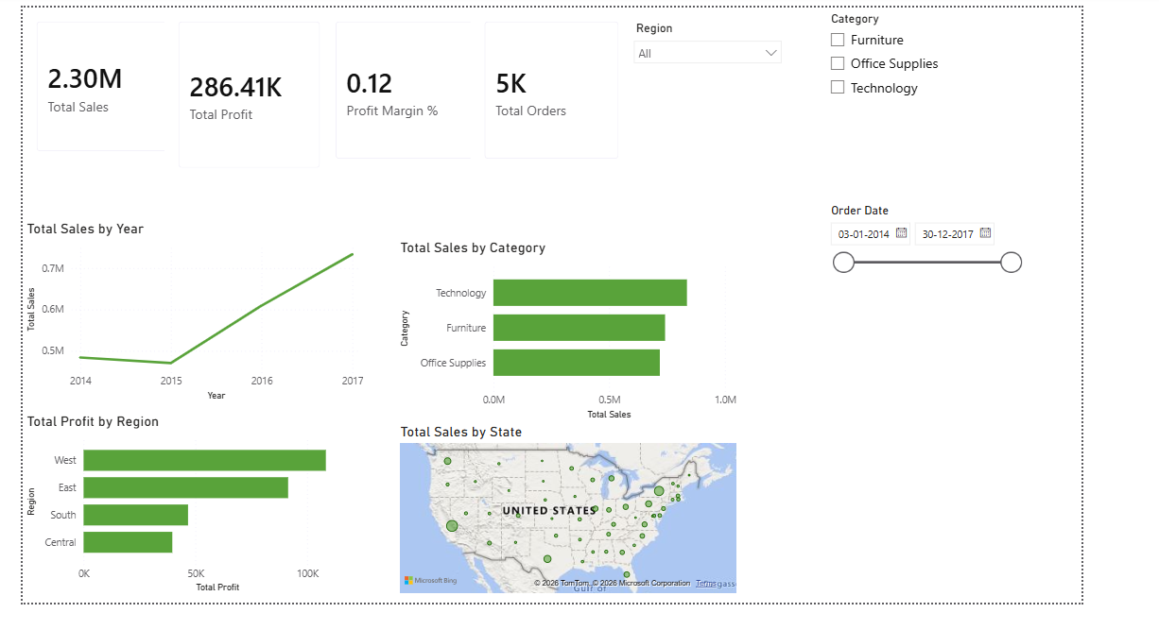
Final Dashboard

Slide 4
Key Insights
2.30M
286.4K
West
Technology
Total Sales
Total Profit
Top Region
Top Category
Generated across all regions over the 4-year period.
Yields an overall profit margin of 12%.
Highest profit contributor; Central region trails behind.
Leads in total sales over Furniture and Office Supplies.
What the dashboard reveals
Sales grew steadily from 2014, with a sharp rise heading into 2017
West and East regions together drive the majority of profit
Technology outsells Furniture and Office Supplies, but margins should be checked per category
Date-range and category slicers let stakeholders drill into any time period or product line instantly

Slide 5
Process & Learnings
1
Imported & cleaned data in Power Query (locale fixes, dedup, type correction)
2
Built DAX measures: Total Sales, Total Profit, Profit Margin %, Total Orders
3
Designed visuals: KPI cards, time-series trend, category & regional bar charts, map
4
Added interactivity with Region, Category, and Order Date slicers
5
Applied a consistent green color theme across all visuals
Key takeaway: Combining clean data, focused KPIs, and interactive filters turns raw sales records into a tool stakeholders can actually use for decisions.

