Slide 1






QUANTUM ARENA 1.0
TITLE PAGE
Problem Statement -Title-Automatic Exam Paper Generator Based On Syllabus Difficulty
Theme -Education Technology/Smart Assesment System
PS Category -Software Solution
Team Name – Alkarise

Slide 2

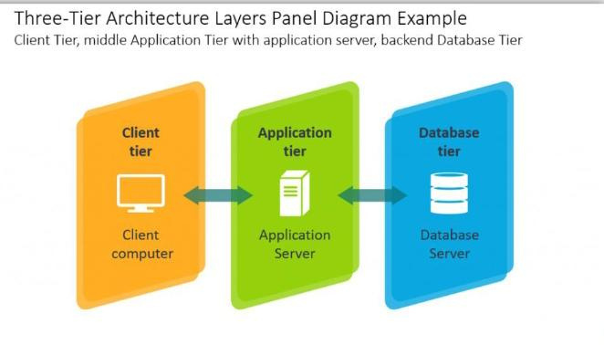
Ttt
Automatic Exam Paper Generator Based on Syllabus Difficulty
Alkarise
🔹 1. Problem Statement :-
Creating Questions papers manually is slow, repetitive and stressful task for teachers. Maintaining fairness and syllabus coverage is difficult.
Making exam papers manually takes a lot of time and effort. It is difficult to create a paper that covers all syllabus topics and has the right difficulty level.
Main Problem:
Manual paper setting is slow
Repeated questions may come in exams
Difficulty level is not balanced
Some syllabus topics may be missed
Mistakes in marks or question selection
Different teachers may set different standards
Last-minute paper making creates stress
Lack of Standarization between classes
@SIH Idea submission- Template
2
Notes:
1.7.2013
2
‹#›

Slide 3

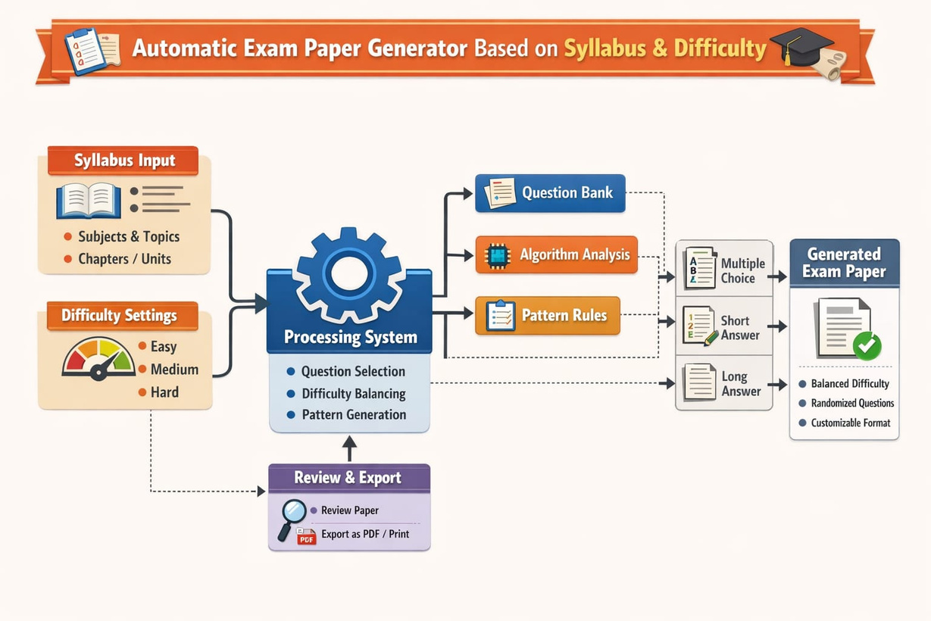
TECHNICAL APPROACH
Alkarise
🔹 Technologies Used:-
Programming: PHP
Database: MySQL
Frontend: HTML, CSS
Server: XAMPP
VS Code
🔹 Working Steps:-
Teacher enters subject name and exam details
Selects syllabus topics and weightage
Chooses difficulty level (Easy / Medium / Hard)
System checks the question bank
Questions are selected randomly as per rules
Duplicate questions are removed
Balanced paper is created automatically
Final question paper is generated in PDF format
@SIH Idea submission- Template
3
Notes:
1.7.2013
3
‹#›

Slide 4

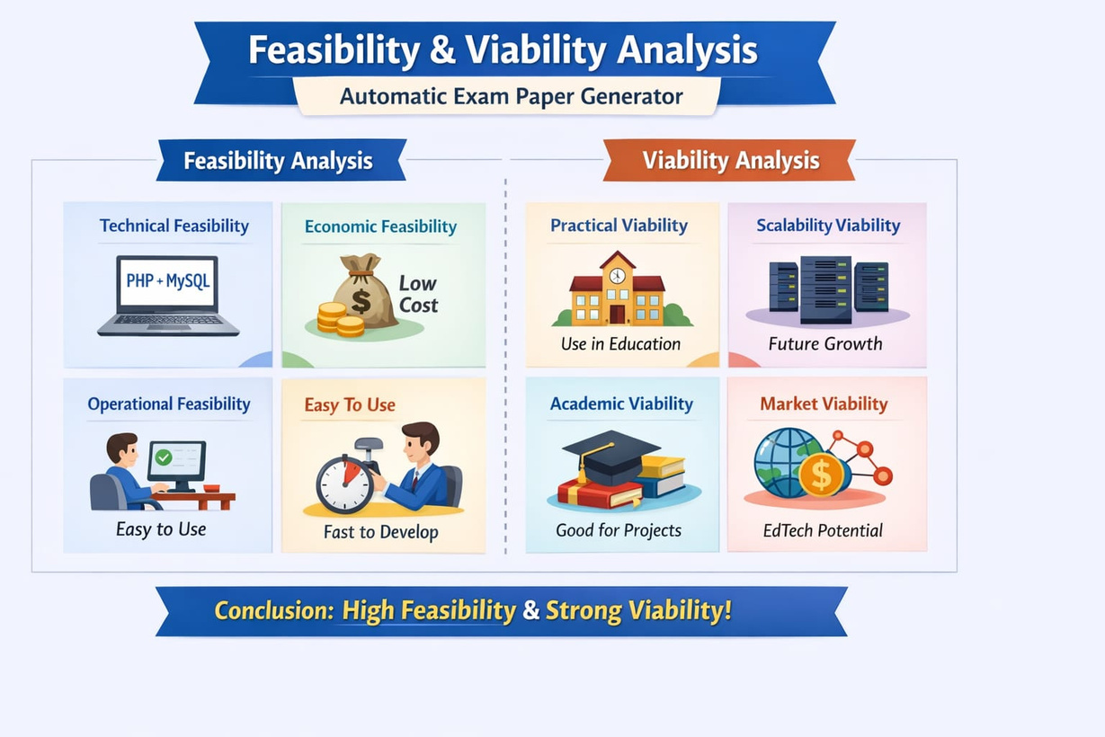
FEASIBILITY AND VIABILITY
Alkarise
🔹Feasibility determines whether your system is:-
Our project is practical, simple to build, and useful for schools and colleges.
Why It Is Feasible:
Uses low-cost and free software tools
Easy to develop and maintain
Can run on laptop or desktop
Simple database for storing questions
Can be used by schools and colleges
Easy to update new questions anytime
🔹 Challenges:-
Limited number of questions in question bank
Wrong difficulty level assigned to questions
Repetition if database is small
Missing some syllabus topics
Slow performance with large data
Errors in PDF formatting
Need regular updates in question bank
Different exam patterns for different subjects
User may enter wrong input details
Data security and backup management
🔹 Solutions:-
Use AI model training for accuracy
Secure database with encryption
Backup attendance system
@SIH Idea submission- Template
4
Notes:
1.7.2013
4
‹#›

Slide 5

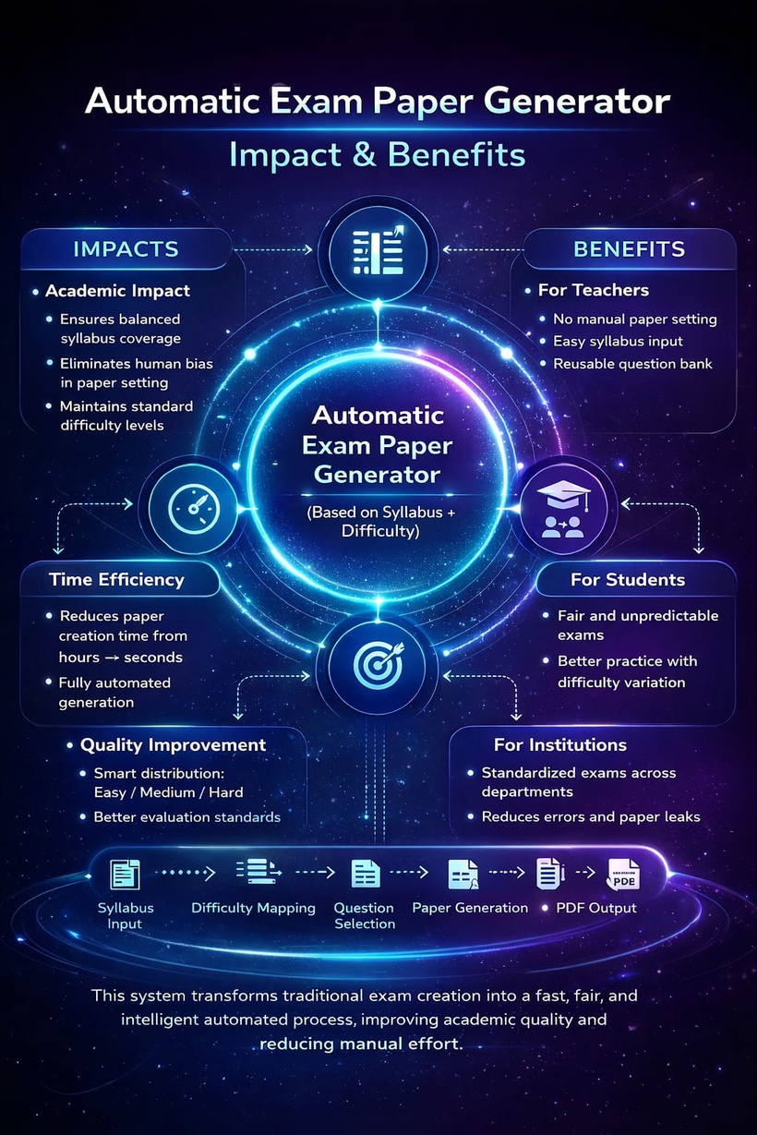
IMPACT AND BENEFITS
Alkarise
Overall Impact of the System:
This system improves the traditional exam process by making it:
Fast → Paper generated in seconds
Automated → No manual work
Balanced → Proper difficulty distribution
Accurate → Reduces human errors
Benefits for Different Users:-
1. For Teachers
Saves time and effort
No need to manually create papers
Easy syllabus coverage
2. For Institutions
Standardized exam pattern
Better evaluation system
Digital transformation
@SIH Idea submission- Template
5
Notes:
1.7.2013
5
‹#›

Slide 6

RESEARCH AND REFERENCES
Alkarise
Reasearch:-
The Automatic Exam Paper Generator is a rule-based system that creates question papers using a structured question bank stored in a database. Instead of manual paper setting, it applies predefined constraints such as:
Marks distribution (e.g., 70 marks total)
Unit-wise syllabus coverage
Difficulty levels (Easy/Medium/Hard)
References (Short):-
Books:
Database System Concepts – Database System Concepts
Learning PHP, MySQL & JavaScript – Learning PHP, MySQL & JavaScript
Web Resources:
PHP Official Documentation – https://www.php.net⁠
MySQL Docs – https://dev.mysql.com⁠
Research Area:
Automated Question Paper Generation Systems
@SIH Idea submission- Template
6
Notes:
1.7.2013
6
‹#›

Slide 7

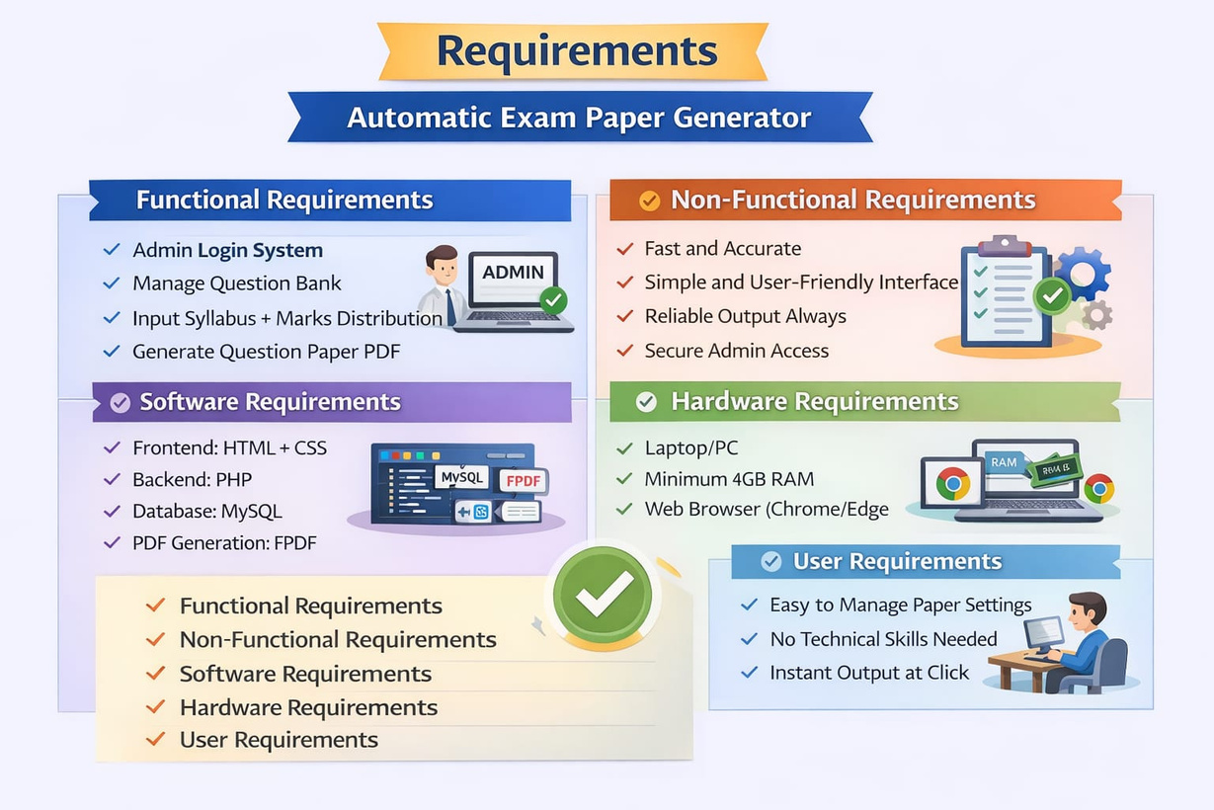
REQUIREMENTS
Alkarise
Hardware Requirements:-
Laptop/PC
Minimum 4GB RAM
Web browser
Software Requirements:-
Frontend: HTML, CSS
Backend: PHP,Java
Database: MySQL
Server: XAMPP/WAMP
PDF Generation: FPDF
Data Requirements:-
Question bank with:
Unit-wise classification
Difficulty tagging
Marks allocation
Predefined rules for selection logic

