Slide 1
RDBMS
MODULE-1

Slide 2
The relational model represents the database as a collection of relations.
A relation is nothing but a table of values.
Every row in the table represents a collection of related data values.
These rows in the table denote a real-world entity or relationship.
The table name and column names are helpful to interpret the meaning of values in each row.
The data are represented as a set of relations.
In the relational model, data are stored as tables.
However, the physical storage of the data is independent of the way the data are logically organized.

Slide 3
RDBMS TERMES
In the formal relational model terminology, a row is called a tuple, a column header is called an attribute, and the table is called a relation.
Domain A domain D is a set of atomic values.
By atomic we mean that each value in the domain is indivisible as far as the formal relational model is concerned.
A datatype or format is also specified for each domain.
A relation schema is used to describe a relation; R is called the name of this relation.
The degree or (arity) of a relation is the number of attributes n of its relation schema.

Slide 4
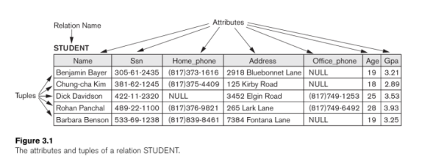

Slide 5
Characteristics of Relations
Ordering of tuples in a relation.
Ordering of Values within a tuple.
Values and NULLs in the tuples.

Slide 6
RELATIONAL MODEL CONCEPTS
Attribute:
Each column in a Table.
Attributes are the properties which define a relation. e.g., Student_Rollno, NAME,etc
2. Tables:
In the Relational model the, relations are saved in the table format.
It is stored along with its entities.
A table has two properties rows and columns.
Rows represent records and columns represent attributes.

Slide 7
RELATIONAL MODEL CONCEPTS
3. Tuple :
It is nothing but a single row of a table, which contains a single record.
5. Degree:
The total number of attributes which in the relation is called the degree of the relation.
4. Relation Schema:
A relation schema represents the name of the relation with its attributes
6. Cardinality:
Total number of rows present in the Table

Slide 8
RELATIONAL MODEL CONCEPTS
7. Column:
The column represents the set of values for a specific attribute.
9. Relation key :
Every row has one, two or multiple attributes, which is called relation key.
8. Relation instance:
Relation instance is a finite set of tuples in the RDBMS system.
Relation instances never have duplicate tuples.
10. Attribute domain :
Every attribute has some pre-defined value and scope which is known as attribute domain

Slide 9
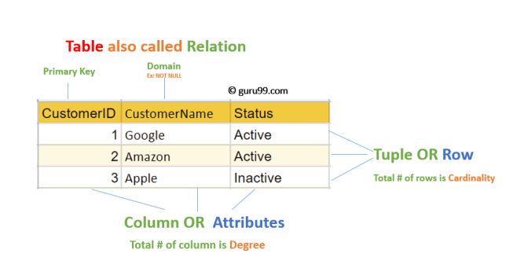

Slide 10
Relational Integrity constraints
Relational Integrity constraints is referred to conditions which must be present for a valid relation.
These integrity constraints are derived from the rules in the mini-world that the database represents.
Domain constraints
Entity integrity constraints
Referential integrity constraints
Key constraints

Slide 11
1. Domain Constraints
Domain A domain D is a set of atomic values.
Domain constraints can be violated if an attribute value is not appearing in the corresponding domain or it is not of the appropriate data type.
Domain constraints specify that within each tuple, and the value of each attribute must be unique.

Slide 12
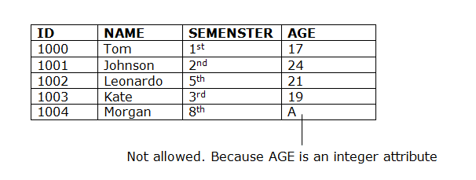
This is specified as data types which include standard data types integers, real numbers, characters, Booleans, variable length strings, etc.
For example, age cannot be less than zero and telephone numbers cannot contain a digit outside 0-9.

Slide 13
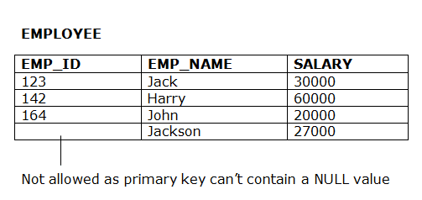
2. Entity integrity constraints
The entity integrity constraint states that primary key value can't be null.
This is because the primary key value is used to identify individual rows in relation and if the primary key has a null value, then we can't identify those rows.
A table can contain a null value other than the primary key field.

Slide 14
3. Referential Integrity Constraints
Referential Integrity constraints in DBMS are based on the concept of Foreign Keys.
A foreign key is an important attribute of a relation which should be referred to in other relationships.
Referential integrity constraint state happens where relation refers to a key attribute of a different or same relation.
However, that key element must exist in the table.

Slide 15
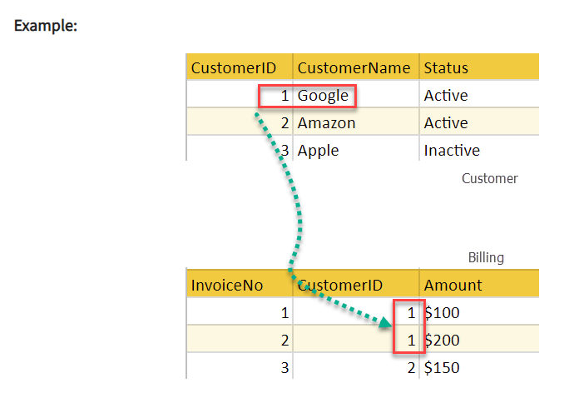

Slide 16
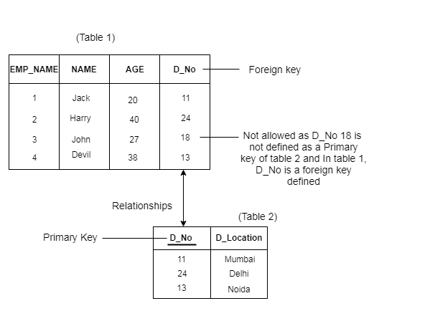

Slide 17
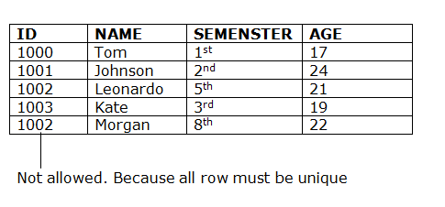
4. Key Constraints
Keys are the entity set that is used to identify an entity within its entity set uniquely.
An entity set can have multiple keys, but out of which one key will be the primary key.
A primary key can contain a unique and null value in the relational table.

Slide 18
OTHER CONSTRAINT TYPES
Semantic integrity constraints:
The salary of an employee should never be more than his supervisor.
Such types of constraints are implemented by the language using triggers and assertions.
State constraints:
at any time, the state of a database should always be valid.
Transition constraints:
the salary of an employee can only increase

Slide 19
Update operations, Transactions, and Dealing with Constraint Violations
The operations of the relational model are as follows:
Retrievals: The user formulates a query that specifies the data of interest; and a new relation is formed by applying relational operators to retrieve the data.
Updates: There are three basic operations that can change the states of relations in the database: Insert, Delete and Update (or Modify).

Slide 20
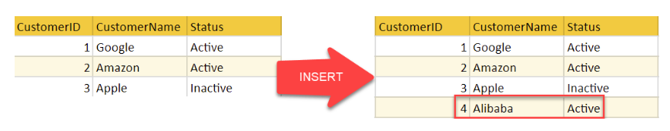
1. The Insert Operation
The insert operation provides a list of attribute values for a new tuple t that is to be inserted into a relation R.
Insert can violate any of the four types of constraints.

Slide 21
Domain constraint: If the attribute does not exist in the table or the value of the attribute is of a different data type.
Key constraint can be violated if a key value in the new tuple t already exists
Entity integrity can be violated if any part of the primary key of the new tuple t is NULL
Referential integrity can be violated if the value of any foreign key in t refers to a tuple that does not exist in the referenced relation

Slide 22
2. The Delete Operation
The delete operation can violate only referential integrity.
This occurs if the tuple being deleted is referenced by foreign keys from other tuples in the database.
Options available if a deletion operation causes a violation are: -
Restrict
Cascade
Set null/ set default

Slide 23
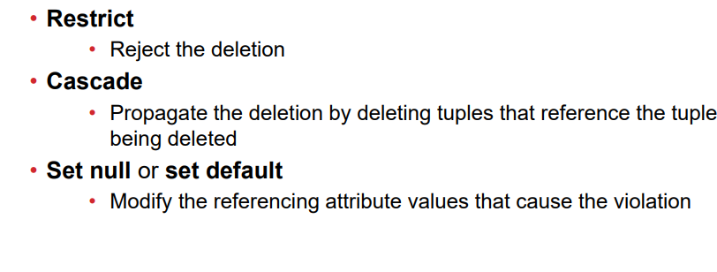

Slide 24
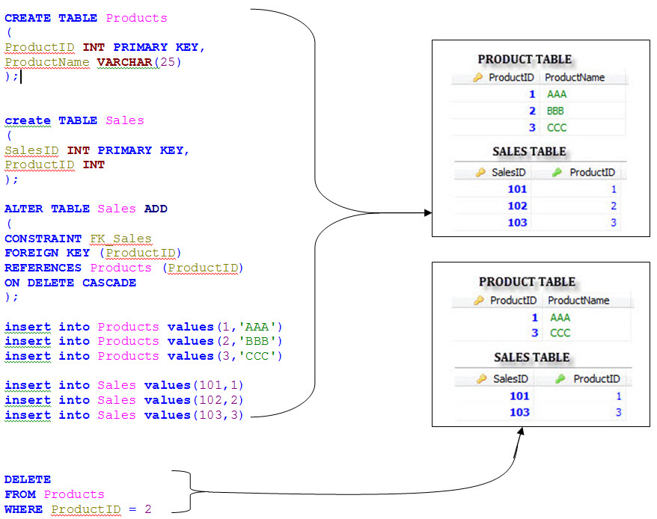

Slide 25
3. The Update Operation:
The update (or Modify) operation is used to change the values of one or more attributes in a tuple (or tuples) of some relation R.
It is necessary to specify a condition on the attributes of the relation to select the tuple (or tuples) to be modified.

Slide 26
