Slide 1
UNIT-2
DML COMMANDS

Slide 2
INTRODUCTION
DML is an abbreviation of Data Manipulation Language.
The DML commands in Structured Query Language change the data present in the SQL database.
We can easily access, store, modify, update and delete the existing records from the database using DML commands.

Slide 3
Following are the four main DML commands in SQL:
INSERT Command
UPDATE Command
DELETE Command
SELECT Command

Slide 4
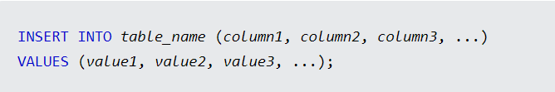
1. The SQL INSERT INTO Statement
The INSERT INTO statement is used to insert new records in a table.
INSERT INTO Syntax
It is possible to write the INSERT INTO statement in two ways:

Slide 5
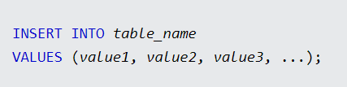
2. If you are adding values for all the columns of the table, you do not need to specify the column names in the SQL query.
However, make sure the order of the values is in the same order as the columns in the table. Here, the INSERT INTO syntax would be as follows:

Slide 6

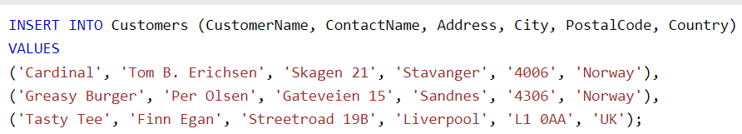
EXAMPLES

Slide 7

2. The SQL DELETE Statement
The DELETE statement is used to delete existing records in a table.
DELETE Syntax

Slide 8


EXAMPLES
Delete All Records

Slide 9
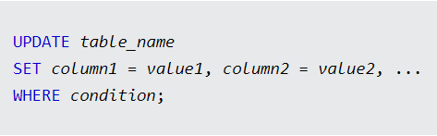
3. SQL UPDATE Statement
The UPDATE statement is used to modify the existing records in a table.
UPDATE Syntax
Note: Be careful when updating records in a table! Notice the WHERE clause in the UPDATE statement.
The WHERE clause specifies which record(s) that should be updated.
If you omit the WHERE clause, all records in the table will be updated!

Slide 10
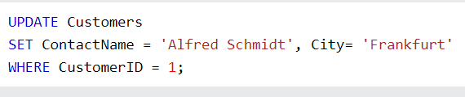

EXAMPLES

Slide 11
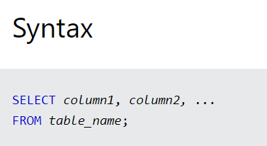


4. SQL SELECT Statement
The SELECT statement is used to select data from a database.

Slide 12
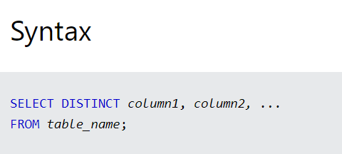

SQL SELECT DISTINCT Statement
The SELECT DISTINCT statement is used to return only distinct (different) values.

Slide 13
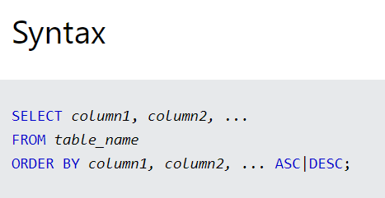

SQL ORDER BY Keyword
The ORDER BY keyword is used to sort the result-set in ascending or descending order.

Slide 14


The ORDER BY keyword sorts the records in ascending order by default. To sort the records in descending order, use the DESC keyword.

Slide 15

ORDER BY Several Columns

Slide 16


The SQL SELECT TOP Clause
The SELECT TOP clause is used to specify the number of records to return.
The SELECT TOP clause is useful on large tables with thousands of records. Returning a large number of records can impact performance.

Slide 17
SQL LIKE Operator
The LIKE operator is used in a WHERE clause to search for a specified pattern in a column.
There are two wildcards often used in conjunction with the LIKE operator:
The percent sign % represents zero, one, or multiple characters
The underscore sign _ represents one, single character

