Slide 1
SQL
UNIT-1

Slide 2
CONTENTS
INTRODUCTION
DATA TYPES IN SQL
DDL STATEMENTSCIN SQL
CONSTRAINTS IN SQL
SCHEMA CHANGING STATEMENTS IN SQL

Slide 3
SQL (Structured Query Language):
Structured Query Language is a database computer language designed for managing data in relational database management systems (RDBMS), and originally based upon Relational Algebra.
Its scope includes data query and update, schema creation and modification, and data access control.

Slide 4
SQL was one of the first languages for Edgar F. Codd's relational model and became the most widely used language for relational databases.
IBM developed SQL in mid of 1970’s.
Oracle incorporated in the year 1979.
SQL used by IBM/DB2 and DS Database Systems.
SQL adopted as standard language for RDBS by ASNI in 1989.

Slide 5
DATA TYPE IN SQL
1. CHAR (Size):
This data type is used to store character strings values of fixed length.
The size in brackets determines the number of characters the cell can hold.
The maximum number of character is 255 characters.
2. VARCHAR (Size) / VARCHAR2 (Size):
This data type is used to store variable length alphanumeric data.
The maximum character can hold is 2000 character.

Slide 6
3. NUMBER :
The NUMBER data type is used to store number (fixed or floating point).
4. DATE:
This data type is used to represent date and time. The standard format is DD- MM-YY as in 17-SEP-2024.
5.LONG:
This data type is used to store variable length character strings containing up to 2GB.
4. INT
This data type is used to store the integer data type

Slide 7
DDL STATEMENTSCIN SQL
The DDL Commands in Structured Query Language are used to create and modify the schema of the database and its objects.
The syntax of DDL commands is predefined for describing the data.

Slide 8
Following are the DDL commands in SQL:
CREATE Command
DROP Command
ALTER COMMAND
SCHEMA CHANGING STATEMENTS IN SQL

Slide 9
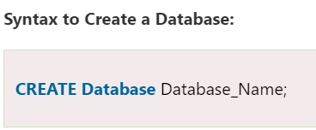

1. CREATE Command
CREATE is a DDL command used to create databases, tables, triggers and other database objects.
CREATE is a DDL command used to create databases, tables, triggers and other database objects.

Slide 10
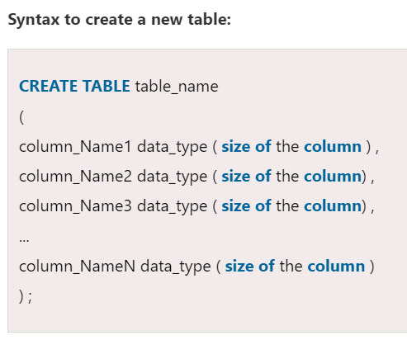
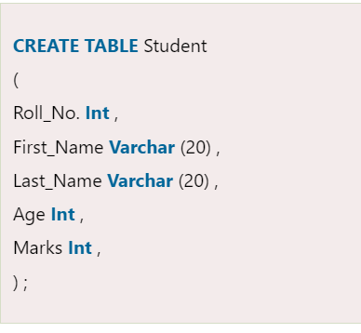
Table creation in sql

Slide 11
Consider the schema diagram and create table for the same
STUDEDNT
EMPLOYEE
PROJECT
Stu_Id | Name | Marks | City | State
Ename | Eno | Address | Salary | Dob
Projectname | Pid | Plocation | Project status

Slide 12
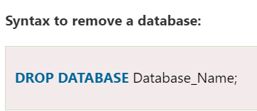

2. DROP COMMAND
DROP is a DDL command used to delete/remove the database objects from the SQL database.
We can easily remove the entire table, view, or index from the database using this DDL command.

Slide 13
Constraints in SQL
CONSTRAINTS AVAILABLE IN SQL ARE:
NOT NULL
UNIQUE
PRIMARY KEY
FOREIGN KEY
CHECK
DEFAULT

Slide 14
1. NOT NULL
NULL means empty, i.e., the value is not available.
Whenever a table's column is declared as NOT NULL, then the value for that column cannot be empty for any of the table's records.
There must exist a value in the column to which the NOT NULL constraint is applied.
CREATE TABLE student(StudentID INT NOT NULL, Student_FirstName VARCHAR(20), Student_LastName VARCHAR(20), Student_PhoneNumber VARCHAR(20), Student_Email_ID VARCHAR(40));

Slide 15
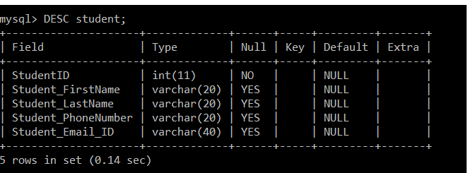

Schema checking with desc command
To verify that the not null constraint is applied to the table's column and the student table is created successfully, we will execute the following query:

Slide 16
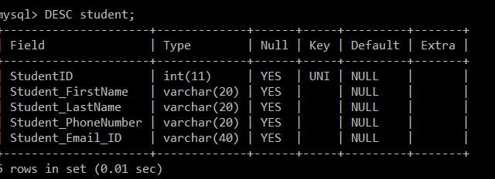

2. UNIQUE
CREATE TABLE student(StudentID INT UNIQUE, Student_FirstName VARCHAR(20), Student_LastName VARCHAR(20), Student_PhoneNumber VARCHAR(20), Student_Email_ID VARCHAR(40));
Duplicate values are not allowed in the columns to which the UNIQUE constraint is applied.
The column with the unique constraint will always contain a unique value.
Using the UNIQUE constraint, you can also modify the already created tables.

Slide 17
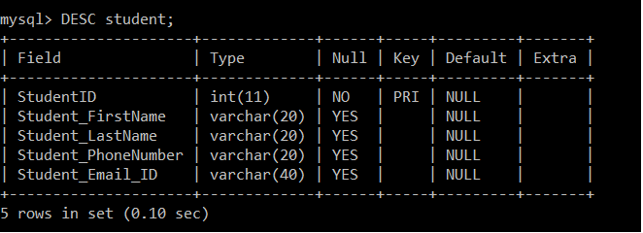

3. PRIMARY KEY
CREATE TABLE student(StudentID INT PRIMARY KEY, Student_FirstName VARCHAR(20), Student_LastName VARCHAR(20), Student_PhoneNumber VARCHAR(20), Student_Email_ID VARCHAR(40));
PRIMARY KEY Constraint is a combination of NOT NULL and Unique constraints.
NOT NULL constraint and a UNIQUE constraint together forms a PRIMARY constraint.
The column to which we have applied the primary constraint will always contain a unique value and will not allow null values.

Slide 18
4. FOREIGN KEY
A foreign key is used for referential integrity.
When we have two tables, and one table takes reference from another table, i.e., the same column is present in both the tables and that column acts as a primary key in one table.
That particular column will act as a foreign key in another table.
CREATE TABLE department(Dept_ID INT NOT NULL PRIMARY KEY, Dept_Name VARCHAR(40), FOREIGN KEY(SID) REFERENCES student StudentID));

Slide 19
5. CHECK
Whenever a check constraint is applied to the table's column, and the user wants to insert the value in it, then the value will first be checked for certain conditions before inserting the value into that column.
CREATE TABLE student(StudentID INT, Student_FirstName VARCHAR(20), Student_LastName VARCHAR(20), Student_PhoneNumber VARCHAR(20), Student_Email_ID VARCHAR(40), Age INT CHECK( Age <= 15));

Slide 20
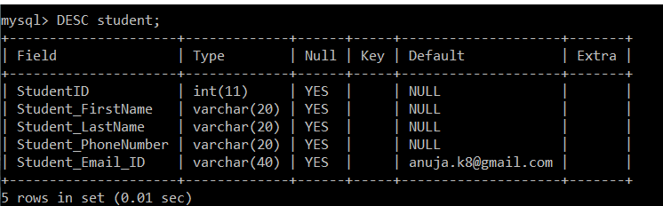

6. DEFAULT
CREATE TABLE student(StudentID INT, Student_FirstName VARCHAR(20), Student_LastName VARCHAR(20), Student_PhoneNumber VARCHAR(20), Student_Email_ID VARCHAR(40) DEFAULT "anuja.k8@gmail.com");
Whenever a default constraint is applied to the table's column, and the user has not specified the value to be inserted in it, then the default value which was specified while applying the default constraint will be inserted into that particular column.

Slide 21

SCHEMA CHANGING STATEMENTS IN SQL
1. DROP
DROP is a DDL command used to delete/remove the database objects from the SQL database.
Remember drop deletes the table with its schema

Slide 22
2. ALTER COMMAND
The ALTER TABLE statement in Structured Query Language allows you to add, modify, and delete columns of an existing table.
This statement also allows database users to add and remove various SQL constraints on the existing tables.
Any user can also change the name of the table using this statement.

Slide 23
ALTER COMMAND
ALTER TABLE - ADD Column
ALTER TABLE - DROP COLUMN
ALTER TABLE - RENAME COLUMN
ALTER TABLE - ALTER/MODIFY DATATYPE

Slide 24


1. ALTER TABLE - ADD Column
SYNATX:
Create table Customers(cid int, cname char(10), cphnoeno int);
alter table Customers add dateofbirth date;

Slide 25


2. ALTER TABLE - DROP COLUMN
To delete a column in a table, use the following syntax (notice that some database systems don't allow deleting a column):
EXAMPLE:

Slide 26

3. ALTER TABLE - RENAME COLUMN
To rename a column in a table, use the following syntax:
Alter table Customers rename coloumn cname to custname;
alter table student rename coloumn sname to stu_name;

Slide 27

4. ALTER TABLE - ALTER/MODIFY DATATYPE
To change the data type of a column in a table, use the following syntax:
Table Creation:
Create table Customers(cid int, cname char(10), cphnoeno int, );
Alter:
Alter table Customers modify(cid varchar(10), cname varchar(10));

Slide 28


The rename command
RENAME: It is used to modify the name of the existing table
Rename Customers to Cust_data;
or
Alter Customers rename to Cust_data;
We can also use the ALTER TABLE statement to change the table name. Syntax:

Slide 29

THE TRUNCATE COMMAND
It empty's the table
The major difference between TRUNCATE and DROP is that truncate is used to delete the data inside the table not the whole table.

Slide 30
LAB PRACTICE ASSIGNMENT:1
Create a table EMPLOYEE with following schema:
(Emp_no, E_name, E_address, E_ph_no)
Draw the schema diagram.
Identify the primary key.
Create the table.
Check the schema.
Add a new column; E_hiredate to the existing relation.
Add a new coloumn Emptype to the existing relation.
Make the Emptype value as default value i.e. “permanent”
Change the datatype of E_ph_no from int to varchar2.
Change the name of column/field Emp_no to E_no.
Rename the table EMPLOYEE to Emp_details.

Slide 31
LAB PRACTICE ASSIGNMENT:2
Create a table DEPARTMENT with following schema:
(Dept_no, Dept_name,Job_id , Salary, Emp_id)
Draw the schema diagram.
Identify the primary key.
Identify the foreign key.
Create the table
Check the schema
Add a new column dlocation to the existing relation.
Make the dlocation value as default value i.e. “Bengaluru”
Change the name of column/field Salary to Dept_package.
Rename the table DEPARTMENT to Dept_details.

