Slide 1
DS 255 – Seminar Presentation RTVirt: Enabling Time-sensitive Computing on Virtualized Systems through Cross-layer CPU Scheduling Ming Zhao and Jorge Cabrera Arizona State University EuroSys ‘18: Thirteenth EuroSys Conference 2018, Portugal
Presenter: Shriram R.
11-Apr-19

Slide 2
Introduction
Challenges in existing virtualized systems to deliver application desired timeliness
Time-sensitive applications are vulnerable to variations of resource availability and difficult to achieve desired timeliness QoS
Lack of awareness between VM host and guest level schedulers
High resource consolidation enabled by virtualization creates complex and dynamic resource contention and performance interference
Resource Management on a virtualized system is optimized for fair sharing and maximizing overall throughput

Slide 3
Key Contributions
RTVirt – A new virtualization architecture that enables
Cross-layer communication and coordination between host & guest schedulers
Built upon paravirtualization (Xen)
Hypercall and Shared Memory
Supports low latency and low overhead interactions
Supports applications with stringent deadline but tolerate few misses
Supports both uniprocessor and multiprocessor VMs
Can schedule periodic and aperiodic requests with dynamic arrivals
Shows good scalability with respect to VMs and applications

Slide 4
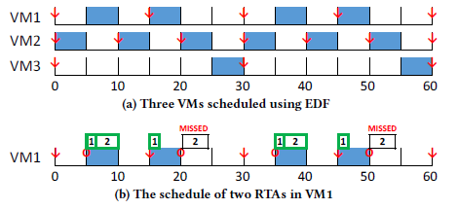
Motivation - Example

Slide 5
Cross-Layer Real-Time Scheduling
Two level architecture
Guest level scheduler – Addresses the timeliness of RTAs and BGAs
Host level scheduler – Addresses the timeliness of VMs in its host
RTA model
Requires a slice s of CPU time over a time interval P
Periodicity of RTAs
Periodic – Arrives at exactly every interval of time P
Sporadic – Not known apriori but arrives at a minimum of P units apart
A portion s/P of CPU needs to be allocated

Slide 6
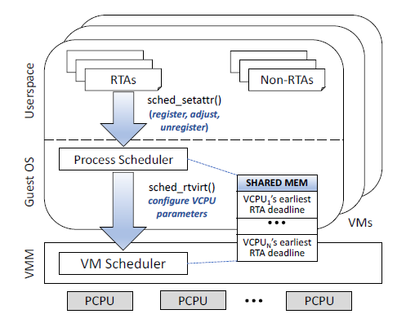
Virtualization Architecture

Slide 7
Guest-Level Process Scheduling
Leverages SCHED_DEADLINE scheduler class in Linux
Performs Earliest Deadline First (EDF) scheduling
RTAs makes explicit request through a system call (E.g. sched_setattr())
System call implementation and scheduler are modified
Performs admission control. Checks if bandwidth is available
Issues new hypercall sched_rtvirt() to request necessary bandwidth
Multiple step process (explained next)

Slide 8
Guest-Level Process Scheduling
New RTA registration
Guest scheduler chooses a vCPU with enough bandwidth
Makes sched_rtvirt() hypercall with INC_BW flag, vCPU ID and bandwidth
EDF scheduler proceeds to assign the RTA to chosen vCPU after confirmation
Existing RTA requesting more bandwidth
Similar to previous scenario
Rescheduling to different vCPU happens through hypercall with INC_DEC_BW flag, vCPU IDs and updated bandwidth requirements
RTA deregistration
Hypercall made with DEC_BW flag, vCPU ID and updated bandwidth

Slide 9
Guest-Level Process Scheduling
SCHED_DEADLINE scheduler class
Global EDF (gEDF) is not used for RTVirt
Modified to perform partitioned EDF (pEDF) scheduling
Tasks are pinned to their vCPUs
Helps to quickly derive scheduling parameters of vCPU from pinning
Task reshuffle is also possible
To satisfy a request when bandwidth is fragmented across the vCPUs
RTVirt uses CPU hotplug to add vCPUs online transparently

Slide 10
Host-level VM Scheduling
Based on DP-WRAP scheduling algorithm
Optimal multiprocessor/multicore scheduler
Schedule tasks using deadline partitioning (DP)
All tasks are scheduled using the same deadline (global deadline)
Global deadlines are the set of deadlines contained in the union of all the tasks’ deadlines
Global slice – partitioned among all tasks based on required bandwidth
Sum of the tasks’ bandwidths is equal or less than the total bandwidth of the processors

Slide 11
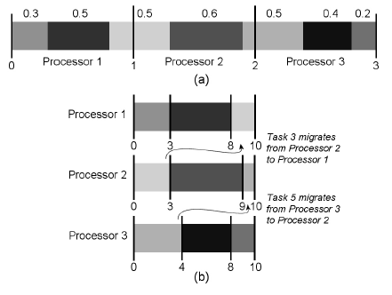
DP-WRAP Scheduling Algorithm

Slide 12
Implementation Notes
Scheduling parameters of vCPU based on bandwidth needs of the RTA
Each vCPU has a budget and period associated
Budget = Sum of bandwidths of all RTAs
Period = Smallest period among the RTA periods
Budget set slightly higher (500 microseconds)
Sporadic tasks
Worst case scenario is followed
Next period is taken to be minimum which is p

Slide 13
Implementation Notes
Guest Level Scheduler shares next earliest deadline on vCPUs with the hypervisor using shared memory
Host level scheduler decides next global deadline based on above
It takes O(log n) time to compute global deadline
RTVirt uses cache coherence property to share scheduling information without explicit synchronization
Smallest global slice : 250 microseconds

Slide 14
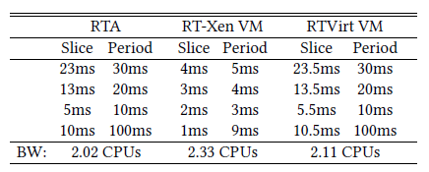
Performance Evaluation
15 processors
Linux 4.6.0 kernel
Implemented in Xen
64GB RAM
400GB SSD, 1TB HDD
Different RTAs
Compared with RTA-Xen

Slide 15
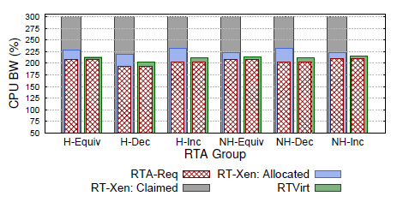
Application Performance

Slide 16
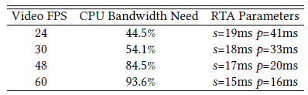
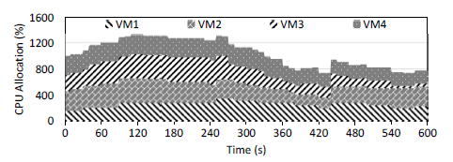
Video Streaming Application Performance
Uses rt-app to model application
Timeliness Requirement
Start time and Duration
vCPU assignment

Slide 17
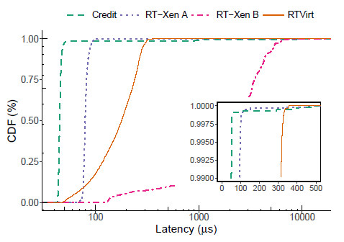
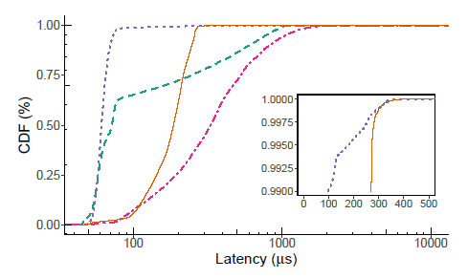
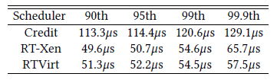
Memcached Application Performance
Competing with Non-RTA VMs
Competing with Video Streaming VMs

Slide 18
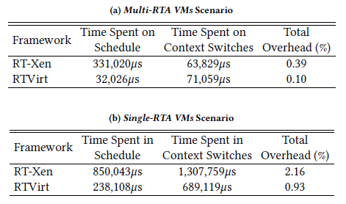
Performance Overheads

Slide 19
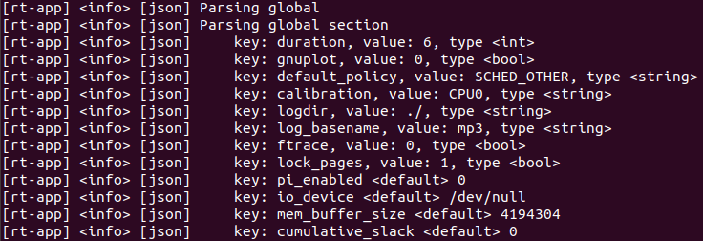
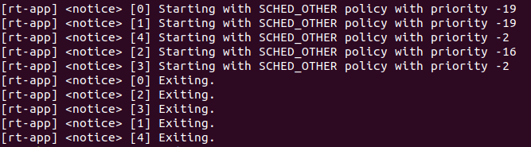
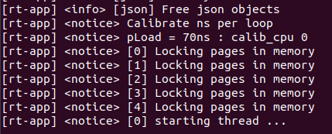
User Interface

Slide 20
Issues & Limitations
Security
RTVirt exposes certain aspects of scheduling to guests trading complete transparency for improved timeliness
Schedulers has to monitor application usage and proportionally deduct CPU allocation if CPU bandwidth is oversubscribed
Overhead
Considerable overhead in migrating VMs across PCPUs
Support for other OSes and VMMs
Only Xen is supported. Need to implement hypercall and shared memory for other VMMs and OSes

Slide 21
References
Zhao, Ming, and Jorge Cabrera. "RTVirt: enabling time-sensitive computing on virtualized systems through cross-layer CPU scheduling." Proceedings of the Thirteenth EuroSys Conference. ACM, 2018.
Levin, Greg, et al. "DP-FAIR: A simple model for understanding optimal multiprocessor scheduling." 2010 22nd Euromicro Conference on Real-Time Systems. IEEE, 2010.
Xi, Sisu, et al. "Real-time multi-core virtual machine scheduling in xen." 2014 International Conference on Embedded Software (EMSOFT). IEEE, 2014.
https://github.com/scheduler-tools/rt-app
https://github.com/jorge-cabrera/rtvirt

