Slide 2
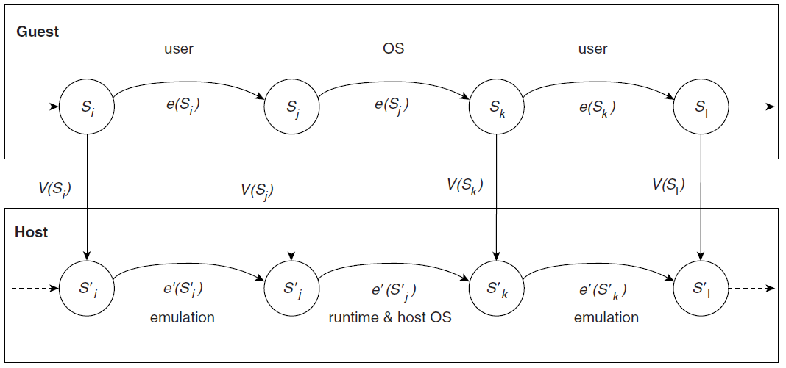

Slide 3
Software Translation Table
Block No.
Host Addr.
Valid
RWE
0000
1000
Y
RW
0001
2000
Y
R
Guest Address Space
0002
5000
Host Virtual Address Space
Host Real Address Space
N
R
……………...
……………...
……………...
……………...
Host Page Table
FFFD
4400
N
R
FFFE
6200
Y
RWE
FFFF
1100
Y
RW

