Slide 2
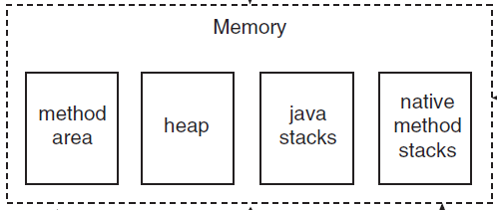
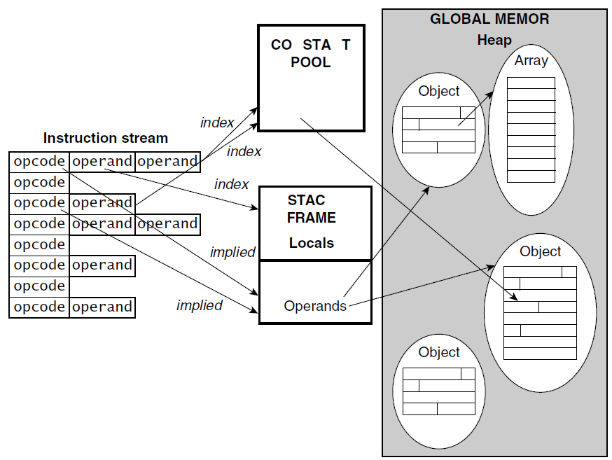

Slide 3
Push 100
Push 2
Pop 2
Pop 100
Push 200
Push 5
Push 390
Push 20
Push 5
Pop 5
Pop 20
Push 4
Pop 4
Pop 390
Push 394
Pop 394
Pop 5
Push 1970
Pop 1970
Pop 200
Push 2170
Push 40
Push 4
Push 10
Pop 10
Pop 4
Push 40
Pop 40
Pop 40
Push 0
Pop 0
Pop 2170
Push 2170
*
*
*
/
+
-
+
390
5
200
-
394
5
200
40
4
2170
2170

Slide 4
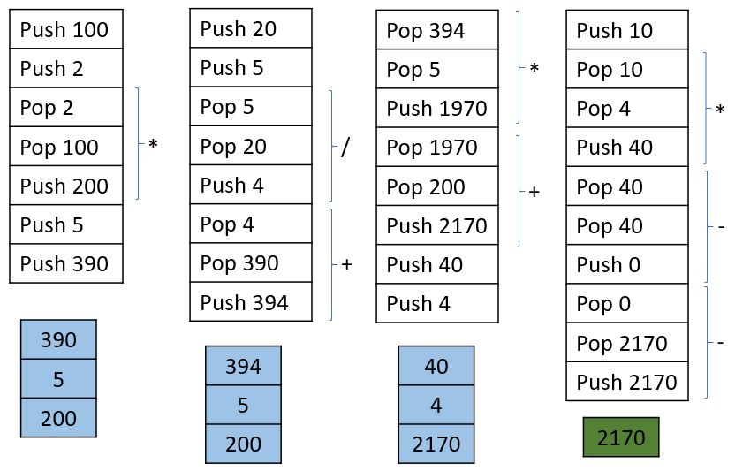

Slide 5
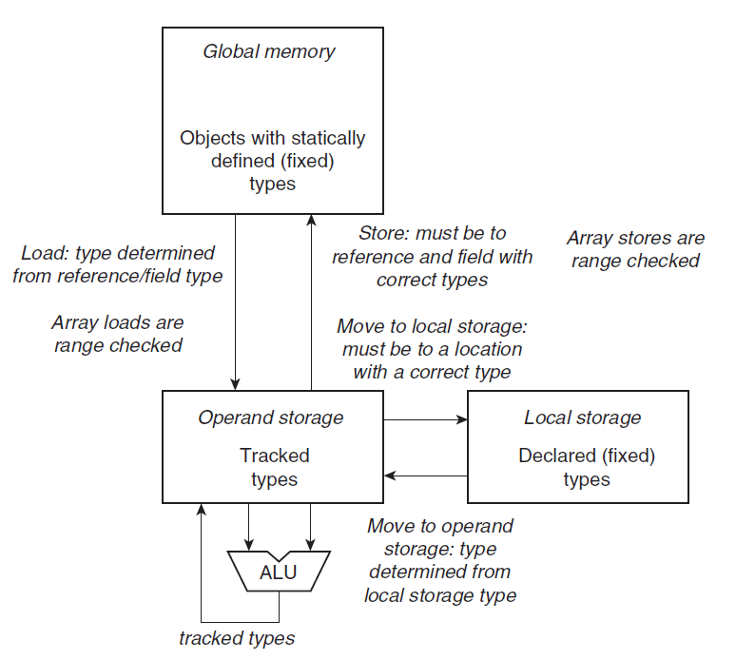

Slide 6
