Slide 1
DS 256 – Seminar Presentation Giraph Unchained: Barrierless Asynchronous Parallel Execution in Pregellike Graph Processing Systems Minyang Han and Khuzaima Daudjee David R. Cheriton School of Computer Science University of Waterloo Proceedings of the VLDB Endowment, Vol. 8, No. 9, 2015
Presenter: Shriram R
04-Apr-19

Slide 2
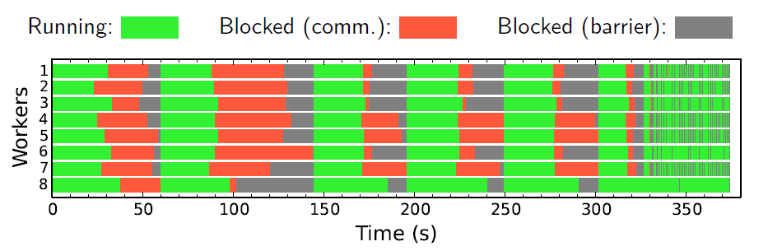
Motivation
Bulk Synchronous Parallel (BSP) Model
Stale Messages
Slower Convergence & longer computation time
Frequent Global Sync. Barriers
Costly Communication overheads
Straggler problem

Slide 3
Motivation
Existing Asynchronous Models
GraphLab (Pull Based)
Gather, Apply, Scatter (GAS) model
Distributed Locking
Giraph++ and GRACE (Push Based)
Asynchronous parallel (AP) model
Global barriers
Shortcomings
Does not Scale
Non-transparent
Leaks info. about asynchrony to the developer API
Does not support graph mutations
Incompatible with algorithms with multiple computation phases

Slide 4
Key Contributions
Barrierless asynchronous parallel (BAP) model
Reduces frequency of global barriers
No distributed locks
Implemented in Giraph and preserves Giraph’s BSP interface
Support for graph mutations
Compatible with multiple computation phases
Up to 5x over synchronous and 86x over asynchronous systems

Slide 5
Asynchronous Parallel (AP) model
Vertices can immediately see their received messages
True for both local and remote messages
Reduces staleness of messages
Retains global barriers
To separate supersteps
Messages that do not arrive in time will become visible in next superstep
Disadvantages
Still suffers from synchronization overhead
Limited algorithmic support

Slide 6
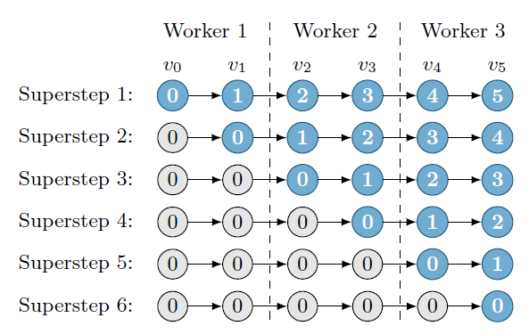
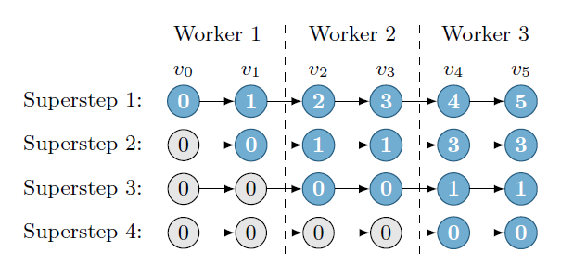
Asynchronous Parallel (AP) model
BSP Example
AP Example

Slide 7
Barrierless asynchronous parallel (BAP) model
Local Barriers
Separates logical supersteps.
Inexpensive and Local to each worker
Pausing point to perform tasks like graph mutations
To decide if a global barrier is necessary
Internal and transparent to developers
Global supersteps is a collection of logical supersteps separated by global barriers

Slide 8
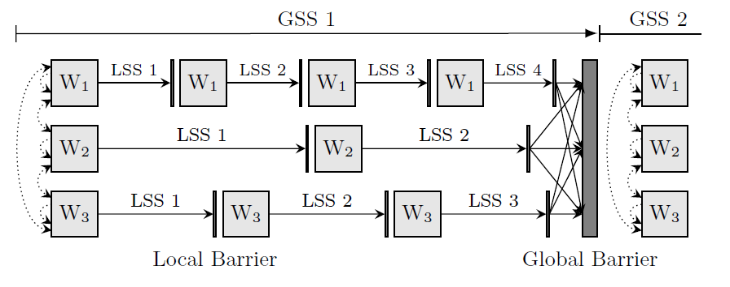
Barrierless asynchronous parallel (BAP) model
BAP Illustration

Slide 9
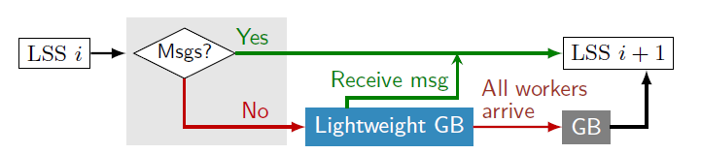
Termination Check
Worker Control Flow
Two steps – First at a local barrier and second occurs globally at the master
Step 1 – Worker independently blocks if there are no messages to process
Step 2 – Regular BSP check once all the workers arrive at the global barrier

Slide 10
Multiple Computation Phases

Slide 11
Theorems
The AP and BAP models correctly execute single-phase BSP algorithms in which vertices do not need all messages from all neighbors.
Given a message store that is initially filled with valid messages, retains old messages, and overwrites old messages with new messages, the BAP model correctly executes single-phase BSP algorithms in which vertices need all messages from all neighbors.
If every message is tagged with a Boolean at the API level and two message stores are maintained at the system level, then the BAP model supports BSP algorithms with multiple computation phases.

Slide 12
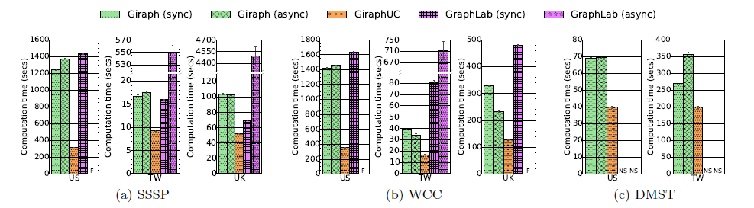
Experimental Evaluation

Slide 13
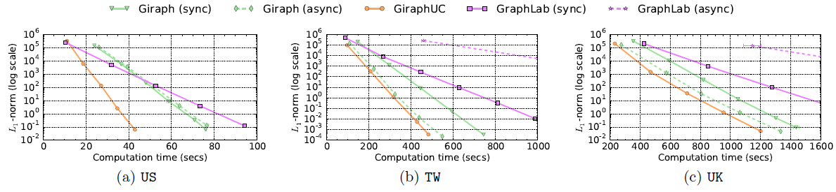
Experimental Evaluation
PageRank Algorithm

Slide 14
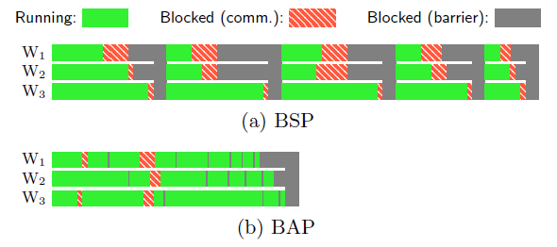
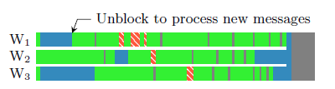
Experimental Evaluation
WCC on 16 workers with TW dataset
SSSP on 16 workers with TW dataset

Slide 15
Takeaways

Slide 16
References

